Slide 1
Assume valence fermions couple in pairs to bosons of spins 0⁺ and 2⁺
IBA
0⁺ s-boson
2⁺ d-boson
  Valence nucleons only
  s, d bosons – creation and destruction operators
H = H_{s} + H_{d} + H_{interactions}
Number of bosons fixed: N = n_{s} + n_{d}
= ½ # of val. protons + ½ # val. neutrons

Slide 2
IBA Models
IBA – 1 No distinction of p, n
IBA – 2 Explicitly write p, n parts
IBA – 3, 4 Take isospin into account
p-n pairs
IBFM Int. Bos. Fermion Model
Odd A nuclei
H = H_{e – e} + H_{s.p.} + H_{int}
core
IBFFM Odd – odd nuclei
[ (f, p) bosons for π = - states spdf IBA ]
Parameters
Different models have different numbers of parameters. Be careful in evaluating/comparing different models. Be alert for hidden parameters. Lots of parameters are not necessarily bad – they may be mandated by the data, but look at them with your eyes open.

Slide 3
Background, References
F. Iachello and A. Arima, The Interacting Boson Model (Cambridge University Press, Cambridge, England, 1987).
F. Iachello and P. Van Isacker, The Interacting Boson-Fermion Model (Cambridge University Press, Cambridge, England, 2005)
R.F. Casten and D.D. Warner, Rev. Mod. Phys. 60 (1988) 389.
R.F. Casten, Nuclear Structure from a Simple Perspective, 2nd Edition (Oxford Univ. Press, Oxford, UK, 2000), Chapter 6 (the basis for most of these lectures).
D. Bonatsos, Interacting boson models of nuclear structure, (Clarendon Press, Oxford, England, 1989)
Many articles in the literature
Notes:
3

Slide 4
IBA has a deep relation to Group theory
That relation is based on the operators that create, destroy s and d bosons
s†, s, d†, d operators
Ang. Mom. 2
d†_{μ} , d_{μ} μ = 2, 1, 0, -1, -2
Hamiltonian is written in terms of s, d operators
Since boson number is conserved for a given nucleus, H can only contain “bilinear” terms: 36 of them.
Gr. Theor. classification of Hamiltonian
Group is called
U(6)
s†s, s†d, d†s, d†d

Slide 5
OK, here’s what you need to remember from the Group Theory
Group Chain: U(6)  U(5)  O(5)  O(3)
A dynamical symmetry corresponds to a certain structure/shape of a nucleus and its characteristic excitations. The IBA has three dynamical symmetries: U(5), SU(3), and O(6).
Each term in a group chain representing a dynamical symmetry gives the next level of degeneracy breaking.
Each term introduces a new quantum number that describes what is different about the levels.
These quantum numbers then appear in the expression for the energies, in selection rules for transitions, and in the magnitudes of transition rates.
Notes:
5

Slide 6
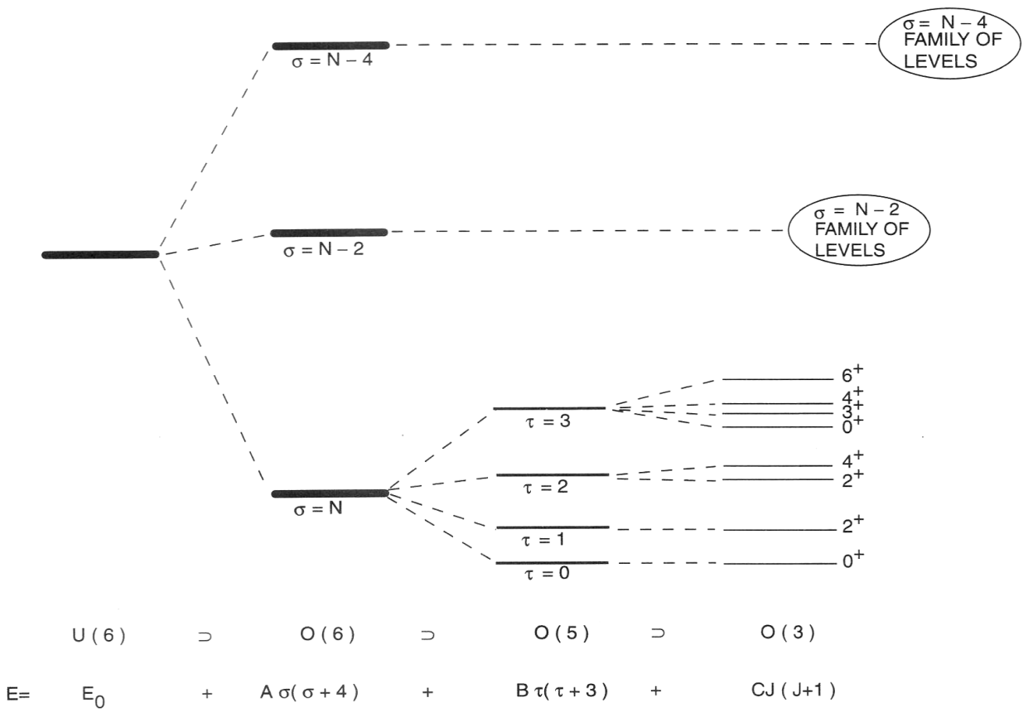
Concept of a Dynamical Symmetry
OK, here’s the key point :
N
Spectrum generating algebra !!
Notes:
6

Slide 7
Group theory of the IBA
U(6) 36 generators conserve N
U(5) 25 generators conserve n_{d}
Suppose:
H = α₁ C_{U(6)} + α₂ C_{U(5)} (1)
All states of a given nucleus have same N. So, if α₂ = 0, i.e., H = α₁ C_{U(6)} only, then all states would be degenerate.
But these states have different n_{d}. Thus, if we consider the full eq. 1, then the degeneracy is broken because C_{U(5)} gives E = f (n_{d}). In group notation
U(6)  U(5)  …
Recall: O(3)  O(2)
Dyn.
Symm.

Slide 8

Group Structure of the IBA
U(5)
s boson :
1
vibrator
U(6)
d boson :
5
SU(3)
rotor
O(6)
Magical group theory stuff happens here
γ-soft
_{Symmetry Triangle of the IBA}
Def.
Sph.

Slide 9
Classifying Structure -- The Symmetry Triangle
Deformed
Sph.
Most nuclei do not exhibit the idealized symmetries but rather lie in transitional regions. Mapping the triangle.
Notes:
9

Slide 10
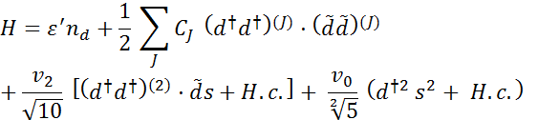
IBA Hamiltonian
Counts the number of d bosons out of N bosons, total. The rest are s-bosons: with Es = 0 since we deal only with excitation energies.
Excitation energies depend ONLY on the number of d-bosons. E(0) = 0, E(1) = ε , E(2) = 2 ε.
Conserves the number of d bosons. Gives terms in the Hamiltonian where the energies of configurations of 2 d bosons depend on their total combined angular momentum. Allows for anharmonicities in the phonon multiplets.
_{d}⁺_{d}
d
Mixes d and s components of the wave functions
Most general IBA Hamiltonian in terms with up to four boson operators (given N)

Slide 11
U(5)
Spherical, vibrational nuclei

Slide 12
Simplest Possible IBA Hamiltonian –
given by energies of the bosons with NO interactions
= E of d bosons + E of s bosons
Excitation energies so, set ε_{s} = 0, and drop subscript d on ε_{d}
What is spectrum? Equally spaced levels defined by number of d bosons
What J’s? M-scheme
Look familiar? Same as quadrupole vibrator.
U(5) also includes anharmonic spectra
3
2
1
0
n_{d}
6⁺, 4⁺, 3⁺, 2⁺, 0⁺
4⁺, 2⁺, 0⁺
2⁺
0⁺

Slide 13
E2 Transitions in the IBA
Key to most tests
Very sensitive to structure
E2 Operator: Creates or destroys an s or d boson or recouples two d bosons. Must conserve N
T = e Q = e[s† + d†s + χ (d† )⁽²⁾]
Specifies relative strength of this term

Slide 14
E2 transitions in U(5)
χ = 0
That is: T = e[s† + d†s]
Why? So that it can create or destroy a single d boson, that is, a single phonon.
3
2
1
0
n_{d}
6⁺, 4⁺, 3⁺, 2⁺, 0⁺
4⁺, 2⁺, 0⁺
2⁺
0⁺

Slide 15
Creation and destruction operators as
“Ignorance operators”
Example: Consider the case we have just discussed – the spherical vibrator.
Why is the B(E2: 4 – 2) = 2 x B(E2: 2– 0) ??
Difficult to see with Shell Model wave functions with 1000’s of components
However, as we have seen, it is trivial using destruction operators WITHOUT EVER KNOWING ANYTHING ABOUT THE DETAILED STRUCTURE OF THESE VIBRATIONS !!!! These operators give the relationships between states.
_{4,2,0}
_{2E}
₂
₂
_{E}
₁
₀
₀

Slide 16
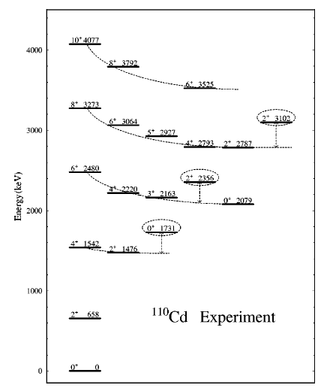
Vibrator
Vibrator (H.O.)
E(I) = n ( ω₀ )
R_{4/2}= 2.0
8⁺. . .
6⁺. . .
2⁺
0⁺

Slide 17
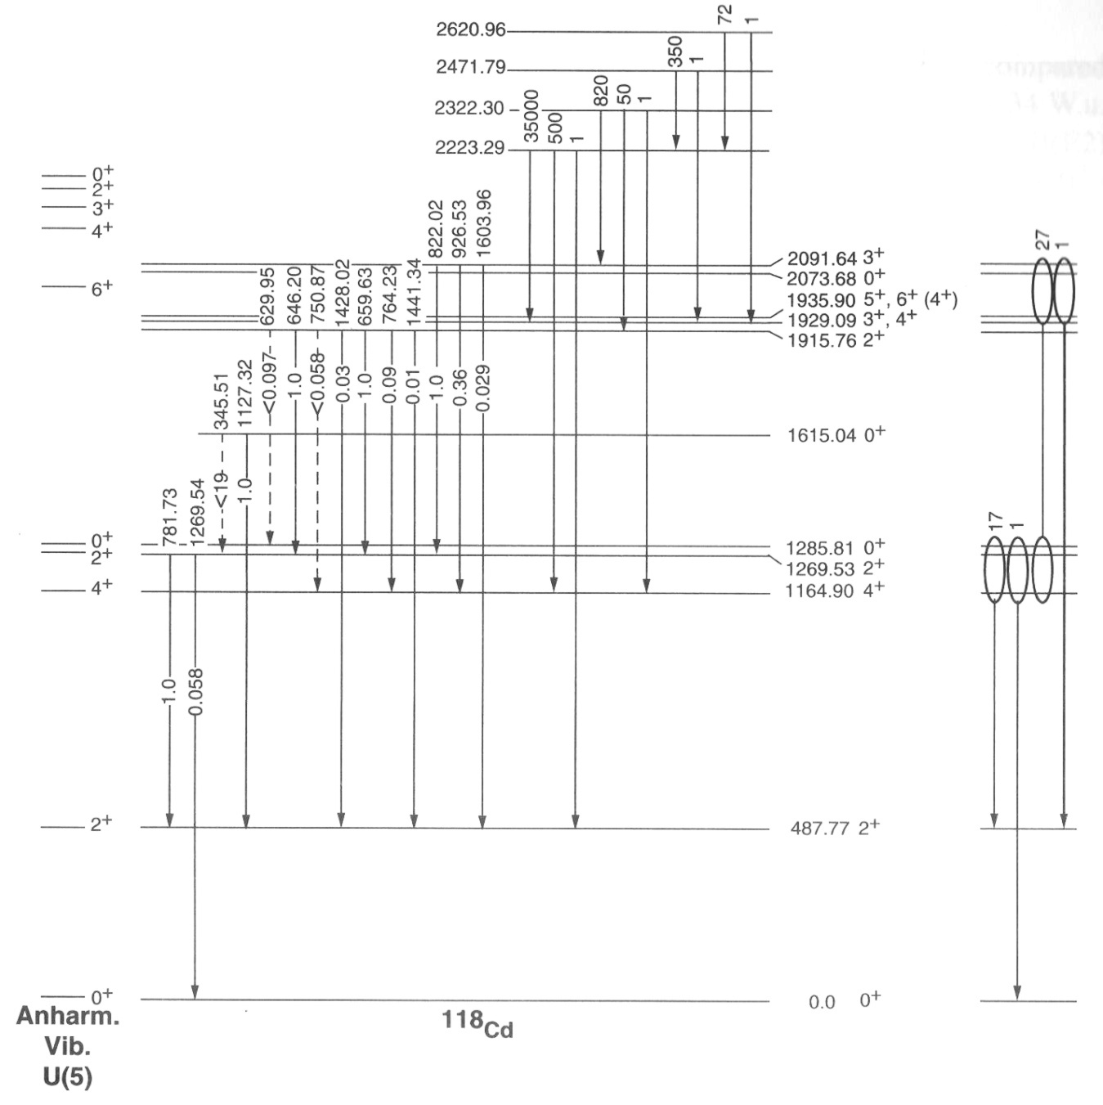

Slide 18
Deformed nuclei
Use the same Hamiltonian but re-write it in more convenient and physically intuitive form

Slide 19
IBA Hamiltonian
Complicated and, for many calculations, not really necessary to use all these terms and all 6 parameters
Truncated form with just two parameters – RE-GROUP and keep some of the terms above.
H = ε n_{d} - κ Q ⋅ Q
Q = e[s† + d†s + χ (d† )⁽²⁾]
Competition: ε n_{d} term gives vibrator.
κ Q ⋅ Q term gives deformed nuclei.
More complicated forms exist but this is the form we will use. It works extremely well in most cases.
Notes:
19

Slide 20
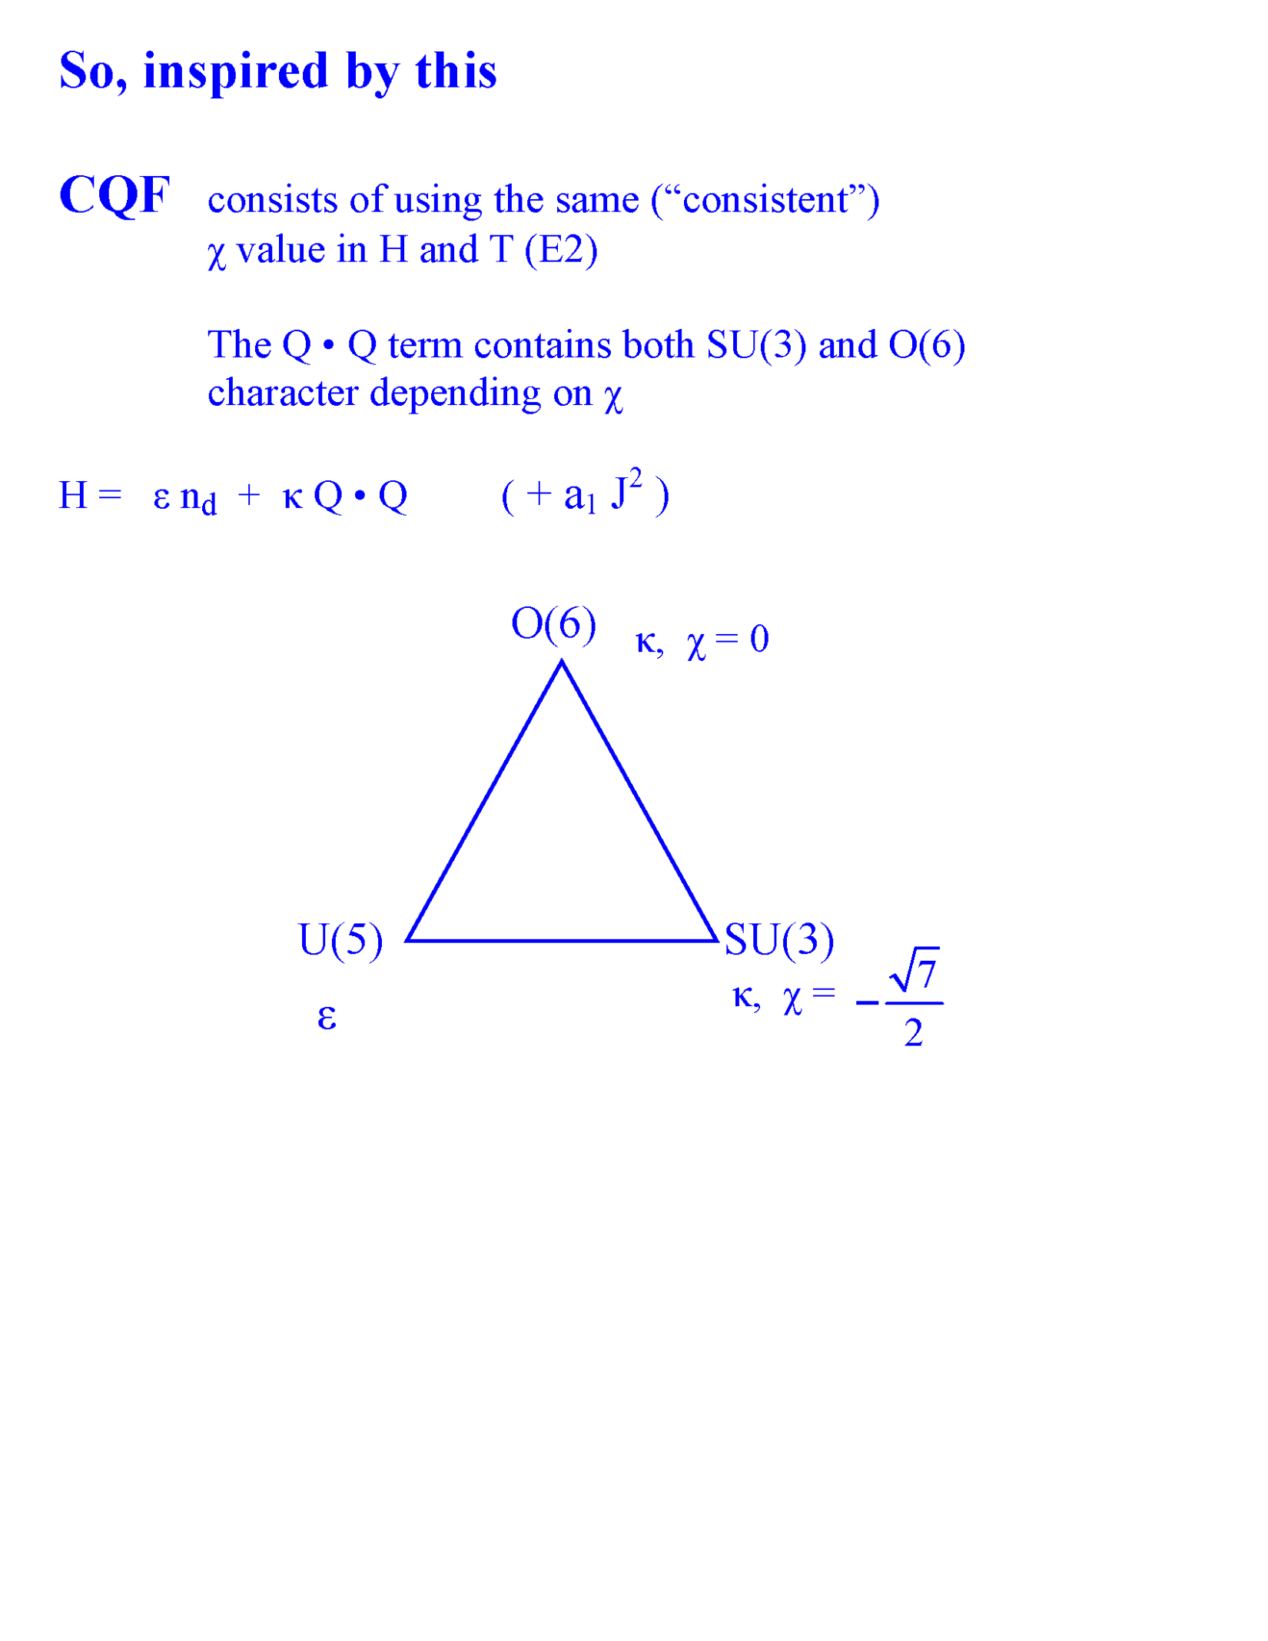
Relation of IBA Hamiltonian to Group Structure
= -1.32
We will see later that this same Hamiltonian allows us to calculate the properties of a nucleus ANYWHERE in the triangle simply by choosing appropriate values of the parameters
Notes:
20

Slide 21
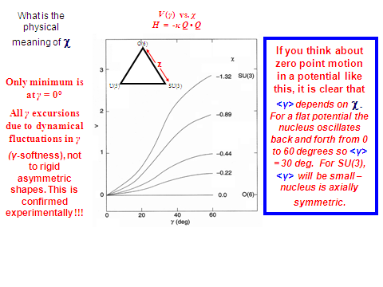
In a region of increasing γ softness, can simulate simply by decreasing |χ| towards zero

Slide 22
SU(3)
Deformed nuclei

Slide 23
Wave functions in SU(3): Consider non-diagonal effects of the QQ term in H on n_{d} components in the wave functions
Q operator: Q = (s† d + d †s) + (d † d )⁽²⁾
QQ = [ { (s† d + d †s) + χ(d †d ) ⁽²⁾ } x { (s† d + d †s) + (d †d )⁽²⁾ } ]
~ s† d s† d + s† d d †s + s† d d † d ….
Δ n_{d} = -2 0 -1 …. 2, 0, 1
Any calculation deviating from U(5) gives wave functions where n_{d} is no longer a good quantum number. If the wave function is expressed in a U(5) – vibrator – basis, then it contains a mixture of terms. Understanding these admixtures is crucial to understanding IBA calculations

Slide 24
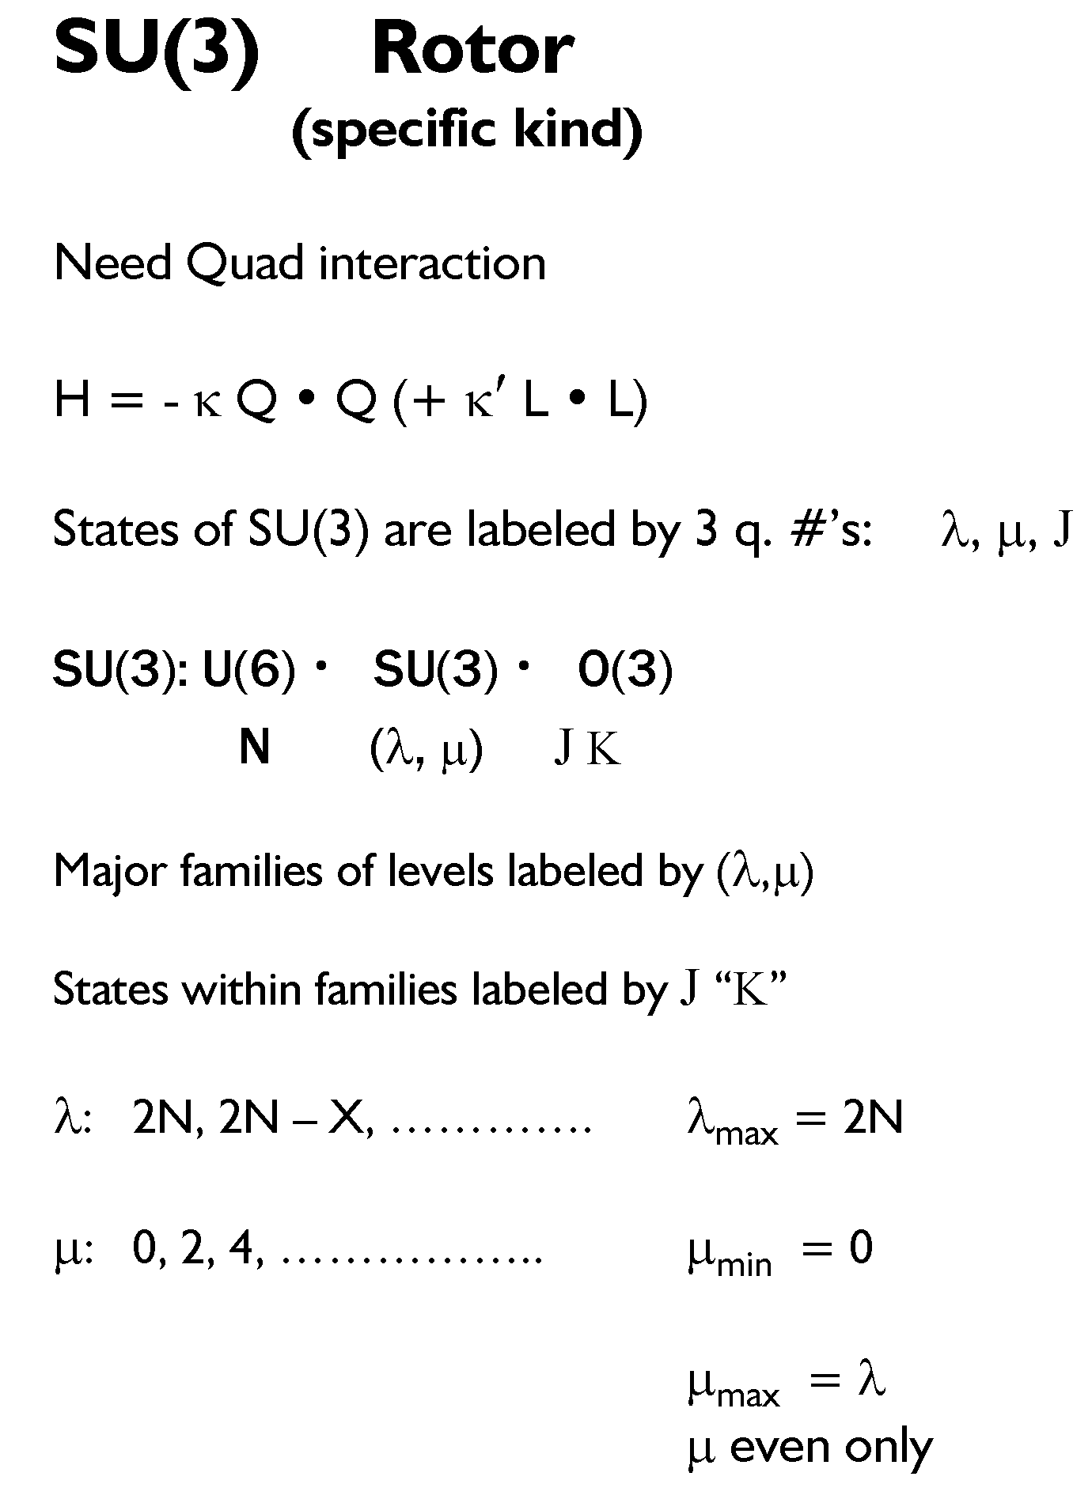


M

Slide 25
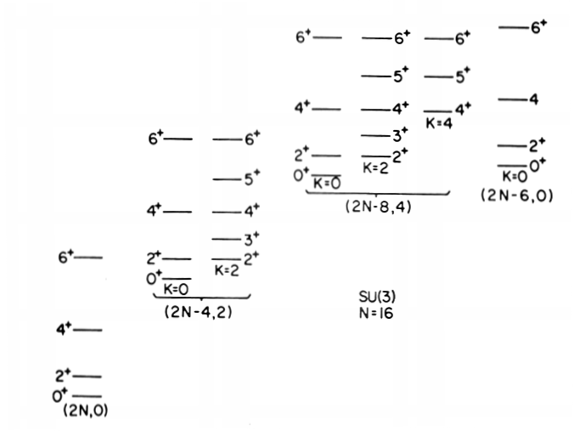
Typical SU(3) Scheme
Characteristic signatures:
Degenerate bands within a group
Vanishing B(E2) values between groups
Allowed transitions
  between bands within a group
  Where? N~ 104, Yb, Hf
SU(3)  O(3)
K bands in (, ) : K = 0, 2, 4, - - - - 

Slide 26
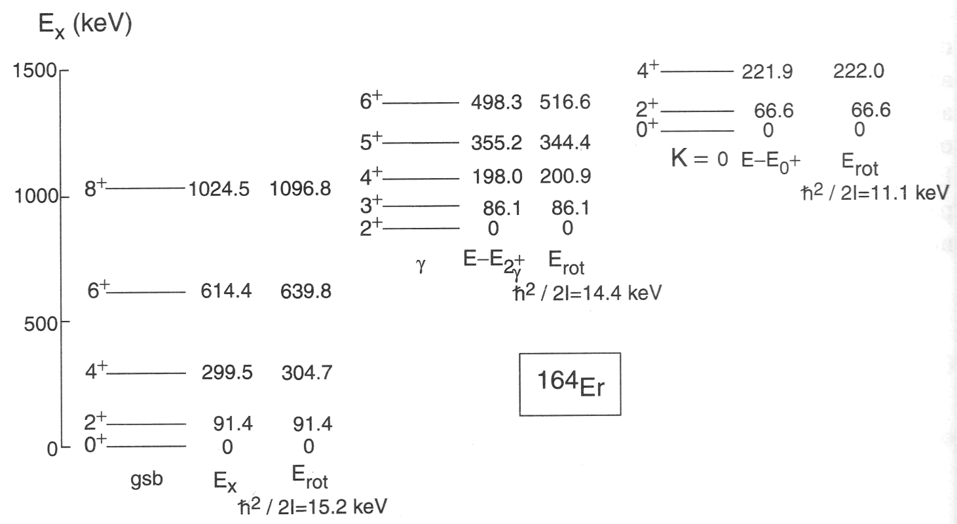
Totally typical example
Similar in many ways to SU(3).
But note that the two excited excitations are not degenerate as they should be in SU(3). While SU(3) describes an axially symmetric rotor, not all rotors are described by SU(3) – see later discussion

Slide 27
O(6)
Axially asymmetric nuclei
(gamma-soft)

Slide 28
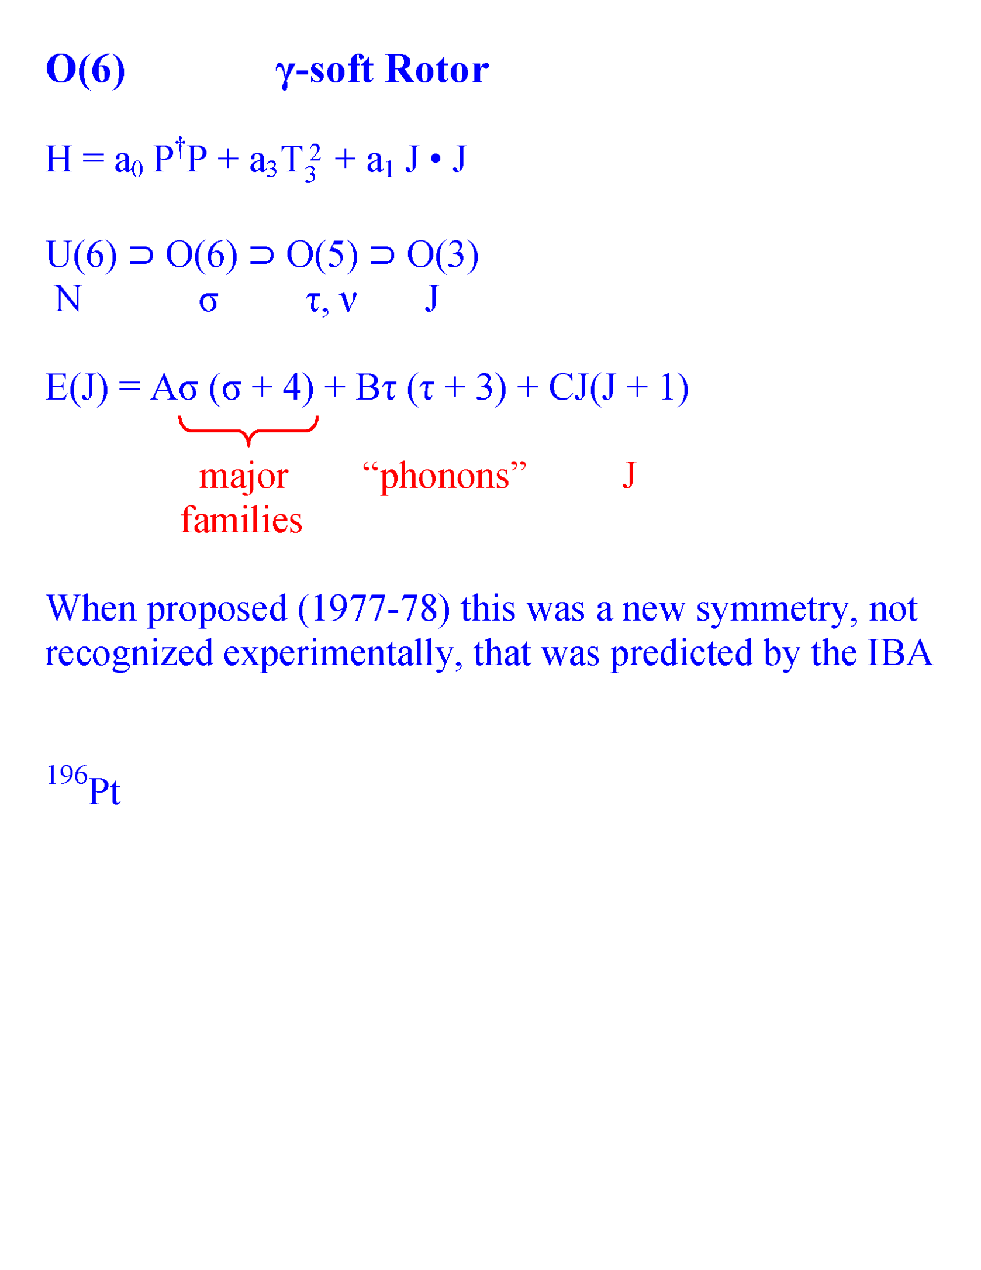

Slide 29
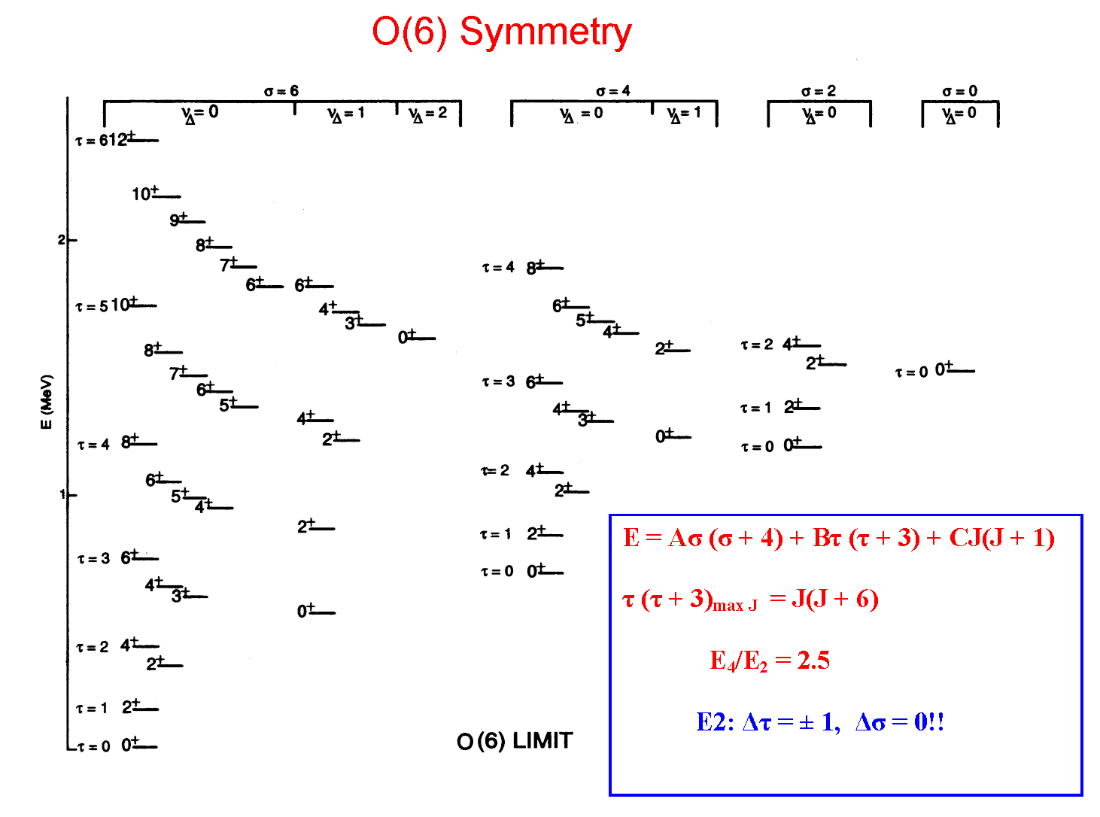

Slide 30
_{Note: Uses} χ ₌ ₀

Slide 31
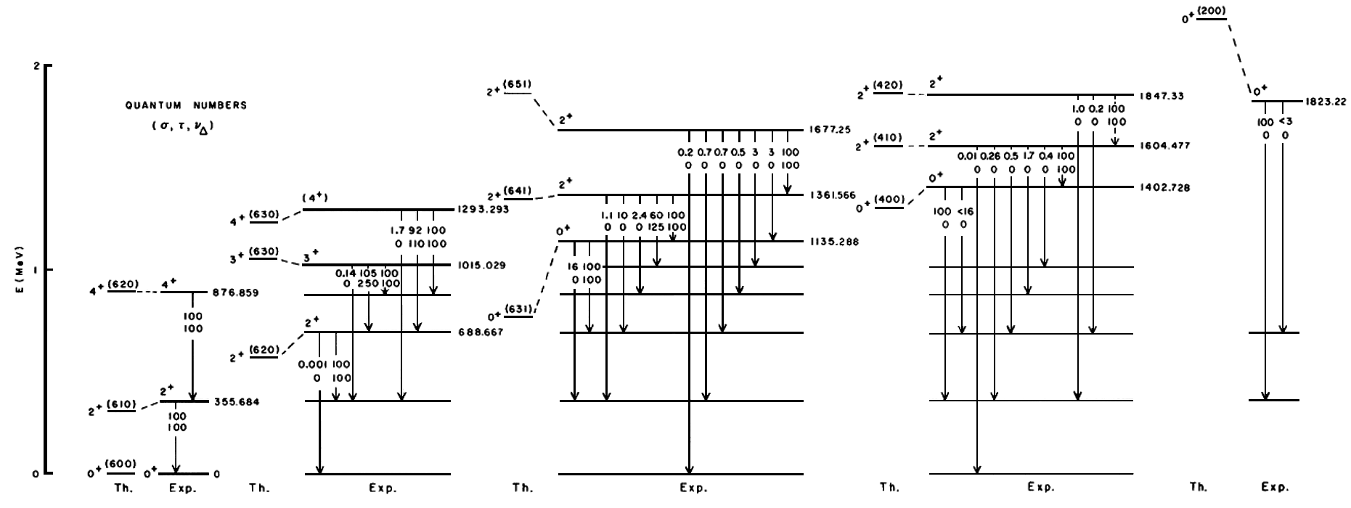
¹⁹⁶Pt: Best (first) O(6) nucleus
γ-soft

Slide 32
More General IBA calculations
Thus far, we have only dealt with nuclei corresponding to one of the three dynamical symmetries. Probably <1% of nuclei do that.
So, how do we treat the others? That is, how do we calculate with the IBA AWAY from the vertices of the symmetry triangle?
A couple of interesting examples first, then a general approach --- The technique of Orthogonal Crossing Contours (OCC)
χ

Slide 33
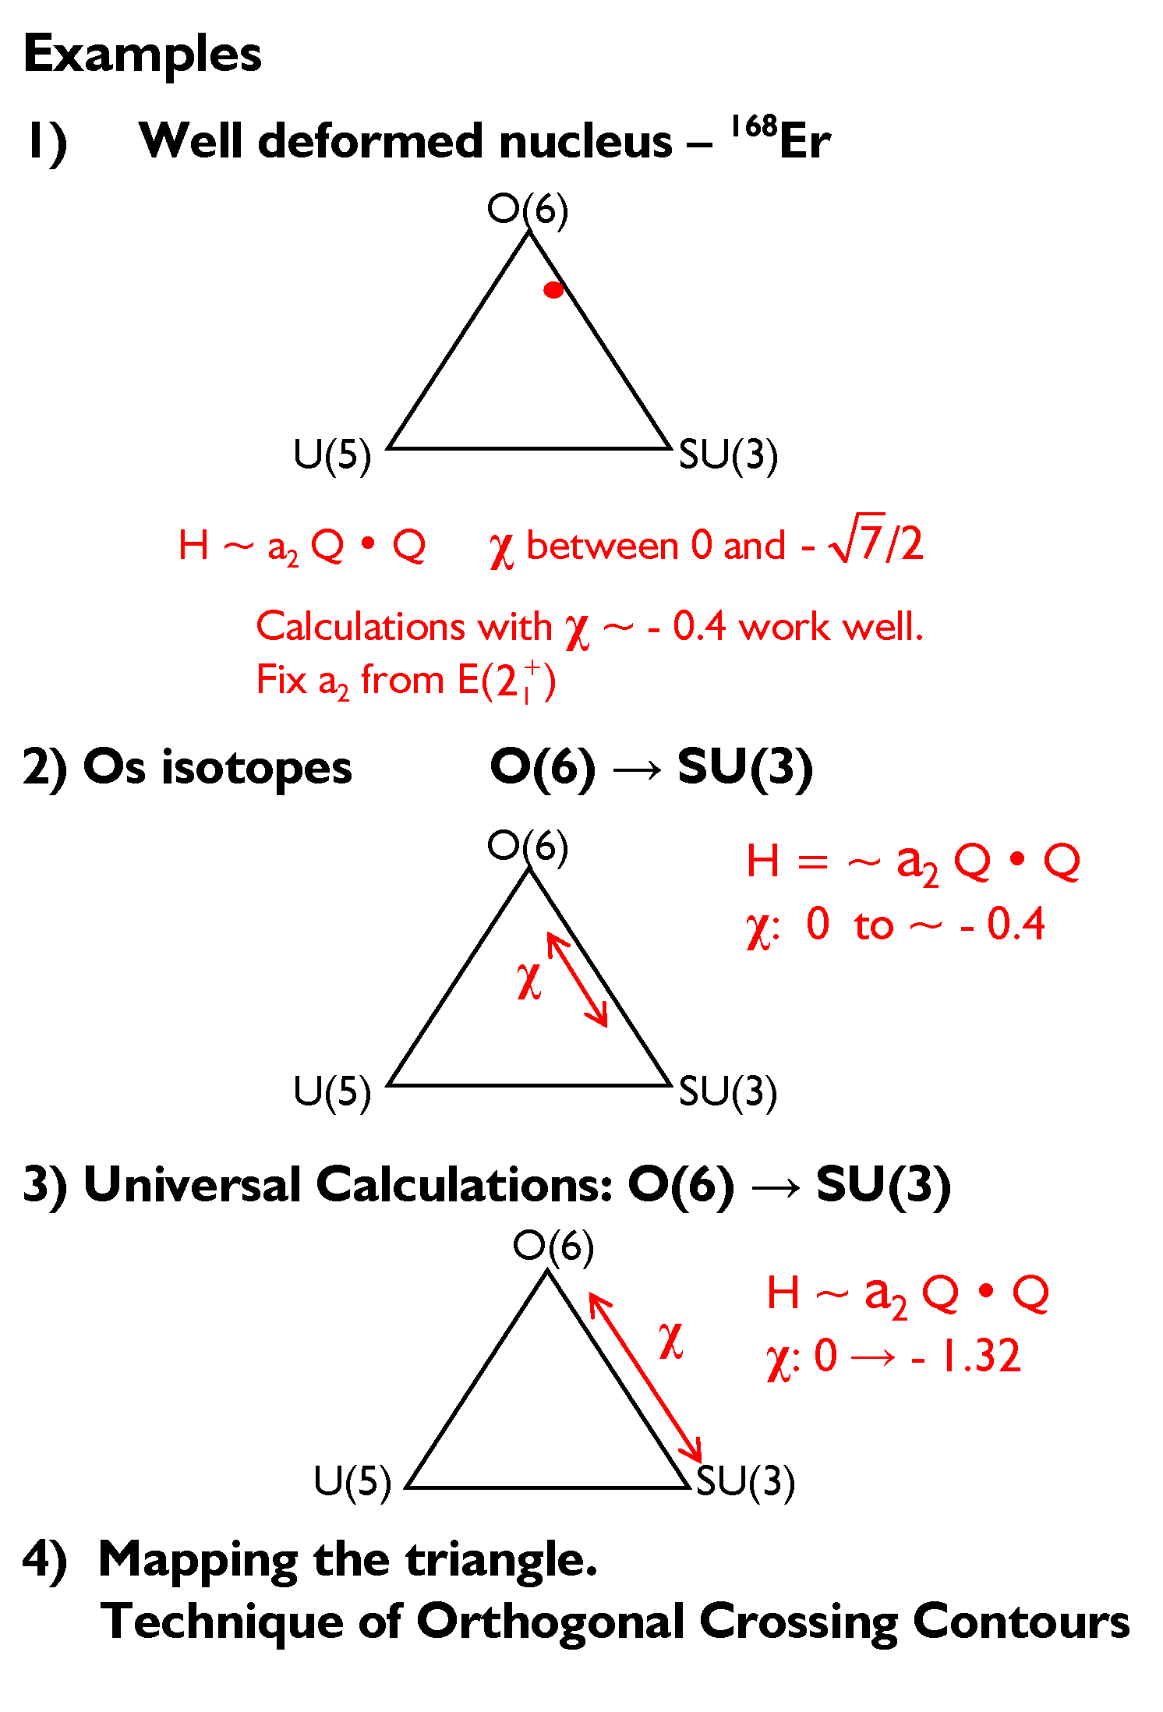
CQF
along the
O(6) – SU(3) leg
H = -κ Q • Q
Only a single parameter, 
We will discuss 1) and 4). The others are included in the slides in the Appendix
H = ε n_{d} - κ Q ⋅ Q
Two parameters
ε /κ and 

Slide 34
168-Er very simple 1-parameter calculation
H = ε n_{d} - κ Q ⋅ Q
ε = 0
χ
H = - κ Q ⋅ Q
is just scale factor
So, only parameter is χ
κ/ε

Slide 35
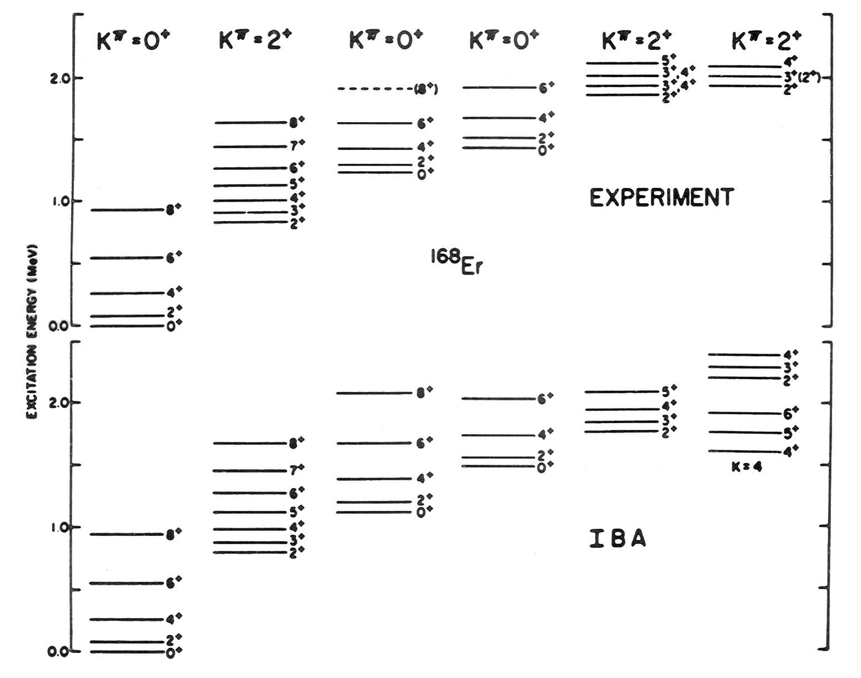
₁

Slide 37
Mapping the Entire Triangle
H = ε n_{d} - κ Q ⋅ Q
Parameters: , χ (within Q)
κ/ε
2 parameters
2-D surface
χ
κ/ε
Problem: varies from zero to infinity: Awkward. So, introduce a simple change of variables
κ/ε

Slide 38

Spanning the Triangle
ζ
H = c [
( 1 – ζ ) n_{d}
-
Q^{χ} ·Q^{χ}
]
4N_{B}
0⁺
4⁺
2⁺
2.5
O(6)
ζ = 1, χ = 0
2⁺
1
0⁺
0
χ
0⁺
2_{γ}⁺
ζ
4⁺
2⁺
0⁺
2.0
4⁺
3.33
2⁺
1
U(5)
SU(3)
2⁺
1
0⁺
0
0⁺
0
ζ = 0
ζ = 1, χ = -1.32

Slide 39




5
3
2
Notes:
39

Slide 40
H has two parameters. A given observable can only specify one of them. What does this imply? An observable gives a contour of constant values within the triangle
R4/2
= 2.9

Slide 41
A simple way to pinpoint structure.
Technique of Orthogonal Crossing Contours (OCC)
At the basic level : 2 observables (to map any point in the symmetry triangle)
Preferably with perpendicular trajectories in the triangle
Simplest Observable: R_{4/2}
2.7
Only provides a locus of structure
2.9
2.5
3.1
2.2
3.3
Notes:
41

Slide 42
Contour Plots in the Triangle
R_{4/2}
2.7
2.9
10
13
7
2.5
3.1
4
2.2
3.3
2.2
17
7
0.05
10
4
13
0.1
0.4
2.2
0.01
17

Slide 43
We have a problem
What we have:
What we need:
Lots of
Just one
Fortunately:
+2.0
+2.9
+1.4
+0.4
+0.1
-1
-0.1
-0.4
-2.0
-3.0

Slide 44
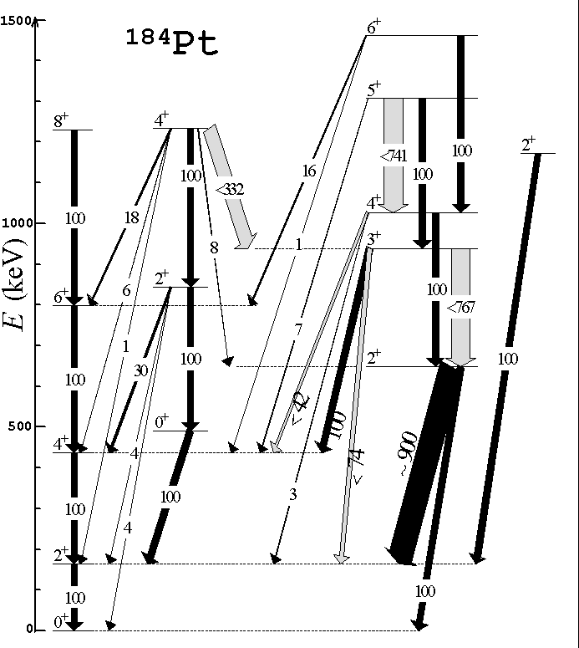
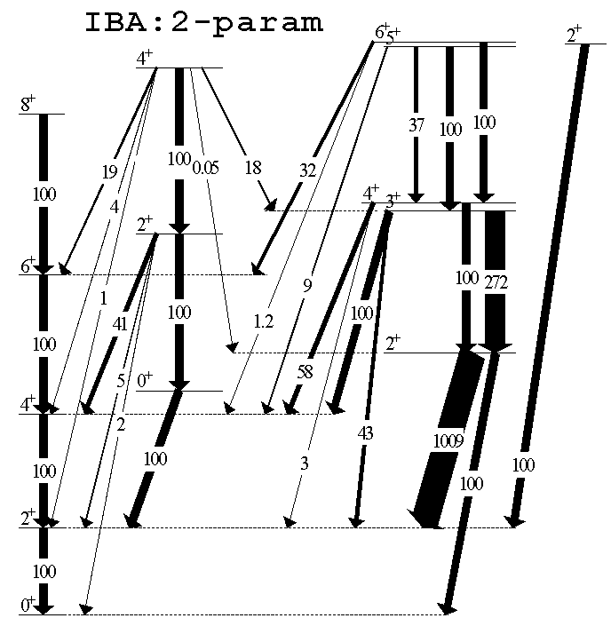

Mapping Structure with Simple Observables – Technique of Orthogonal Crossing Contours
γ - soft
Vibrator
Rotor
Burcu Cakirli et al.
Beta decay exp. + IBA calcs.

Slide 45
Evolution of Structure
Complementarity of macroscopic and microscopic approaches. Why do certain nuclei exhibit specific symmetries? Why these evolutionary trajectories?
What will happen far from stability in regions of proton-neutron asymmetry and/or weak binding?

Slide 46
Special Thanks to:
Franco Iachello
Akito Arima
Igal Talmi
Dave Warner
Peter von Brentano
Victor Zamfir
Jolie Cizewski
Hans Borner
Jan Jolie
Burcu Cakirli
Piet Van Isacker
Kris Heyde
Many others

Slide 47
Appendix:
Trajectories-by-eye
Running the IBA program using the Titan computer at Yale
Examples “2” and “3” skipped earlier of the use of the CQF form of the IBA

Slide 48
Trajectories at a Glance
R_{4/2}

Slide 49
Nuclear Model Codes at Yale
Computer name: Titan
Connecting to SSH: Quick connect
Host name: titan.physics.yale.edu
User name: phy664
Port Number 22
Password: nuclear_codes
cd phintm
pico filename.in (ctrl x, yes, return)
runphintm filename (w/o extension)
pico filename.out (ctrl x, return)

Slide 50
U(5)
---------------------------
L P = 1+
No states
---------------------------
L P = 2+
Energies
0.2000 0.4000 0.6000 0.8000 0.8000 1.0000 1.0000 1.2000 1.2000
---------------------------
L P = 3+
Energies
0.6000 1.0000 1.2000
---------------------------
L P = 4+
Energies
0.4000 0.6000 0.8000 0.8000 1.0000 1.0000 1.2000 1.2000 1.2000
---------------------------
L P = 5+
Energies
0.8000 1.0000 1.2000
---------------------------
L P = 6+
Energies
0.6000 0.8000 1.0000 1.0000 1.2000 1.2000 1.2000
--------------------------
Transitions: 2+ -> 0+ (BE2)
2+,1 -> 0+,1: 6.00000 2+,1 -> 0+,2: 2.00000 2+,1 -> 0+,3: 0.00000
2+,2 -> 0+,1: 0.00000 2+,2 -> 0+,2: 0.00000 2+,2 -> 0+,3: 2.40000
2+,3 -> 0+,1: 0.00000 2+,3 -> 0+,2: 5.60000 2+,3 -> 0+,3: 0.00000
and 0+ -> 2+ (BE2)
0+,1 -> 2+,1: 30.00000 0+,2 -> 2+,1: 10.00000 0+,3 -> 2+,1: 0.00000
0+,1 -> 2+,2: 0.00000 0+,2 -> 2+,2: 0.00000 0+,3 -> 2+,2: 12.00000
0+,1 -> 2+,3: 0.00000 0+,2 -> 2+,3: 28.00000 0+,3 -> 2+,3: 0.00000
Transitions: 4+ -> 2+ (BE2)
4+,1 -> 2+,1: 10.00000 4+,1 -> 2+,2: 0.00000 4+,1 -> 2+,3: 2.28571
4+,2 -> 2+,1: 0.00000 4+,2 -> 2+,2: 6.28571 4+,2 -> 2+,3: 0.00000
4+,3 -> 2+,1: 0.00000 4+,3 -> 2+,2: 0.00000 4+,3 -> 2+,3: 3.85714
Input
$diag
eps = 0.20, kappa = 0.00, chi =-0.00,
nphmax = 6,
iai = 0, iam = 6, neig = 3,
mult=.t.,ell=0.0,pair=0.0,oct=0.0,ippm=1,print=.t.
$
$em
E2SD=1.0, E2DD=-0.00
$
SLCT 2 2+ 0+ 2
99999
Output
---------------------------
L P = 0+
Basis vectors
|NR> = |ND,NB,NC,LD,NF,L P>
---------------------------
| 1> = | 0, 0, 0, 0, 0, 0+>
| 2> = | 2, 1, 0, 0, 0, 0+>
| 3> = | 3, 0, 1, 0, 0, 0+>
| 4> = | 4, 2, 0, 0, 0, 0+>
| 5> = | 5, 1, 1, 0, 0, 0+>
| 6> = | 6, 0, 2, 0, 0, 0+>
| 7> = | 6, 3, 0, 0, 0, 0+>
Energies
0.0000 0.4000 0.6000 0.8000 1.0000 1.2000 1.2000
Eigenvectors
1: 1.000 0.000 0.000
2: 0.000 1.000 0.000
3: 0.000 0.000 1.000
4: 0.000 0.000 0.000
5: 0.000 0.000 0.000
6: 0.000 0.000 0.000
7: 0.000 0.000 0.000
Basis
Energies
Pert.
Wave
Fcts.

Slide 51
O(6)
Input
$diag
eps = 0.0, kappa = 0.02, chi =-0.0,
nphmax = 6,
iai = 0, iam = 6, neig = 5,
mult=.t.,ell=0.0,pair=0.0,oct=0.0,ippm=1,print=.t.
$
$em
E2SD=1.0, E2DD=-0.00
$
99999
Output
---------------------------
L P = 0+
Basis vectors
|NR> = |ND,NB,NC,LD,NF,L P>
---------------------------
| 1> = | 0, 0, 0, 0, 0, 0+>
| 2> = | 2, 1, 0, 0, 0, 0+>
| 3> = | 3, 0, 1, 0, 0, 0+>
| 4> = | 4, 2, 0, 0, 0, 0+>
| 5> = | 5, 1, 1, 0, 0, 0+>
| 6> = | 6, 0, 2, 0, 0, 0+>
| 7> = | 6, 3, 0, 0, 0, 0+>
Energies
0.0000 0.3600 0.5600 0.9200 0.9600 1.0800 1.2000
Eigenvectors
1: -0.433 0.000 0.685 0.000 0.559
2: -0.750 0.000 0.079 0.000 -0.581
3: 0.000 -0.886 0.000 0.463 0.000
4: -0.491 0.000 -0.673 0.000 0.296
5: 0.000 -0.463 0.000 -0.886 0.000
6: 0.000 0.000 0.000 0.000 0.000
7: -0.094 0.000 -0.269 0.000 0.512
---------------------------
L P = 1+
No states
---------------------------
L P = 2+
Energies
0.0800 0.2000 0.5600 0.6400 0.7600 0.8000 1.0400 1.1200 1.1600
--------------------------
L P = 3+
Energies
0.3600 0.9200 1.0800
---------------------------
L P = 4+
Energies
0.2000 0.3600 0.5600 0.7600 0.8000 0.9200 1.0800 1.1200 1.1600
--------------------------
L P = 5+
Energies
0.5600 0.8000 1.1200
---------------------------
L P = 6+
Energies
0.3600 0.5600 0.8000 0.9200 1.0800 1.0800 1.1200
---------------------------
Binding energy = -0.6000 , eps-eff = -0.1200
Basis
Energies
Pert.
Wave
Fcts.

Slide 52
SU(3)
******************** Input file contents ********************
$diag
eps = 0.00, kappa = 0.02, chi =-1.3229,
nphmax = 6,
iai = 0, iam = 6, neig = 5,
mult=.t.,ell=0.0,pair=0.0,oct=0.0,ippm=1,print=.t.
$
$em
E2SD=1.0, E2DD=-2.598
$
99999
*************************************************************
---------------------------
L P = 0+
Basis vectors
|NR> = |ND,NB,NC,LD,NF,L P>
---------------------------
| 1> = | 0, 0, 0, 0, 0, 0+>
| 2> = | 2, 1, 0, 0, 0, 0+>
| 3> = | 3, 0, 1, 0, 0, 0+>
| 4> = | 4, 2, 0, 0, 0, 0+>
| 5> = | 5, 1, 1, 0, 0, 0+>
| 6> = | 6, 0, 2, 0, 0, 0+>
| 7> = | 6, 3, 0, 0, 0, 0+>
Energies
0.0000 0.6600 1.0800 1.2600 1.2600 1.5600 1.8000
Eigenvectors
1: 0.134 0.385 -0.524 -0.235 0.398
2: 0.463 0.600 -0.181 0.041 -0.069
3: -0.404 -0.204 -0.554 -0.557 -0.308
4: 0.606 -0.175 0.030 -0.375 -0.616
5: -0.422 0.456 -0.114 0.255 -0.432
6: -0.078 0.146 -0.068 0.245 -0.415
7: 0.233 -0.437 -0.606 0.606 0.057
---------------------------
L P = 1+
No states
---------------------------
L P = 2+
Energies
0.0450 0.7050 0.7050 1.1250 1.1250 1.3050 1.3050 1.6050
---------------------------
L P = 3+
Energies
0.7500 1.1700 1.6500
---------------------------
L P = 4+
Energies
0.1500 0.8100 0.8100 1.2300 1.2300 1.2300 1.4100 1.4100
---------------------------
L P = 5+
Energies
0.8850 1.3050 1.3050
---------------------------
L P = 6+
Energies
0.3150 0.9750 0.9750 1.3950 1.3950 1.5750 1.5750
---------------------------
Binding energy = -1.2000 , eps-eff = -0.1550
Wave fcts. in U(5) basis

Slide 53
“Universal” IBA Calculations
for the SU(3) – O(6) leg
₂
H = - κ Q • Q
κ is just energy scale factor
Ψ’s, B(E2)’s independent of κ
Results depend only on χ
[ and, of course, vary with N_{B} ]
Can plot any observable as a set of
contours vs. N_{B} and χ.

Slide 54
Universal O(6) – SU(3) Contour Plots
H = -κ Q • Q
χ = 0 O(6)
χ = - 1.32 SU(3)
SU(3)

Slide 56
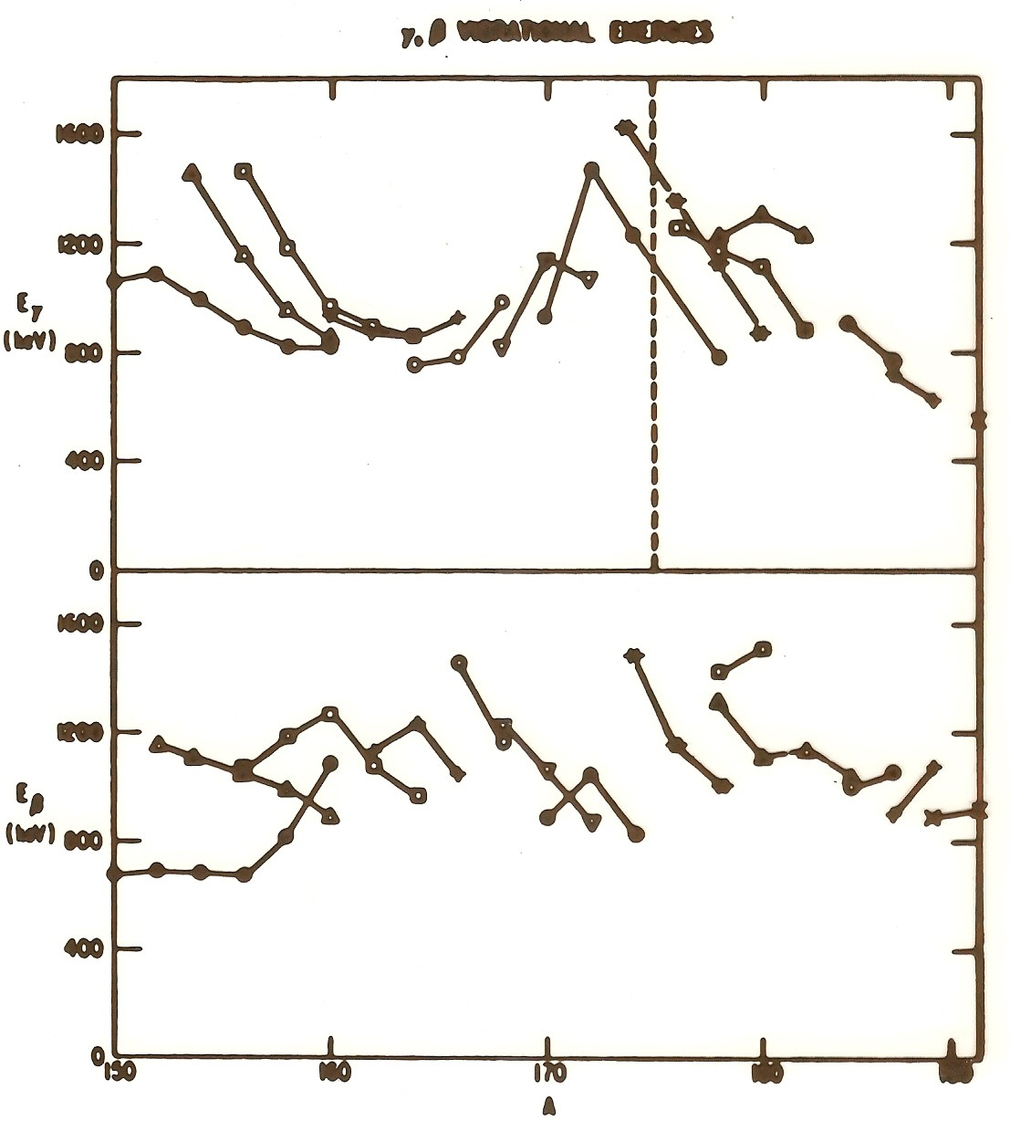
Systematics and collectivity of the lowest vibrational modes in deformed nuclei
Max. Coll.
Increasing γ softness
Notice that the the β mode is at higher energies (~ 1.5 times the γ vibration near mid-shell)* and fluctuates more. This points to lower collectivity of the β vibration.
* Remember for later !
Notes:
56

Slide 58
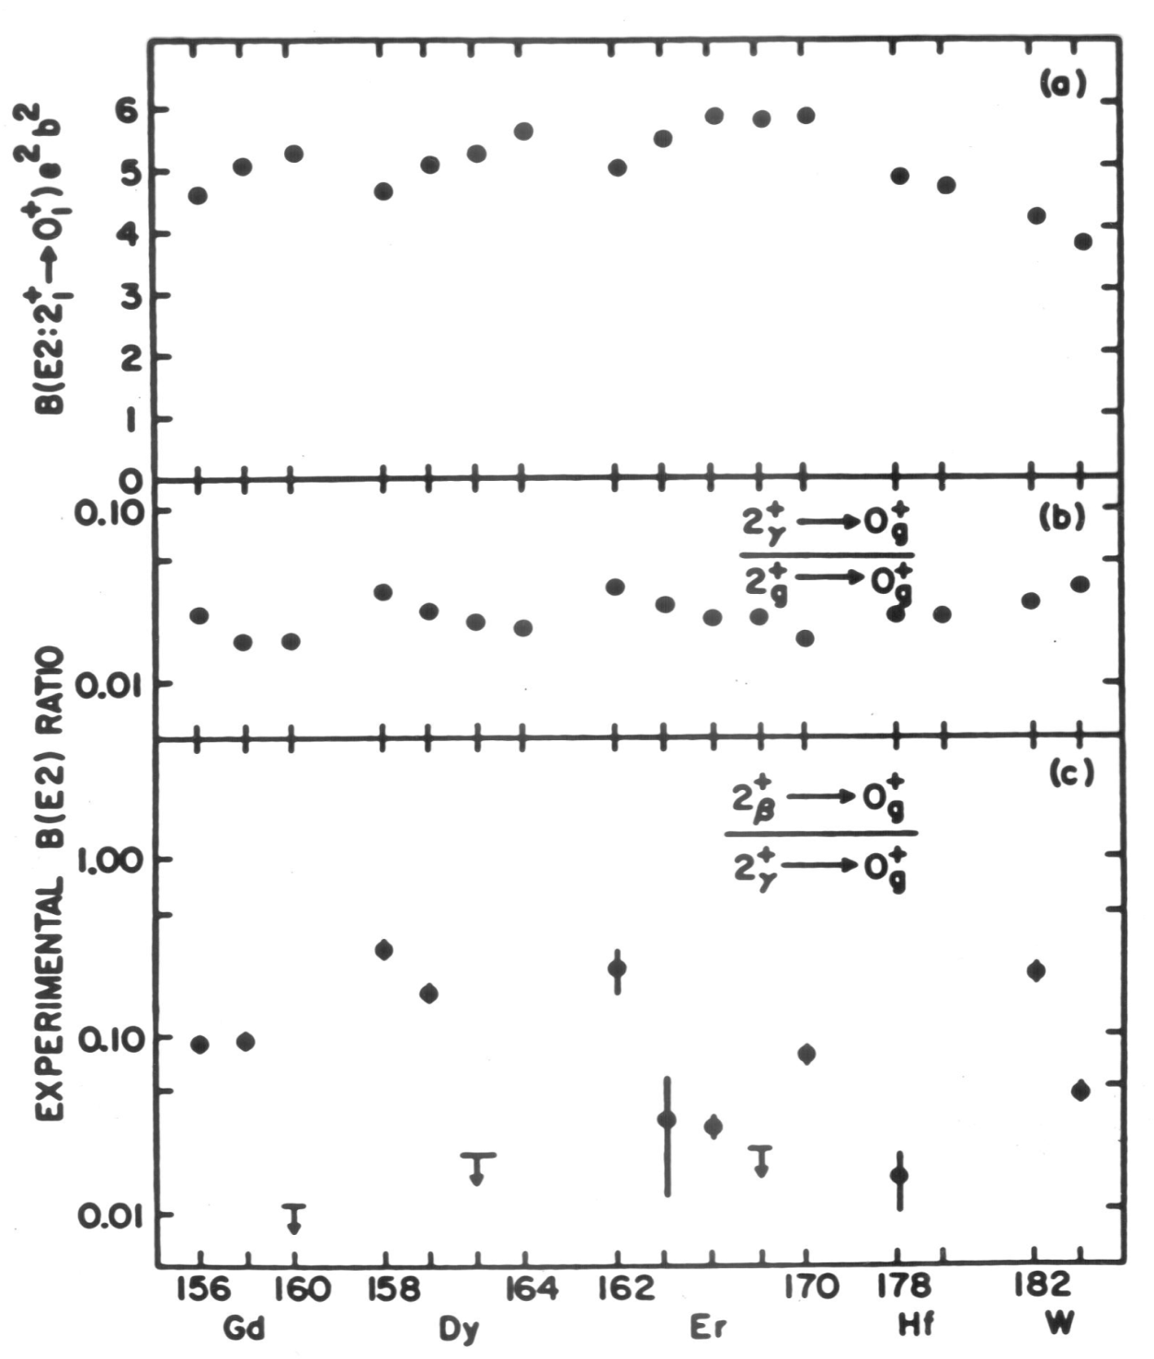
Notes:
I can’t find this one.
58

Slide 59
Os isotopes from A = 186 to 192: Structure varies from a moderately gamma soft rotor to close to the O(6) gamma-independent limit. Describe simply with:
H = -κ Q • Q  : 0  small as A decreases
₃

Slide 60
End of Appendix

