Slide 1
How nuclei behave: a simple perspective based on symmetry and geometry
(with a discussion of the microscopic drivers of structural evolution)
R. F. Casten
WNSL, Yale

Slide 2
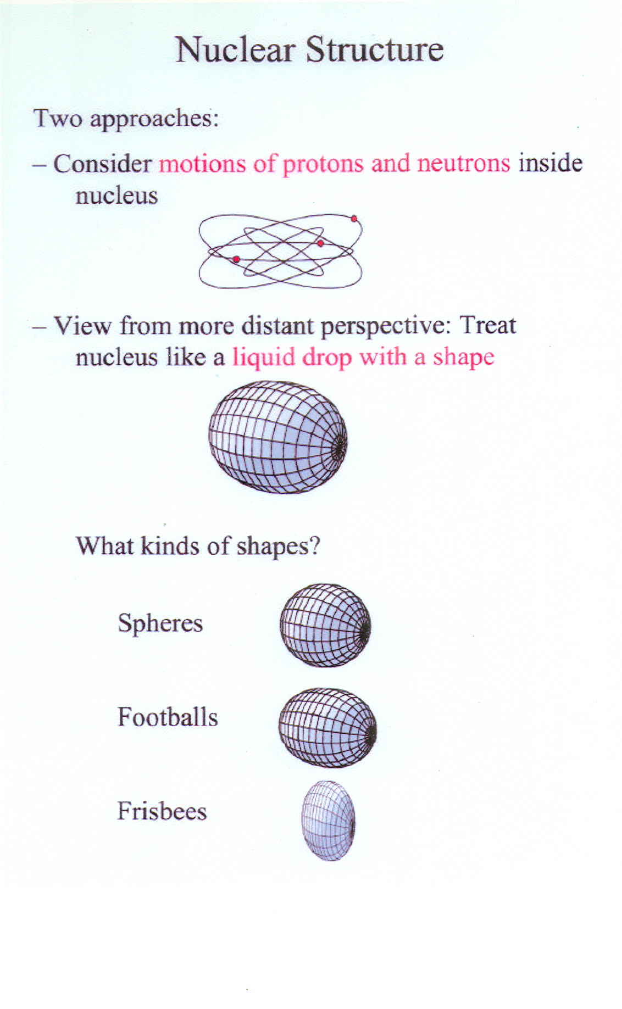
Themes and challenges of Modern Science
Complexity out of simplicity -- Microscopic
  How the world, with all its apparent complexity and diversity can be constructed out of a few elementary building blocks and their interactions
Simplicity out of complexity – Macroscopic
  How the world of complex systems can display such remarkable regularity and simplicity
What is the force that binds nuclei?
What are the simple patterns that nuclei display and what is their origin ?

Slide 3
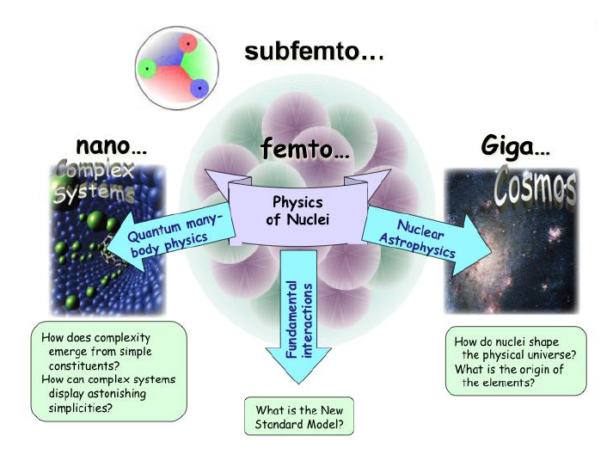
Where do nuclei fit into the overall picture?

Slide 4
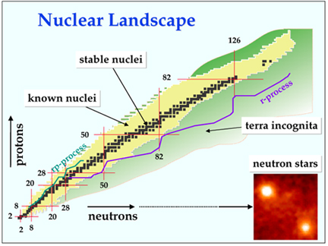
The scope of Nuclear Structure Physics
The Four Frontiers
Proton Rich Nuclei
Neutron Rich Nuclei
Heaviest Nuclei
Evolution of structure within these boundaries
Terra incognita — huge gene pool of new nuclei
We can customize our system – fabricate “designer” nuclei to isolate and amplify specific physics or interactions

Slide 5



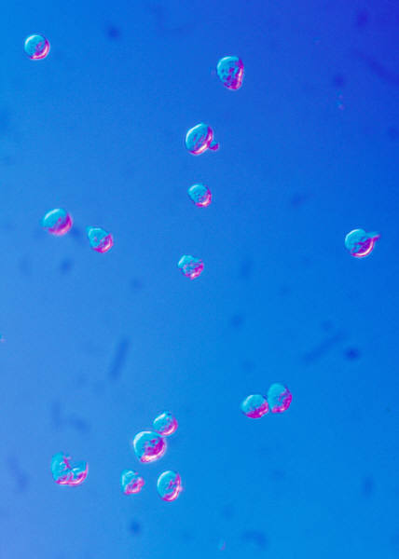

A confluence of advances leading to a great opportunity for science
Production and extraction of exotic nuclei
Guided by theory
A new
era in
the science
of nuclei,
and their
applications
Stable Beams
New detectors, separators, traps,
and experimental techniques
Advanced computing for data
acquisition, analysis, and theory
This enterprise depends critically on a
continuing influx of bright new people into the field

Slide 6

HIE-ISOLDE
ISOLDE
ISAC-II
ISAC-I
SPIRAL2
SPIRAL
FAIR
SIS
RIBF
RARF
NSCL
HRIBF
In Flight
ISOL
Fission+Gas Stopping
CARIBU@ATLAS
FRIB
Beam on target
Stable Beams
2000
2005
2010
2015
2020

Slide 7
Simple Observables - Even-Even Nuclei
1400
2⁺
1000
4⁺
400
2⁺
Masses,
Radii
0
0⁺
E (keV)
J^{π}

Slide 8
Reminder slide:
The Independent Particle Model
V_{ij}
U_{i}
⇒
r
Clusters of levels + Pauli Principle → magic numbers, inert cores, valence nucleons
Key to structure. Many-body → few-body: each body counts.
(Addition of 2 neutrons in a nucleus with 150 can drastically alter structure)

Slide 9
Residual Interactions
Need to consider a more complete Hamiltonian:
H_{Shell Model} = H_{IPM} + H_{residual}
H_{residual} reflects interactions not in the single particle potential.
NOT a minor perturbation. In fact, these residual interactions determine almost everything we know about most nuclei.
These interactions mix different independent particle model wave functions so that a physical wave function for a given state in the Shell Model is a linear combination of many independent Particle Model configurations.
This mixing is essential to understanding structure and structural evolution.

Slide 10
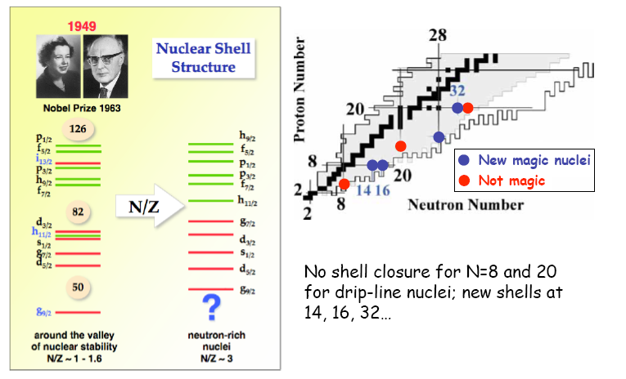
Caveat slide: Fragility of the Shell Model
Independent Particle Model – Trouble in Paradise
How can we see changes in shell structure experimentally. We will soon see one easy tool:
E(2⁺₁)

Slide 11
Key Nuclear observables and their behavior with N and Z
What nuclei do, how we study them (what observables), and some simple ideas about structure – single particle and collective aspects
Remember: The nuclei are always right !!! Don’t impose our preconceptions on them. Let them tell us what they are doing.

Slide 12
Let’s start with R_{4/2}. How does it vary, and why, and why do we care
We care because it is the almost the only observable whose value immediately tells us something (not everything – as we on shall see in the third lecture on the IBA model!!!) about the structure.
We care because it is easy to measure.
Other observables, like E(2₁⁺) and masses, are measurable even further from stability. They too can give valuable information in the context of regional behavior, but generally not as directly.

Slide 13
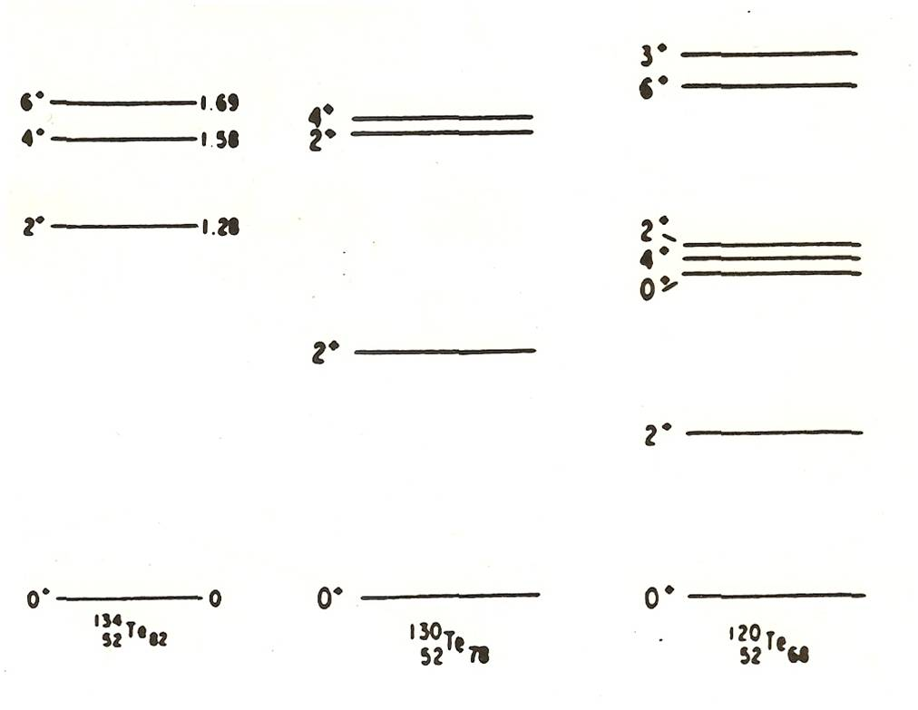
Starting from a doubly magic nucleus, what happens as the numbers of valence neutrons and protons increase?
Case of few valence nucleons:
Lowering of energies, development of multiplets. R_{4/2} → ~2-2.4
Two nucleons of one type
Few nucleons of both types
This evolution is the emergence of collective behavior
Notes:
13

Slide 14
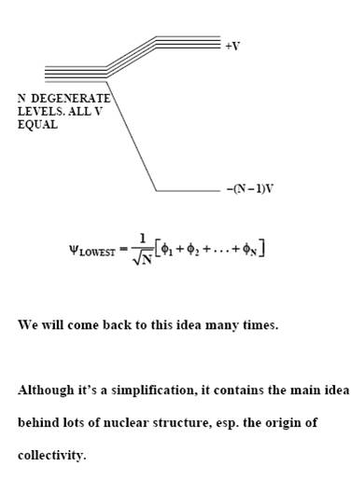
Origin of collectivity:
Mixing of many configurations
A illustrative special case of fundamental importance
Consider a toy model: Mixing of degenerate states
This is about as important as it gets.
Please remember it and think about it often (and try to develop a deep love for it).
This is the origin of collectivity in nuclei.
T
Notes:
14
14

Slide 15
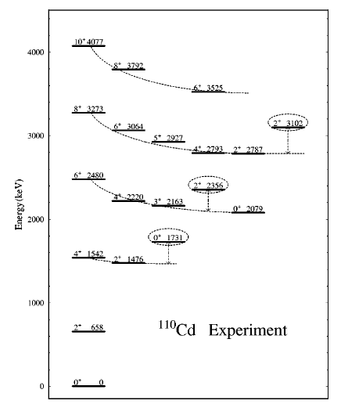
Types of collective structures
Few valence nucleons of each type:
The spherical vibrator
Vibrator (H.O.)
E(J) = n ( ω₀ )
R_{4/2}= 2.0
8⁺. . .
6⁺. . .
2⁺
n = 2
0⁺
n = 1
n = 0

Slide 16
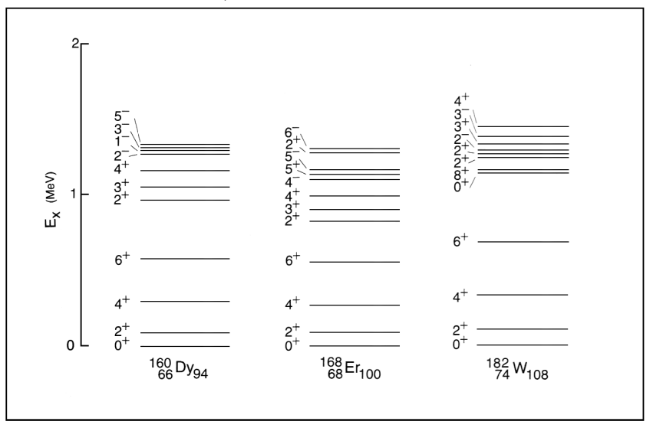
Lots of valence nucleons of both types: emergence of deformation and therefore rotation (nuclei live in the world, not in their own solipsistic enclaves)
R_{4/2} → ~3.33

Slide 17
Deformed nuclei – rotational spectra
Rotor
E(J) ∝ ( ħ²/2J )J(J+1)
R_{4/2}= 3.33
8⁺
6⁺
4⁺
2⁺
0⁺

Slide 18
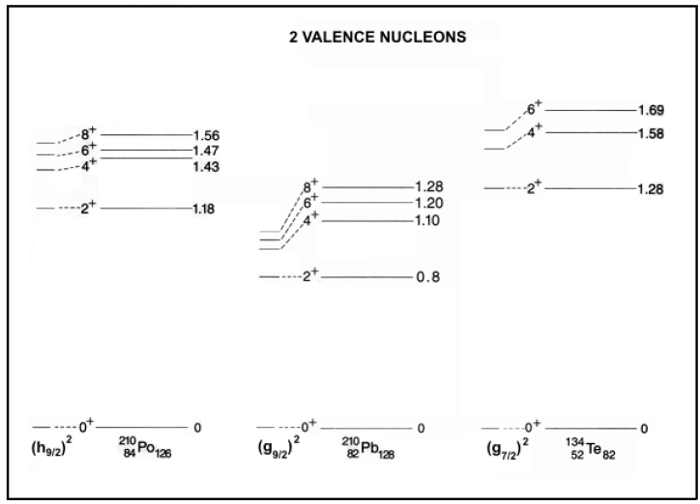
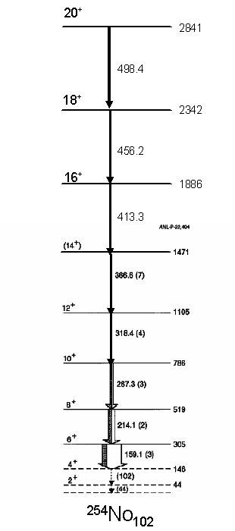
Doubly magic plus 2 nucleons
R_{4/2}< 2.0
Vibrator (H.O.)
E(J) = n ( ω₀ )
R_{4/2}= 2.0
Rotor
E(J) ∝ ( ħ²/2I )J(J+1)
R_{4/2}= 3.33
8⁺. . .
6⁺. . .
n = 2
2⁺
n = 1
0⁺
n = 0

Slide 19
Value of paradigms
Paradigm
Benchmark
700
333
100
0
Rotor J(J + 1)
Amplifies structural differences
Centrifugal stretching
Deviations
?
Without
rotor
paradigm
6⁺ 690
4⁺ 330
2⁺ 100
0⁺ 0
J E (keV)
Identify additional
degrees of freedom

Slide 20
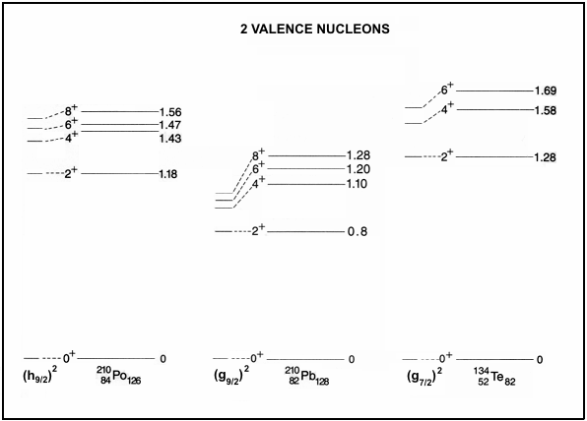
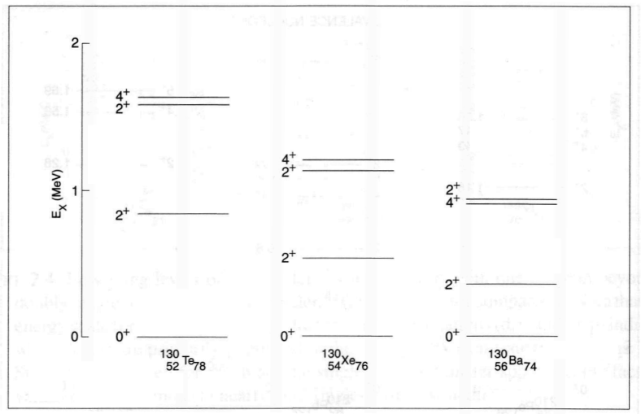
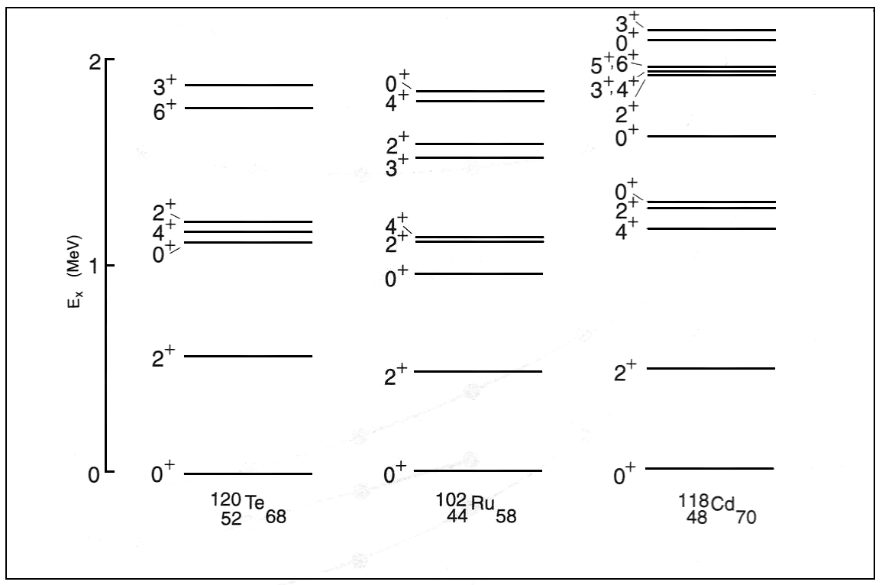
Reminder of several types of spectra and where they occur
Few valence nucleons
More valence nucleons
Many valence nucleons –> mid-shell

Slide 21
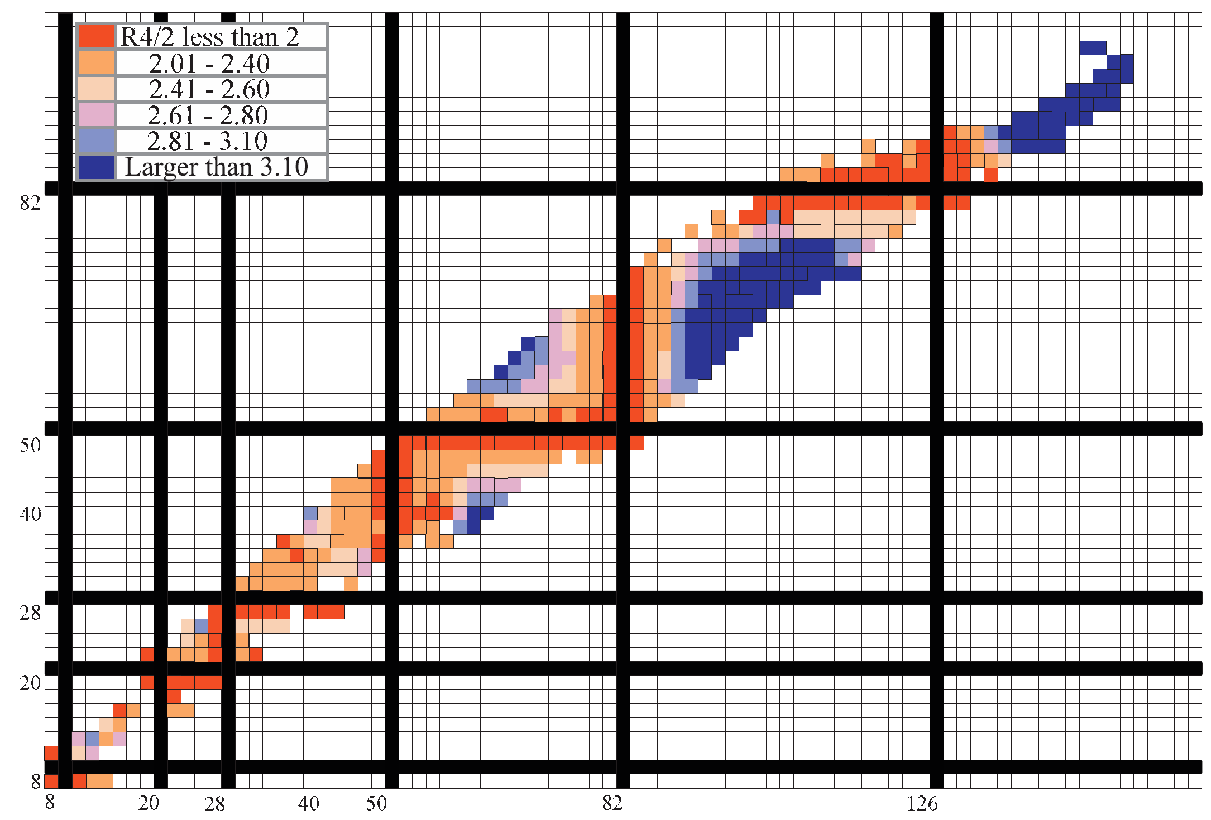
Broad perspective on structural evolution

Slide 22
A special phenomenon – rapid structural change
Cakirli

Slide 23
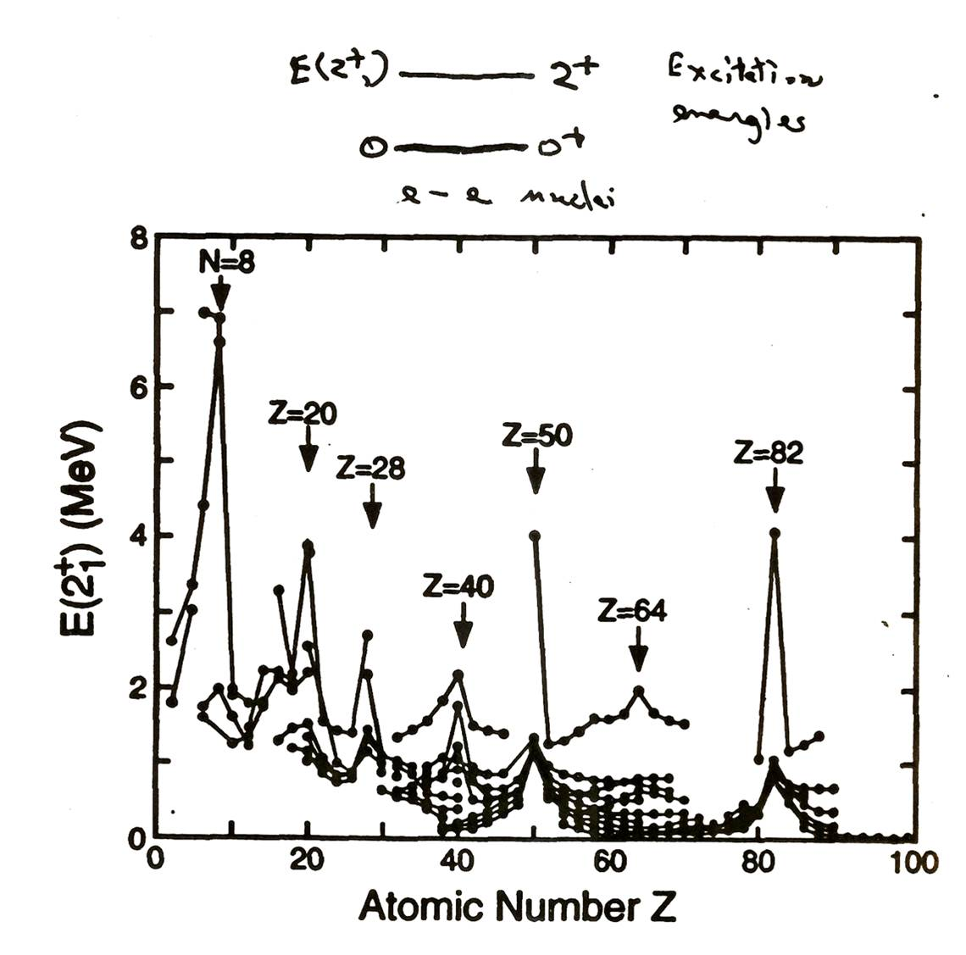
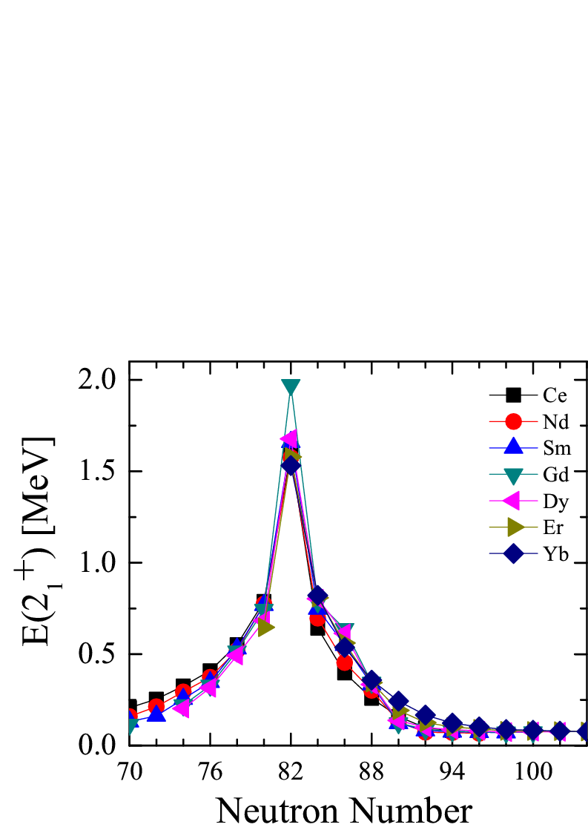
E(2⁺₁)
E(2⁺₁ )
a simple measure of collectivity
Notes:
23

Slide 24
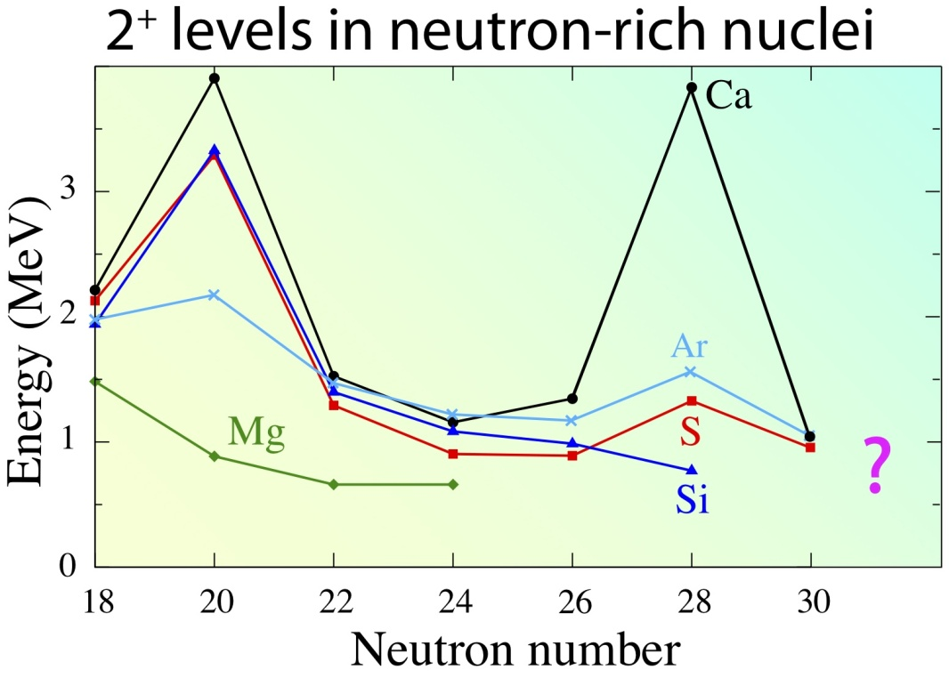
Note that N = 20 is NOT magic for Mg and N = 28 is NOT magic for Si and S !!!! Studying the evolution of shell structure is one of the most active and important areas of nuclear structure research today.

Slide 25
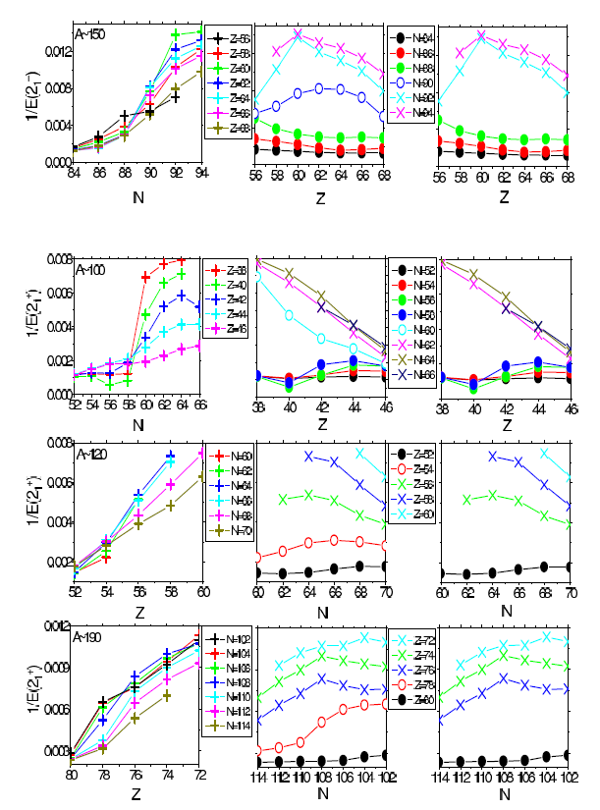
R_{4/2} and E(2⁺₁ )
Rotor
R_{4/2} across a typical region
Vibrator
!
Often, esp. in exotic nuclei, R_{4/2} is not available.
E(2₁⁺) is easier to measure, and often works as well.
Often better to use in the form 1/ E(2₁⁺) !!!
Notes:
25

Slide 26
Broad perspective on structural evolution
Z=50-82, N=82-126
The remarkable regularity of these patterns is one of the beauties of nuclear systematics and one of the challenges to nuclear theory.
Whether they persist far off stability is one of the fascinating questions
for the future
Cakirli
Notes:
One of the fascinating questions for the future is to see if these remarkable patterns continue in nuclei far from stability.

Slide 27
Think about the striking regularities in these data.
Take a nucleus with A ~100-200. The summed volume of all the nucleons is ~ 60 % the volume of the nucleus, and they orbit the nucleus ~ 10²¹ times per second!
Instead of utter chaos, the result is very regular behavior, reflecting ordered, coherent, motions of these nucleons.
This should astonish you.
How can this happen??!!!!
Much of understanding nuclei is understanding the relation between nucleonic motions and collective behavior

Slide 28
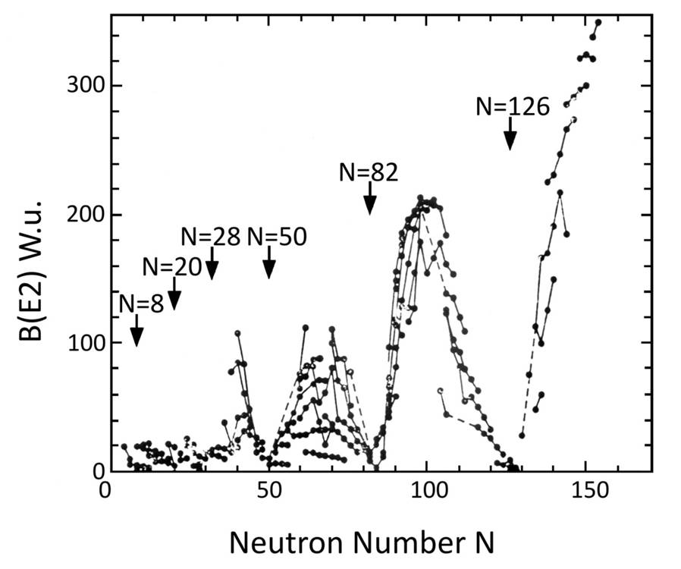
Transition rates (half lives of excited levels) also tell us a lot about structure
2⁺
B(E2: 0⁺₁ → 2⁺₁) ∝ ⟨ 2⁺₁ ⎢⎢E2 ⎢⎢0⁺₁⟩²
0⁺
Collective
Magic
Notes:
28

Slide 29
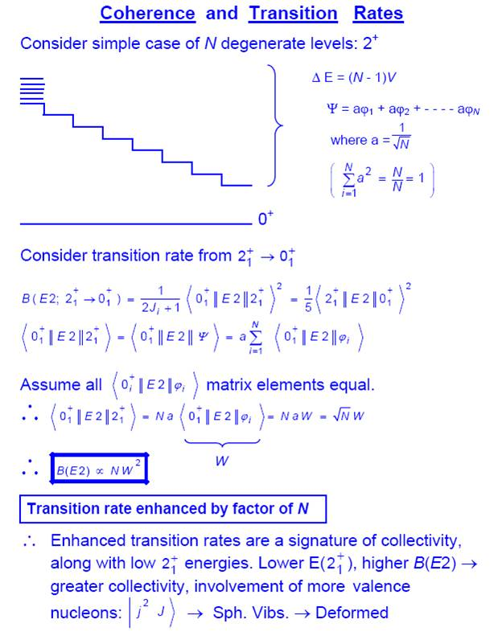
W
The more configurations that mix, the stronger the B(E2) value and the lower the energy of the collective state. Fundamental property of collective states.
Notes:
29

Slide 30
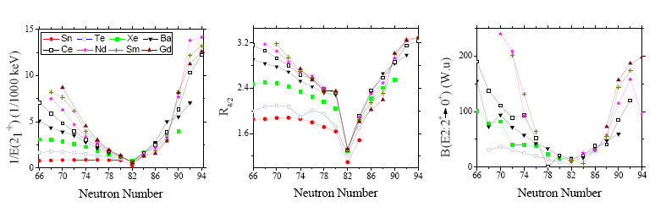
Alternate look:
Behavior of key observables centered on a shell closure
Cakirli

Slide 31
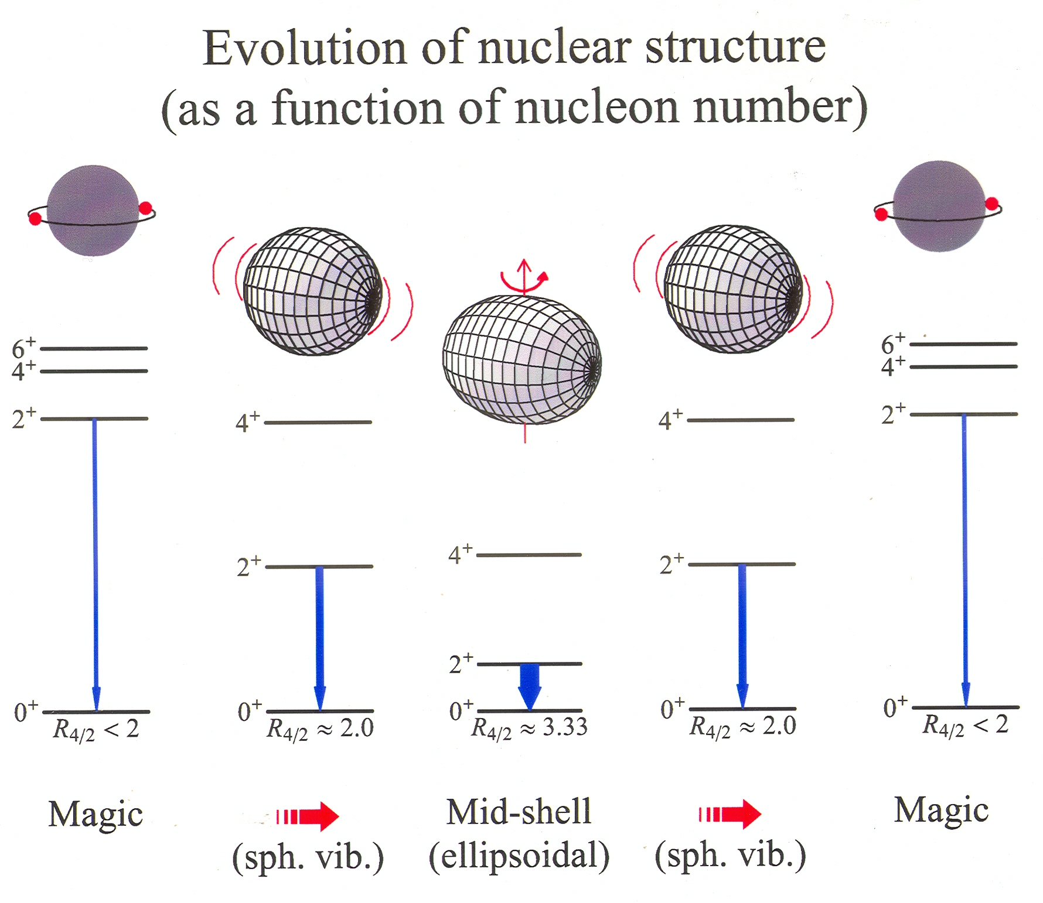
B(E2; 2⁺ → 0⁺ )

Slide 32
Two-neutron separation energies
S_{2n} = A + BN + S_{2n} (Coll.)
Normal behavior: ~ linear segments with drops after closed shells
Discontinuities at first order phase transitions

Slide 33
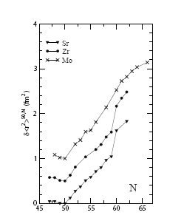
Isotope Shifts – sensitive to structural changes, especially deformation

Slide 34
So far, everything we have plotted has been an individual observable against N or Z (or A)
Now we introduce the idea of correlations of different observables with each other.

Slide 35
Correlations of Collective Observables
4⁺
2⁺
0⁺
There is only one appropriate reaction to this result ….
Wow !!!!!!!!
There is only one worry, however …. accidental or false correlations. Beware of lobsters !!!

Slide 36

BEWARE OF FALSE CORRELATIONS!

Slide 37
How can we understand collective behavior
Do microscopic calculations, in the Shell Model or its modern versions, such as with density functional theory or Monte Carlo methods. These approaches are making amazing progress in the last few years. Nevertheless, they often do not give an intuitive feeling for the structure calculated.
Collective models, which focus on the structure and symmetries of the many-body, macroscopic system itself. Two classes: Geometric and Algebraic
Geometrical models introduce a potential which depends on the shape of the nucleus. One can then have rotations and vibrations of that shape.
Algebraic models invoke symmetries of the nucleus and use group theoretical approaches to solve as much as possible analytically.

Slide 38
Nuclear Shapes
Need to specify the shape. Need two parameters, β and γ. The concept of “intrinsic frame”.
  β specifies the ellipsoidal deformation of the shape. (We consider quadrupole shapes only – American football or frisbee shapes.)
  γ specifies the amount of axial asymmetry
H = T + V(β,γ) Models are primarily a question of choosing V(β,γ)
Kinetic energy contains rotation if the nucleus is not spherical. So we must specify orientation of the nucleus in space (the lab frame). Introduces three more coordinates, Euler angles.

Slide 39
The Geometric Collective Model
H = T + T_{rot} + V(β,γ)
V ~ C₂β² + C₃ β³ cos 3 γ + C₄β⁴ + ....
Six terms in all for the potential. These three are normally the only ones used as they allow a rich variety of collective structures without an explosion of parameters. In addition, there is a kinetic energy term.
This is a phenomenological model which cannot predict anything without being “fed”. One selects simple data to help pinpoint the parameters, then uses the model to calculate other observables.

Slide 41
Key ingredient: Quantum mechanics -- confinement
Particles in a “box” or “potential” well
Confinement is origin of quantized energies levels
3
1
2
Energy ~ 1 / wave length
n = 1,2,3 is principal quantum number
E up with n because wave length is shorter

Slide 42
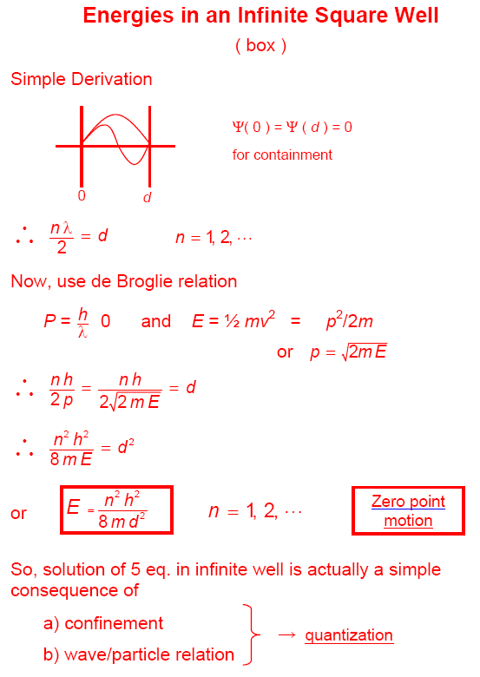
Notes:
42

Slide 43
H = T + T_{rot} + V(β,γ)

Slide 44
Next time …
Geometric models
Types of collective nuclei
The microscopic drivers of collectivity – the valence p-n interaction
Simple ways of estimating the structure of any nucleus
Introduction to the Interacting Boson Approximation (IBA) Model

