Slide 1
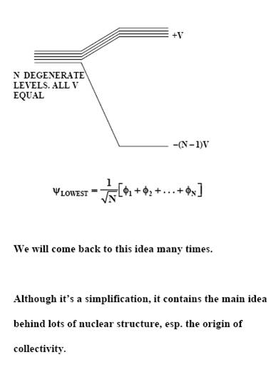
Development of collective behavior in nuclei
Results primarily from correlations among valence nucleons.
Instead of pure “shell model” configurations, the wave functions are mixed – linear combinations of many components.
Leads to a lowering of the collective states and to enhanced transition rates as characteristic signatures.

Slide 2
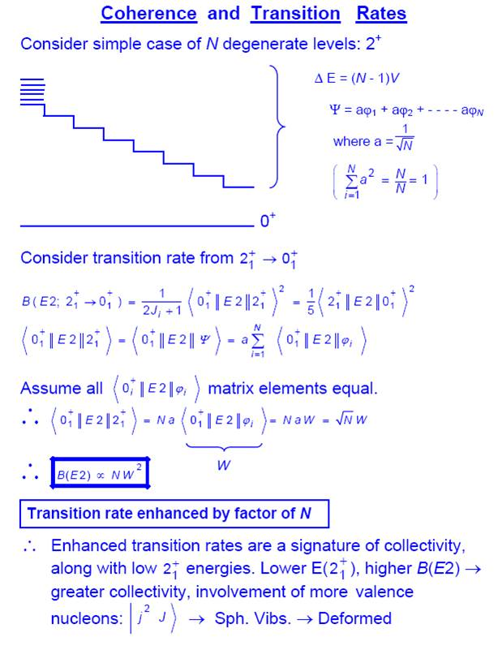
W
The more configurations that mix, the stronger the B(E2) value and the lower the energy of the collective state. Fundamental property of collective states.
Notes:
2

Slide 3
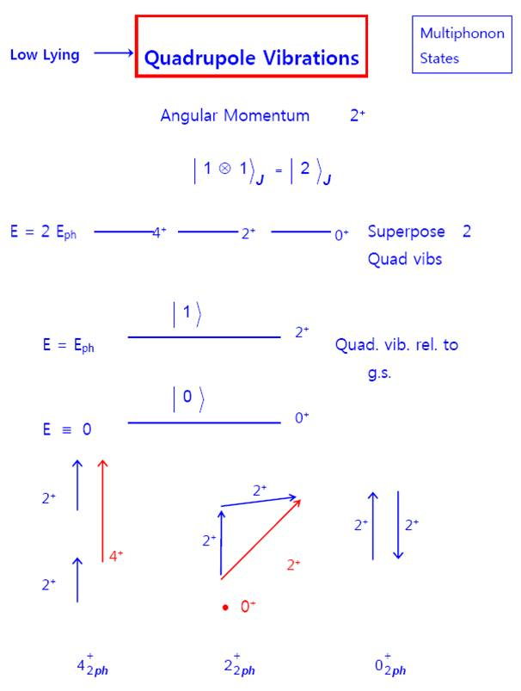
|2>
Notes:
3

Slide 4
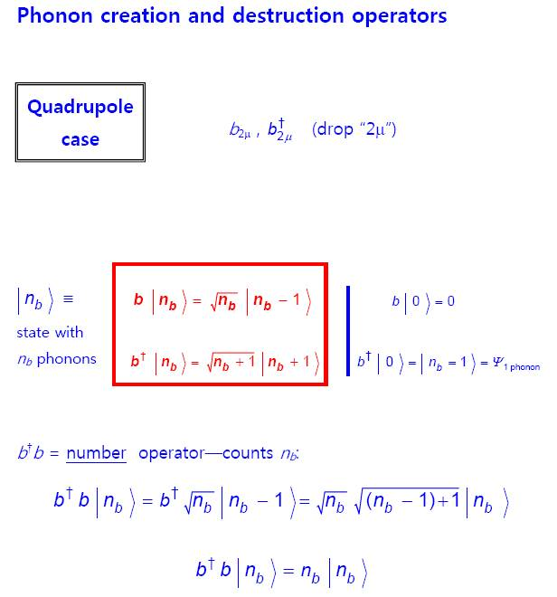

Slide 5
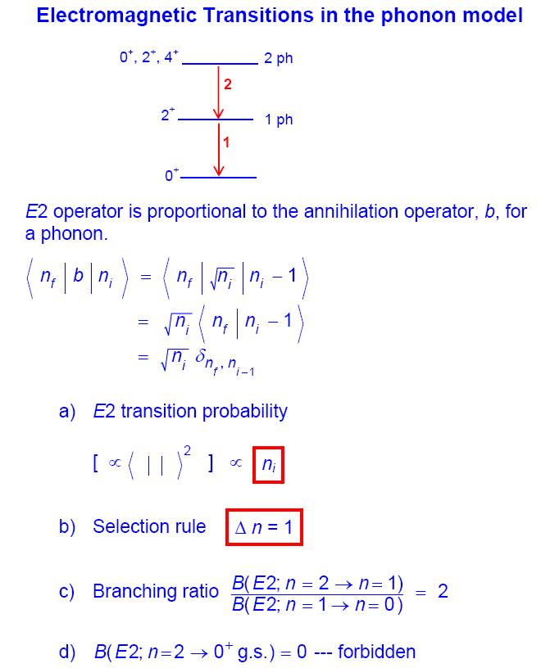

Slide 6
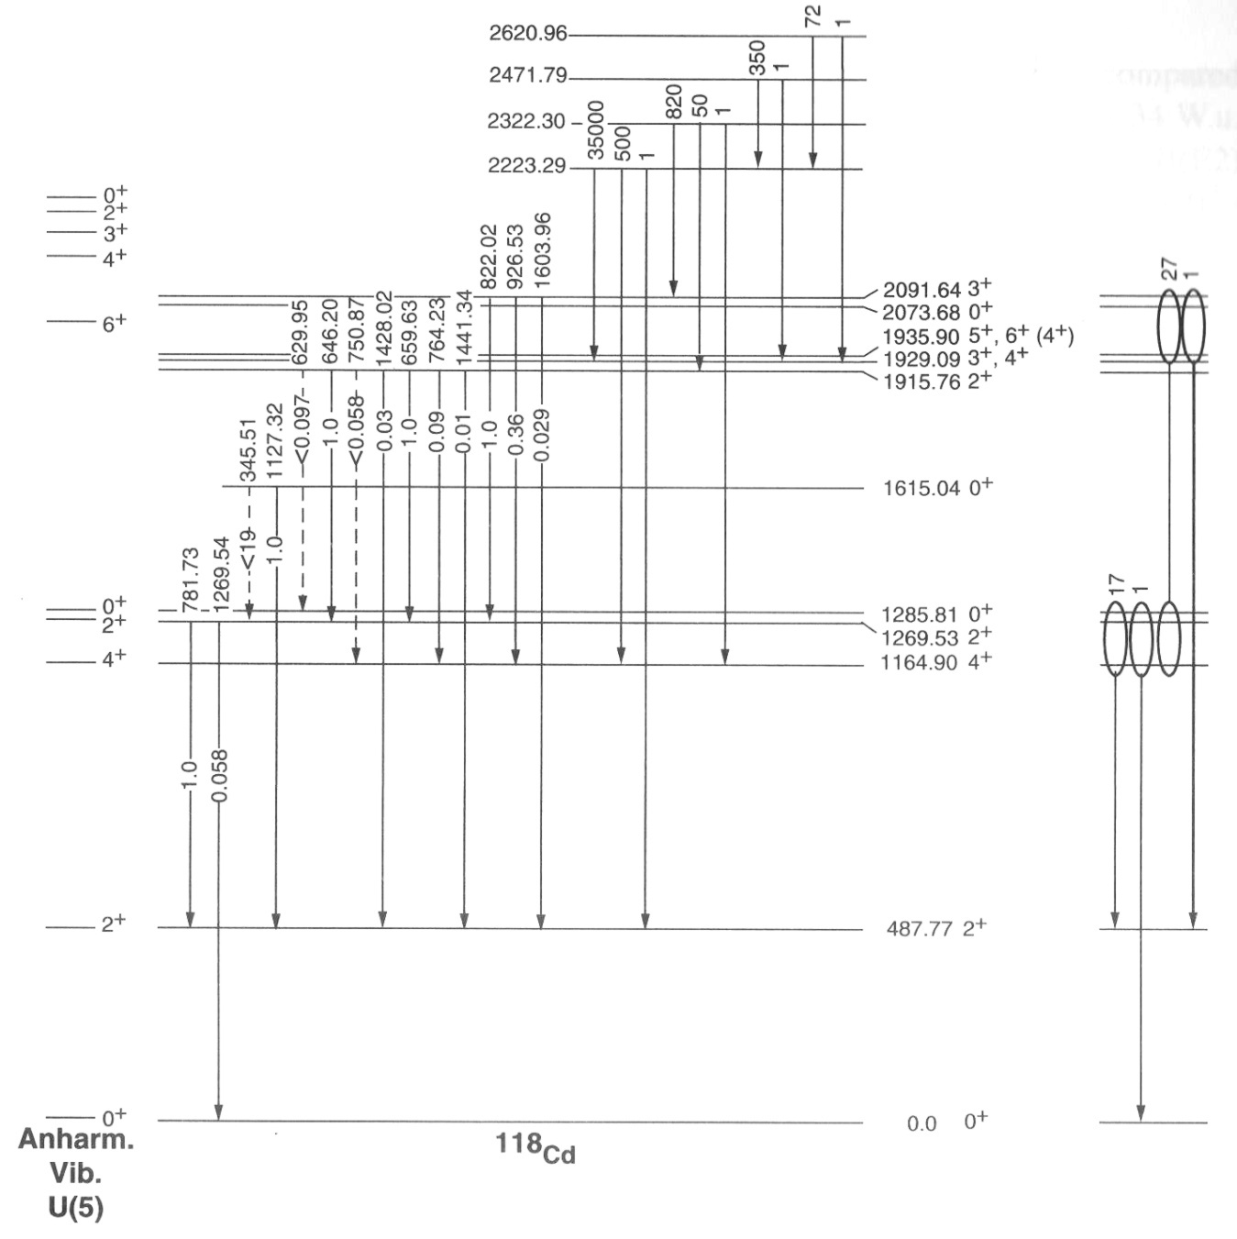

Slide 7
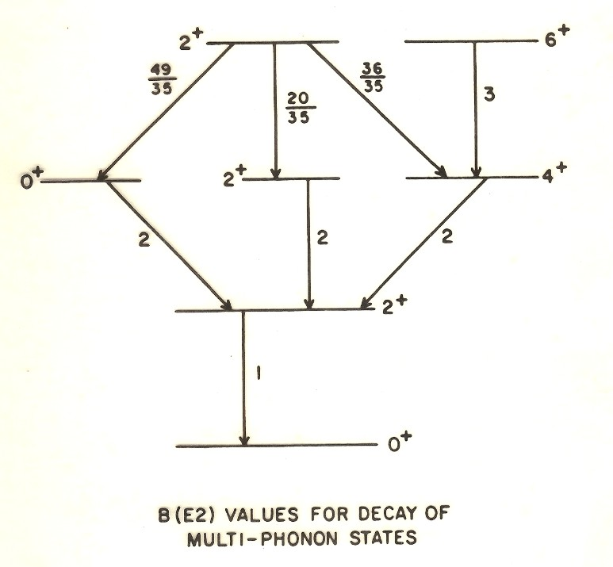

Slide 8
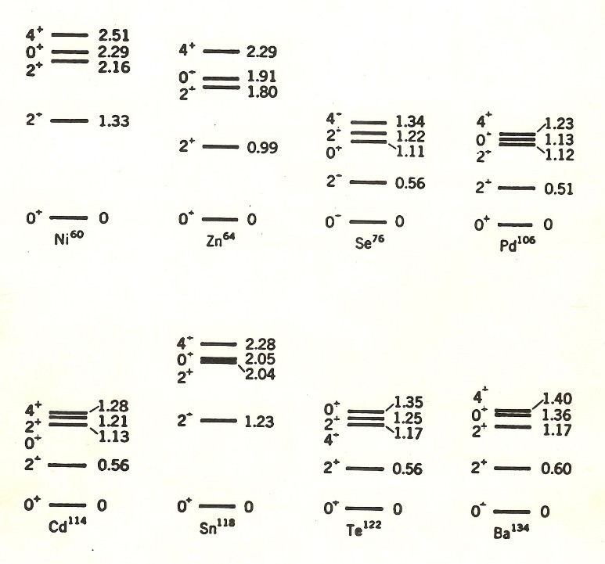
V ~ C₂β²
Notes:
8

Slide 9
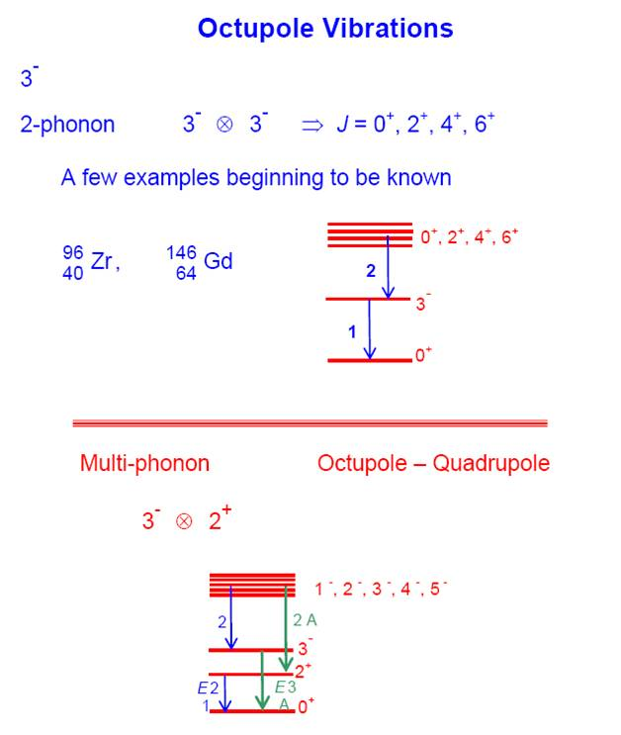

Slide 10
Deformed, ellipsoidal, rotational nuclei
Lets look at a typical example and see the various aspects of structure it shows
Axially symmetric case
Axial asymmetry

Slide 11
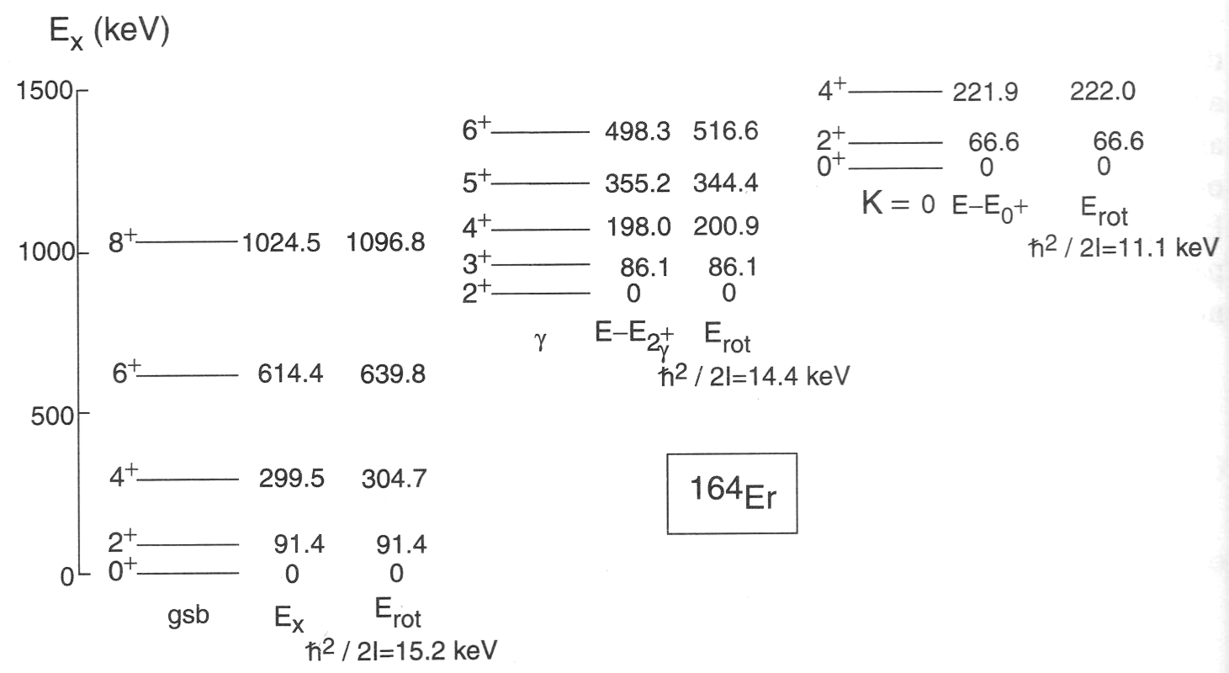
Rotational states built on (superposed on) vibrational modes
Vibrational excitations
V ~ C₂β²
+ C₃ β³ cos 3 γ
+ C₄β⁴
Rotational states
8⁺
Ground or equilibrium state
6⁺
4⁺
2⁺
0⁺

Slide 12
Axial asymmetry (Triaxiality)
(Specified in terms of the coordinate γ (in degrees), either from 0 –> 60 or from -30 –> +30 degrees – zero degrees is axially symmetric)
γ − rigid
γ − soft (flat, unstable)
V(γ)
axially “symm”
V(γ)
γ
γ
γ
C₃= 0
V ~ C₂β² + C₃cos 3 γ β³ + C₄β⁴
Note: for axially symm. deformed nuclei, MUST have a large C₃ term

Slide 13
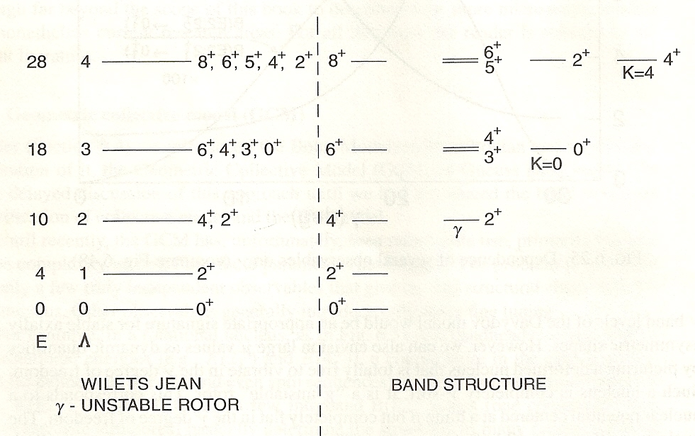
Axial Asymmetry in Nuclei – two types
E ~ Λ ( Λ + 3 ) ~ J ( J + 6 )
6⁺
5⁺
4⁺
Note staggering in gamma band energies
3⁺
Gamma Rigid
Gamma Soft
Davydov, Gamma rigid
Wilets-Jean, Gamma unstable
Notes:
13

Slide 14
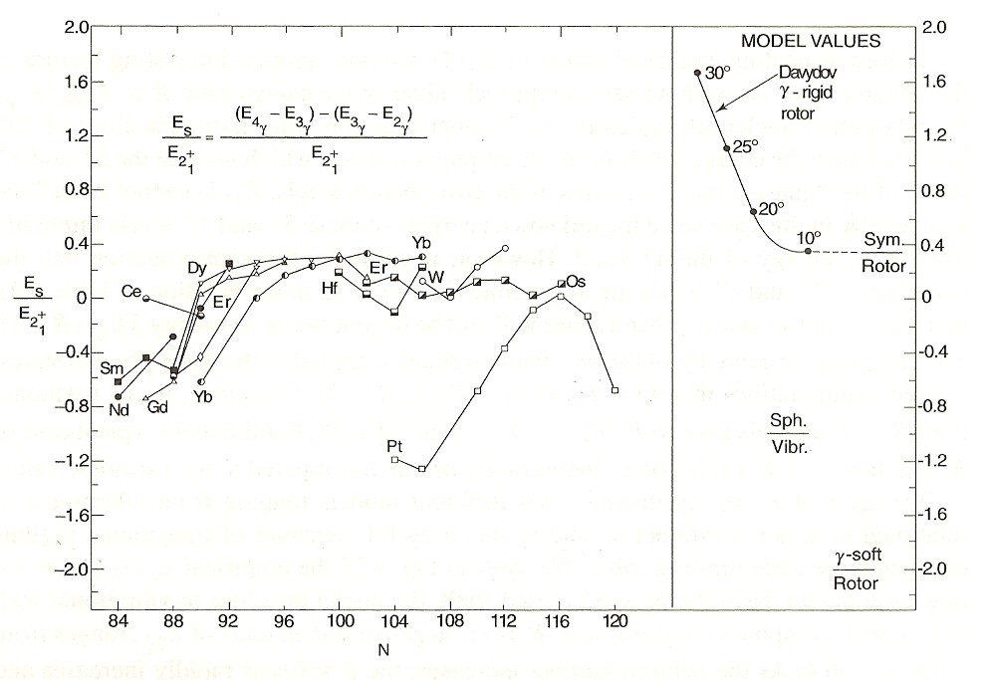
Use staggering in gamma band energies as signature for the kind of axial asymmetry
Notes:
14

Slide 15
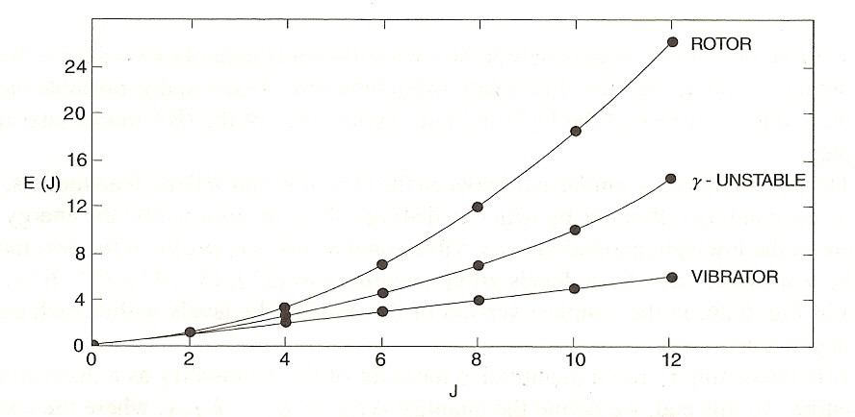
Overview of yrast energies
Can express energies as E ~ J ( J + X )
E ~ J ( J + 1 )
E ~ J ( J + 6 )
8
E ~ J ~ J ( J + )
Notes:
15

Slide 16
Now that we know some simple models of atomic nuclei, how do we know where each of these structures will appear? How does structure vary with Z and N? What do we know?
Near closed shells nuclei are spherical and can be described in terms of a few shell model configurations.
As valence nucleons are added, configuration mixing, collectivity and, eventually, deformation develop. Nuclei near mid-shell are collective and deformed.
The driver of this evolution is a competition between the pairing force and the p-n interaction, both primarily acting on the valence nucleons.

Slide 17
Estimating the properties of nuclei
We know that ¹³⁴Te (52, 82) is spherical and non-collective.
We know that ¹⁷⁰Dy (66, 104) is doubly mid-shell and very collective.
What about:
¹⁵⁶Te (52, 104) ¹⁵⁶Gd (64, 92) ¹⁸⁴Pt (78, 106) ???
All have 24 valence nucleons. What are their relative structures ???

Slide 18
Valence Proton-Neutron Interaction
Development of configuration mixing, collectivity and deformation – competition with pairing
Changes in single particle energies and magic numbers
Partial history: Goldhaber and de Shalit (1953); Talmi (1962); Federman and Pittel ( late 1970’s); Casten et al (1981); Heyde et al (1980’s); Nazarewicz, Dobacewski et al (1980’s); Otsuka et al( 2000’s); Cakirli et al (2000’s); and many others.

Slide 19
The idea of “both” types of nucleons – the p-n interaction
Sn – Magic: no valence p-n interactions
Both valence protons and neutrons

Slide 20
If p-n interactions drive configuration mixing, collectivity and deformation, perhaps they can be exploited to understand the evolution of structure.
Lets assume, just to play with an idea, that all p-n interactions have the same strength. This is not realistic since the interaction strength depends on the orbits the particles occupy, but, maybe, on average, it might be OK.
How many valence p-n interactions are there? N_{p} x N_{n}
If all are equal then the integrated p-n strength should scale with N_{p} x N_{n}
The N_{p}N_{n} Scheme

Slide 21
Valence Proton-Neutron Interactions
Correlations, collectivity, deformation. Sensitive to magic numbers.
N_{p}N_{n}
Scheme
P = N_{p}N_{n}/ (N_{p}+N_{n})
p-n interactions per
pairing interaction
Highlight deviant nuclei

Slide 22
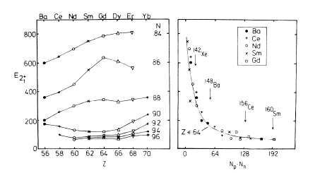
The N_{p}N_{n} scheme: Interpolation vs. Extrapolation

Slide 23
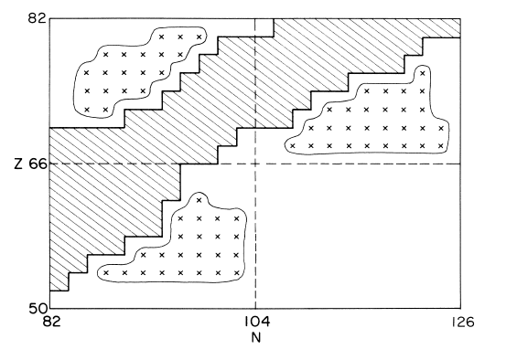
Predicting new nuclei with the N_{p}N_{n} Scheme
All the nuclei marked with x’s can be predicted by INTERpolation

Slide 24
Competition between pairing and the p-n interactions
A simple microscopic guide to the evolution of structure
(The next slides allow you to estimate the structure of any nucleus by multiplying and dividing two numbers each less than 30)
(or, if you prefer, you can get the same result from 10 hours of supercomputer time)

Slide 25
Valence p-n interaction: Can we measure it?
δVpn (Z,N) =
- ¼ [ {B(Z,N) - B(Z, N-2)} - {B(Z-2, N) - B(Z-2, N-2)} ]
-
-
-
p n p n p n p n
Int. of last two n with Z protons,
N-2 neutrons and with each other
-
Int. of last two n with Z-2 protons,
N-2 neutrons and with each other
Empirical average interaction of last two neutrons with last two protons

Slide 26
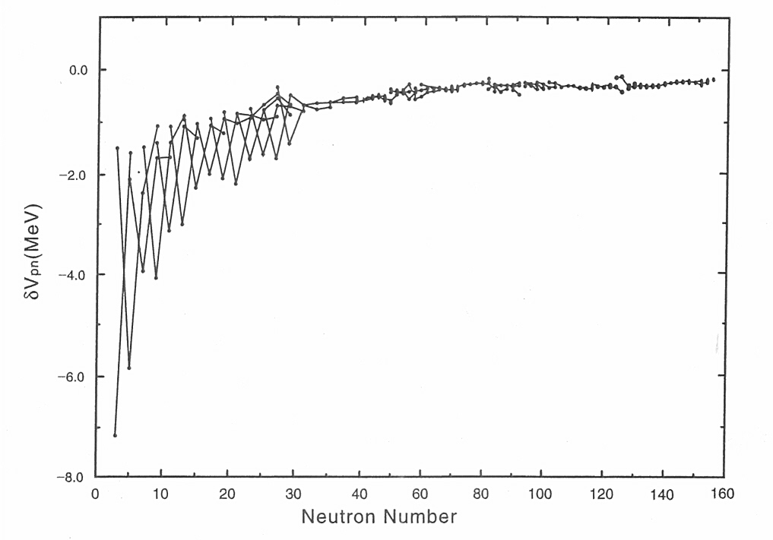
Empirical interactions of the last proton with the last neutron
V_{pn} (Z, N) = -¼{[B(Z, N ) – B(Z, N - 2)]
- [B(Z - 2, N) – B(Z - 2, N -2)]}

Slide 27
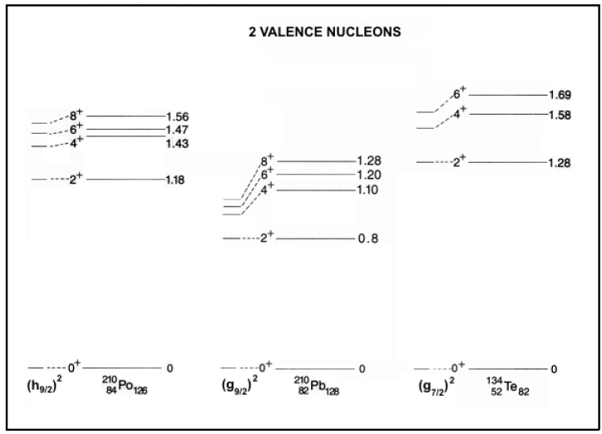
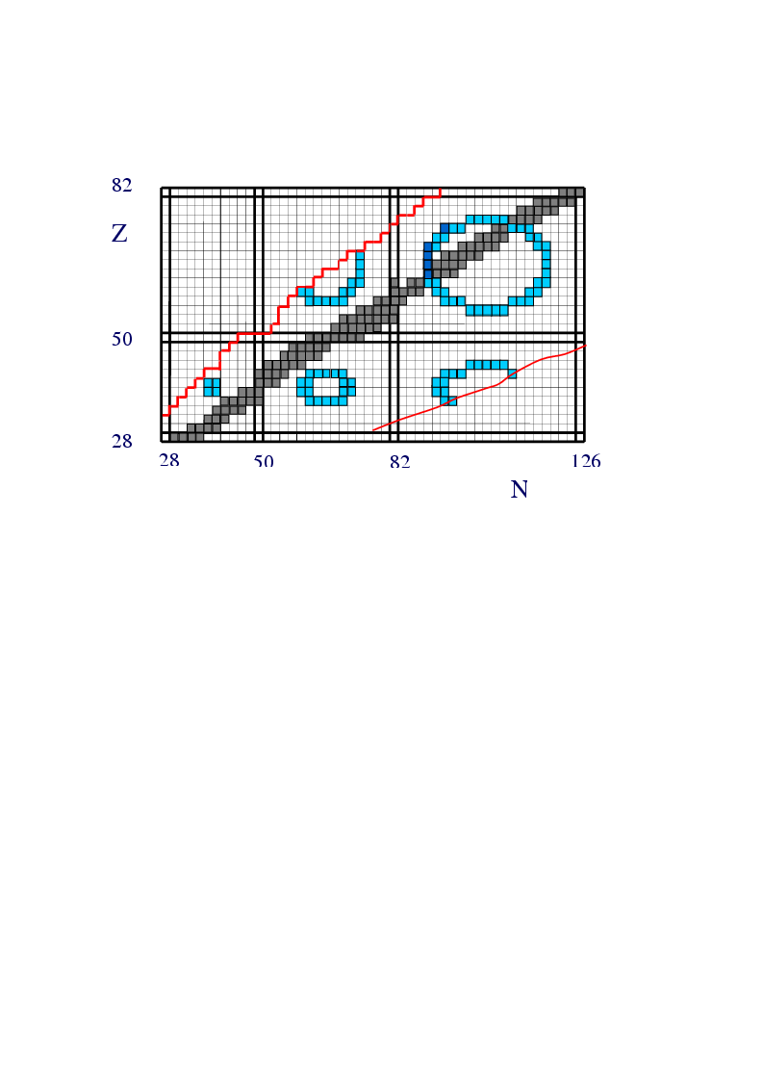
p-n / pairing
N_{p}N_{n}
p – n
p-n interactions per
pairing interaction
P
=
∼
N_{p} + N_{n} pairing
Pairing int. ~ 1 MeV, p-n ~ 200 keV
Hence takes ~ 5 p-n int. to compete with one pairing int.
P ~ 5
P~5

Slide 28
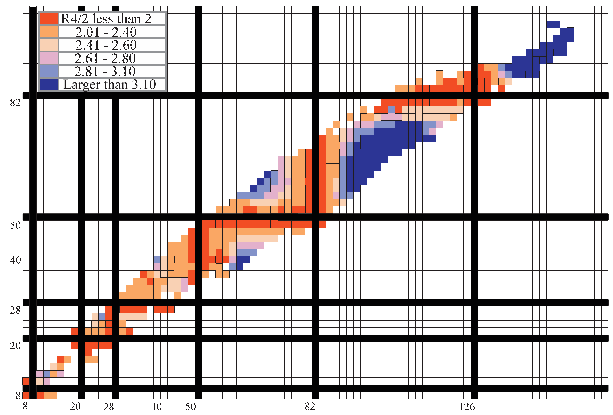

Comparison with the data

Slide 29
The IBA
The Interacting Boson Approximation Model
A very simple phenomenological model, that can be extremely parameter-efficient, for collective structure
Why the IBA
Basic ideas about the IBA, including a primer on its Group Theory basis
The Dynamical Symmetries of the IBA
Practical calculations with the IBA

Slide 30
IBA – A Review and Practical Tutorial
F. Iachello and A. Arima
Drastic simplification of
shell model
  Valence nucleons
  Only certain configurations
  Simple Hamiltonian – interactions
  “Boson” model because it treats nucleons in pairs
  2 fermions boson
Notes:
30

Slide 31
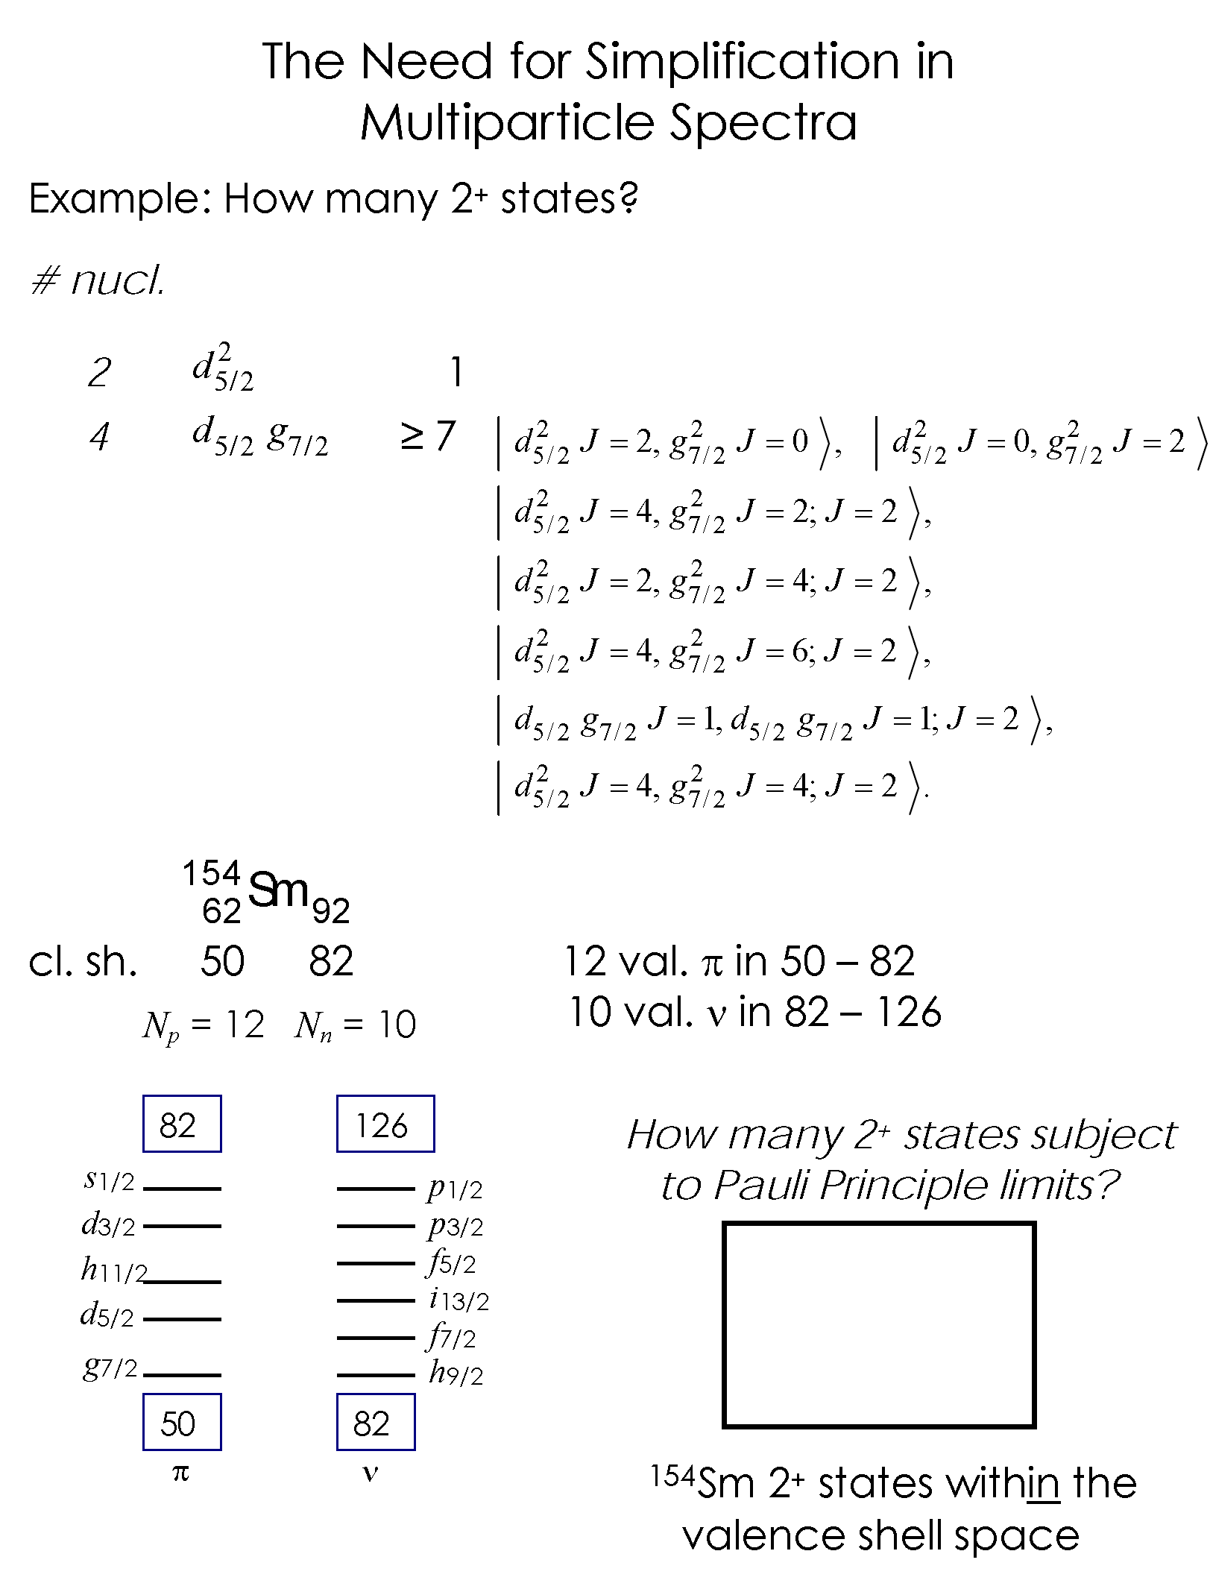

Why do we need to simplify – why not just calculate with the Shell Model????

Slide 32
Shell Model Configurations
Fermion configurations
Roughly, gazillions !!
Need to simplify
The IBA
Boson configurations
(by considering only configurations of pairs of fermions with J = 0 or 2.)
Notes:
32

Slide 33
Assume fermions couple in pairs to bosons of spins 0+ and 2+
IBM
valence
0⁺ s-boson
2⁺ d-boson
s boson is like a Cooper pair
d boson is like a generalized pair
  Valence nucleons only
  s, d bosons – creation and destruction operators
H = H_{s} + H_{d} + H_{interactions}
Number of bosons fixed: N = n_{s} + n_{d}
= ½ # of val. protons + ½ # val. neutrons

Slide 34
Why s, d
bosons?
Lowest state of all e-e First excited state in non-magic
s nuclei is 0⁺ d e-e nuclei almost always 2⁺
δ - fct gives 0⁺ ground state δ - fct gives 2⁺ next above 0⁺

Slide 35

Modeling a Nucleus
Why the IBA is the best thing since baseball, a jacket potato, aceto balsamico, Mt. Blanc, raclette, pfannekuchen, baklava, ….
¹⁵⁴Sm
Shell model
3 x 10¹⁴
2⁺ states
Need to truncate
IBA assumptions
Is it conceivable that these 26 basis states are correctly chosen to account for the properties of the low lying collective states?
1. Only valence nucleons
2. Fermions → bosons
J = 0 (s bosons)
J = 2 (d bosons)
IBA: 26 2⁺ states

Slide 36
Why the IBA ?????
Why a model with such a drastic simplification – Oversimplification ???
Answer: Because it works !!!!!
By far the most successful general nuclear collective model for nuclei
Extremely parameter-economic

Slide 37
Note key point:
Bosons in IBA are pairs of fermions in valence shell
Number of bosons for a given nucleus is a fixed number
∴
N_{π} = 6 5 = N_{ν} ⇒ N_{B} = 11
Basically the IBA is a Hamiltonian written in terms of s and d bosons and their interactions. It is written in terms of boson creation and destruction operators.

Slide 38
Where the IBA fits in the pantheon of nuclear models
Shell Model - (Microscopic)
Geometric – (Macroscopic)
Third approach — “Algebraic”
Dynamical
Symmetries
Group Theoretical
Phonon-like model with microscopic basis explicit from the start.
IBA
Microscopic
Collectivity
Shell Mod.
Geom. Mod.

Slide 39
IBA has a deep relation to Group theory
That relation is based on the operators that create, destroy s and d bosons
s†, s, d†, d operators
Ang. Mom. 2
d†_{μ} , d_{μ} μ = 2, 1, 0, -1, -2
Hamiltonian is written in terms of s, d operators
Since boson number is conserved for a given nucleus, H can only contain “bilinear” terms: 36 of them.
Gr. Theor. classification of Hamiltonian
Group is called
U(6)
s†s, s†d, d†s, d†d

Slide 40
Brief, simple, trip into the Group Theory of the IBA
DON’T BE SCARED
You do not need to understand all the details but try to get the idea of the relation of groups to degeneracies of levels and quantum numbers
A more intuitive name for this application of Group Theory is
“Spectrum Generating Algebras”

Slide 41




Review of phonon creation and destruction operators
What is a creation operator? Why useful?
Bookkeeping – makes calculations very simple.
B) “Ignorance operator”: We don’t know the structure of a phonon but, for many predictions, we don’t need to know its microscopic basis.
is a b-phonon number operator.
For the IBA a boson is the same as a phonon – think of it as a collective excitation with ang. mom. 0 (s) or 2 (d).

Slide 42
Concepts of group theory
First, some fancy words with simple meanings: Generators, Casimirs, Representations, conserved quantum numbers, degeneracy splitting
Generators of a group: Set of operators , O_{i} that close on commutation.
[ O_{i} , O_{j} ] = O_{i} O_{j} - O_{j} O_{i} = O_{k} i.e., their commutator gives back 0 or a member of the set
For IBA, the 36 operators s†s, d†s, s†d, d†d are generators of the group U(6).
Generators: define and conserve some quantum number.
Ex.: 36 Ops of IBA all conserve total boson number
ex:
N = s†s + d†
= n_{s} + n_{d}
e.g:
Casimir: Operator that commutes with all the generators of a group. Therefore, its eigenstates have a specific value of the q.# of that group. The energies are defined solely in terms of that q. #. N is Casimir of U(6).
Representations of a group: The set of degenerate states with that value of the q. #.
A Hamiltonian written solely in terms of Casimirs can be solved analytically
or:
Notes:
42

Slide 43
Sub-groups:
Subsets of generators that commute among themselves.
e.g: d†d 25 generators—span U(5)
They conserve n_{d} (# d bosons)
Set of states with same n_{d} are the representations of the group [ U(5)]
Summary to here:
Generators: commute, define a q. #, conserve that q. #
Casimir Ops: commute with a set of generators
∴ Conserve that quantum #
∴ A Hamiltonian that can be written in terms of Casimir Operators is then diagonal for states with that quantum #
Eigenvalues can then be written ANALYTICALLY as a function of that quantum #
Notes:
43

Slide 44
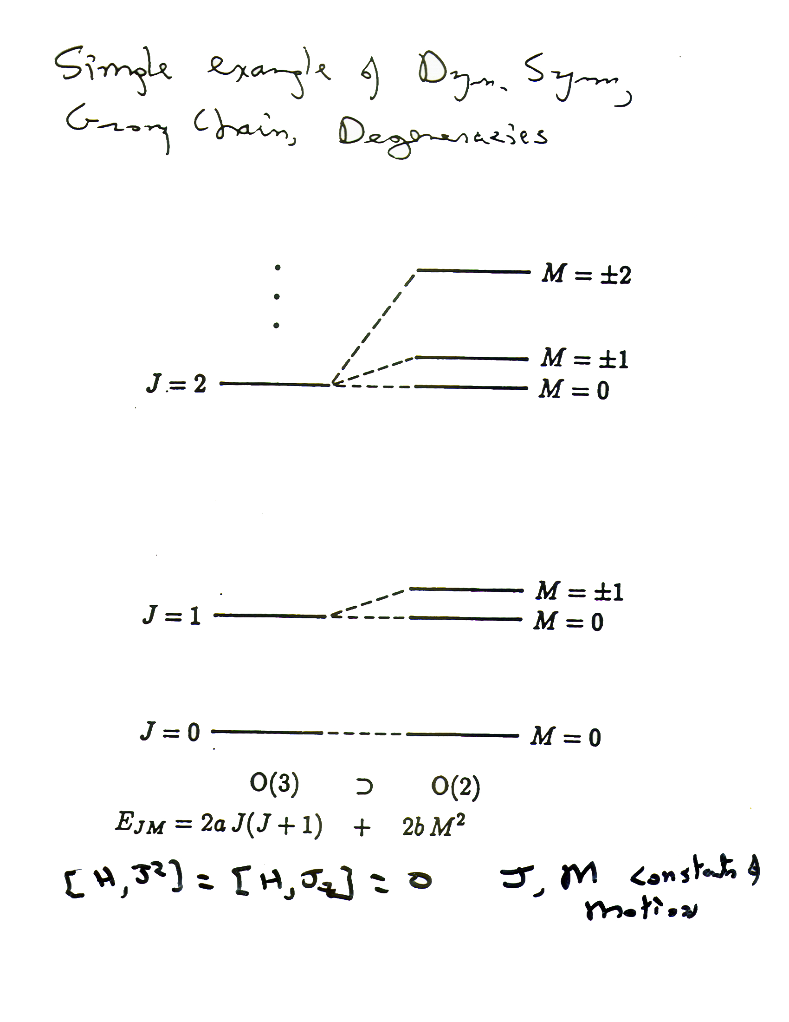
Simple example of dynamical symmetries, group chain, degeneracies
[H, J ² ] = [H, J _{Z} ] = 0 J, M constants of motion

Slide 45
Let’s illustrate group chains and degeneracy-breaking.
Consider a Hamiltonian that is a function ONLY of: s†s + d†d
That is: H = a(s†s + d†d) = a (n_{s} + n_{d} ) = aN
In H, the energies depend ONLY on the total number of bosons, that is, on the total number of valence nucleons.
ALL the states with a given N are degenerate. That is, since a given nucleus has a given number of bosons, if H were the total Hamiltonian, then all the levels of the nucleus would be degenerate. This is not very realistic (!!!) and suggests that we should add more terms to the Hamiltonian. I use this example though to illustrate the idea of successive steps of degeneracy breaking being related to different groups and the quantum numbers they conserve.
The states with given N are a “representation” of the group U(6) with the quantum number N. U(6) has OTHER representations, corresponding to OTHER values of N, but THOSE states are in DIFFERENT NUCLEI (numbers of valence nucleons).

Slide 46
H’ = H + b d†d = aN + b n_{d}
Now, add a term to this Hamiltonian:
Now the energies depend not only on N but also on n_{d}
States of a given n_{d} are now degenerate. They are “representations” of the group U(5). States with different n_{d} are not degenerate

Slide 47
H’ = aN + b d†d = a N + b n_{d}
N + 2
2a
N + 1
a
2b
2
1
Etc. with further terms
b
N
0
0
0
n_{d}
E
U(6) U(5)
H’ = aN + b d†d

Slide 48
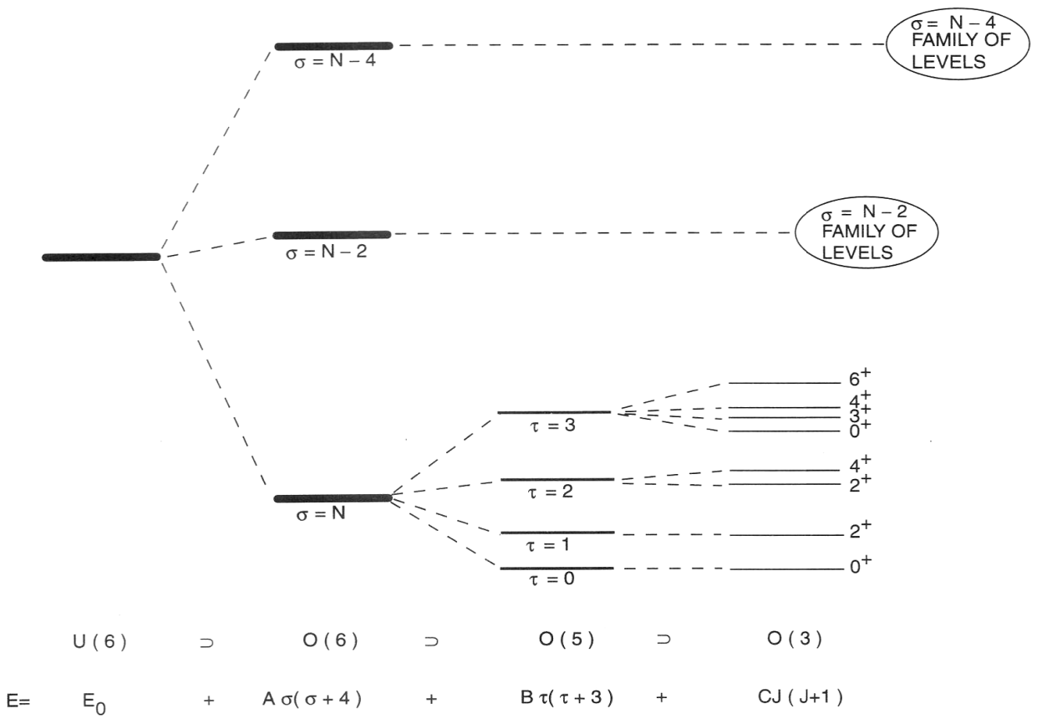
Concept of a Dynamical Symmetry
OK, here’s the key point :
N
Spectrum generating algebra !!
Notes:
48

Slide 49
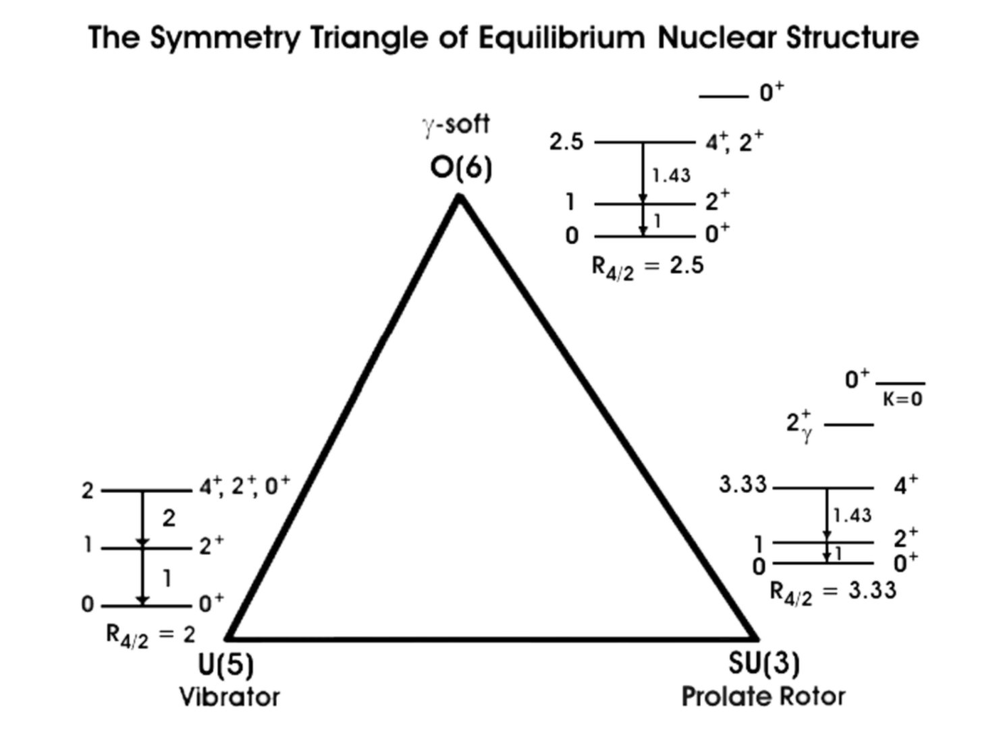
Next time
Deformed
Sph.
Classifying Structure -- The Symmetry Triangle

