Slide 1
First beta spectrum shape measurement at WISArD
Collaboration meeting
Simon Vanlangendonck
22 March 2021

Slide 2
Outline
Theoretical foundation
Beta spectrum shape measurements
WISArD
First results
Set-up
Measurements
First spectra

Slide 3
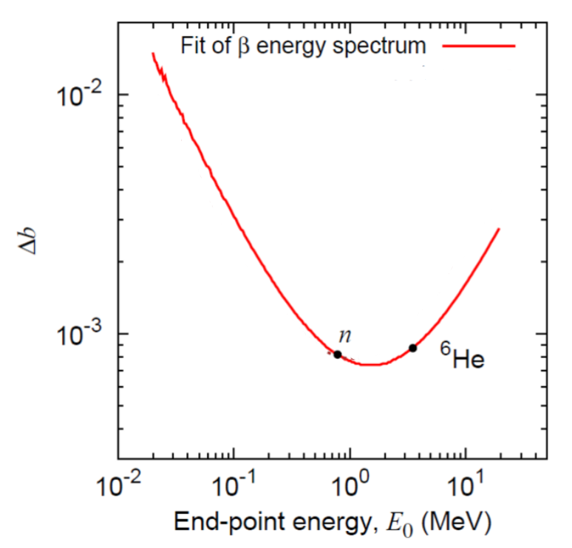
Spectrum shape
$E_{0}$=190.3 keV
$$5^{+}$$
96.75(24)% IT
$T_{1/2}$= 49.51 d
$$1^{+}$$
99.50(15)% $β_{ }^{−}$
$T_{1/2}$=71.9 s
$${}_{49}^{114}{In}$$
Measure the beta-spectrum shape of ${}_{ }^{114}{In}$
Pure Gamow-Teller decay
$$2^{+}$$
$E_{0}$=688.7 keV
I = 0.140 %
$$0^{+}$$
Look for QCD influence on the decay
Weak-Magnetism ($b_{WM}$)
Look for BSM physics
Fierz interference term
$E_{0}$= 1988.6(6) keV
I = 99.36 %
$${}_{50}^{114}{Sn}$$
Kinematic sensitivity to the Fierz term of β-decay differential spectra M. Gonález-Alonso and O. Naviliat-Cuncic, 2018
Notes:
99.5% beta. 0.5% electron caption (X-rays/Augers <<100 keV. most pronounced gamma I=0.03%)
Isomeric: 3.25% ec (max( I gamma) = 4.4%) + detectors not efficient

Slide 4
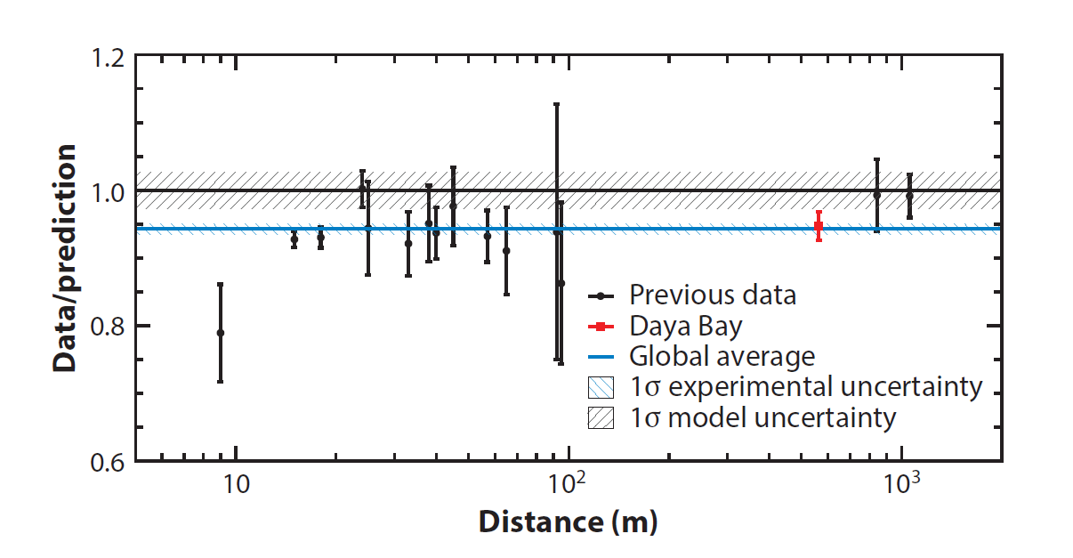
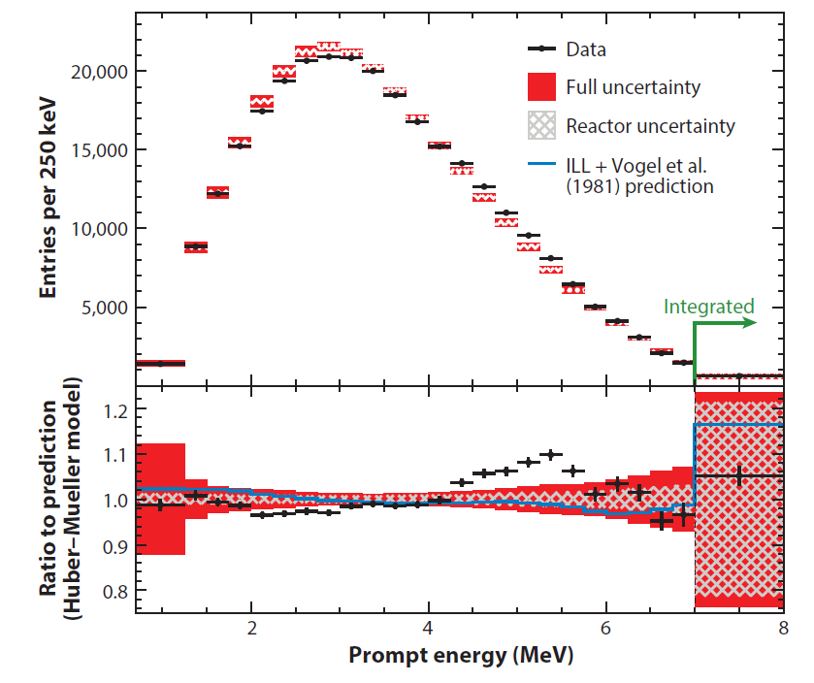
Reactor neutrino anomaly
Solution?
Sterile neutrinos?
Prediction error?
Pandemonium-free spectra (M. Estienne et al. PRL 123(2). 2019)
First-forbidden transitions (L. Hayen et al. PRC 99(3). 2019)
Weak-magnetism
Reactor Neutrino Spectra A. Hayes and P. Vogel. 2016

Slide 5
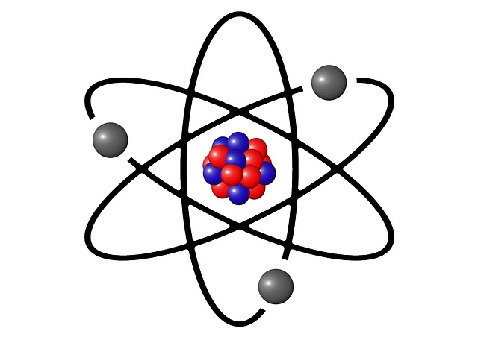
Theoretical description spectrum shape
$${\overline{ν}}_{e}$$
$$p$$
$$n$$
$$e^{−}$$

Slide 6
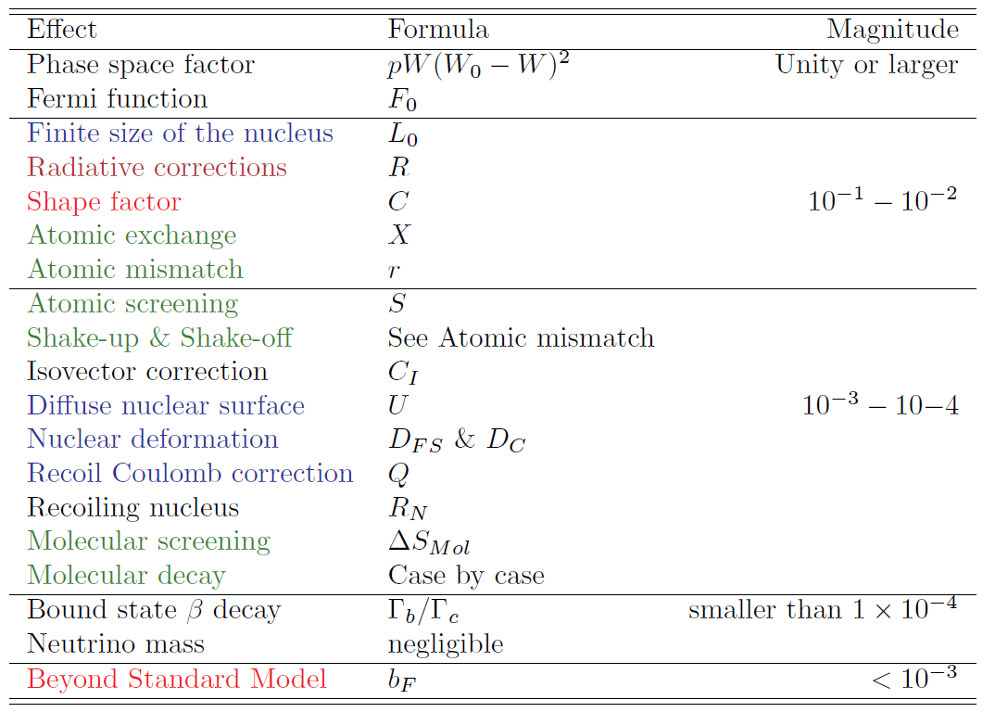
Theoretical description spectrum shape
Corrections on Fermi function
Radiative corrections
Nuclear structure related
Atomic + molecular
Adapted from Beta Spectrum Generator: High precision allowed β spectrum Shapes L. Hayen et al.. 2019
Notes:
Corrections on Fermi + recoil corrections: due to way of calculation of most important terms

Slide 7
Precision spectrum measurement
Goal:
Several difficulties:
Measure as precise as possible the energy distribution of the electron emerging from beta decay
Energy loss (source):
Detector dead layer:
Backscattering:
$$e^{−}$$
$$e^{−}$$
$$e^{−}$$
Rely on technical progress and simulations
Intrinsic problem!
Notes:
Deadlayer Si(Li): “Gold entrance window 0.2µm equivalent Si”

Slide 8
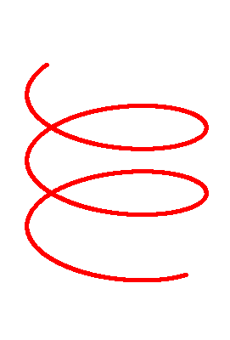
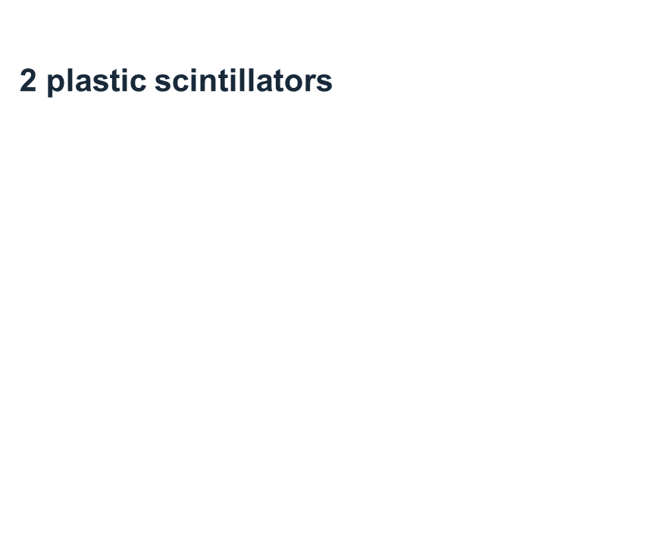
InESS@WISArD
WISArD (2018)
Upper plane
Upper plane
$$e^{+}$$
$$e^{−}$$
Source
$${}_{ }^{114}{In}$$
$$\vec{B}$$
Catcher
$$\vec{B}$$
$$p$$
Lower plane
$${}_{ }^{32}{Ar}$$
Lower plane
4 Silicon detectors on each plane
1 plastic scintillator
2 plastic scintillators

Slide 9
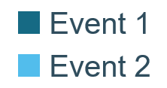
Integration time
Upper plane
Advantage to use WISArD:
Full solid angle
Limiting the influence of backscattering
Due to the magnetic field
$$e^{−}$$
Source
$$\vec{B}$$
Lower plane
$$E_{1}$$
$${E′}_{1}$$
$$E_{3}$$
$$E_{2}$$
Time
Start
Stop
Start

Slide 10
Integration time
Fake Event
Pile-up
$$E_{1}$$
$$E_{1}$$
$$E_{1}$$
$$E_{2}$$
Time
Time
Start
Stop
Start
Start
Stop

Slide 11
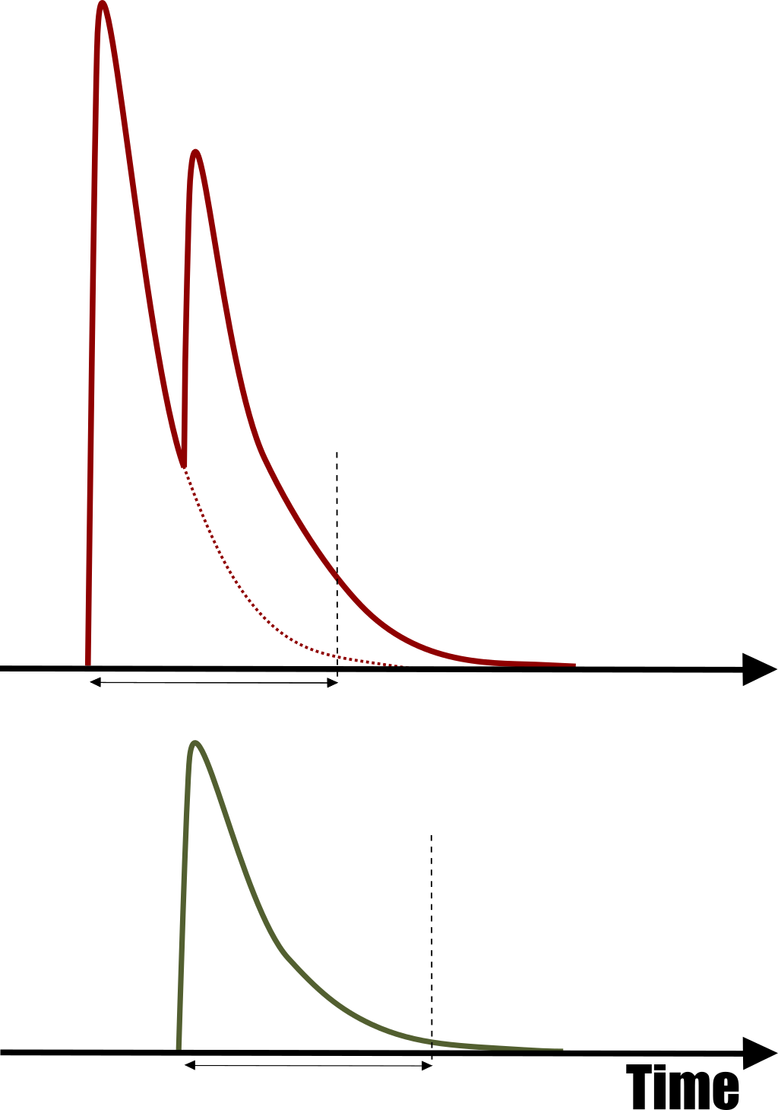
Integration time
Detector 1
Detector 2

Slide 12
First Results
Theoretical foundation
Beta spectrum shape measurements
WISArD
First results
Set-up
Measurements
First spectra

Slide 13
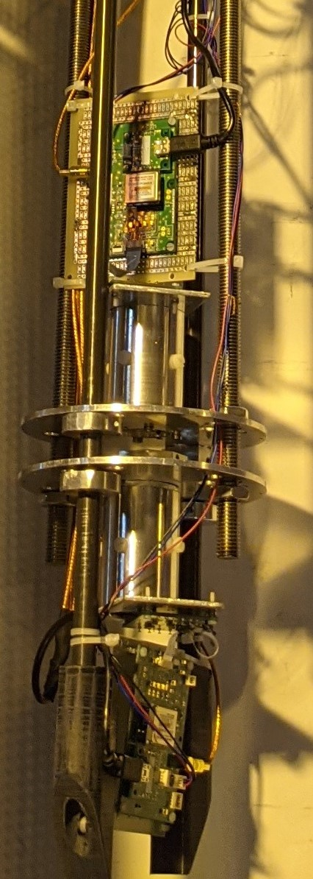
Experimental set-up
Upper plane
$$e^{−}$$
Source
$${}_{ }^{114}{In}$$
$$\vec{B}$$
Lower plane

Slide 14
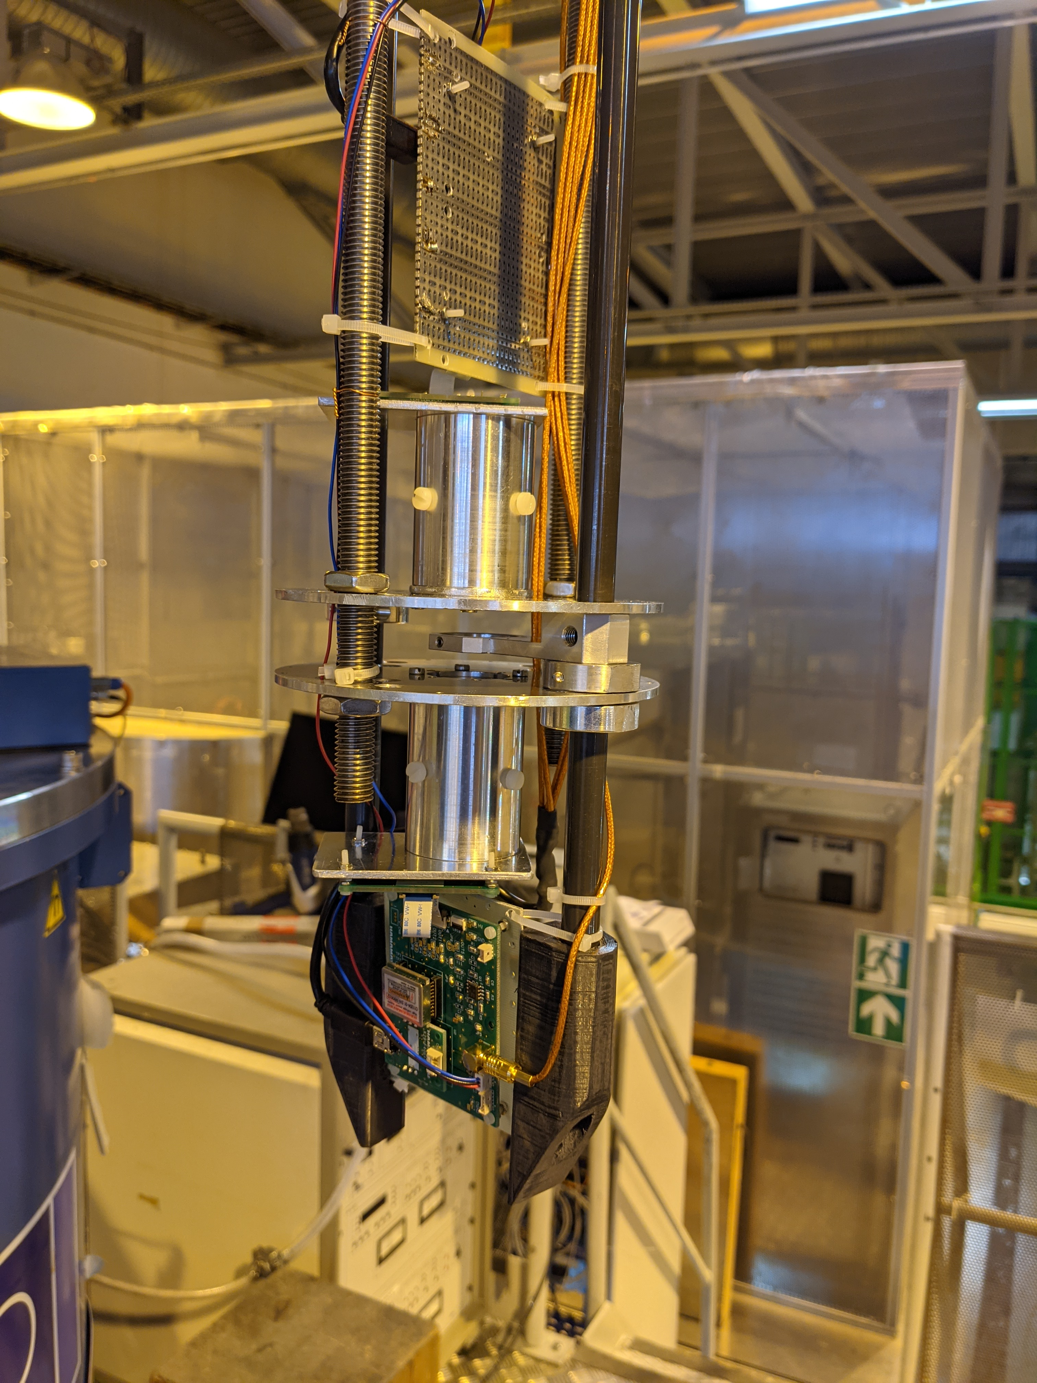
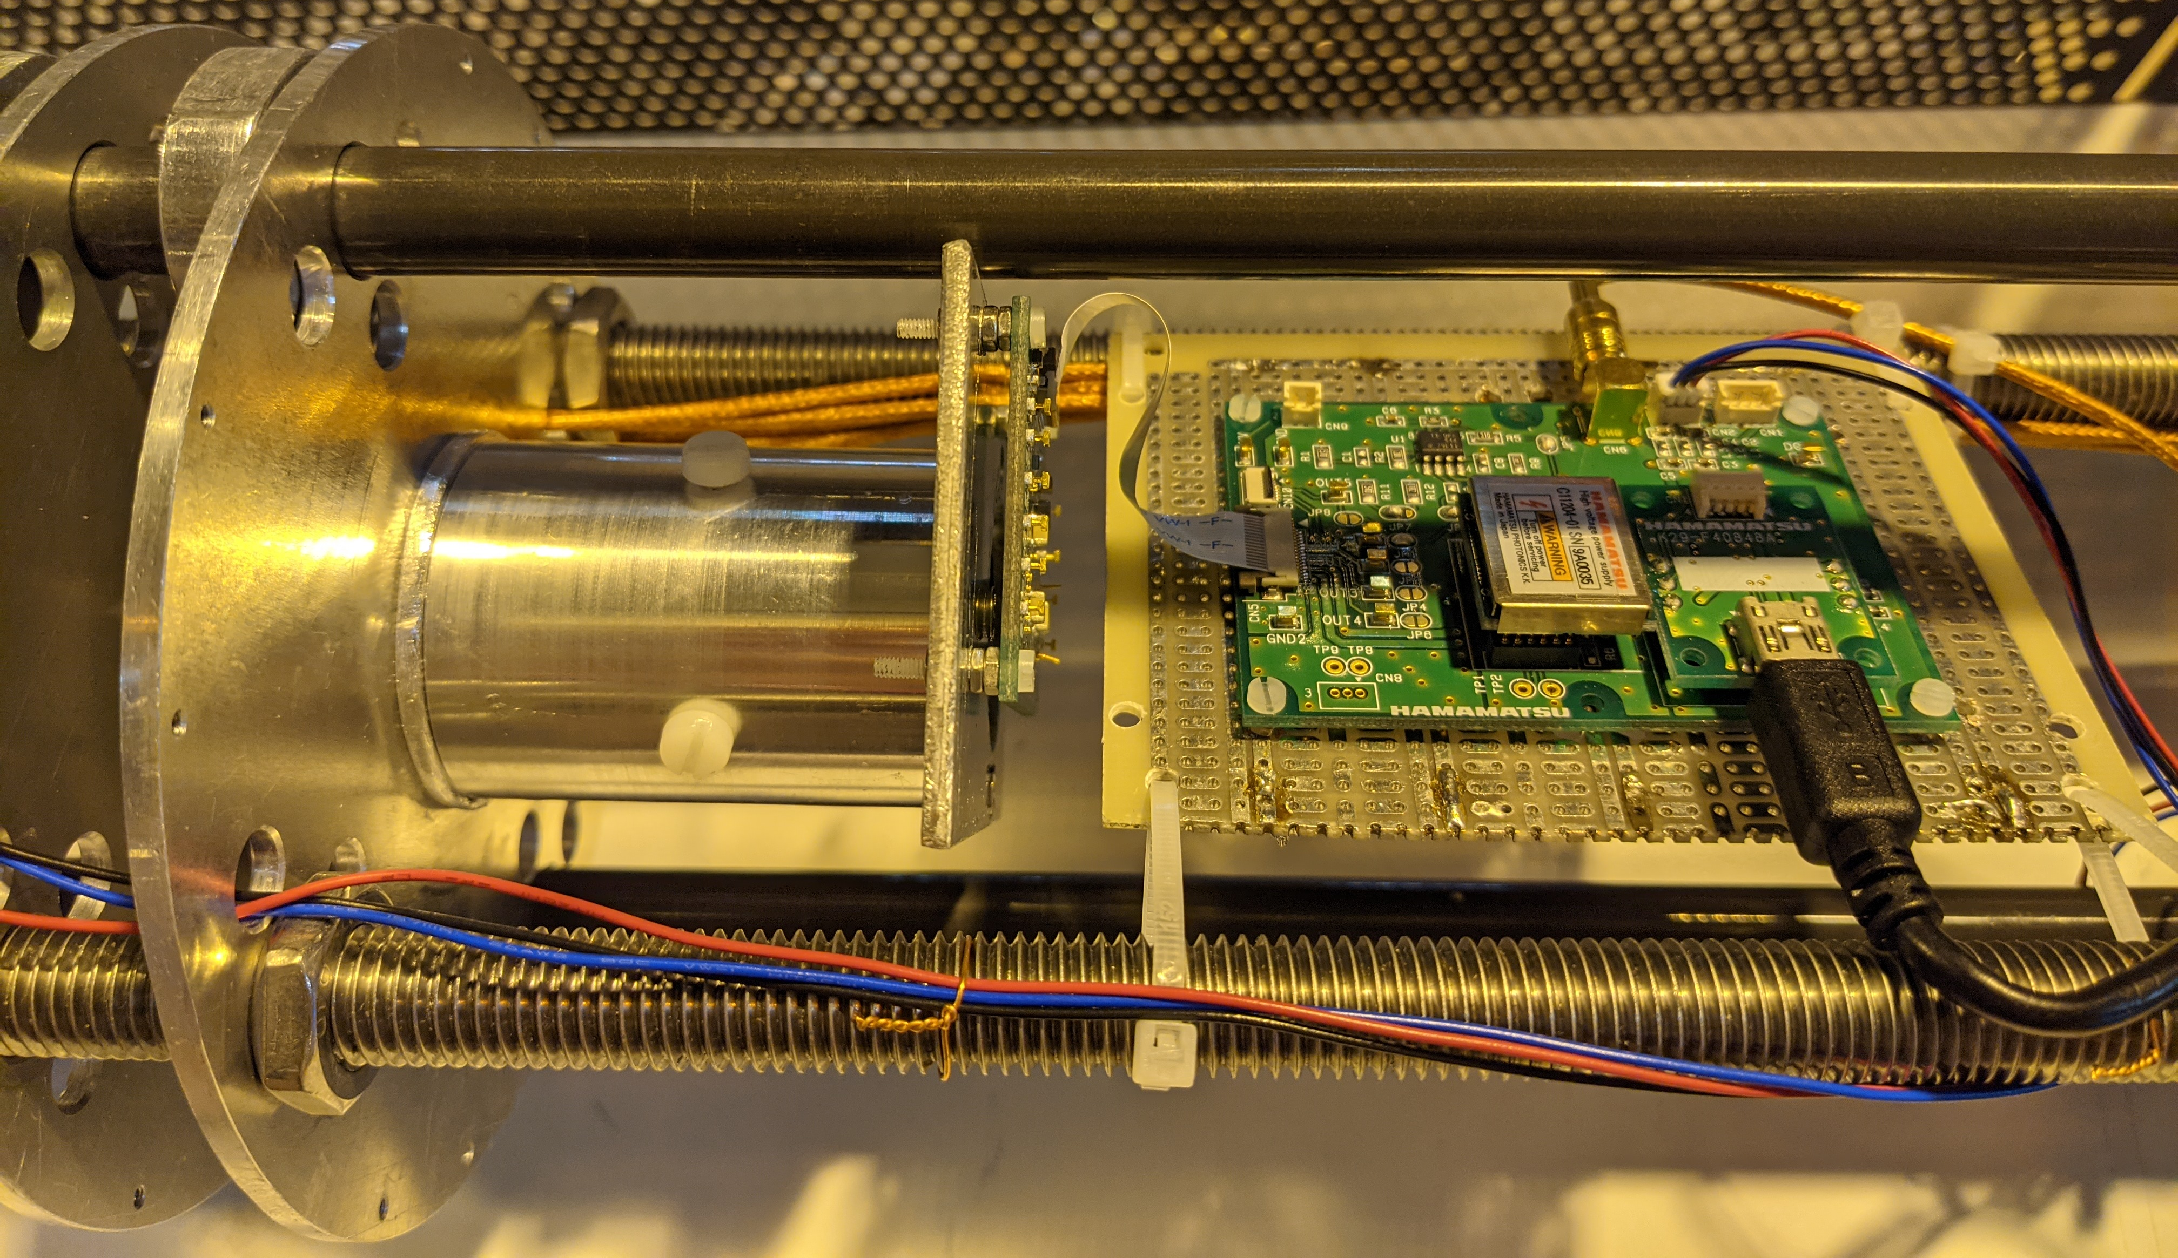
Experimental set-up
Some more pictures

Slide 15
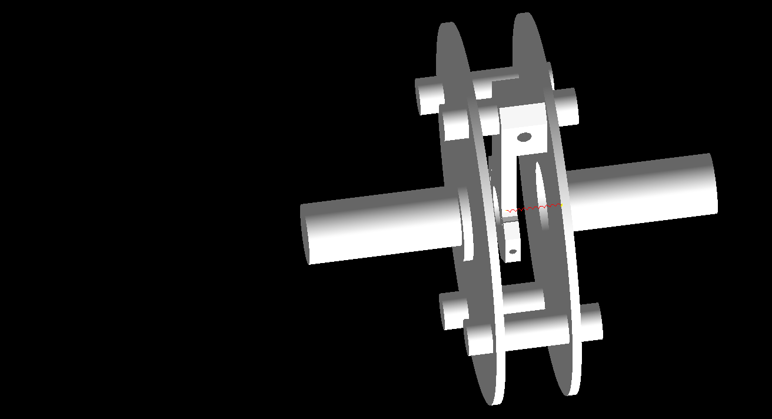
Simulation geometry

Slide 16
Experimental Campaign
November-December 2020
Set-up characterization + actual measurements
${}_{ }^{207}{Bi}$
${}_{ }^{137}{Cs}$
${}_{ }^{90}{Sr}$
${}_{ }^{114}{In}$ (1 kBq + 5 kBq)
Background
Notes:
Calibration
Resolution
Comparable β endpoint
Pile-up

Slide 17
Experimental Campaign
Isotope | Duration
Bi207 | 1 day – 1 night
STB
Sr90 | 1 day – 1 night
STB
In114 (5kBq) | 1 day – 2 nights
STB
In114 (1kBq) | 5 days – 6 nights
STB
Bi207 | 1 day – 1 night
STB
Cs137 | 1 day – 1 night
STB
Background | 8 days – 9 nights
Thermal stabilisation between sources
Measurements at different magnetic fields:
0T
1.3 T
1.9 T (${}_{ }^{207}{Bi}$)
2.5 T
4T
6T (${}_{ }^{114}{In}$)
Overnight measurements @4T
Notes:
Calibration
Resolution
Comparable β endpoint
Pile-up

Slide 18
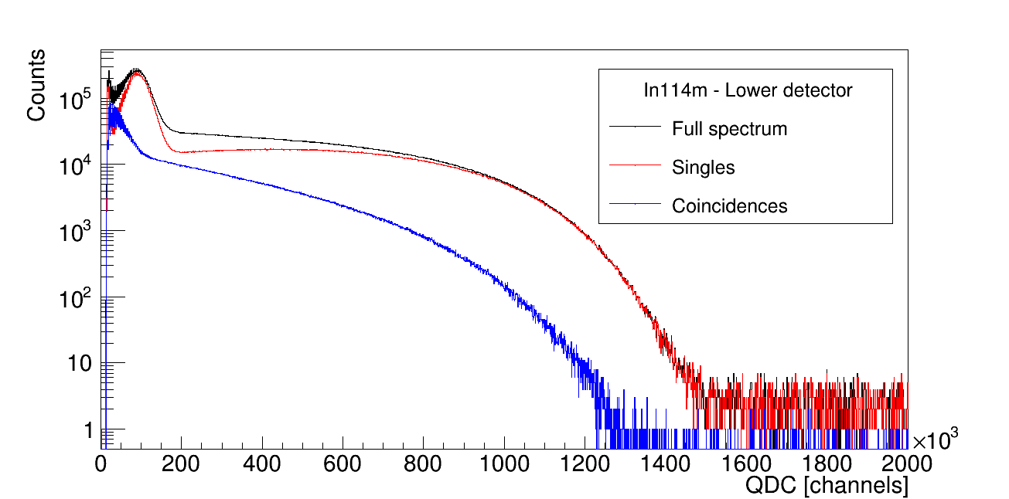
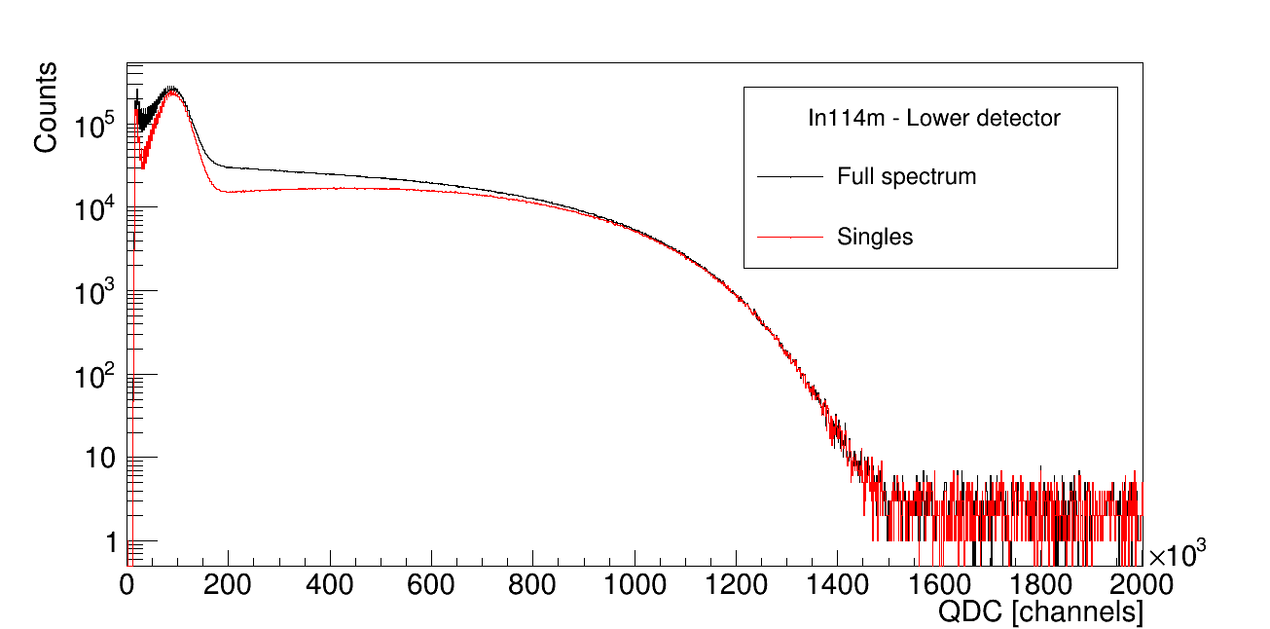
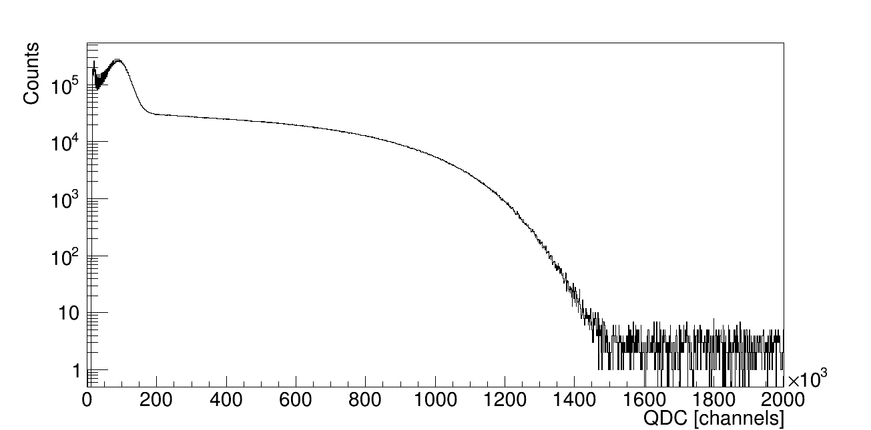
Experimental Results – ${}_{ }^{114}{In}$
$E_{0}$=190.3 keV
$$5^{+}$$
96.75(24)% IT
$T_{1/2}$= 49.51 d
$$1^{+}$$
$${}_{49}^{114}{In}$$
I = 99.36 %
$$0^{+}$$
$E_{0}$= 1988.6(6) keV
Lower detector
$${}_{50}^{114}{Sn}$$
3.25e7 events
74.03%
25.97%

Slide 19
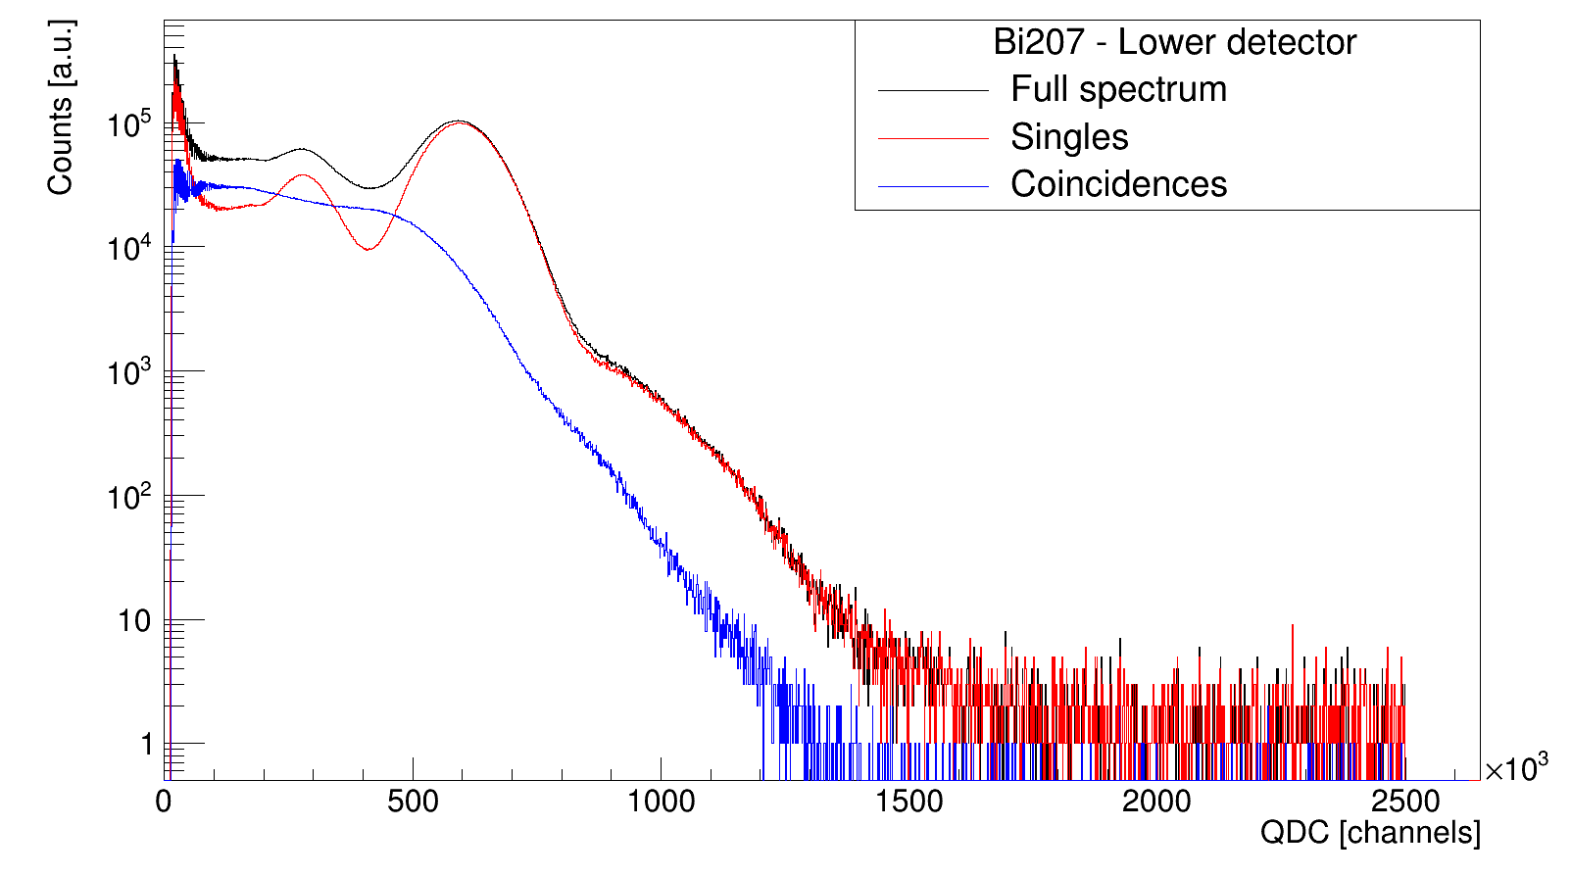
Experimental Results – ${}_{ }^{207}{Bi}$
$$1^{+}$$
$${}_{83}^{207}{Bi}$$
I = 7.03 %
$${7/2}^{−}$$
$E$= 2339.9 keV
I = 84.0 %
$${13/2}^{+}$$
$E$= 1633.4 keV
I = 8.9 %
$${5/2}^{−}$$
$E$= 569.7 keV
$${1/2}^{−}$$
$${}_{82}^{207}{Pb}$$
Notes:
Add percentages -> that many events, part of singles and part of coincidences
7/2: I = 7%
13/2: I = 84%
5/2: I = 9%

Slide 20
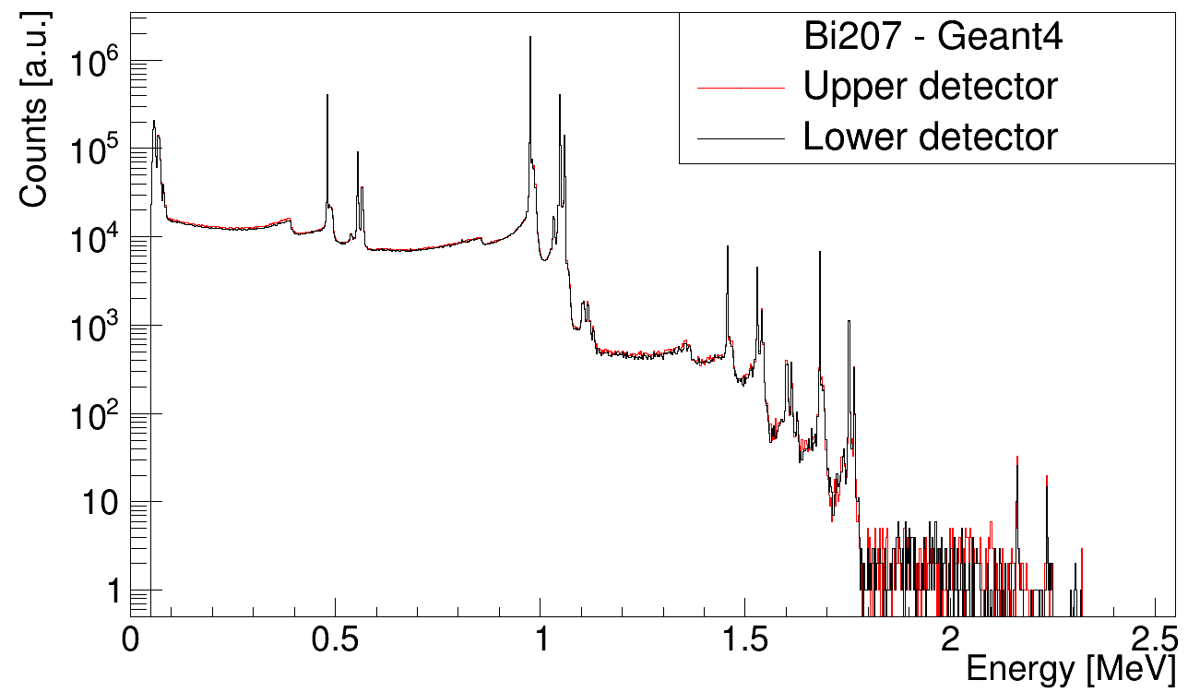
Simulation
500 keV peak
Sum peaks
1.7 MeV peak
1 MeV peak

Slide 21
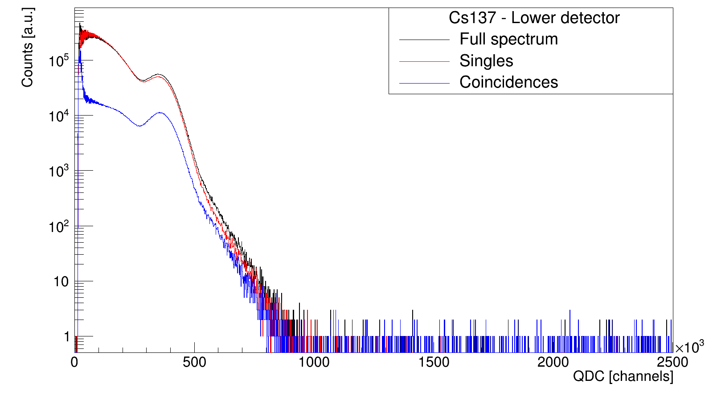
Experimental Results – ${}_{ }^{137}{Cs}$
$${7/2}^{+}$$
$${}_{55}^{137}{Cs}$$
I = 94.7 %
$${11/2}^{−}$$
$E$= 661.7 keV
I = 5.3 %
$${3/2}^{+}$$
$${}_{82}^{207}{Pb}$$
Notes:
Add percentages -> that many events, part of singles and part of coincidences

Slide 22
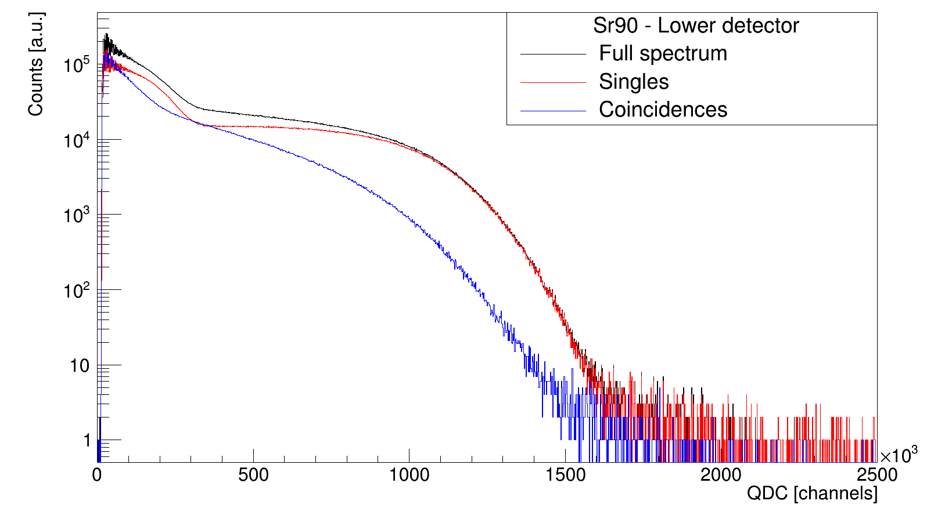
Experimental Results – ${}_{ }^{90}{Sr}$
$$0^{+}$$
$${}_{38}^{90}{Sr}$$
$$2^{−}$$
$E_{0}$= 545.9 keV
$${}_{39}^{90}Y$$
$$0^{+}$$
$E_{0}$= 2278.5 keV
$${}_{40}^{90}{Zr}$$
Notes:
Add percentages -> that many events, part of singles and part of coincidences

Slide 23
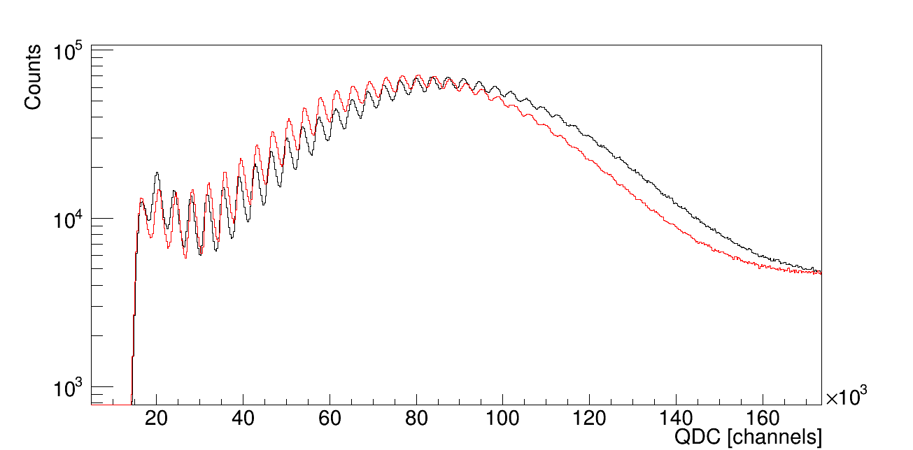
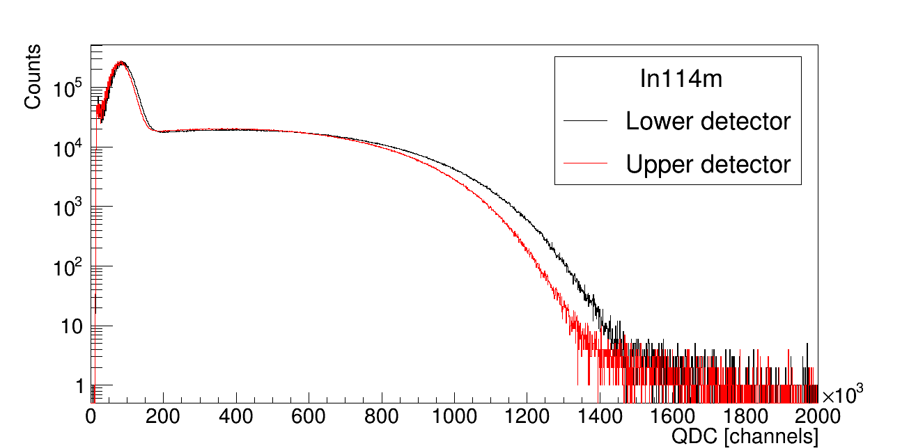
Experimental Results

Slide 24
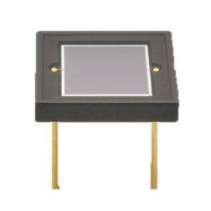
SiPm – Hamamatsu S13360-6050CS
Silicon pixels in Geiger mode
14 400 pixels
# of pixels $\sim$ E deposition
0 | 0 | 0 | 0 | 0 | 0
0 | 0 | 0 | 0 | 0 | 0
0 | 0 | 1 | 0 | 0 | 0
0 | 0 | 0 | 1 | 0 | 0
0 | 0 | 0 | 0 | 0 | 0
0 | 0 | 0 | 0 | 1 | 0
γ
6 mm
50 µm
Fill factor: 74%

Slide 25
SiPm – Hamamatsu S13360-6050CS
0 | 0 | 0 | 0 | 0 | 0
0 | 0 | 0 | 0 | 0 | 0
0 | 0 | 1 | 0 | 0 | 0
0 | 0 | 0 | 1 | 0 | 0
0 | 0 | 0 | 0 | 0 | 0
0 | 0 | 0 | 0 | 1 | 0

Slide 26
SiPM
Slide met berekeningen zoals in mails Bertram en Xavier? Met berekening oscillatie pieken
What you could do is the following: -if you use a source, estimate the average energy deposited Edep, or Edep for specific peaks (but I don't see peaks here). -then the number of produced photons should be ~ Edep/100eV for a plastic scintillator (EJ204 or BC400 or equivalent). For other kind of scintillators, look for the photon yield. -If the scintillator has no sophisticated wraping for light collection, then collection efficiency through the back face of the scintillator should be ~0.3-0.2 -then account for ratio between scintillator back area and SiPM effective area -then account for quantum efficiency of SiPM
my calculation below: The peak structure ends at about 400 keV (first Bi207 peak). So: 400 keV / 100eV (per photon) * 0.3 (photon losses) * 0.02 (SiPM over full Sci area) * 0.5 (typical quantum efficiency) = 12

Slide 27
SiPM

Slide 28
Thank you for your attention!
Please feel free to ask questions or provide your feedback!

Slide 29
Other isotopes
${}_{ }^{32}P$ (1+ to 0+, 14.27 d, 1.71 MeV, log ft=7.9)
${}_{ }^{61}{Co}$ -> check decay scheme (1.65h, 1.25 MeV endpoint, logft=5.2, and gs to gs, but it is a 7/2- to 5/2- transition so more complex for the higher order matrix elements)
${}_{ }^{63}{Ni}$ (1/2- to 3/2-, 101 y, 67 keV endpoint log ft=6.7
${}_{ }^{6}{He}$
${}_{ }^{45}{Ca}$
Forbidden decays?
Notes:
Bertram: For Co61, you are not afraid that the 4% branch to a higher excited state and the low-energy gamma ray cause trouble? And it's not gs to gs. at least in the Firestone

Slide 30
Data analysis
Beschrijf plan van aanpak

Slide 31
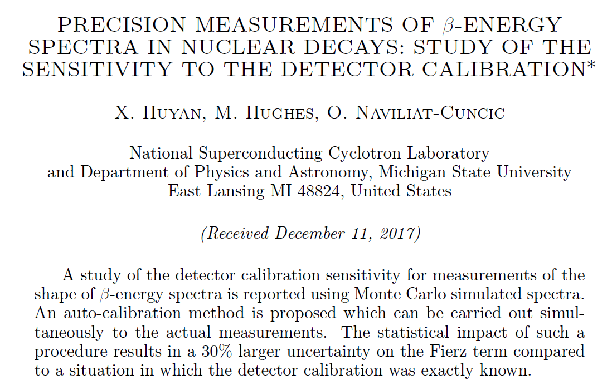
Data analysis
Beschrijf fit routine

