Slide 1
Silicon tests update
Marcin Pomorski
CENBG, IN2P3, CNRS

Slide 2
Outline
Detector adventures
New, larger chamber
Temperature drift of pre-amp
AIFIRA tests

Slide 3
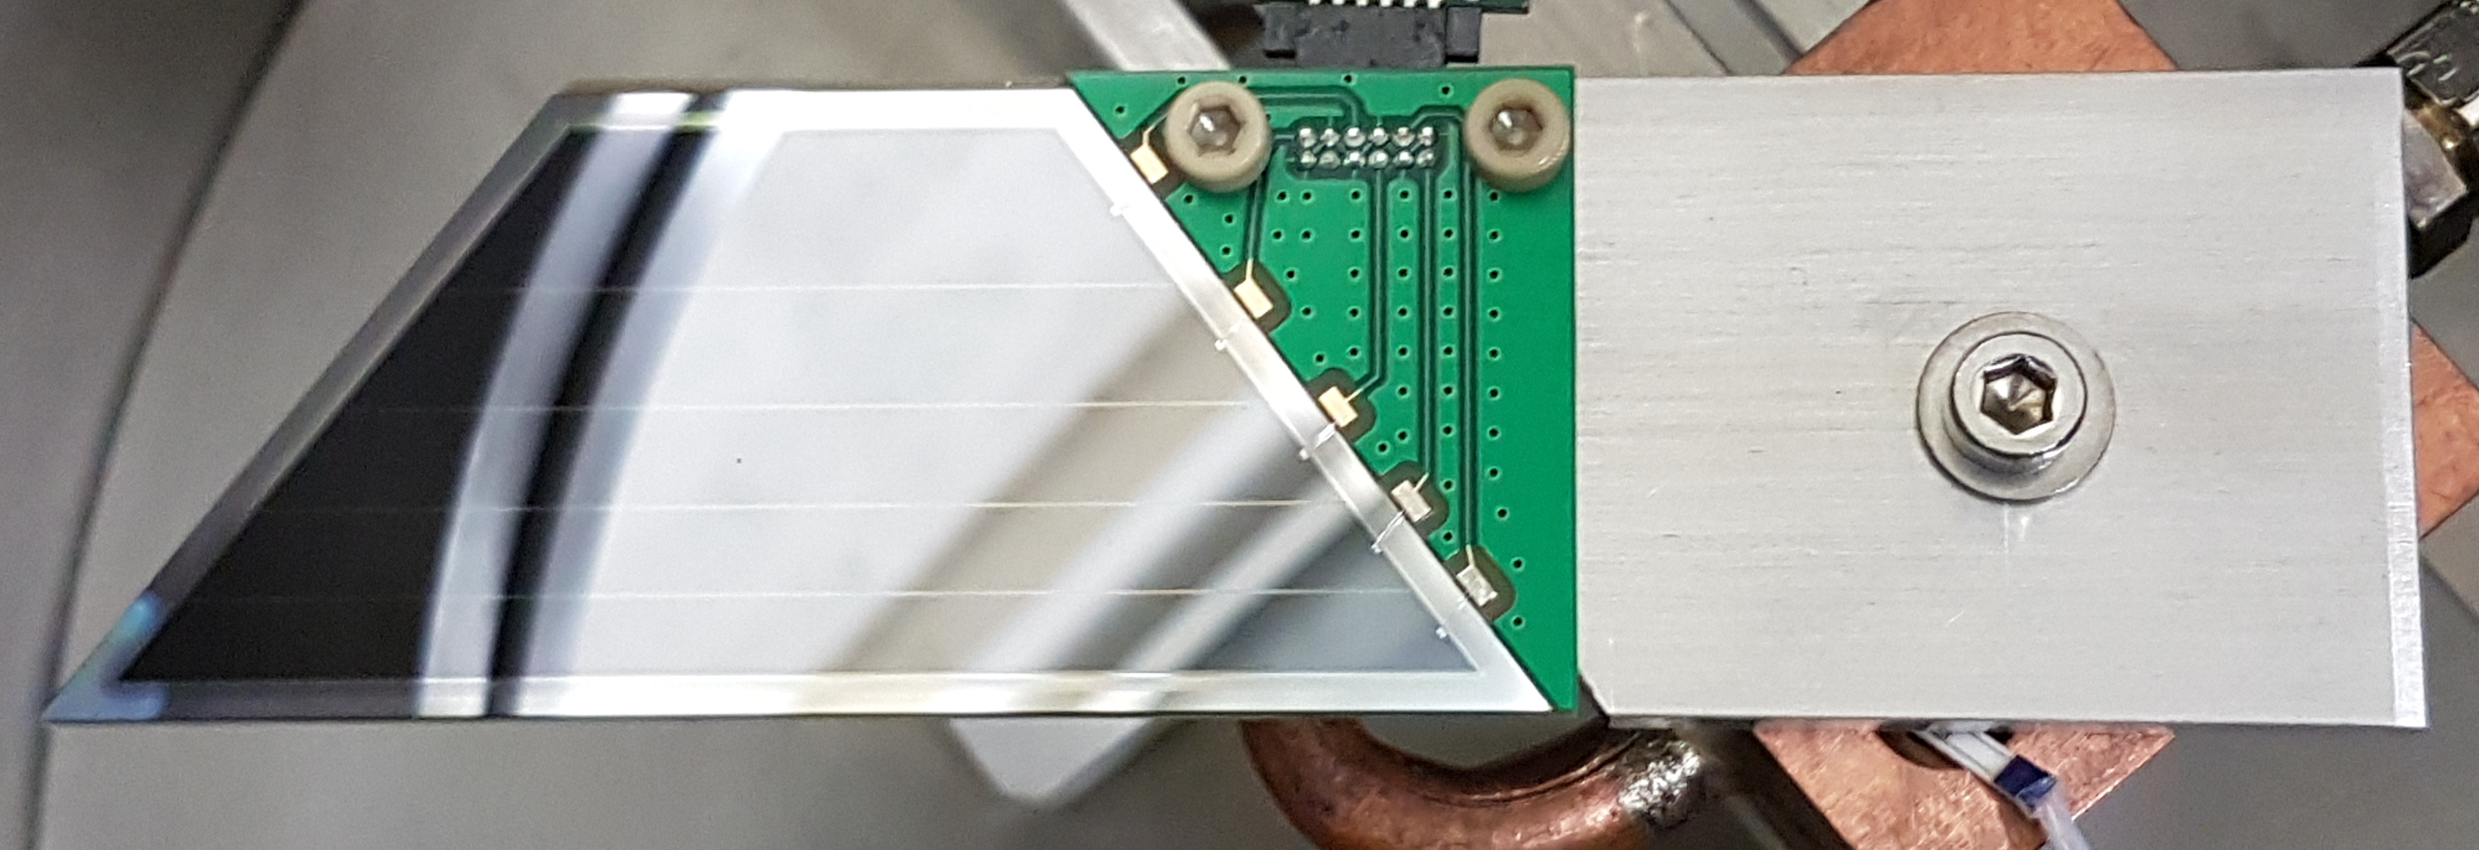
Breaking, fixing, cleaning etc. of detector

Slide 4
Breaking, cleaning etc. of detector
Cleaning with isopropanol
No drying…
No mechanical cleaning

Slide 5
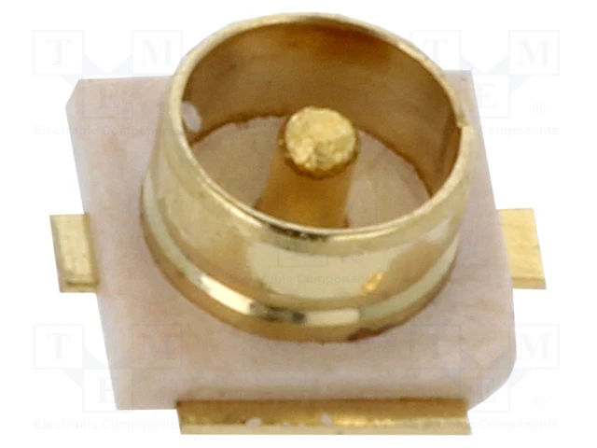
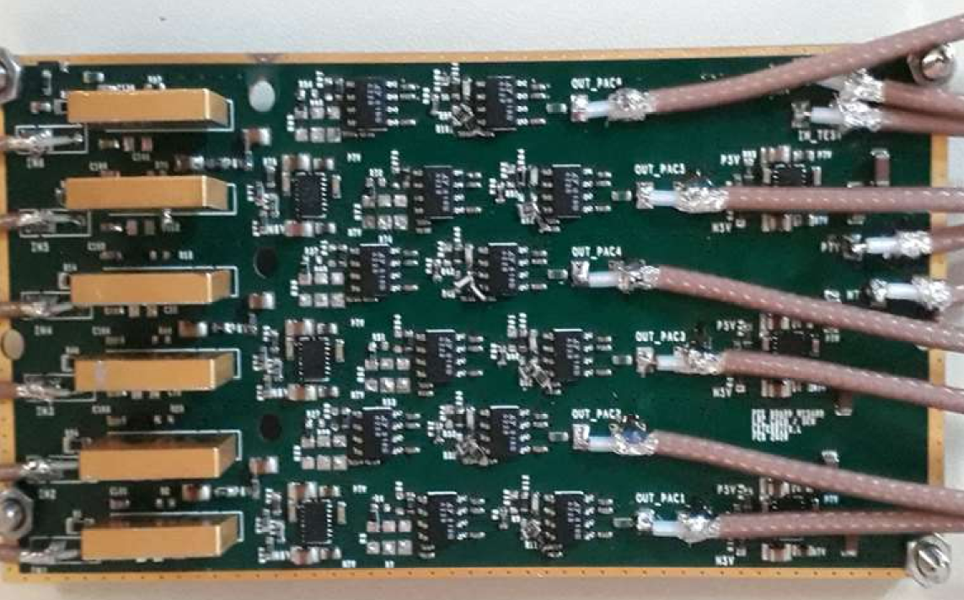
Cables problems...
Stress to cables in small chamber caused lots of failures
The SMD resistors on the PS lines are my nightmare…
Maybe use u.FL connector? only 2.6x2.6 mm2...

Slide 6
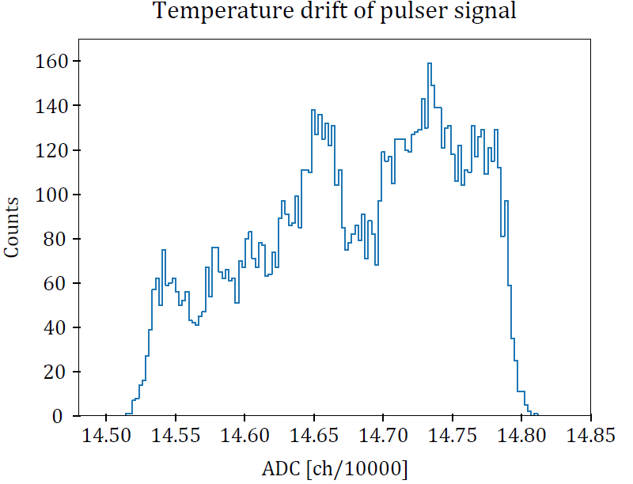
Temperature drift
Very apparent (maybe because we always cooled pre-amp and detector together before?
Some stability required...

Slide 7
AIFIRA nano chamber

Slide 8
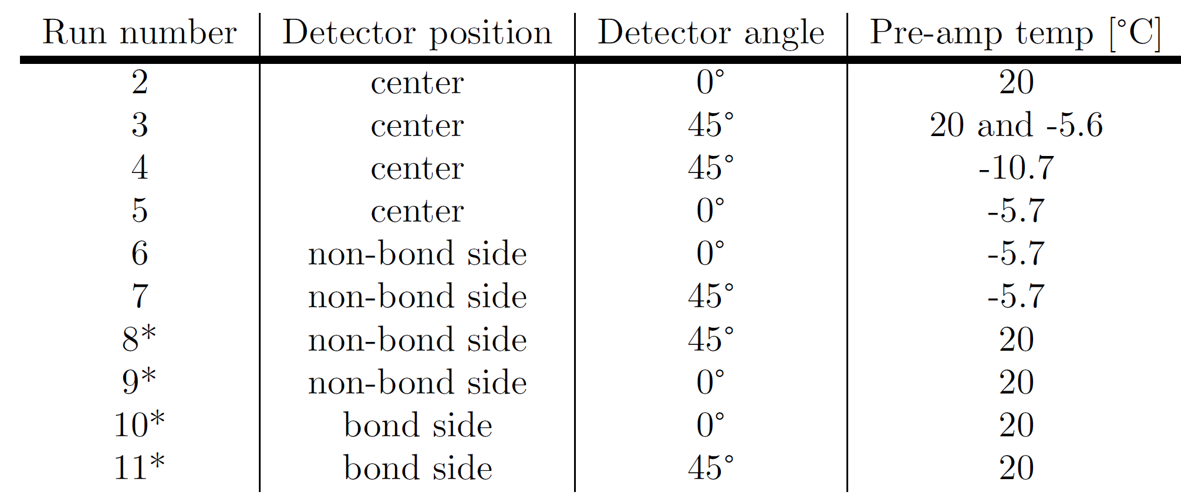
Runs list

Slide 9
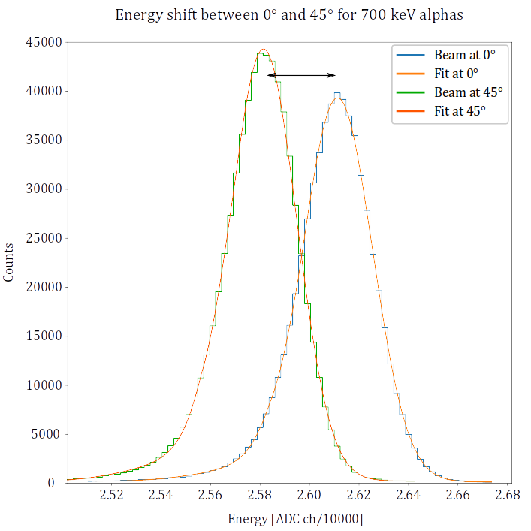
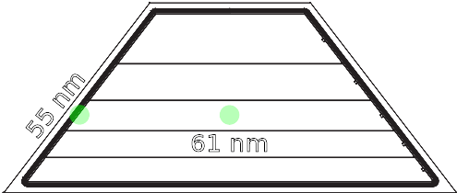
Energy shift and dead layer estimation
First
prototype
8.1 keV
Second
prototype

Slide 10
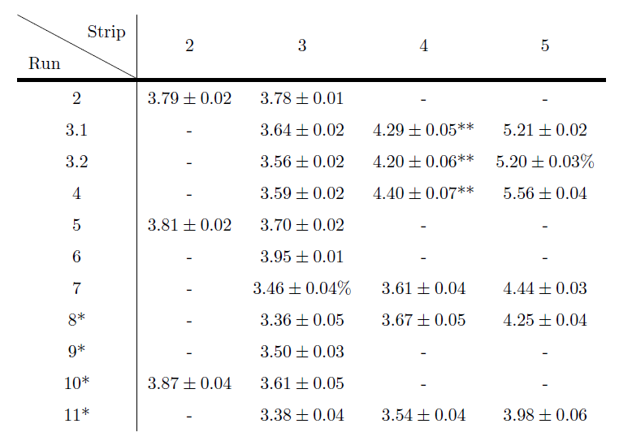
Resolution
On average we observed thickness of 61 ± 4nm
This corresponds to shift of ~1 keV for protons in actual experiment
𝜎 values in keV

Slide 11
Other news / ideas
We have two detectors now. Complete set (7 more detectors) to be ordered soon from MICRON
Temperature measurement in WISArD? (TC? Feedthrough?)

Slide 12
Coming up:
“Fix” stepper motor problem
Test temperature dependence of detector and pre-amp separatly
Do AIFIRA test on all detectors

