Slide 1
Plastic+SiPM for positron detection
Dinko Atanasov
dinko.atanasov@cern.ch
CERN, Experimental Physics department
on behalf of
the WISArD collaboration
WISArD Collaboration Meeting
22 March 2021

Slide 2
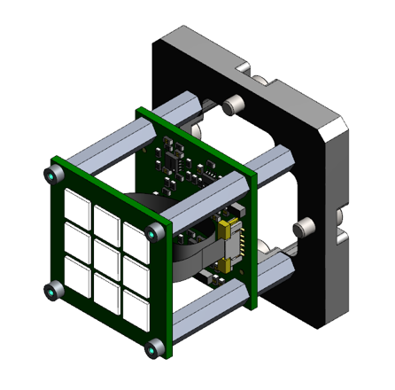
Context
ISOLDE FAST Tape station:
3x3 cells (6mm SiPM x 9)
Sensl J-series (22 292 Microcells)
PreAmp board sum all 9 signals
2 Outputs of PreAmp fast (30ns) and slow (3 us)
Prototype developed by IFIN (Romania)

Slide 3
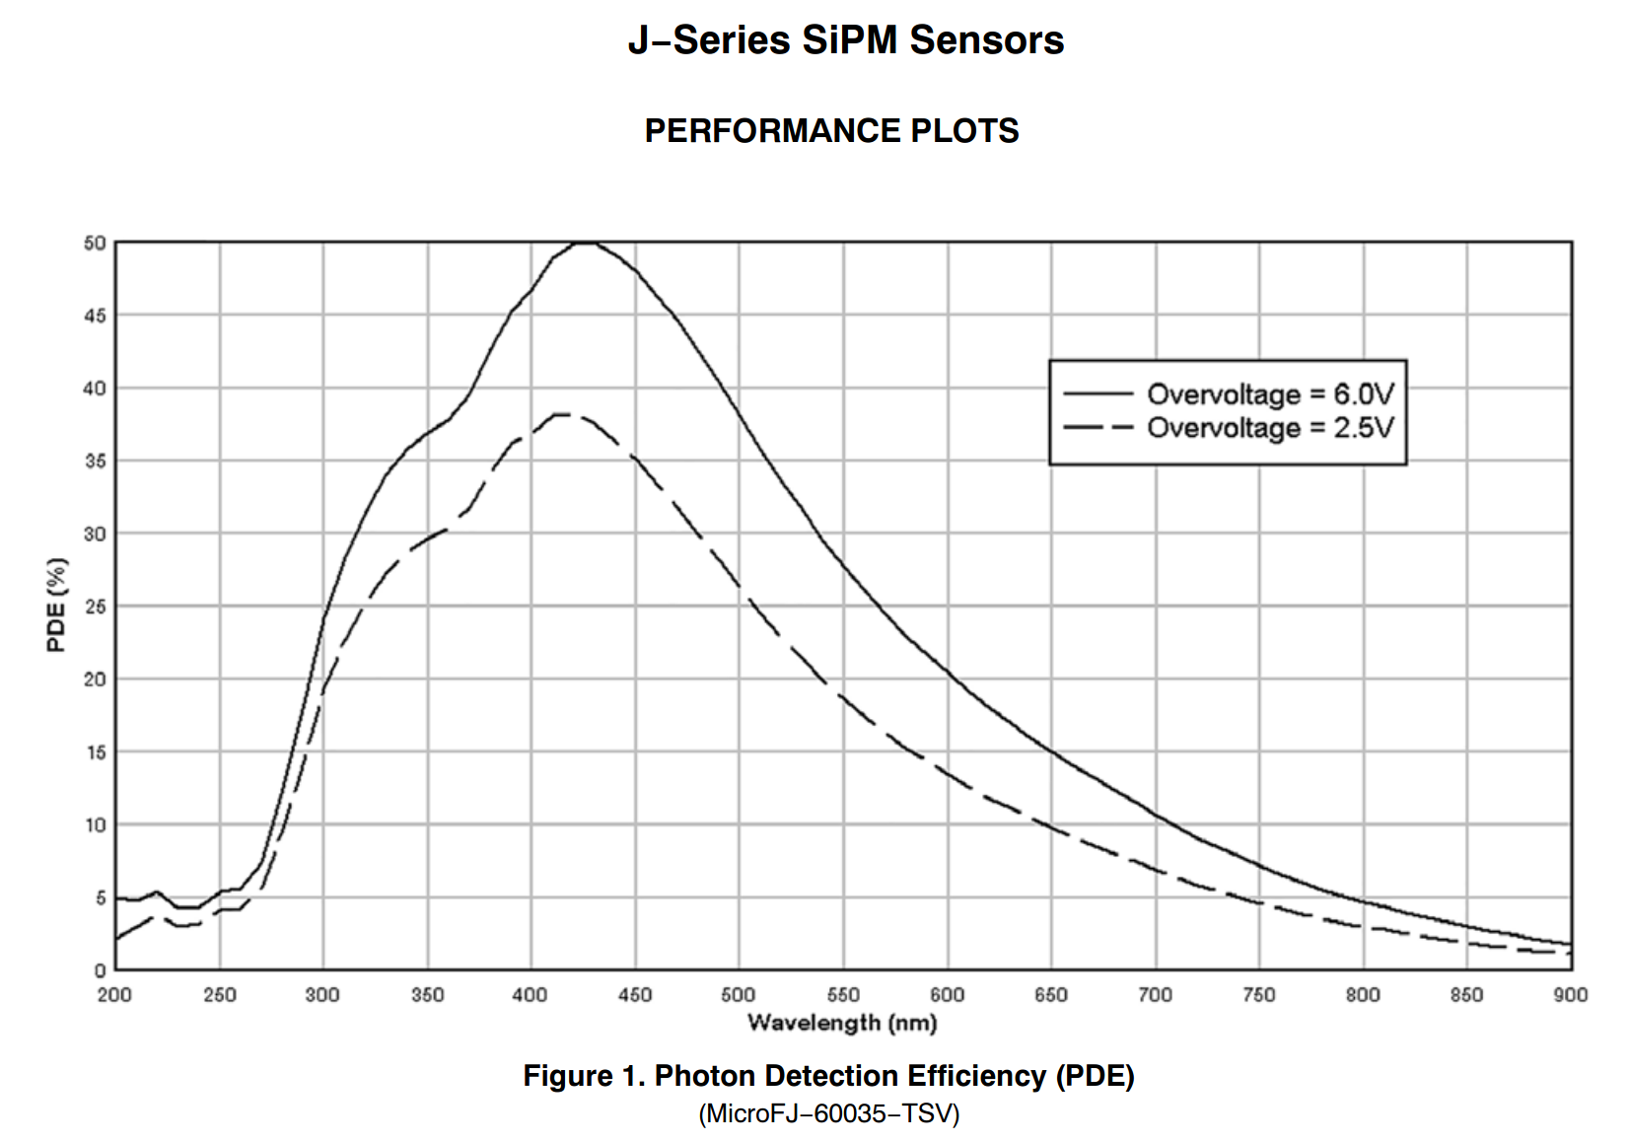
Sensil J-series

Slide 4
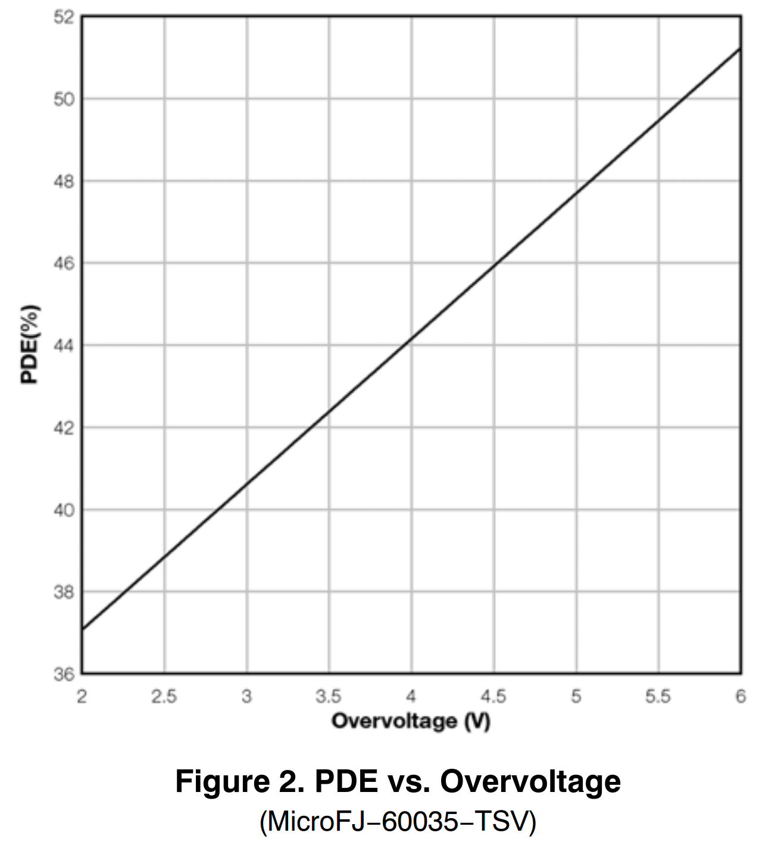
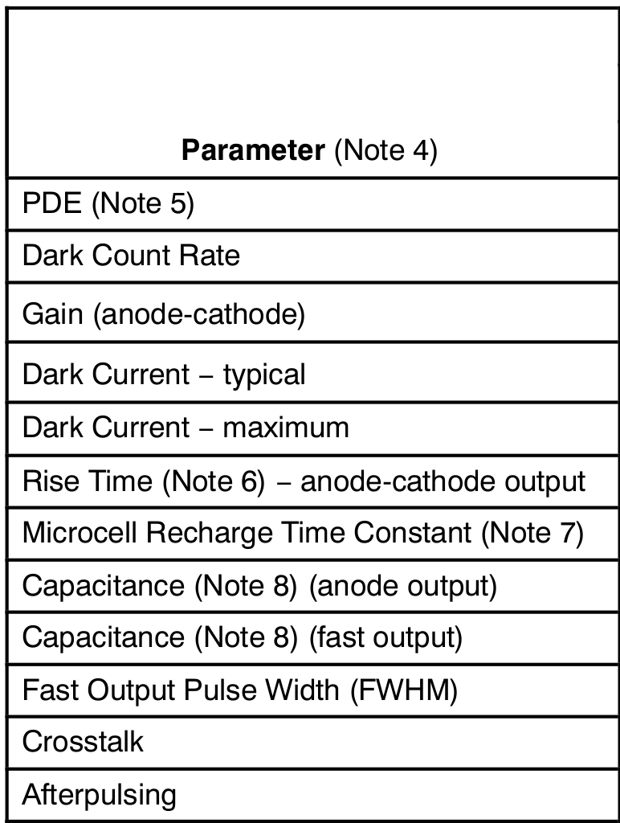
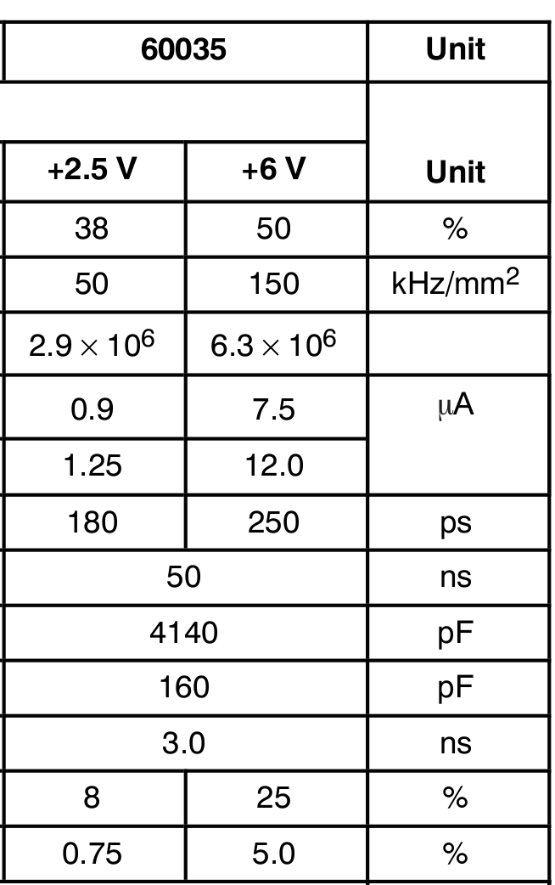
Sensil J-series
Compared to HAMAMATSU:
Lower operating voltage
Crosstalk slightly higher

Slide 5
WISArD beta detector
Plastic scintillator (EJ-200) polystyrene
diameter = 30mm
length = 50 mm
Detector surface = 707 mm²
9 x SiPM pixels = 324 mm²
Improve S/N ratio by improving the collection efficiency!

Slide 6
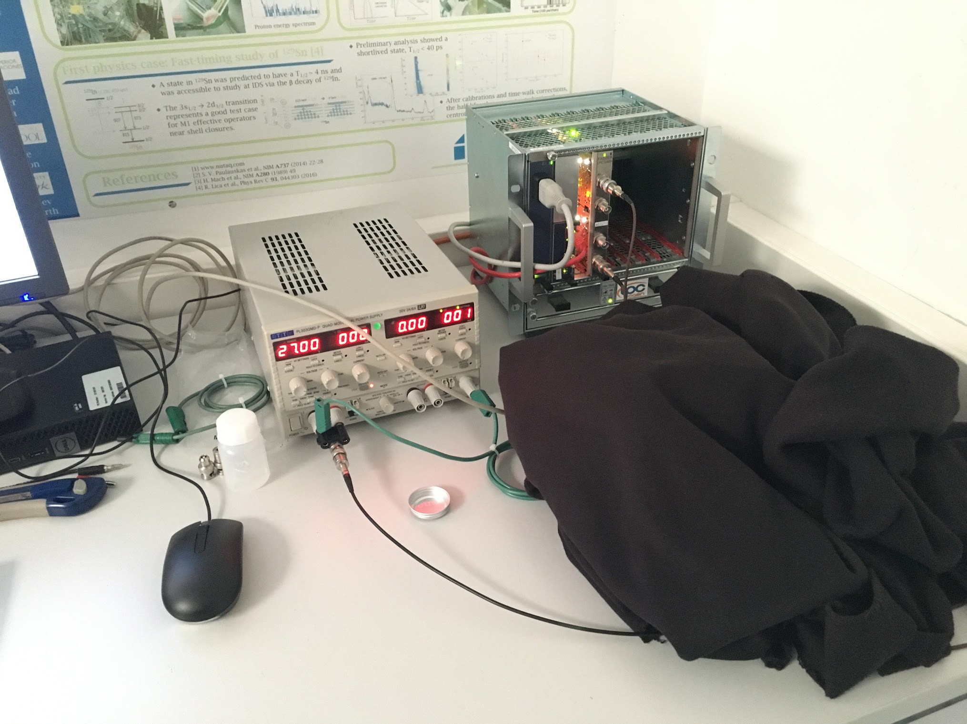
Test setup (preliminary)
FASTER DAQ
w CARAS board
Stable PS for bias voltage
⁹⁰Sr source (5 kBq)
Plastic + SiPM

Slide 7
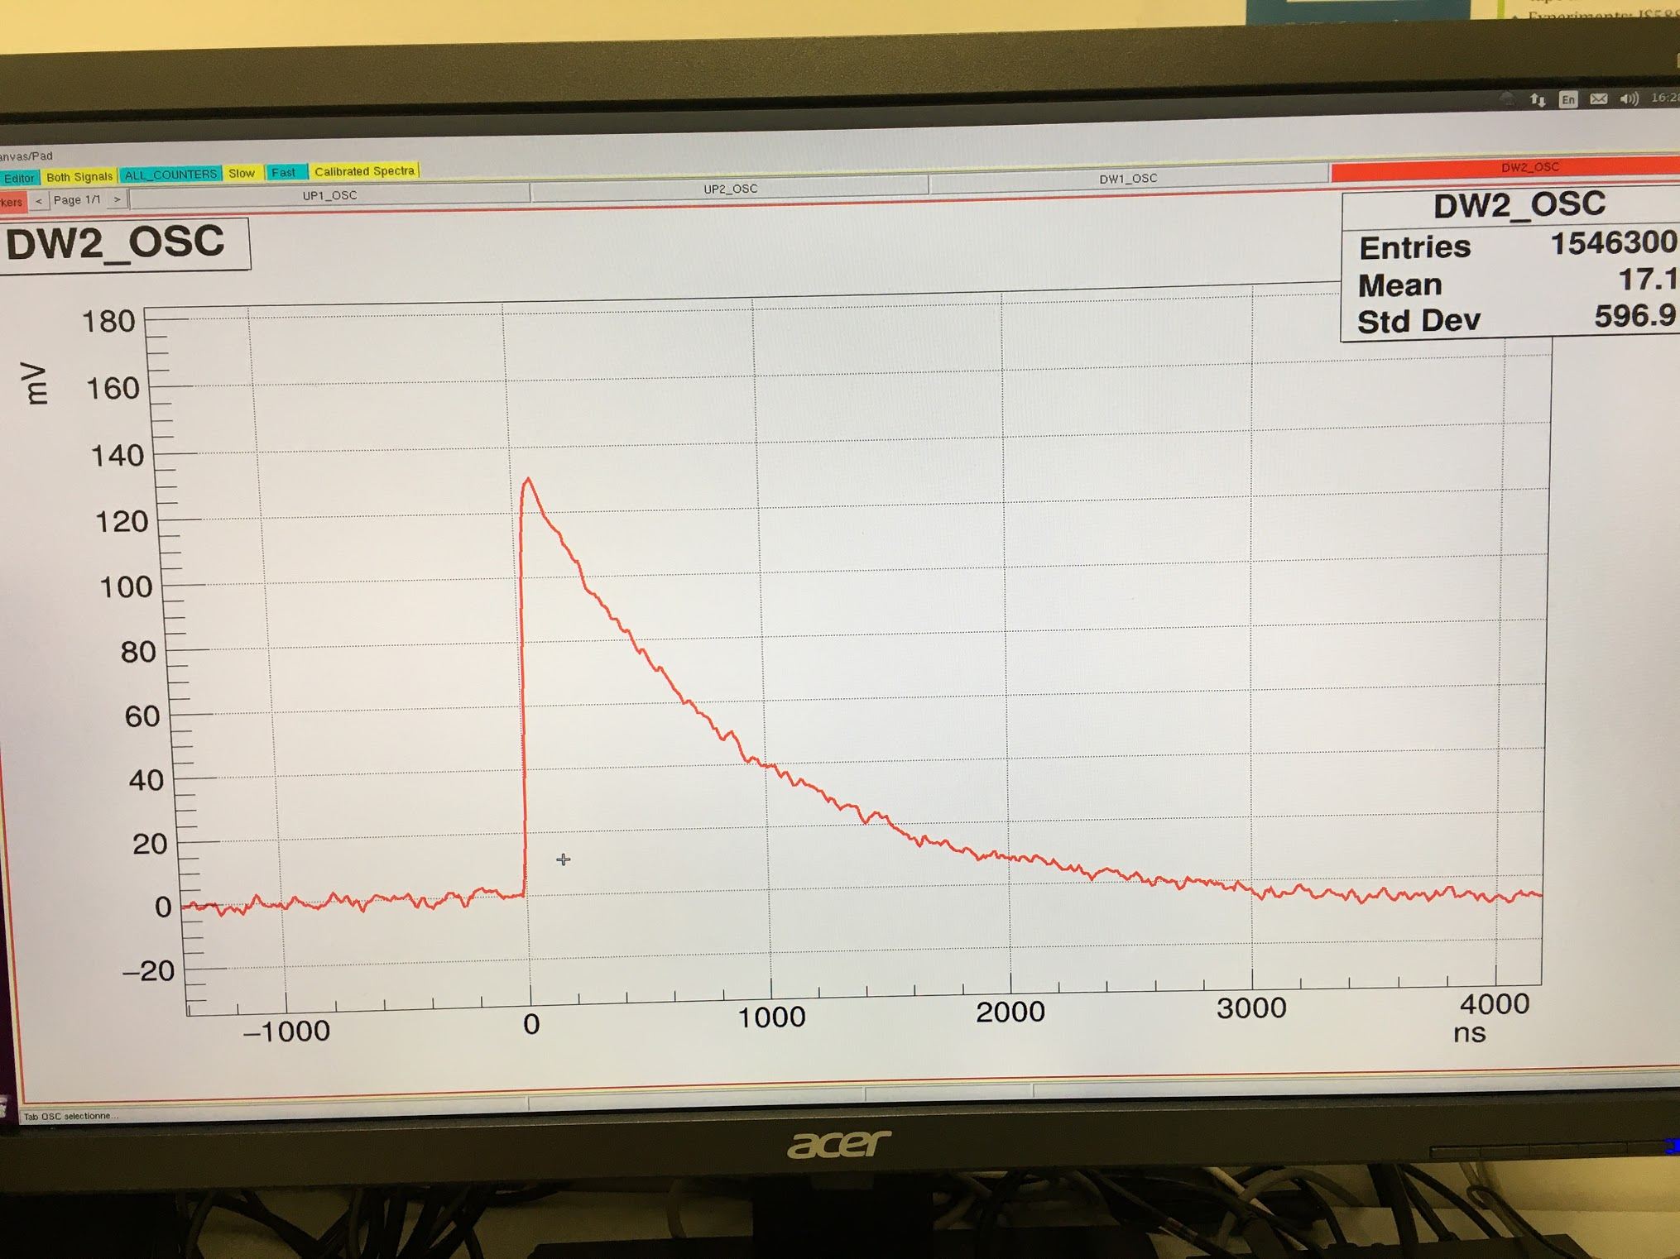
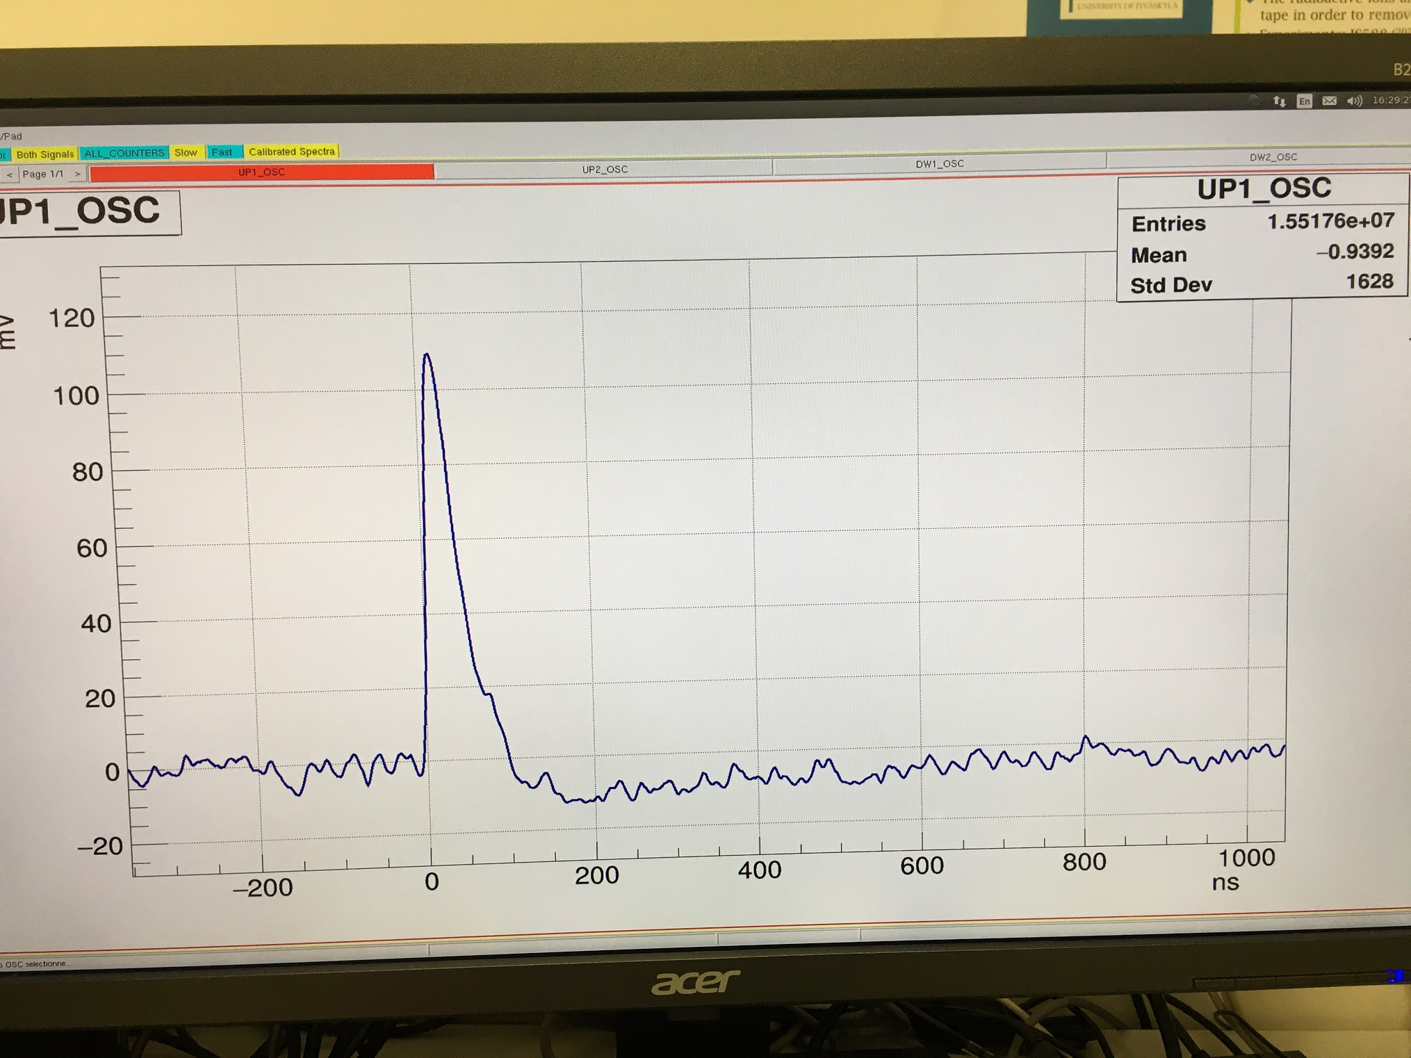
Signals
Slow signal not compatible with CARAS input
Fast signal not great for the QDC module
t ~ 3 us
t ~ 35 ns
Noise level is about 5Vpp

Slide 8
QDC spectrum (fast signal)
Qualitatively spectrum looks fine.

Slide 9
ADC spectrum (slow signal)
CARAS board configured as :
ADC + CRRC4 filter (shaping amplifier)
Signal did not look well after shaping: The preamp configuration was not suitable for CARAS!

Slide 10
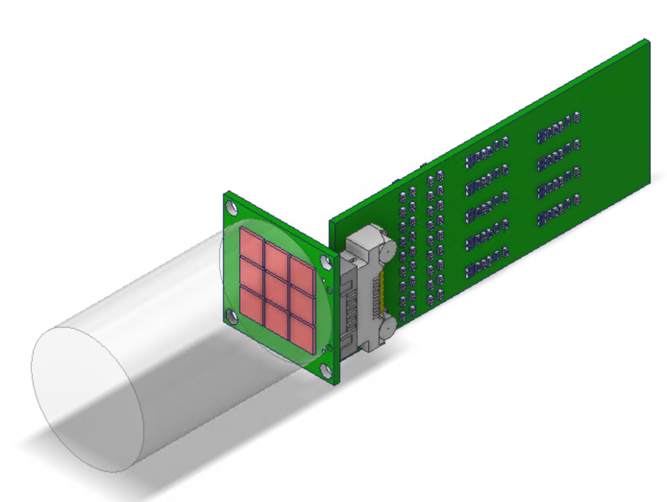
WISArD design
Signals (separated):
Signal decay: 0.6 - 1 us decay time
Signal rise time: no restriction for fast-timing, can be slower > 30 ns
Signal height: DAQ input is +/- 1.15V dynamic range on 50 Ohms but can be also made to +/-2V by software offset of -1.1V and 1.1V.
SiPMs equipped with High and Low Gain outputs.
Prototype will be ready (mid/end) April 2021
paid through IFIN contribution to ISOLDE

