Slide 1
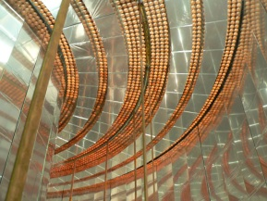

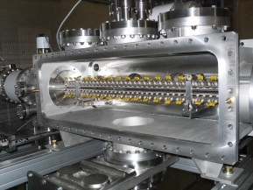
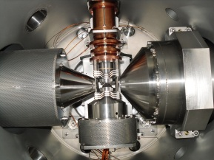
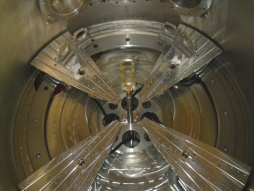
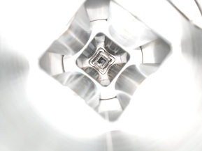
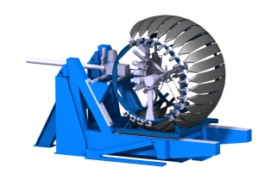



Status of the preamp development and cables for the silicon detectors
Monday 22 nd March 2021
Laurent Leterrier, Xavier Fléchard

Slide 2

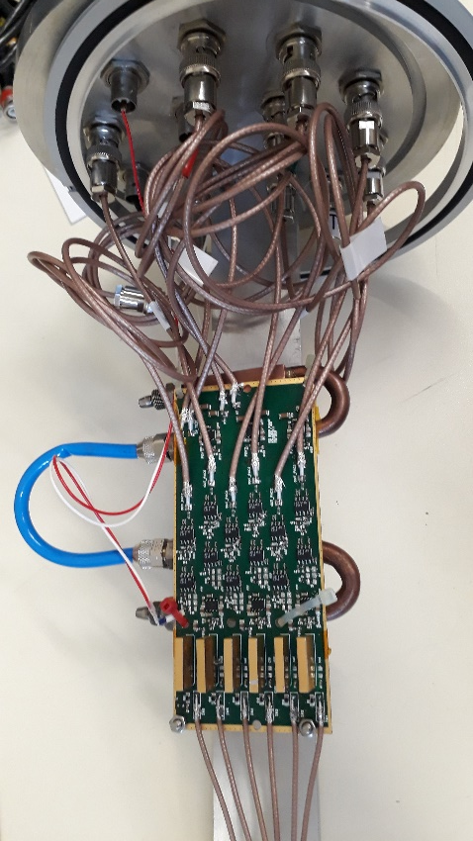
Test results of the first prototype :
Amptek version
Resolution < 4,5 keV_{Si} FWHM
at room temperature
Cd ≈ 100 pF + 10 cm cable
Optimal shaping time = 4 µs
- Measurements were performed with the faster system and pulse generator.
- Resolution for the rear side is about 20 keV_{si} FWHM in the same conditions except Cd ≈ 470 pF and optimal shaping time ≈ 7 µs.
- Power consumption ≈ 2,8 W / board
More in Marcin’s talk (test at AIFIRA with Silicon detectors & 700keV alpha beam)
[WISArD, Visio conf meeting, Monday 22 nd March]

Slide 3
Second prototype board :
CAEN Version
Advantage : Cost ≈ 200 € per unit ( AMPTEK : cost = 600 $ per unit)
Disadvantage : Size = 39 x 20 x 3 mm (AMPTEK : size = 17 x 10 x 3 mm)
Uncertainty : Operating temperature ? ⇨ to be checked !
Main features of the board:
- 6 channels with 6 charge sensitive amplifiers CAEN A1422H version F2
- For each channel :
- 400 mV/MeV_{Si} ⇨ 2.4 V for 6 MeV_{Si} in CSA output
- CSA output connected directly to input FASTER
Choice of FASTER input range: 5V → Max 12.5 MeV, LSB 0.75 keV
2V → Max 5 MeV, LSB 0.30 keV
- Decay time ≈ 27 µs
- Power consumption ≈ 288 mW / channel ⇨ 1.8 W / board
- NEC (Cd = 100 pF + Ccoax = 10 pF) ≈ 3 keV at room Temperature
[WISArD, Visio conf meeting, Monday 22 nd March]

Slide 4
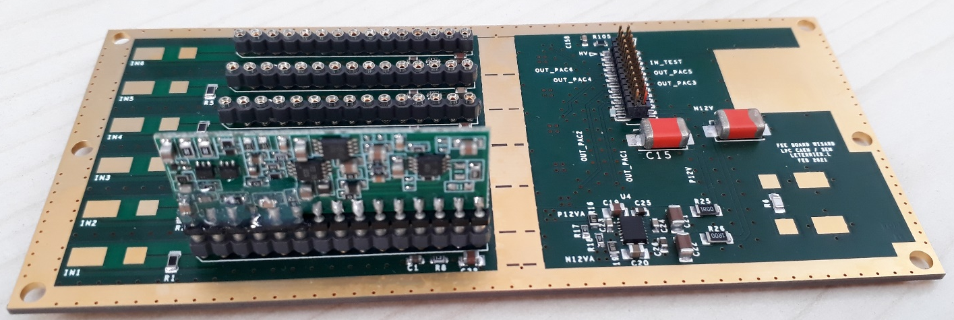
Second prototype board :
CAEN Version
I/O connecteur
CAEN preamplifiers
1 input for ohmic side
HV input (100 V max)
5 inputs for jonction side
TEST input (50Ω)
6 outputs
Power ± 12 V
Test scheduled for the end of March
[WISArD, Visio conf meeting, Monday 22 nd March]

Slide 5
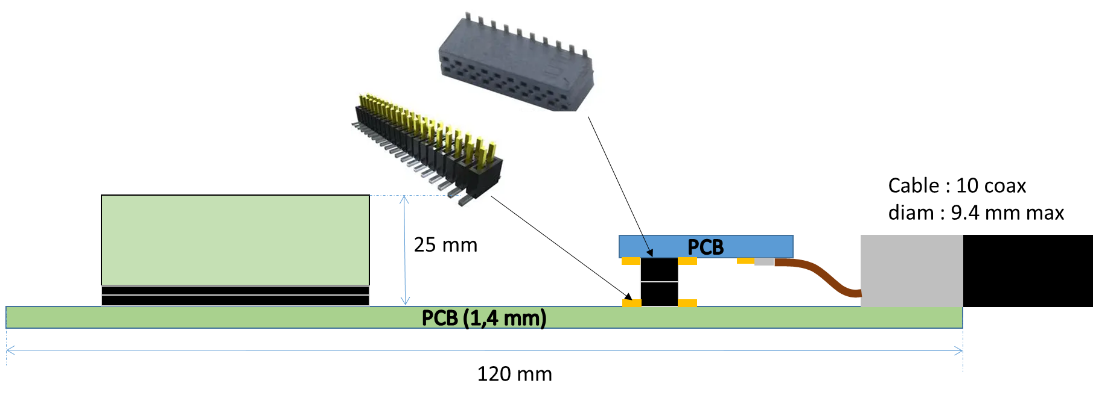
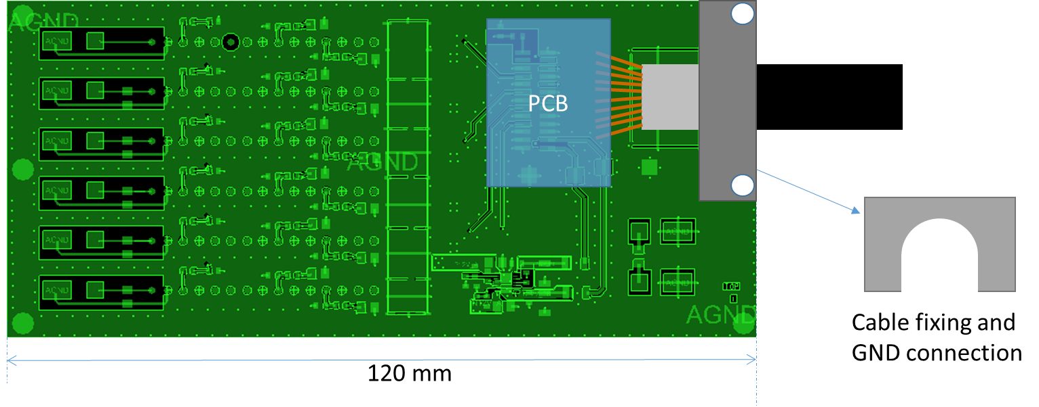
Second prototype board :
CAEN Version
Not final version,
depends on mecanical constraints !
[WISArD, Visio conf meeting, Monday 22 nd March]

Slide 6
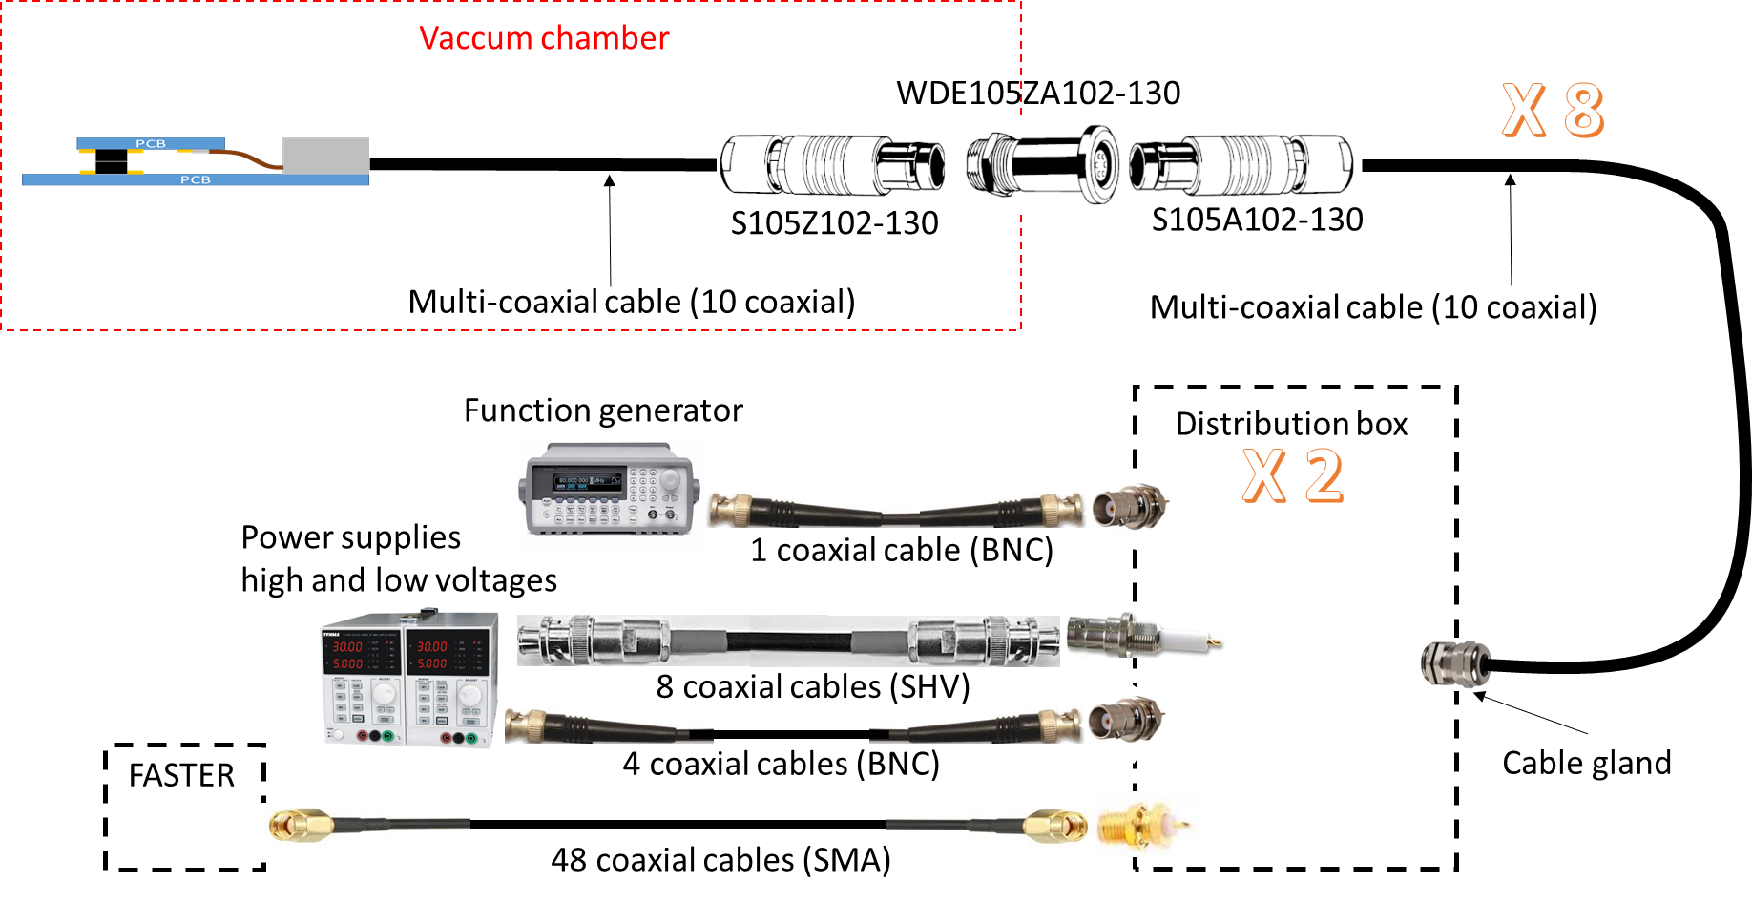
Cable and connection :
- Use of Fischer connector (105 serie) : 104 serie not compatible with the cable
Quotation : 3600 euros for Fischer connectors, 5100 euros for cables (full custom, 300 m)
The cost of the distribution boxes is not estimated
Delivery time : 14 weeks ⇨ decision to be made before the end of march !
[WISArD, Visio conf meeting, Monday 22 nd March]

Slide 7
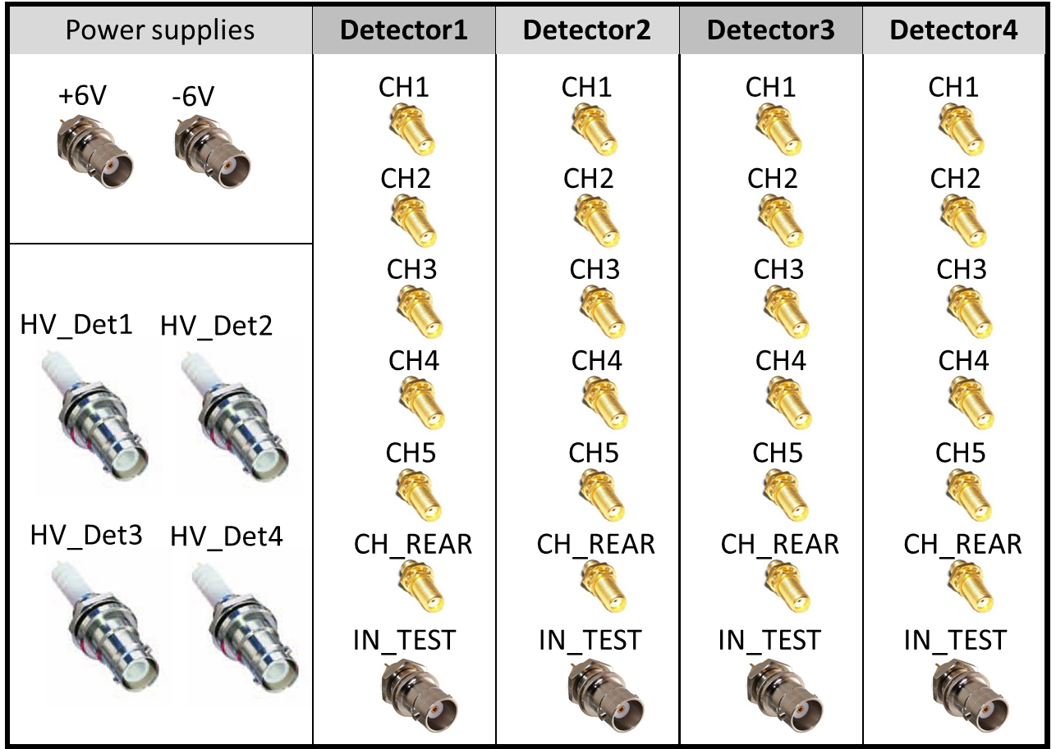
Connection proposal for the WISArD project :
Front panel for one distribution box
One distribution box for 4 detectors
[WISArD, Visio conf meeting, Monday 22 nd March]

Slide 8
beta detector calibration
at low energy

Slide 9
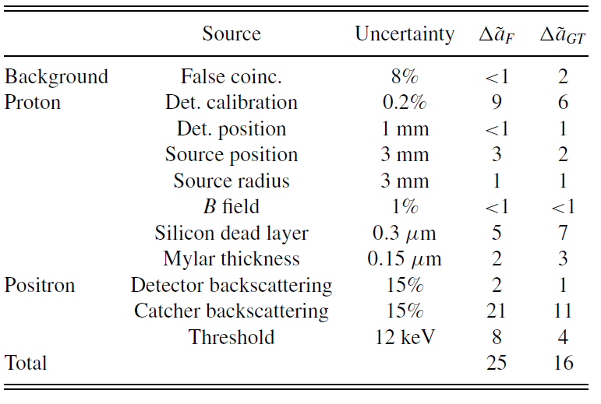
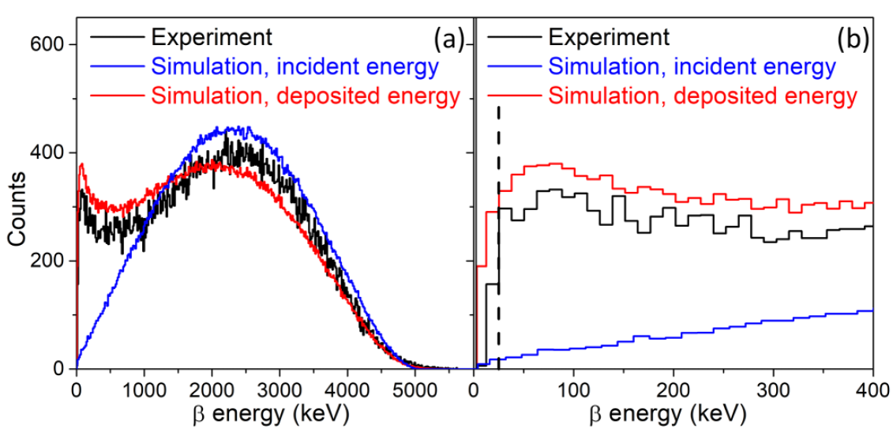
Need for accurate calibration at low energy
Systematic error 10⁻³ (from 2018 test experiment)
To reach .1% level:
Lower threshold down to 10 keV
(x2.5 on Bck scat error)
Threshold uncertainty of 1-1.5 keV
(x10 on Threshold error)
What matters:
Knowledge of threshold
(direct effect)
Achieve very low threshold
(backscattering)
Need for a precise characterization of positron detector at very low energy
[WISArD, Visio conf meeting, Monday 22 March 2021]

Slide 10
Build low energy low intensity electron gun
Test bench “CEBI”
(canon à electron basse intensité)
Monoenergetic e- beam (0-30 keV)
~ 600 counts per second on detector
Simulations:
G4: no X rays on detector
SIMION: e- from anode only
[WISArD, Visio conf meeting, Monday 22 March 2021]

Slide 11
First tests with PVT scintillator (EJ204)
[WISArD, Visio conf meeting, Monday 22 March 2021]

Slide 12
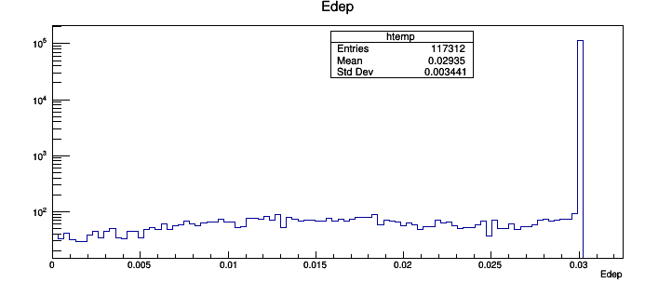
Bkg subtraction & fit
For n e-, the response function is a convolution of n response functions obtained for 1 e-
Fit with combination of 5 Gaussian functions
7 free parameters: x1,w1,A1,A2,A3,A4 & A5
With xn = n x x1, and wn = sqrt(n) x w1
G4 simulations: backscattering negligible
Mean Edep=29.35 keV
[WISArD, Visio conf meeting, Monday 22 March 2021]

Slide 13
Results for EJ204 scintillator
30keV
25keV
20keV
15keV
10keV
2 sets of measurements
Reproducibility limited by
BKG fluctuations
Gain fluctuations
to be improved
[WISArD, Visio conf meeting, Monday 22 March 2021]

Slide 14
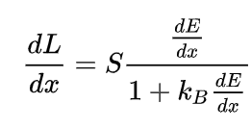
Extract Birks quenching coefficient
L: light yield
S: scintillation efficiency
Should allow to set a threshold around 10keV
with precision of at least 2-3 keV
[WISArD, Visio conf meeting, Monday 22 March 2021]

Slide 15
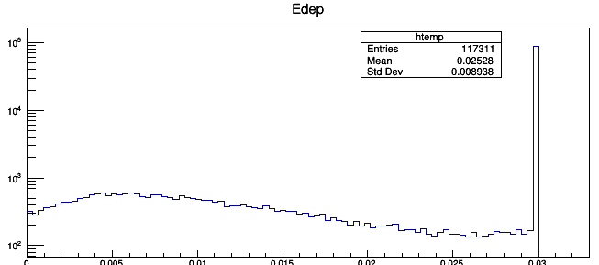
Tests with YAP scintillator
Backscattering not negligible…
Better resolution but requires more complex fitting procedure
G4 simulations
[WISArD, Visio conf meeting, Monday 22 March 2021]

Slide 16
Next
Characterization of other PVT scintillators
(2018 experiment, Simon exp…)
Tests with SiPMs
Calibration of future beta detector for WISArD…
goal: threshold < 10 keV & ~1-1.5 keV precision (0.1% on a_{βν})
Mid April?
Removable 241Am source
(ref for experiment @ ISOLDE)
[WISArD, Visio conf meeting, Monday 22 March 2021]

Slide 17
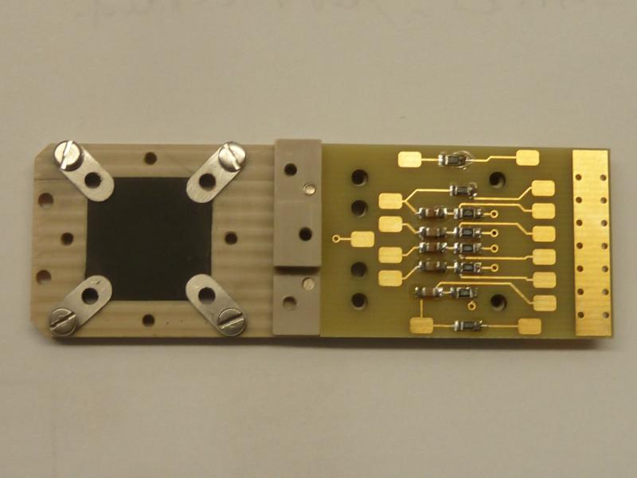
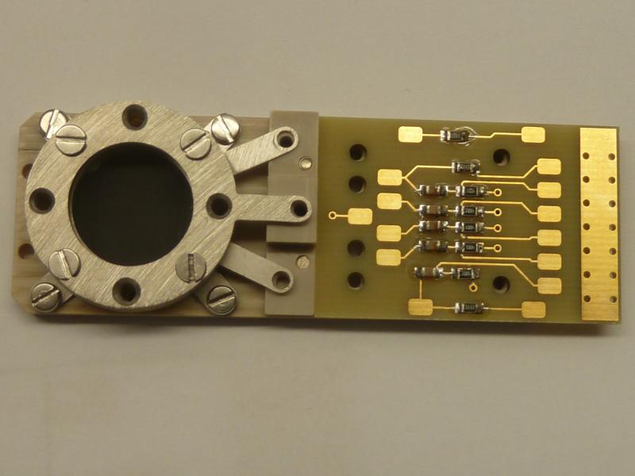
MCP detector
Goal: monitoring implantation profile on catcher (resolution better than 300um)
Constraints: compact, works in strong Bfield
25mm
Resistive anode
2 MCPs
To be tested soon with mask & alpha source…
[WISArD, Visio conf meeting, Monday 22 March 2021]

