Slide 1
Nuclear Physics at GSI/FAIR
(Facility for Antiproton and Ion Research)

Slide 2
The GSI/FAIR facility
GSI
FAIR
Notes:
The FAIR facility is currently being built in Darmstadt, Germany. It is a significant extension of the existing GSI facility. The GSI facility is shown in blue and FAIR is shown in red. The GSI facility consists of a linear accelerator UNILAC, which accelerates U up to 11 A MeV, at the end of the Unilac there several experimental areas, in particular the SHIP separator which is well know for the discovery of various super-heavy elements. After the UNILAC, the beams are injected into the SIS18 synchrotron where U can be accelerated up to 1 A GeV. After the SIS a production target can be used for the production of seondary beams via fragmentation or fission. The secondary beams can be identified in charge and mass with the fragment separator and then distributed to the ESR storage ring or to other experimental areas.
In the future FAIR facility, the beams from SIS18 are then injected into the SIS100 synchrotron, which can then accelerate fully stripped uranium up to 10 A GeV. After the interaction of the primary beams with a production target the secondary beams can be identified and selected with the large-acceptance Super-fragment separator. After the fragment separator the RIBs can be distributed to different experimental areas following the low-energy branch, the high-energy branch and the ring branch. An additional element of the new facility is the CRYRING storage ring, which is coupled to the ESR.

Slide 3
Strengths of GSI/FAIR
Only facility world-wide able to provide a ²³⁸U²⁸⁺ beam at 1.5 A GeV with ~10¹¹ pps
World-record intensities for radioactive beams of fully stripped ions up to the heaviest masses near U
Large variety of energies (stopped, MeV/u, >1 GeV/u)
High-quality radioactive beams (beam cooling at rings), unrivalled experience
State of the art detection systems are or will be available
Notes:
With SIS100, GSI/FAIR will be the only facility world-wide to provide… 1.5 A GeV is the optimum energy for RIB production.
Thanks to the very high primary beam intensities and energy, and the very large acceptance of the super-FRS world record intensities…
Fully stripped beams are of great advantage for some experiments.
A large variety of energies are possible, from stopped, A MeV and A GeV ranges)
But intensity and energy are not the only asset of GSI/FAIR, thanks to beam cooling techniques that can be applied in the storage rings, the beams delivered by FAIR can have an outstanding quality in terms of emittance and momentum spread.
Last but not least, the facility already hosts and will host in the future state of the art detection systems.

Slide 4
Experiments at GSI/FAIR
FAIR-phase0 is running, current experiments benefit from the upgrade of UNILAC and SIS-18, and from CRYRING
First experiments using the Super-FRS expected towards the end of 2025
France is one of the 10 share-holders of FAIR and enables its scientific community the access to FAIR
Notes:
As I said, FAIR is being constructed, but during the construction the facility delivers about 3 months of beam time for experiments in the so-called FAIR-phase0…

Slide 5
Nuclear-physics projects at GSI/FAIR coordinated by IN2P3 scientists
(2020-2024)
→For AGATA@FAIR, see talk by A. Lopez-Martens!
→Ideas for experiments with GRIT@FAIR, see talk by D. Baumel
Notes:
In the following we will describe 6 projects to be conducted at GSI/FAIR in the next 5 years. They will strongly contribute to answer to some of the open questions described by O. Sorlin in his talk. France is also part of the AGATA collaboration and the AGATA detector will be installed at FAIR, but this will be discussed in the dedicated talk on AGATA by Araceli Lopez Martens.

Slide 6
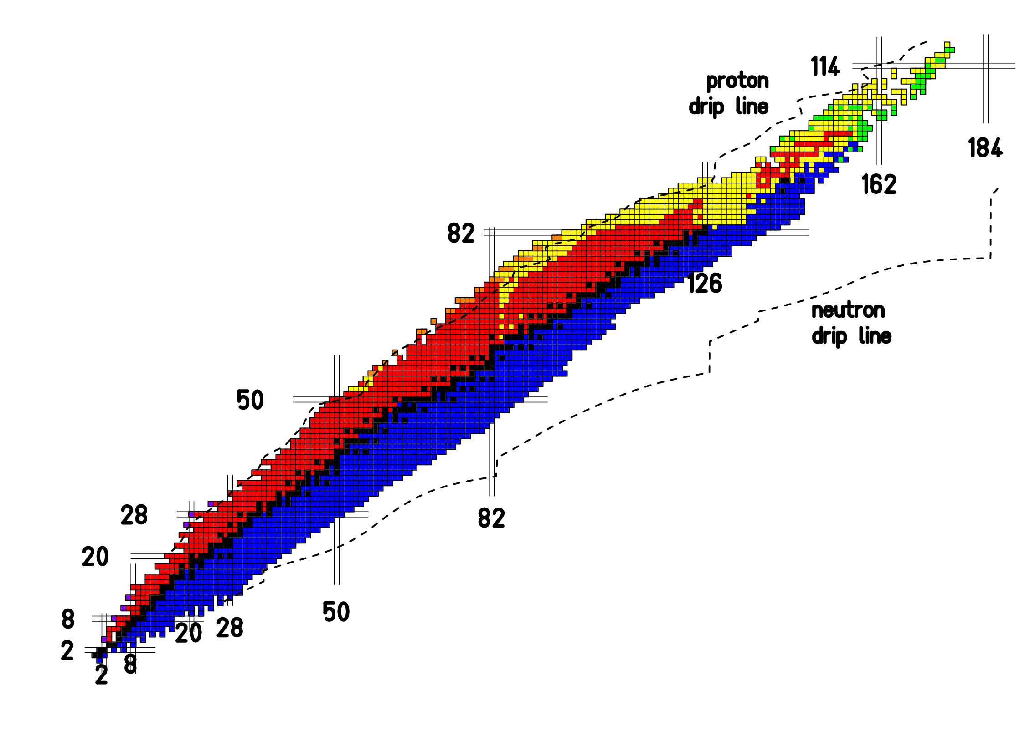
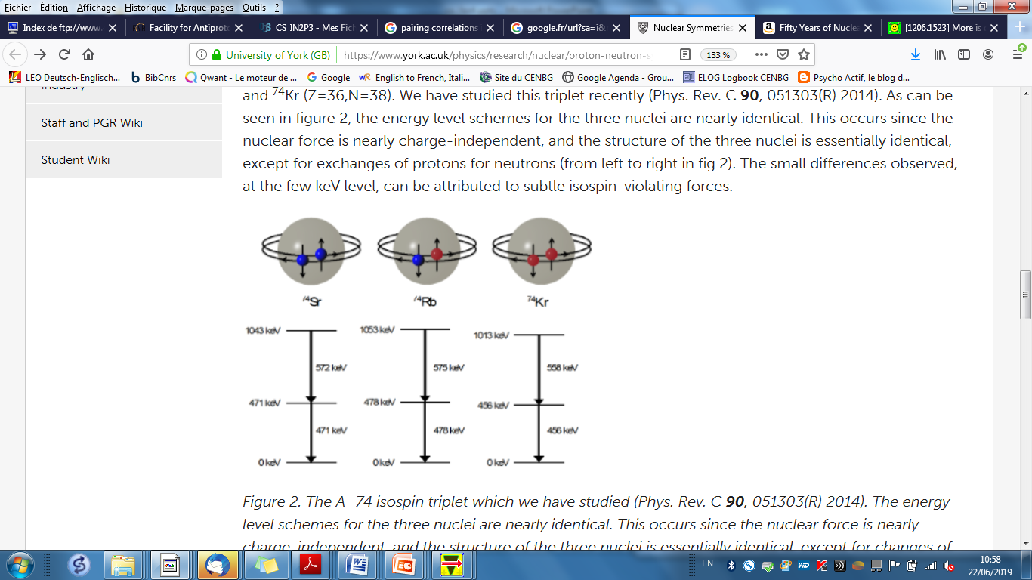
Overview of French projects
(Pairing correlations)
2-proton radioactivity
Neutron-neutron
correlations
Notes:
Pairing correlations are the most important residual interaction in nuclei and are responsible for some remarkable features like the significant increase of binding energy of nuclei with an even number of protons and neutrons. Like the e- in superconductors, nuclei are particularly stable and have peculiar properties when their nucleons are paired.
We have two complementary projects that will contribute to understand how pairing correlations evolve when we go to the drip lines. One project investigates neutron-neutron correlations in very neutron-rich nuclei in the C-O region. The other experiment studies a very exotic decay, which is the emission of two-protons that occurs in the opposite side of the chart, with very neutron-deficient nuclei close to the proton drip line between Ni and Sn.

Slide 7

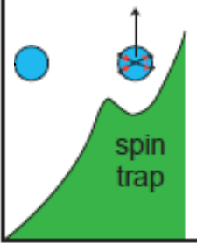
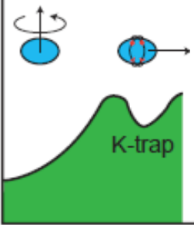
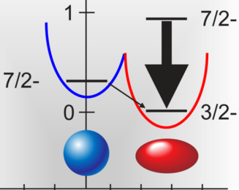
Overview of French projects
(Evolution of shells, onset of deformation and collectivity)
Magnetic moments
of isomeric states
Energy
Energy
Nuclear Shape
PRL 102, 092501 (09)
Nuclear Spin
Nature 399, 35 (99)
Notes:
Another project leads with heavier nuclei in the Sn and Pb regions and aims at measuring the magnetic moments of isomeric states. Isomeric states are excited, metastable states of nuclei. Nuclei get “trapped” in these states because one of their properties significantly differs from that of the gs, e.g their ang. Momentum, or their deformation or the orientation of their spin. Therefore, isomers are particularly interesting to investigate sudden changes in structure and new unexpected phenomena. Magnetic moments are very interesting observables because they are directly linked to the angular momentum of the state.

Slide 8
Overview of French projects
(Nuclear fission, extreme deformation)
Fission barriers
Fission-
fragment
yields
Fission
probabilities
Notes:
Two other projects deal with even heavier nuclei in the pre-actinide and actinide region and investigate the fission of these nuclei. Fission is the result of a large scale collective motion where the nucleus gets more and more deformed until it splits into two fragments, as shown in the figure. Fission is a very rich laboratory for investigating the behavior of nuclei at extreme deformation. The two projects are complementary, one aims at measuring fission probabilities, which make possible to study the evolution from the ground state to the fission barrier, the other measures the fission-fragment yields which enable the investigation of the evolution from the fission barrier down to scission.

Slide 9
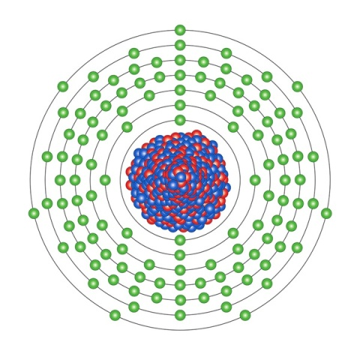
Overview of French projects
(Limits of stability, super-heavy nuclei)
Laser spectroscopy
Notes:
Finally, we go to the region of the heaviest nuclei, whose existence is due to quantum mechanical shell effects. This project aims to study the nuclear structure properties of very heavy nuclei, which are needed in order to understand the effects that make possible the existence of super-heavy nuclei, to understand how big can nuclei get! We show here a sketch of a superheavy nucleus with the e- orbits around, the level structure of these e- orbitals is a very precise finger print of the nucleus structure because the nuclear spin, multipole moments, radial extent of the charge distribution, distribution of magnetism and the mass produce (measurable) perturbations of the atomic structure. The present project aims to exploit this information by using high resolution laser spectroscopy.

Slide 10
Evolution of pairing correlations towards the neutron dripline from di-neutron and tetra-neutron correlations
O. Sorlin, GANIL

Slide 11
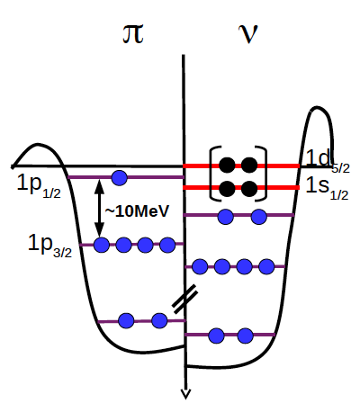
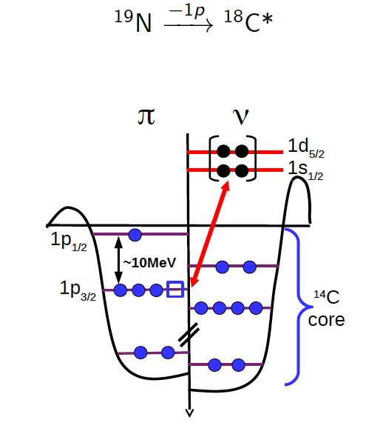
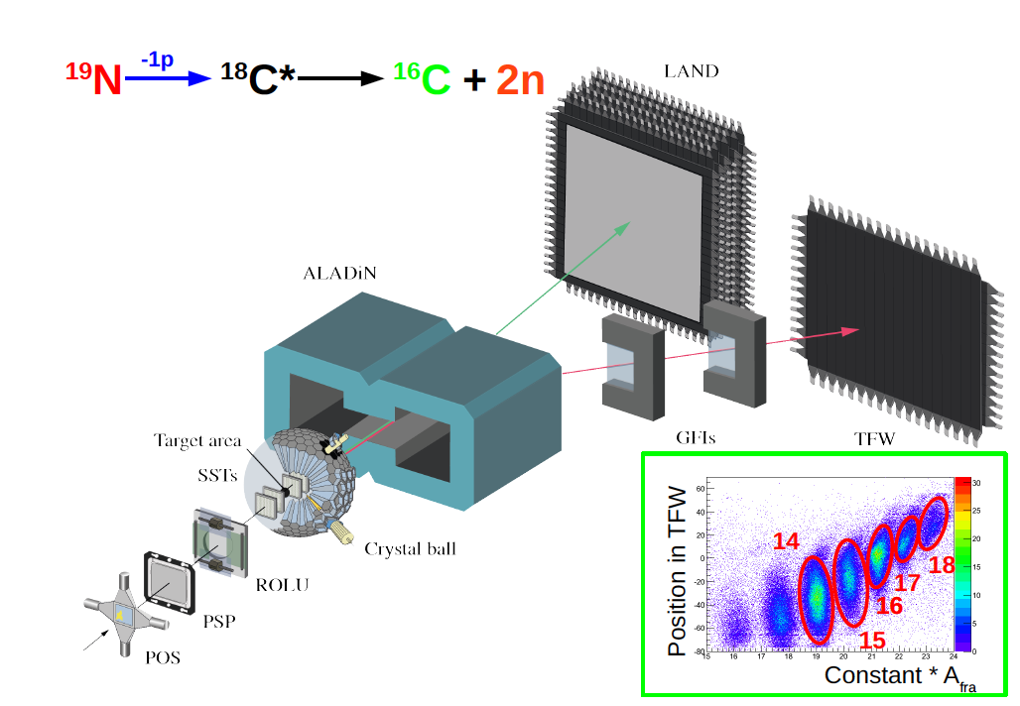
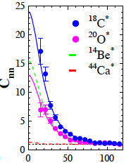
Motivation:
Evolution of pairing scheme towards drip-line, from BCS to BEC ? (Hagino et al. PRL99 (2007))
Existence of an ensemble of 4 interacting neutrons? (Marques et al.,PRC 65 (2002), Kisamori et al. PRL 116 (2016))
High-energy proton knock out:
Particularly well suited reaction mecanism to investigate 2n or 4n correlations:
Suddenly promotes neutrons into the continuum without affecting the n-n correlations!
Need of high energy projectile beams ~400 A MeV!
¹⁹N
¹⁹N (-1p) ¹⁸C* -> ¹⁶C+2n
R3B set-up (after FRS)
n
n
C_{nn}
¹⁸C :Most correlated system
ever observed!
¹⁶C
C isotopes
q_{nn}
Largest cross section
for the ¹⁴C + 4n channel
-> 4n correlations can be
investigated in the future
¹⁹N
A. Revel et al. Phys. Rev. Lett . 120, 152504 (2018)
Notes:
The strength of the attractive pairing force is expected to increase when the nuclear density decreases. When the pairing force is very strong one expects that two fermions form a bosonic bound state with condensation in the ground state. Neutron-rich nuclei are characterized by a dilute neutron density around the nuclear surface and there are theoretical studies that predict that they may show a transition from BCS-type pairing correlations (which describes pairing in nuclei under standard conditions) to the Bose-Einstein condensation (BEC). Another motivation is the search for the existence of an ensemble of 4 interacting neutrons, which has been proposed from experimental studies.
The aim of this project is to investigate these two points by measuring 2n and 4n correlations by using the very well suited high-energy proton knock out reaction mechanism, where a deeply bound proton is ejected out of the nucleus. Everything happens so fast that the remaining nucleons don’t have time to adapt to the new configuration, neutrons are suddenly promote into de the continuum w/out affecting the n-n correlations. To realise this mechanism one needs high beam energies of about 400 A MeV so that the wavelength is small enough to consider a collision between individual nucleons.
O. Sorlin and collab. Have investigated this reaction mechanism recently with a 19N beam a proton was removed from the projectile. They considered the decay channel where the excited 18C emitted 2n and investigated the correlation between the two neutrons by measuring the momenta of all the reaction products with the R3B set-up and in particular the LAND neutron detector. They observed indeed that the two neutrons where very strongly correlated indicating that indeed the reaction mechanism does not disturb the n-n correlations. It was not possible to study 4n correlations because of lack of resolution of the Land detector.

Slide 12
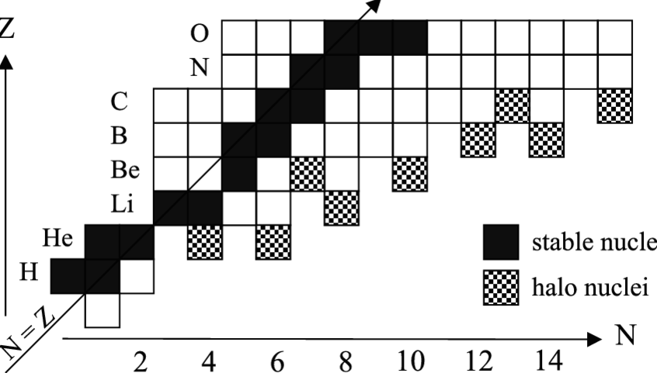
Future studies of 2n and 4n correlations in atomic nuclei at FAIR/GSI
Experiment accepted, planned in 2020
Program:
Use of quasi-free proton knockout mechanism to promote 1n, 2n or 4n in the continuum
Study of 2n or 4n correlations as a function of nuclear structure and the proximity of the drip line
-> Evolution of nuclear superfluidity
Spectroscopy of drip-line nuclei with excellent energy resolution -> shell evolution
-1n
¹⁷B
¹⁴Be
unbound
-1p
¹¹Li
Means:
Study of all steps of the reaction with full kinematics for ions and neutrons
Very good (neutron) energy resolution (NEULAND), Highest efficiency worldwide
Good γ energy resolution and efficiency (CALIFA)
Notes:
For the next years the group will conduct an experiment that has been accepted by the last PAC and that is expected to take place in 2020. In this experiment nuclei between very n-rich nuclei between Be and C will be investigated. The idea is to use the proton knock-out mechanism to promote neutrons into the continue and study 2n and 4n correlations. In addition, the spectroscopy of these nuclei will be studied with high resolution to investigate the shell evolution in this region. This will be possible by using the upgraded R3B set-up located behind the FRS with the new NeuLand neutron detector, which has a better granularity and the largest efficiency worldwide to investigate 4n correlations and CALIFA a gamma-ray calorimeter that detects also the high-energy protons ejected in the reaction which. This project requests some contribution to Neuland and Califa.

Slide 13
Two-proton radioactivity
J. Govinazzo, CENBG

Slide 14
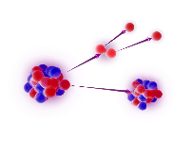
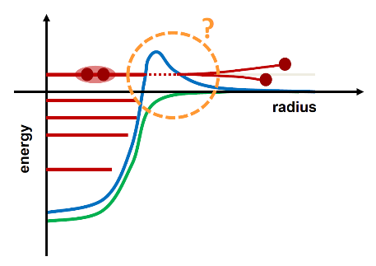
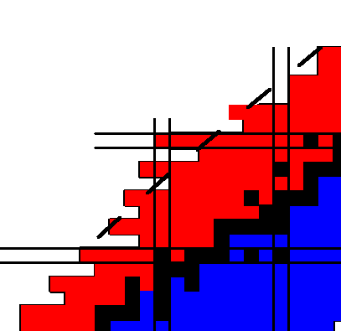
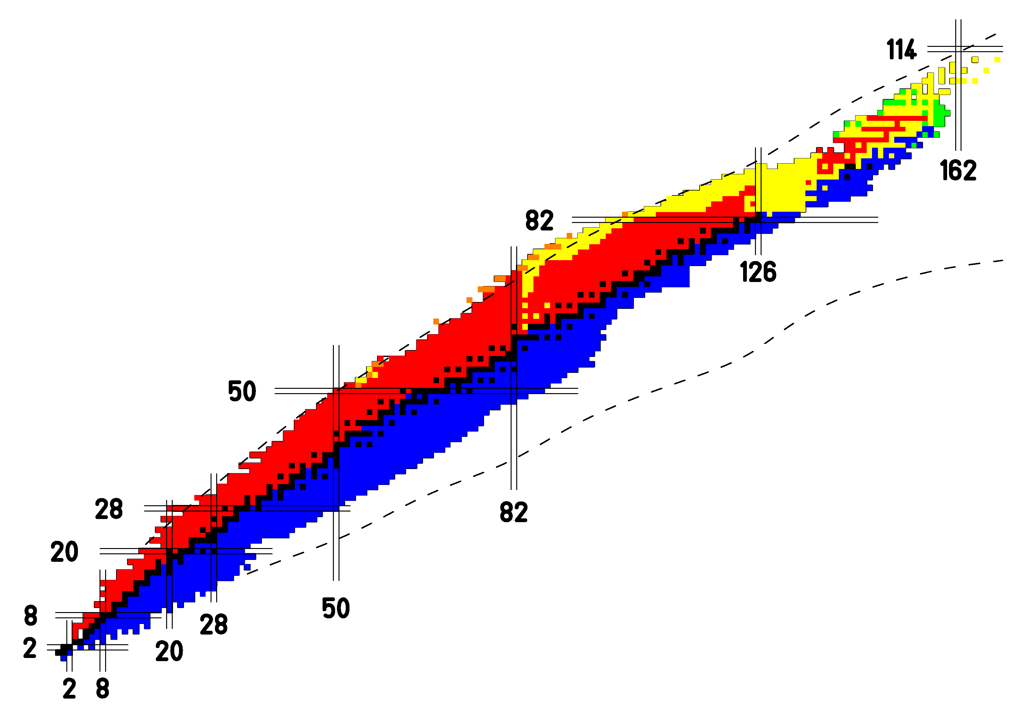
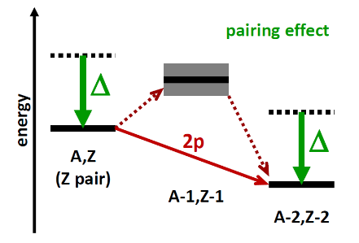
2-proton radioactivity
a unique & very exotic decay mode
for unbound even-Z nuclei
unbound…
+ Coulomb barrier
+ pairing correlations
(proton-proton)
physics motivation (beyond drip-line)
 pairing
 drip-line and masses
 tunnel effect
 nuclear structure
• predicted in the 60’s
indirect evidence in the 2000’s
observed cases: ⁴⁵Fe (GANIL, GSI), ⁴⁸Ni (GANIL,NSCL), ⁵⁴Zn (GANIL),
⁶⁷Kr (RIKEN)
• correlations (tracking exp., TPC): ⁴⁵Fe [+ poor data on ⁵⁴Zn]
difficult theoretical interpretation
• combine decay dynamics & nuclear structure
• new calculations (deformation) → Gamow coupled channels
need for various cases
orbital configurations / deformation
CS-IN2P3 – june 2019
GSI / FAIR – 2-proton radioactivity
Notes:
The two-proton radioactivity is a very exotic decay where two protons are emitted simultaneously, it occurs beyond the proton dripline. The first condition for this decay to be possible is that the S2p<0 and S1p>0, as we can see here, this is possible for nuclei with an even proton number thanks to the pairing interaction which lowers down the ground state of even-Z neighboring nuclei, in that way is more convenient for the nucleus to directly emit two protons, than to emit first 1 proton and then another proton (sequential decay). The two interacting protons that are emitted are hold together thanks to the coulomb barrier, the di-proton system is not bound outside the nucleus. The study of this decay carries very valuable information not only on pairing, but also on dripline masses, the tunneling of the two neutrons through the barrier is also rather unique and the correlation between the two protons gives information on the orbital configuration of the nucleus. Even though it was predicted in the 60s, the first 2p emitter was observed only in the years 2000, since then 4 long-lived 2p emitters have been observed… For the first three nuclei located near the Z=28 shell models that combine dynamics and structure reproduce well the data, however for 67Kr, which is far from the shell, the predicted half-life is several orders of magnitude longer than the measured one. it is not clear if this is due to the structure or to the onset of the formation. More similar cases have to be investigated.

Slide 15
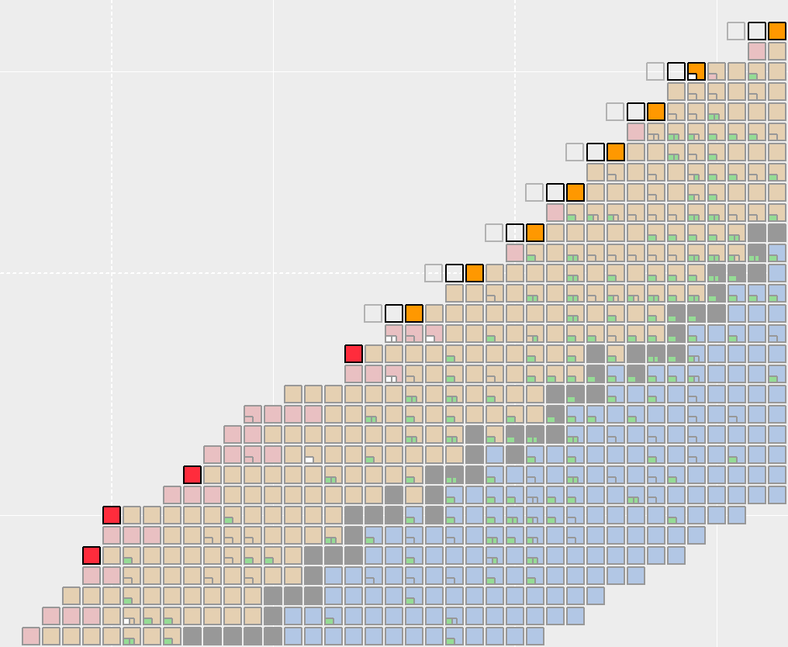
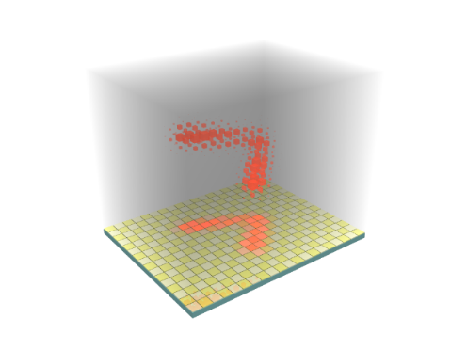
2-proton radioactivity @ GSI/FAIR
 current facilities (proj. fragmentation) – limited possibilities
⬥ GANIL (95 MeV/A)
⬥ NSCL (160 MeV/A)
⬥ RIKEN (350 MeV/A)
 FAIR (FRS / Super-FRS)
rate estimates (courtesy of B. Blank)
∼70 ⁴⁸Ni / day with ⁵⁸Ni beam → ∼50 × more / GANIL
∼200 ⁶⁷Kr / day with ⁷⁸Kr beam → ∼20 × more / RIKEN
∼100 ⁷¹Sr, ∼60 ⁷⁵Zr / day with ⁹²Mo beam
∼10 ⁷⁹Mo /day with ⁹²Mo beam
∼10 ⁹⁸Sn /day with ¹²⁴Xe beam
 2-step experiments
⬥ search for candidates
decay identification (DSSD)
→ NUSTAR / DESPEC
⬥ correlations (tracking exp.) → ACTAR TPC
⬥ equipment already available
?
Z = 50 (Sn)
mid-shells &
deformation region
Z = 36 (Kr)
⁶⁷Kr
(RIKEN)
⁵⁴Zn
⁴⁸Ni
Z = 28 (Ni)
(GANIL/NSCL/GSI)
⁴⁵Fe
AME 2016
isotopes
ACTAR TPC
CS-IN2P3 – june 2019
GSI / FAIR – 2-proton radioactivity
Notes:
GSI/FAIR offers the best conditions to investigate heavier 2p emitters. Thanks to the high energy and the large variety of intense primary beams available, it will be possible to form very neutron-deficient nuclei by fragmentation with rates much larger than in any other facility. The main objective of this project at GSI/FAIR is to investigate nuclei located between Kr and Sn. The experiments will be done after the FRS or the Super-FRS in 2 steps, a first experiment will search for candidates by implanting the nuclei in a Si array, arrays of this type like AIDA are or will be available at GSI/FAIR. Once the emitters are identify, proton correlation will be investigated with a TPC (ACTAR-TPC), which is also already available. So the equipment necessary for this project is already available.

Slide 16
Nuclear magnetic moments of isomeric states
R. Lozeva, CSNSM

Slide 17
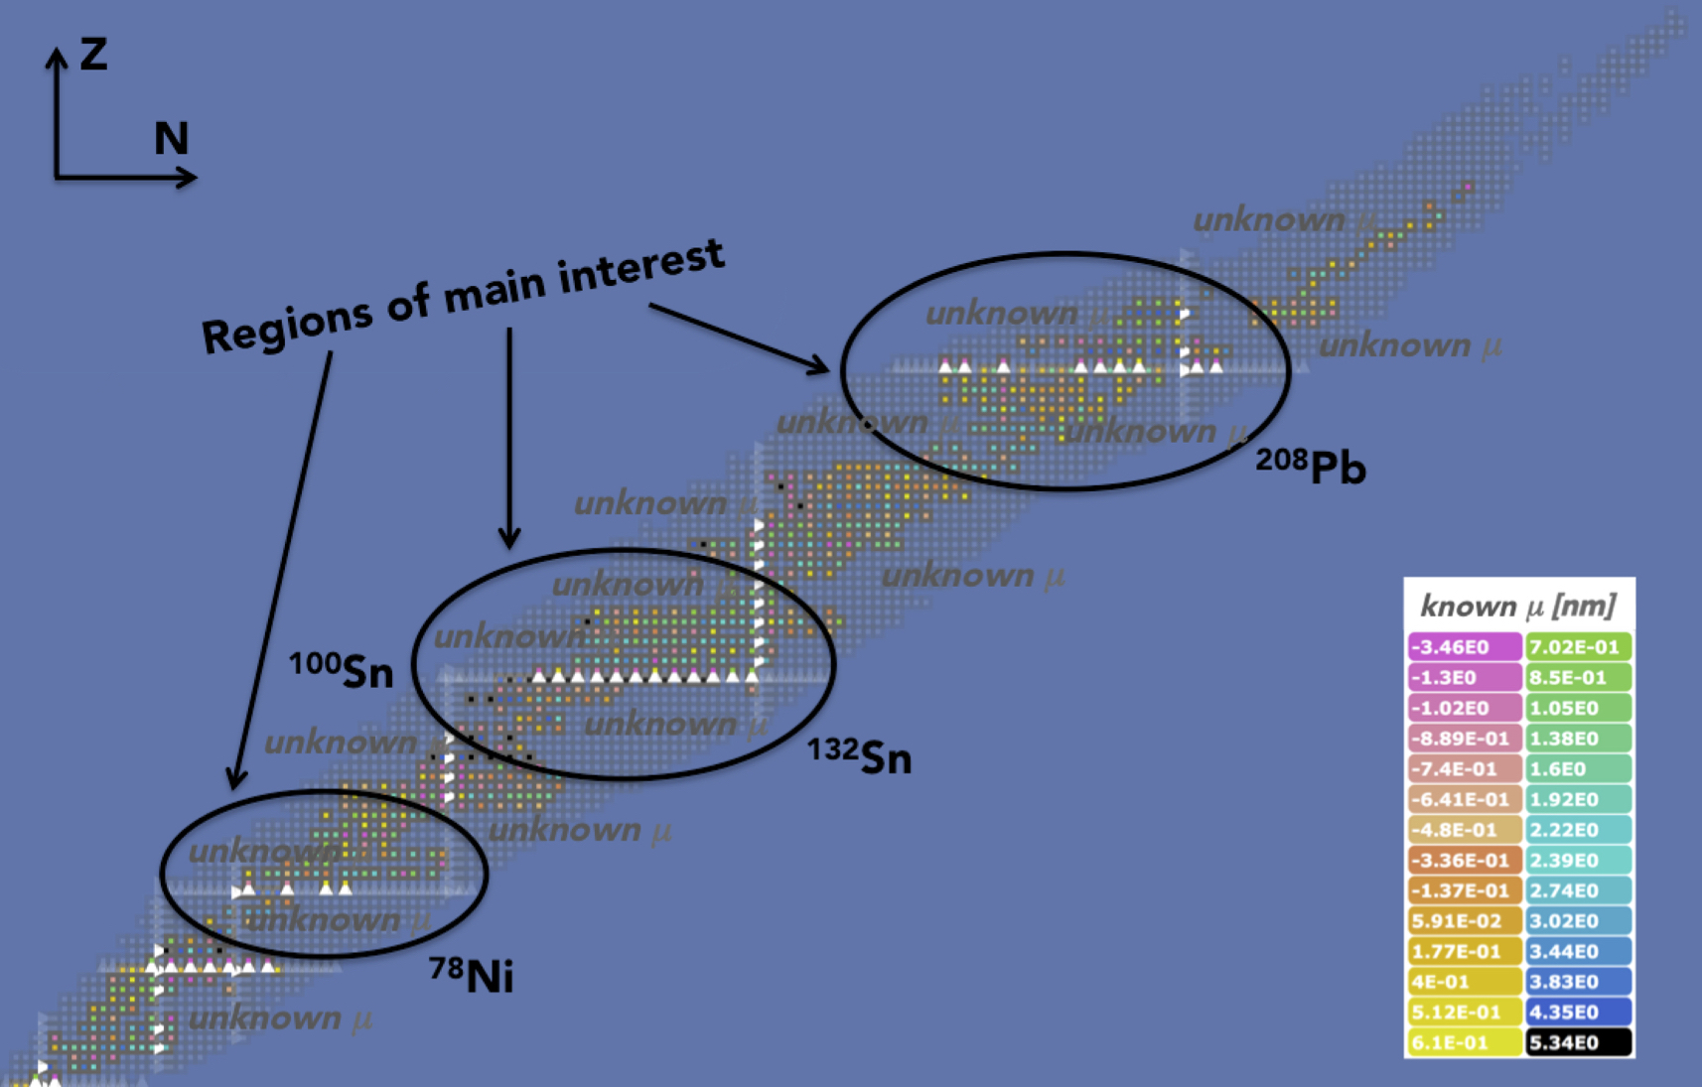
gSPEC@FAIR
Scientific motivation
Unknown g factors for excited isomeric states : unknown configuration
g factor : the dimensionless magnetic moment, M1 operator
measure of the valence nucleon configuration
single-particle excitations, orbital evolution, development of collectivity & deformation
Shape
Isomers
(Po, Rn)
FAIR-1
MEASURE g factors of isomeric states
Yrast
isomers
(near ¹³²Sn
& ²⁰⁸Pb)
FAIR-0
18 collaboration LoIs @gSPEC workshop 2018
K-Isomers (La, Nd)
Isomers in
¹⁰⁰Sn region
FAIR-1
Isomers in
Ni region
HI 240, 55 (19) and references therein
Notes:
This project is called gSpec, its aim is to measure at FAIR the g-factors associated to excited isomeric states whose quantum configuration is not known. The g-factor is the constant of proportionality that links the magnetic moment of a state to its angular momentum. Therefore, g-factors can provide very precise information on the angular momentum of isomeric states, which as I said in the introduction, are a signature of significant changes in the nucleus structure. This chart of nuclei shows the measured GS magnetic moments, we can see that most of them are located close to stability, the situation is much worse for excite states, which are in the scope of this project. There are three regions of interest that can be investigated at FAIR, around Ni, Sn and Pb. The first measurements within FAIR-Phase0 will concentrate on the study of Yrast isomers near 208Pb and 132Sn. Later, when the full capabilities of FAIR will be available the regions near 78Ni, 100Sn will be explored. Kisomers above Sn and shape-isomers above Pb will also become accesible at FAIR.

Slide 18
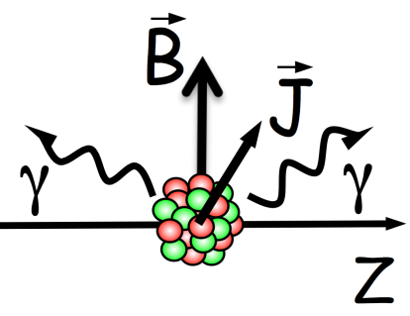
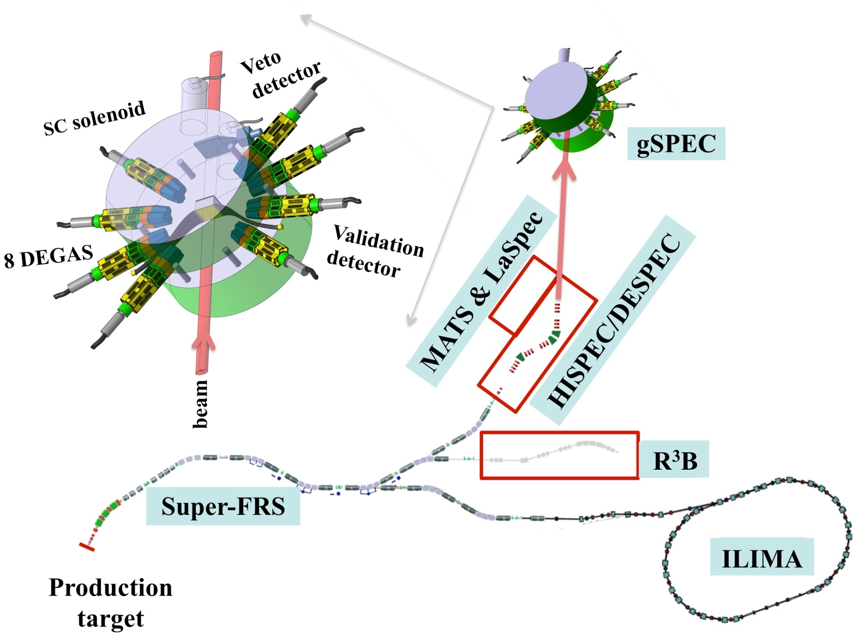
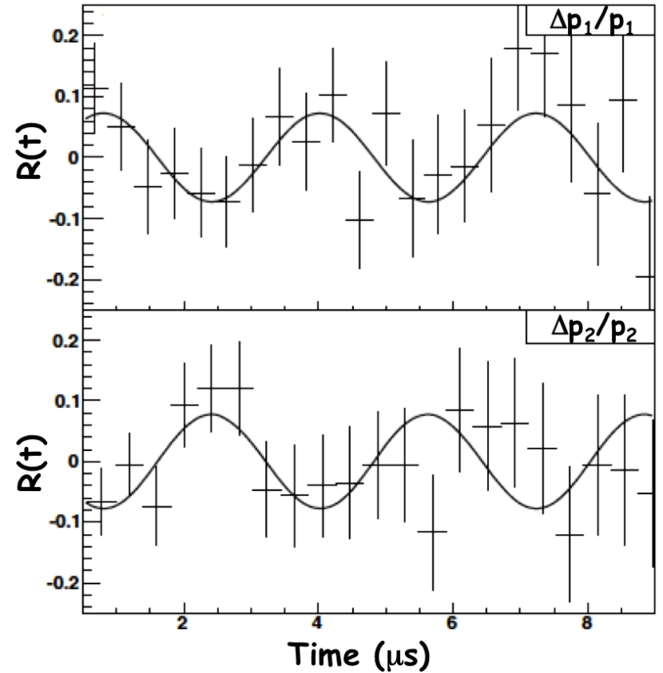
gSPEC@FAIR
Experimental method
Well established!
Main experimental SETUP
Spin (J) precession in Field (B)
Magnet + HpGe detectors + ancillary
(x,y) detectors for high B + host => R&D needed!
B>2T
Host
material
g factor : πν configuration
Secondary
Fragments
Alignment
mainly Fission/Fragmentation of ²³⁸U primary beam
Notes:
To measure the g factors, a spin-aligned ensemble of isomeric states is implanted into a suitable host material, which is immersed in a sufficiently strong static magnetic field. In a classical picture, the static field induces a Larmor precession of the nuclear spins. This spin precession gives rise to a time dependent change in the angular distribution of the radiation emitted by the isomers. As a consequence, the intensity of the radiation measured by a gamma-ray detector at an angle θ will change with the time, as shown in this figure. The period of the g-ray intensity oscillation is directly related to the g-factor.
Here we see the set-up required to perform these measurements. It will be placed after the FRS or the S-FRS on the HISPEC/DESPEC experimental area. It consists of an electromagnet including the host material and surrounded by the DEGAS array of Ge detectors, which already exists. Ancillary detectors are also required for position and time measurement. The design of the magnet is very challenging because it has to be adapted to the large size of the secondary beams. This project requests support for the development of the magnet and the ancillary detectors.
N.B. (only for me) An ensemble of nuclei is spin aligned if the projections of the angular momenta of the nuclei along a symmetry axis show a distribution that has certain symmetries

Slide 19
High-precission decay-probability measurements at CRYRING
B. Jurado, CENBG

Slide 20
The interest of measuring decay probabilities induced by transfer or
inelastic scatering reacions
d’
Decay probabilities depend on:
Low-lying level structure, level densities, γ-ray strength functions, particle transmission coefficients, fission barriers…
Model calculations for these quantities can completely diverge if no data are available!!
d
E*~10 MeV
E=10 A MeV
P_{f}
P_{n} or P_{p}
P_{γ}
Transfer or inelastic scattering reactions in inverse kinematics make possible:
Systematic studies with different reactions and in different regions
Simultaneous measurement of all probabilities to completely constrain model calculations, also useful for validating the experimental procedure since ∑P_{i}=1
Significant improvement of model predictions of n-induced cross-sections far from stability needed for e.g. understanding the origin of the elements in nuclear astrophysics!

Slide 21
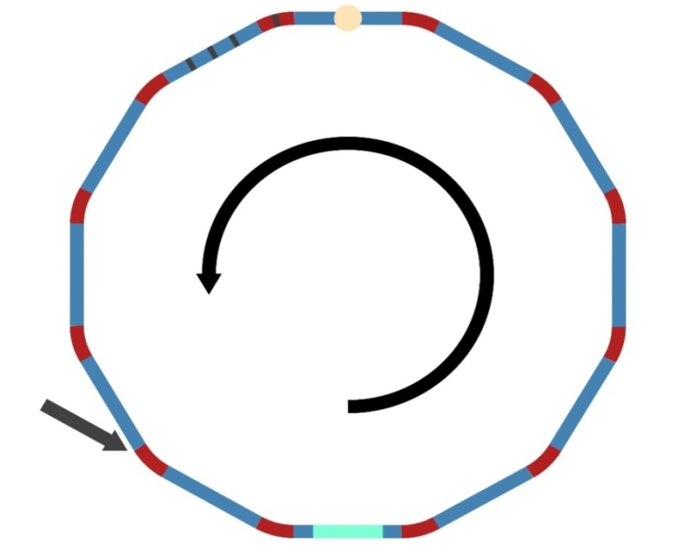
High-precision decay-probability measurements at CRYRING
Fission-fragment
detectors (solar cells)
Target-like
detectors
Dipole
Beam: 10⁷-10⁸ stored
²³⁸U⁹²⁺ at 10 A MeV
20°
Dipole
Gas-jet
Target D₂ 10¹³/cm²
Beam cooling & ultra-thin gas-jet target →Excellent energy and position resolution of the beam, negligible straggling effects
Pure targets, pure beams, (no windows, no contaminants)
Simultaneous measurement of fission, γ- and n-emission probabilities of many short-lived nuclei
E* resolution ~200 keV
Nearly 100% detection efficiency for all reaction products
ONLY POSSIBLE AT GSI/FAIR!!
Unreacted
beam
Beam
10 A MeV
Detector for
beam-like nuclei
Injection

Slide 22
High-precision nuclear fission studies with SOFIA
L. Audouin, IPNO

Slide 23
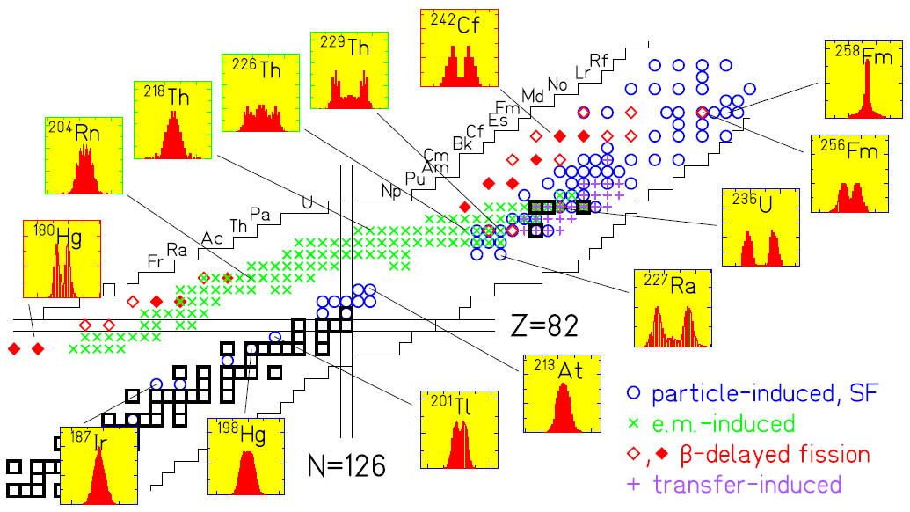
The big puzzle of fission fragment yields
Asymmetric fission in the U-Pu region
Explained (recently!) by deformed (octupole) shell effects (Z~54)
Scamps & Simenel, Nature 564 (2018) 382
Transition from asymmetric to symmetric fission in the Ra-Th region
New asymmetric region around 180Hg!
Lack of high-precision data in trans-uranium region
Completely unexplored region of neutron-rich pre-actinides
SOFIA has contributed
and will significantly
contribute to
understand the
complexity of
fission-fragment yields!
Notes:
This chart of nuclei represents the fissioning nuclei that have been investigated up to now with different reactions to induced fission. In the yellow panels we see in red some selected fission-fragment distributions, representing the probability of having a fission fragment of a given mass or charge. We can see that, as you may know, in the actinide region nuclei fission asymmetrically with one light and one heavy fragment. In this region, it is observed since many years that heavy fragments have a mean charge Z=54, for all fissioning nuclei. The explanation for this has been given only recently in the Nature article as being due to deformed shell effects that appear when calculations include octupole deformation. Still, the region of U-Pu lacks sufficiently accurate data required for applications. But the shapes of the distributions change when we move to other regions. We can see that when moving along the Th isotopic chain the distribution goes from asymmetric to symmetric (with two fragments of similar size). There is a region then of symmetric fission, but when we go to very neutron deficient Hg isotopes the distribution becomes asymmetric again, this was discovered recently, in 2010. You can see that the region of 180Hg is largely unexplored, as well as the region of neutron-rich pre-actinides. SOFIA@GSI is a project that measures FF yields in Z and A with high precision and has already contributed to provide precious data on the fission of some actinides like 238,236U, and also in the Th region. SOFIA is very well suited to investigate the unexplored regions and has already contributed and will significantly contribute to understand the complexity of fission yields. Because we do not have yet a complete picture that explains all these features.

Slide 24
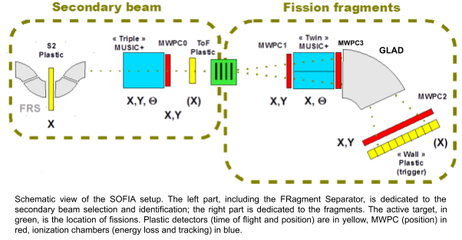
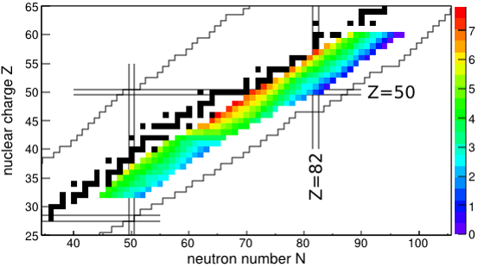
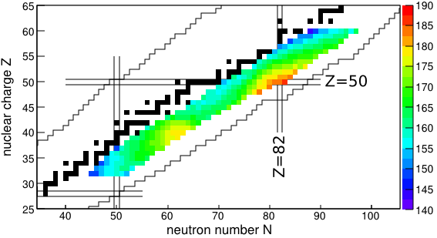
SOFIA@GSI/FAIR : a unique tool for fission studies
Strengths :
Unique range of secondary beams (ms isotopes)
Excellent selection and definition of the secondary beam (FRS)
High fission efficiency due to extreme forward-focusing + large GLAD acceptance
Identification (A, Z) of both fission fragments (ΔE-Bρ-ToF technique)
Unprecedented Z resolution and excellent precision in A (tailored detectors + high kinetic energy)
Event-by-event determination of the emitted neutron number
Precise total kinetic energy measurement
Experiment accepted to explore the 180Hg region in 2020!
Total n multip.
(Z,N) id matrix
Total kinetic energy
A. Chatillon et al. Phys. Rev. C 99 (2019) 054628
E. Pellereau et al. Phys. Rev. C 95 (2017) 054603
Notes:
Here we see the latest version of the SOFIA set-up, which is located downstream the FRS (or in the future the S-FRS). It consists of an active target where fission of a large range of secondary beams separated by the FRS is induced by Coulomb excitation. Thanks to the high kinetic E of the beam and the large acceptance of the GLAD magnet, it is possible to detect both fission fragments. The identification in mass and charge is done by measuring the E loss, magnetic rigidity and the TOF of both fission fragments. The outstanding quality of the results is shown here in this ID matrix where you can see the unprecedented resolution in Z, the horizontal lines are different Zs and are fully separated. The resolution in A or in neutron number is also excellent. This has been possible thanks to the high kinetic energy and the tailored detectors. It has also been possible to determine with high precision other fission observables the total neutron multip (for the first time measured event-by event) and the kinetic energies of the fragments. SOFIA is particularly well adapted to explore the 180Hg region, the experiment has been accepted and will take place in 2020. This project requests some funding for an upgrade of the position detectors (MWPC).

Slide 25
High-resolution Laser spectroscopy of super-heavy nuclei
N. Lecesne, GANIL

Slide 26
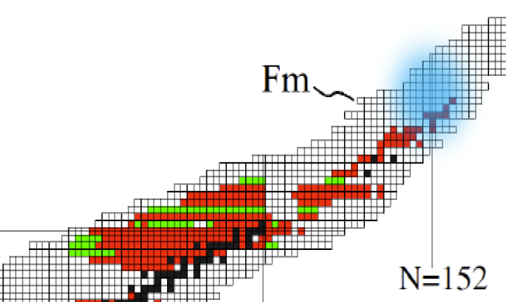
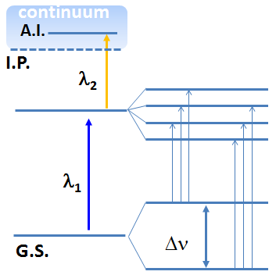
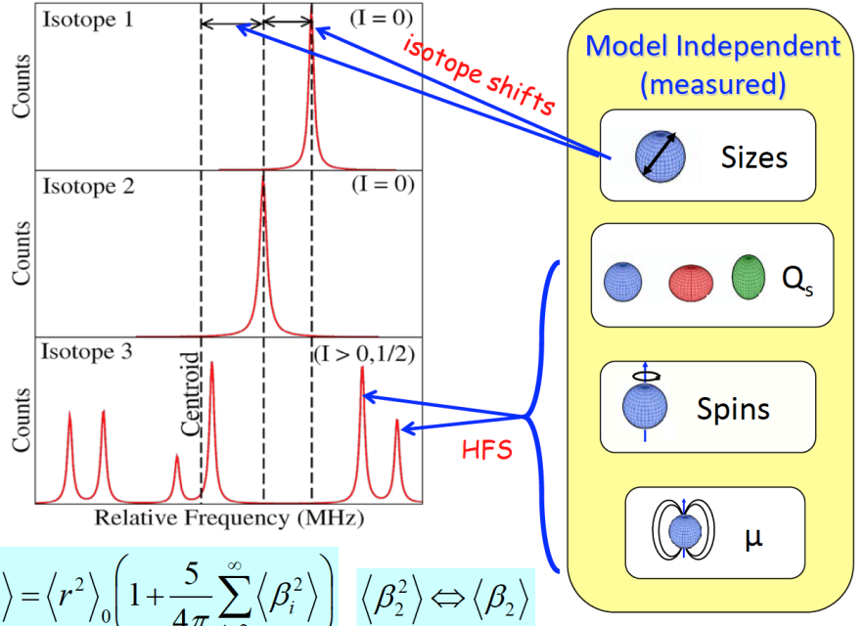
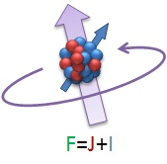
High resolution laser spectroscopy of super heavy nuclei
North-eastern limit of existence?
How do the magic numbers evolve?
Is there an island of stability?
Make use of the atomic structure of transfermium elements (Z>100) to infer nuclear properties of the heaviest elements (spin, moments, sizes and shapes)
Blaum K., Dilling J., Nörtershäuser W. Phys. Scr. T152 (2013) 014017
Resonant Ionisation Laser Spectroscopy
Isotope shifts: Change in the mean-square charge radii between the two isotopes
Hyperfine structure:
Nuclear spins and moments
Model independent!
Hyperfine structure due to coupling of e⁻ orbitals with nucleus
Courtesy I. Moore
Notes:
Quantum shell effects are responsible for the existence of super-heavy nuclei, increasing the fission barrier and making them more resistant against fission. The fundamental question what are the heaviest nuclei that can be produced remains to be answer. In addition, models predict the existence of an island of stability with particularly long half-lifes, but its localisation is not clear. In order for models to answer to these questions, it is necessary to investigate the nuclear properties (spins, moments, sizes and shapes) of nuclei in this region to constrain models. The present project will make use of the atomic structure of super-heavy nuclei to obtain this information. As we have said in the introduction, the hyperfine structure of the electron orbitals is a unique finger print of the nucleus, it even differs for different isotopes and isomeric states. Laser spectroscopy techniques are based on the interaction of laser beams with the atomic electrons, one scans the frequency of the laser beam until resonant excitation of the atomic electrons is induced. From the distance of the resonances of different isotopes one obtains information on the size, and from the patern of hyperfine resonances one obtains model independent information on the shape, magnetic moments and spin.

Slide 27
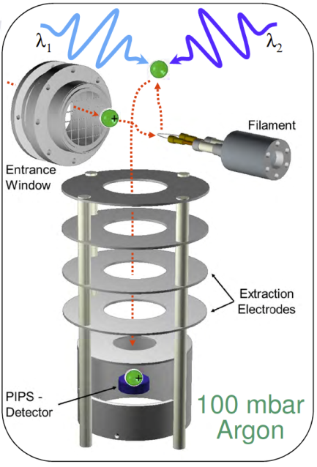
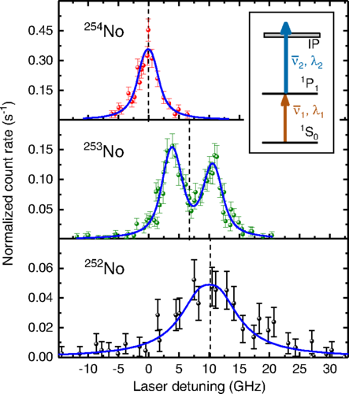
Laser spectroscopy of super heavy nuclei at SHIP
Very challenging!
Very low production cross sections and lack of knowledge on optical transitions
RADRIS (Radiation Detected Resonant Ionization Spectroscopy)
M. Laatiaoui et al.,
Nature (London) 538, 495 (2016)
P. Chhetri et al.,
PRL 120, 263003 (2018)
S. Raeder et al.,
PRL 120, 263003 (2018)
7 years were necessary to find the 1st No(Z=102) gs transition experimentally !
Perspectives:
New set-up, in-gas-jet resonance ionisation spectroscopy
Improved resolution
Experiments foreseen to study more
exotic No isotopes and Lr (Z=103)
New laser system 10kHz required
Preparatory phase for S³LEB at SPIRAL2
Notes:
Laser spectroscopy of superheavy nuclei is very challenging because these nuclei are very difficult to produce and there is a great lack of information on the atomic level structure of these nuclei. This explains why it took 7 years to be able to perform laser spectroscopy on No isotopes. The RADIS set-up was used. The separated fusion-evaporation products are stopped in a gas cell, neutralised in a filament, released and ionised by the lasers. The photo-ions are then guided by electric fields towards a particle detector where the ion is detected via its radioactive decay. A new setup is currently being built, the concept is similar to the RADIS setup except that the neutral atoms leave the cell
through the nozzle and laser spectroscopy is performed by resonant ionization in the low density and low-temperature gas jet, significantly increasing the resolution. This new set-up will be used to further study No isotopes and heavier elements like Lr. The present project requests financial support to provide a new 10kHz pump laser. A similar system will be built for S3 at Spiral2.

Slide 28
Conclusions
GSI/FAIR offers unrivaled conditions (intensity, energy, variety, quality & detection) for experiments with radioactive beams
Six projects from IN2P3 researchers to be conducted between 2020-2024, within FAIR-Phase0
The physics covered is included in NUSTAR, one of the four pillars of GSI/FAIR
Our projects will contribute to answer relevant open questions on pairing correlations, evolution of shell structure, onset of deformation and collectivity, nuclear fission and the structure of super heavy nuclei
GSI/FAIR is currently the only facility where the proposed experiments can be performed
Most of the projects open bright perspectives for future measurements at FAIR after Phase-0

Slide 29
Back-up slides
FAIR

Slide 30
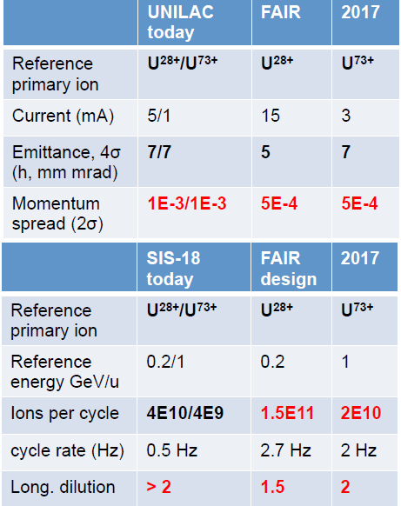
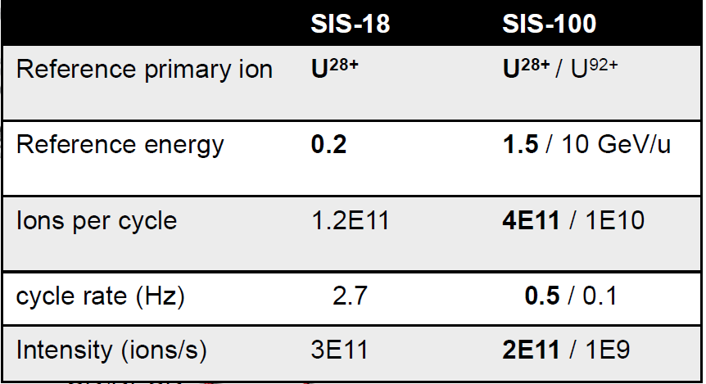
GSI/FAIR expected intensities
Today= 2015

Slide 31
Back-up slides
O. Sorlin

Slide 32
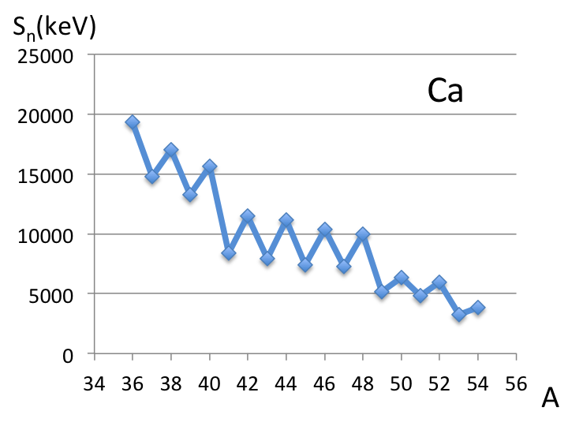
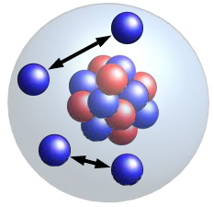
Physics case: Signs of superfluidity and their evolution towards the drip line
Pairing correlations play essential role in atomic nuclei and in neutron stars (NS)
- oscillations in S_{n} values
- g.s. spin 0⁺ of even-even nuclei
- Moment of inertia << rigid value
- Enhanced pair transfer
- cooling of NS, glitches
Evolution of pairing scheme towards drip-line, from BCS to BEC ? (e.g. Hagino et al. PRL99 (2007))
Few information available
-> Study of n-n correlations in various systems
-> Evolution with binding energy ?
-> Determine average distance r_{nn} between neutrons
-> Amount of sequential / direct decay
BCS pairing
Enhanced BEC pairing ?
ρ(r)
ρ(r)
Drip line
r_{nn}
skin
r_{nn}
5
3
4
5
5
1
1
1
1
2
2
2
4
3
4
3
6
6
6
r (fm)
r (fm)
r (fm)
Possible existence of a narrow 4n resonance (e.g. Marquès, Shimura)
4n correlations could play a role in describing the nuclear superfluidity
-> Role not yet revealed or studied in atomic nuclei

Slide 33
Previous work: Experimental method to study neutron correlations (in ¹⁸C)
¹⁸C ≈ ¹⁴C core +4n valence neutrons
¹⁹N
¹⁹N (-1p) ¹⁸C* -> ¹⁶C+2n
p_{n1}
FSI
p_{n2}
Ed ≤ 14 MeV
High energy proton knock-out reaction (p,2p) at GSI (400A.MeV) -> quasi-free mechanism
Deeply bound proton orbitals -> energy piston to promote neutrons into the continuum
Sudden approximation -> neutron correlations weakly affected by proton knock-out
Deduce information on the n-n correlations from their observed decay patterns

Slide 34
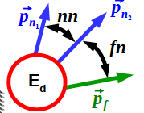
Results: Study of n-n correlations in ¹⁸C and ²⁰O at R3B
m²_{nn}
q
m²
C_{nn}
0< <14
MeV
¹⁸C :Most correlated system
ever observed- > Why ?
q_{nn}
n
n
¹⁶C
¹⁸O
C isotopes
Largest cross section
for the ¹⁴C + 4n channel
-> 4n correlations can be
investigated in the future
¹⁹N
²¹O

Slide 35
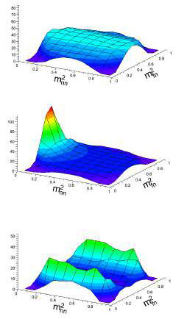
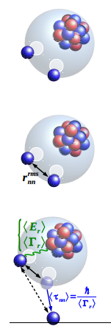
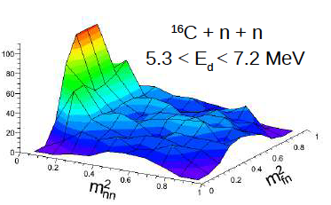
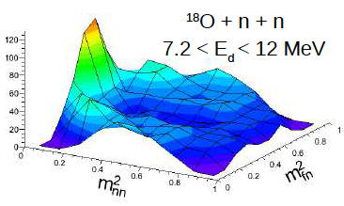
Results: Dalitz plots and n-n correlations in ¹⁸C and ²⁰O (core + 4n systems)
Phase space
A. Revel et al Phys. Rev. Lett. 112 (2018)
Direct decay
r_{nn}≈ 4 fm
85% direct
Sequential decay
r_{nn}≈ 4 fm
50 % direct

Slide 36
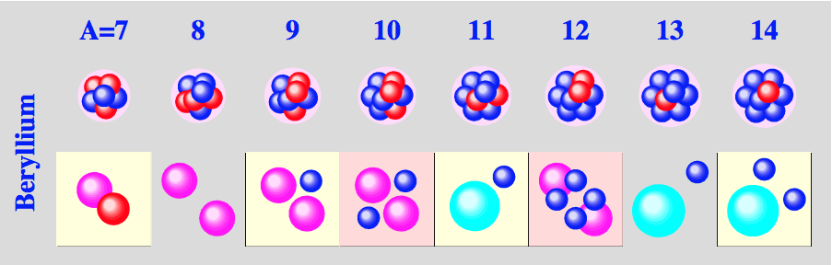
Summary of results from the previous experiment
Two-neutron correlations in the ¹⁸C, ²⁰O isotones
(A. Revel et al. Phys. Rev. Lett . 120, 152504 (2018)
Study of pn interaction at the drip line
Study of the multi-facets ¹²Be nucleus
2⁺₃
3949
3/2⁻
3867
2⁺
3887
5/2⁻
3410
3/2⁺
2690
3/2⁻
1778
5/2⁺
2⁺₂
10%
70%
320
1/2⁻
3170
20%
1/2⁺
¹⁰Be+2n
2702
1⁻
¹¹Be+n
2240
0⁺
2102
2⁺
M. Vandebrouck, A. Lepailleur et al., Phys. Rev. C 96, 054305 (2017)
0⁺
A. Kamenyero (PhD en cours)
¹²Be
As one experiment produces a cocktail of nuclei and many reactions, it leads to several PhD thesis
(3 from IN2P3 on different topics, in addition to other PHD from the collaboration)
At least two more results to be published on mirror symmetry in ¹⁵C - ¹⁵O and the influence of the
coupling to continuum in ¹⁴B

Slide 37
Study of 2n and 4n correlations in atomic nuclei at FAIR/GSI
Planned studies 2020 (core+4n, haloes, drip-line)
Program:
Use of quasi-free proton knockout mechanism to promote 1n, 2n or 4n in the continuum
Spectroscopy of drip-line nuclei with excellent energy resolution -> shell evolution
Study of 2n or 4n correlations as a function of nuclear structure and the proximity of the drip line
-> Evolution of nuclear superfluidity
-1n
¹⁷B
¹⁴Be
unbound
-1p
¹¹Li
Means:
Study of all step of the reaction with full kinematics
for ions and neutrons
Very good (neutron) energy resolution (NEULAND)
Highest efficiency worldwide
Good γ energy resolution and efficiency (CALIFA)

Slide 38
Type | 2020 | 2021 | 2022 | 2023 | 2024 | total
NeuLAND double planes or Califa detectors | 30 ⁽¹⁾ | 30 | 30 | 30 | 30 | 150 k€
Travel (k€) | 3 ⁽²⁾ +1.5 ⁽³⁾ | 2.5 ⁽³⁺⁴⁾ | 2.5 ⁽³⁺⁴⁾ | 2.5 ⁽³⁺⁴⁾ | 2.5 ⁽²⁾ | 14.5 k€
PhD (k€) |  | 40 | 40 | 40 |  | 120 k€
Senior with student | 1 | 1 | 1 | 1 | 1 | 5 k€
Total (k€) | 35.5 | 73.5 | 73.5 | 73.5 | 33.5 | 289.5 k€
⁽¹⁾ Yearly contribution to buy 1 double plane of NeuLAND or two ring of CALIFA array in 5 years.
⁽²⁾ For running our accepted experiment supposed to be scheduled in 2020.
⁽³⁾ For 2 yearly R3B collaborations (6 people in total)
⁽⁴⁾ For the participation of the IN2P3 researchers to other experiments of the collaboration
Human resources | 2020 | 2021 | 2022 | 2023 | 2024 | total
Researchers (2 GANIL+ 3 IPNO + 1 LPC) spokesperson | 0.8 0.3 | 0.2 0.2 | 0.2 0.2 | 0.8 0.3 | 0.2 0.2 | 2.2 1.2
PhD | 0.9 | 0.9 | 0.9 | 0.9 | 0.9 | 4.5
Total | 2 | 1.3 | 1.3 | 2 | 1.3 | 8.9
Estimated counted time are for running experiments, attending R3B meeting, participating to tests
or other experimental programs. It is assumed that another proposal will be deposited in the
period (2021), with another experiment running in 2023. As for student’s work, the time includes
data analysis as well.

Slide 39
SWOT analysis
SCIENCE / HUMAN RESOURCES
strength
weakness
Full kinemtics of the reaction, The best existing neutron detector array
Not yet involved in technical development and tests. Modest knowhow on detectors / electronics / mechanics
Many students in different countries can share analysis
Large european community involved in R3B
French physicists involved in the program already involved in other facilities
Big investment from CEA (magnet + cryogenic target)
Unequal engagment in terms of budget and physicists ifrom France as compared to ther countries
Different scientif topics to be carried out with this beam line (incl. Fission)
Cross fertilize exchanges between different communities
Competition with RIKEN:
-> need to better define the contours of each scientific programs.
Super FRS in 2023
opportunity
threat

Slide 40
2-proton radioactivity @ GSI/FAIR
Additional slides
J. Giovinazzo
CS-IN2P3 – june 2019
GSI / FAIR – 2-proton radioactivity

Slide 41
2-proton radioactivity – main exp. results
1996 ⁴⁵Fe observation GSI PRL 77, B. Blank et al.
2000 ⁴⁸Ni observation GANIL PRL 84, B. Blank et al.
2002 2P radioactivity (indirect) of ⁴⁵Fe GANIL PRL 89, J. Giovinazzo et al.
2002 2P radioactivity (indirect) of ⁴⁵Fe GSI EPJA 14, M. Pfützner et al.
2005 observation and 2P (indirect) of ⁵⁴Zn GANIL PRL 94, B. Blank et al.
2007 direct obs. of ⁴⁵Fe 2P decay GANIL PRL 99, J. Giovinazzo et al.
2007 angular correl. in ⁴⁵Fe 2P decay NSCL PRL 99, K. Miernik et al.
2011 direct obs. of ⁵⁴Zn 2P decay GANIL PRL 107, P. Ascher et al.
2011 direct obs. of ⁴⁸Ni 2P decay NSCL PRC 83, M. Pomorski et al.
2016 ⁶⁷Kr observation RIKEN PRC 93, B. Blank et al.
2016 2P radioactivity (indirect) of ⁶⁷Kr RIKEN PRL 117, T. Goigoux et al.
IN2P3 / CENBG not involved
IN2P3 / CENBG involved
IN2P3 / CENBG leading
CS-IN2P3 – june 2019
GSI / FAIR – 2-proton radioactivity

Slide 42
2-proton radioactivity @ GSI/FAIR – SWOT analysis
positive
negative
strengths
• known exp. techniques
- standard impl./decay technique
- ACTAR TPC tested
• very limited investment
• strong visibility of IN2P3
weaknesses
• manpower for analysis
(PhD funding…)
internal
opportunities
• unprecedented prod. rates
• join NUSTAR collaboration
threats
• beam time / accepted exp.
• beam availability
external
CS-IN2P3 – june 2019
GSI / FAIR – 2-proton radioactivity

Slide 43

2-proton radioactivity @ GSI/FAIR – timeline
2019
2020
2021
2022
2023
2024
2025
GANIL prog. (⁴⁸Ni/⁵⁴Zn correl./ACTAR TPC)
RIKEN prog. (⁶⁷Kr correl./ACTAR TPC)
join NUSTAR collab., prepare proposals
(travel)
new candidates exp.
(travel, PhD…)
FRS
Super-FRS
correlation exp.
(travel, PhD, engineers, setup adaptation…)
CS-IN2P3 – june 2019
GSI / FAIR – 2-proton radioactivity

Slide 44
Backup gSPEC

Slide 45
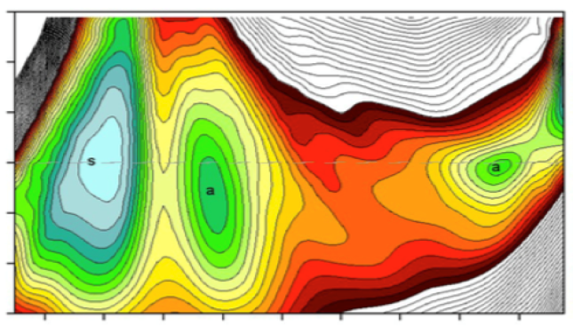
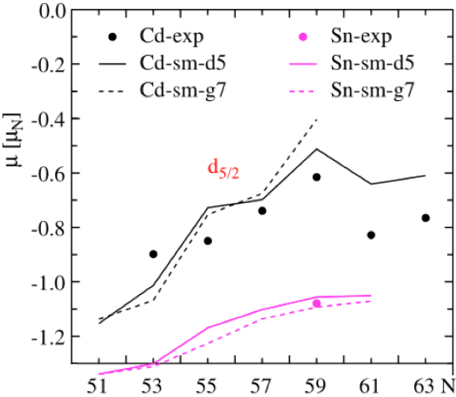
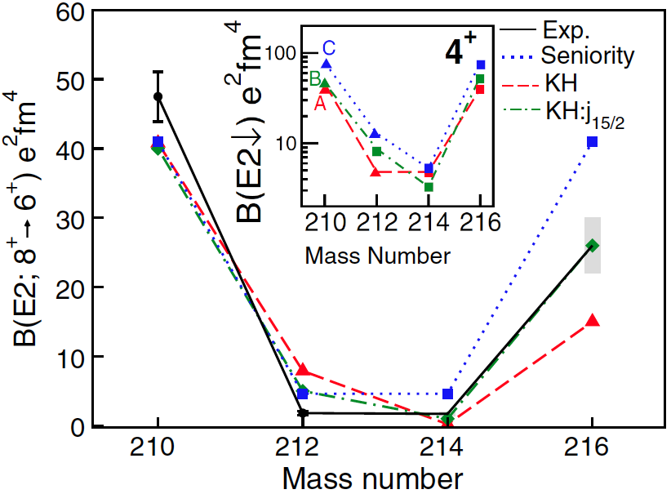
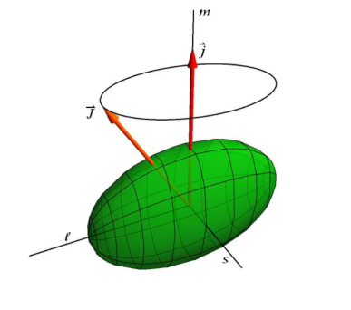
gSPEC@FAIR
Scientific motivation
Unknown g factors for excited isomeric states : unknown configuration
g factor : the dimensionless magnetic moment, M1 operator
measure of the valence nucleon configuration
single-particle excitations, orbital evolution, development of collectivity and deformation
g factors of shape isomers
²⁰⁸Pb region (Po-Rn)
=> deformation/shapes
Campaign@FAIR-0
PRL 78, 2920 (97)
Isomers in ¹⁰⁰Sn region => πν interaction, pairing
core polarization from g
18 collaboration LoIs @gSPEC workshop 2018
g factors of yrast isomers
²⁰⁸Pb region or ¹³²Sn region
=> tensor interaction, 3body
K-isomers (La-Nd) => g configuration
PRC 98, 011303(R) (18)
PRL 109, 162502 (12)
Puzzling g.s.
?Info on e.s.
PRC 99, 014308 (19)
Campaigns@FAIR-1
HI 240, 55 (19) and references therein

Slide 46
Budget gSPEC@FAIR
Type of budget | 2020 | 2021 | 2022 | 2023 | 2024 | Total
Equipment | 120 k€ Detectors (ancillary) + Design magnet | 780 k€ magnet | 50 k€ Detector + Magnet manipulators | - | - | 950 k€
Running costs | 10 k€ | 10 k€ | 10 k€ | 10 k€ | 10 k€ | 50 k€
Travel | 15 k€ | 15 k€ | 15 k€ | 20 k€ | 10 k€ | 75 k€
Personnel | PostDoc (75 k€) | PostDoc (75 k€) | PostDoc (75 k€) PhD (40 k€) | PhD(40 k€) | PhD(40 k€) | 345 k€
Total | 220 k€ | 880 k€ | 190 k€ | 70 k€ | 60 k€ | 1420 k€
Equipment : ~1 M€ (demanded contribution)
Outside this demand :
  HpGe detector R&D and production, electronics, DAQ
  Beam tracking FRS/SuperFRS, electronics, DAQ
  Ancillary gSPEC backend electronics & DAQ
  All supports (table, magnet, HpGe detectors, ancillary detectors)
  All hosts + degraders (for gSPEC)
  Possible 2nd setup chamber+cooling (for gSPEC)
  Possible another encapsulation HpGe (R&D+production for gSPEC)

Slide 47
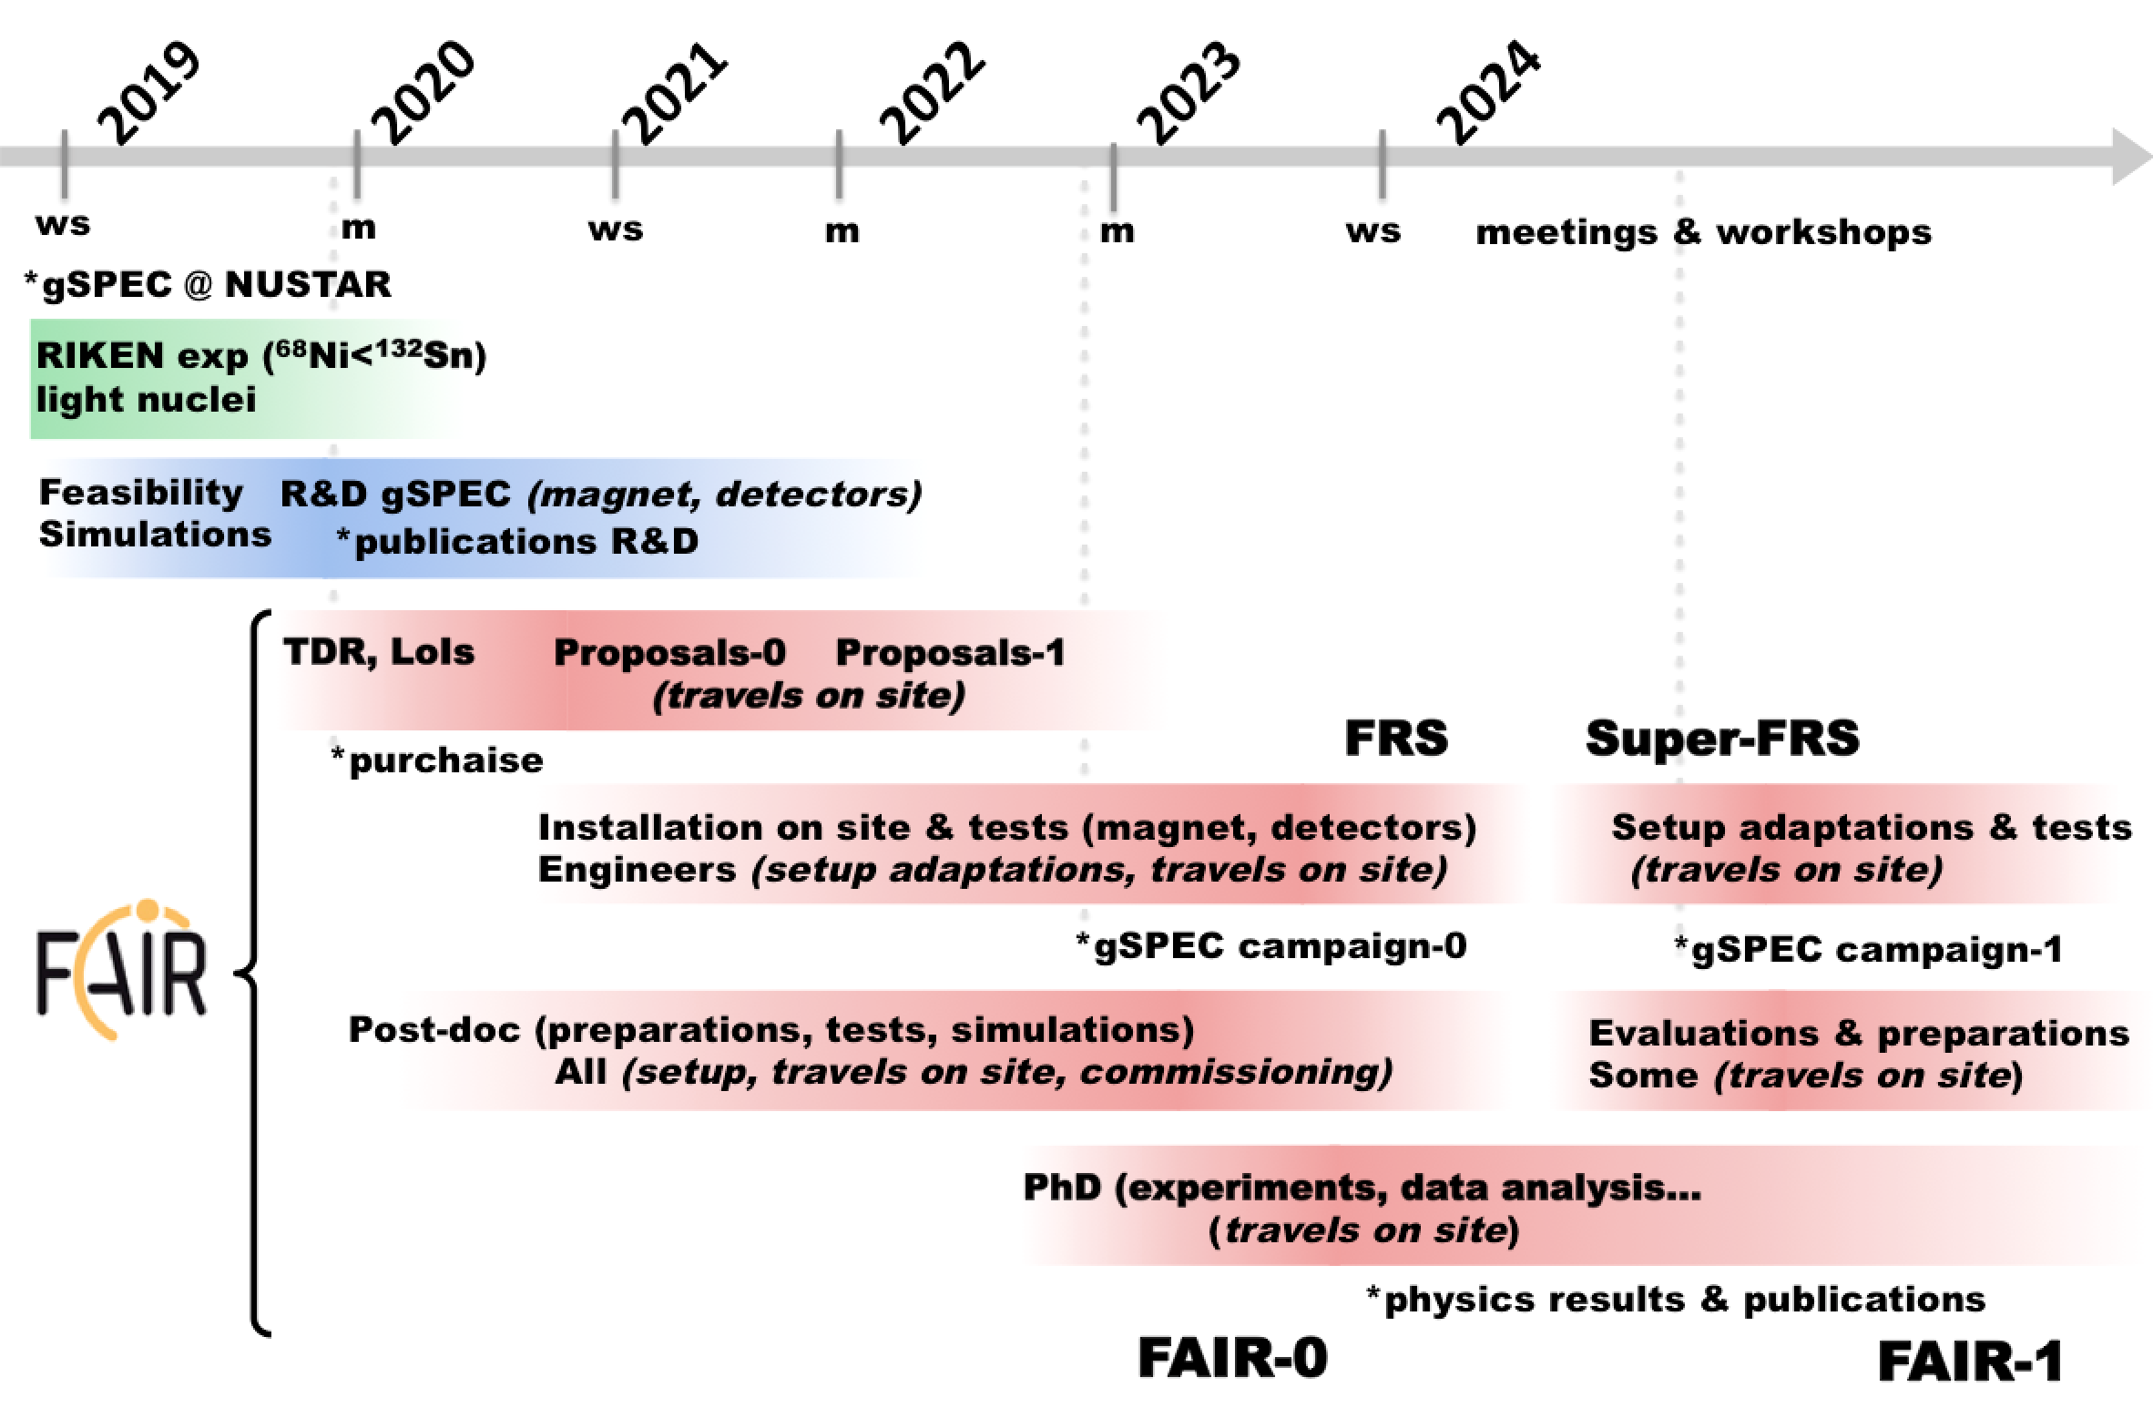
Timeline gSPEC@FAIR

Slide 48
SWOT gSPEC@FAIR
Strengths Develop, build and exploit a state-of-the-art spectrometer for g factors Technical expertise in superconducting magnets, HPGe detectors, electronics and DAQ Expertise in hyperfine interactions International effort Precision spectroscopy of exotic nuclei Discovery potential | Weaknesses International effort Few experts
Opportunities Involvement of a new company Design Study and possible collaboration with University-based magnet Design Study and production New R&D on particle detectors in high magnetic field New encapsulation HpGe in collaboration with partners Exploitation of new techniques Subsequent Q experimental campaigns | Threats Lack of funding and Human Resources Little beam time in the host sites may require relocation

Slide 49
Back-up slides
B. Jurado

Slide 50
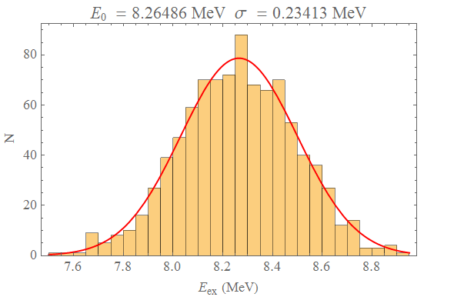
Detailed Geant 4 simulations: excitation-energy resolution
Fission-
fragment
detectors
Target-like
detectors
Dipole
Gas-jet
20°
Dipole
²³⁸U+d→²³⁸U*+d’ @ 11 A MeV
ε_{x}=ε_{y}=0.05 mm⋅mrad σ_{p}/p=2⋅10⁻⁴
Detector segmentation 64x128 ch
Pocket window (25 μm)
Gas-jet radius 0.5 mm
Detector energy resolution 1%
Dispersion at gas-jet 1.5 m
Unreacted
beam
Detectors for
beam-like
nuclei
ΔE*≈200 keV

Slide 51
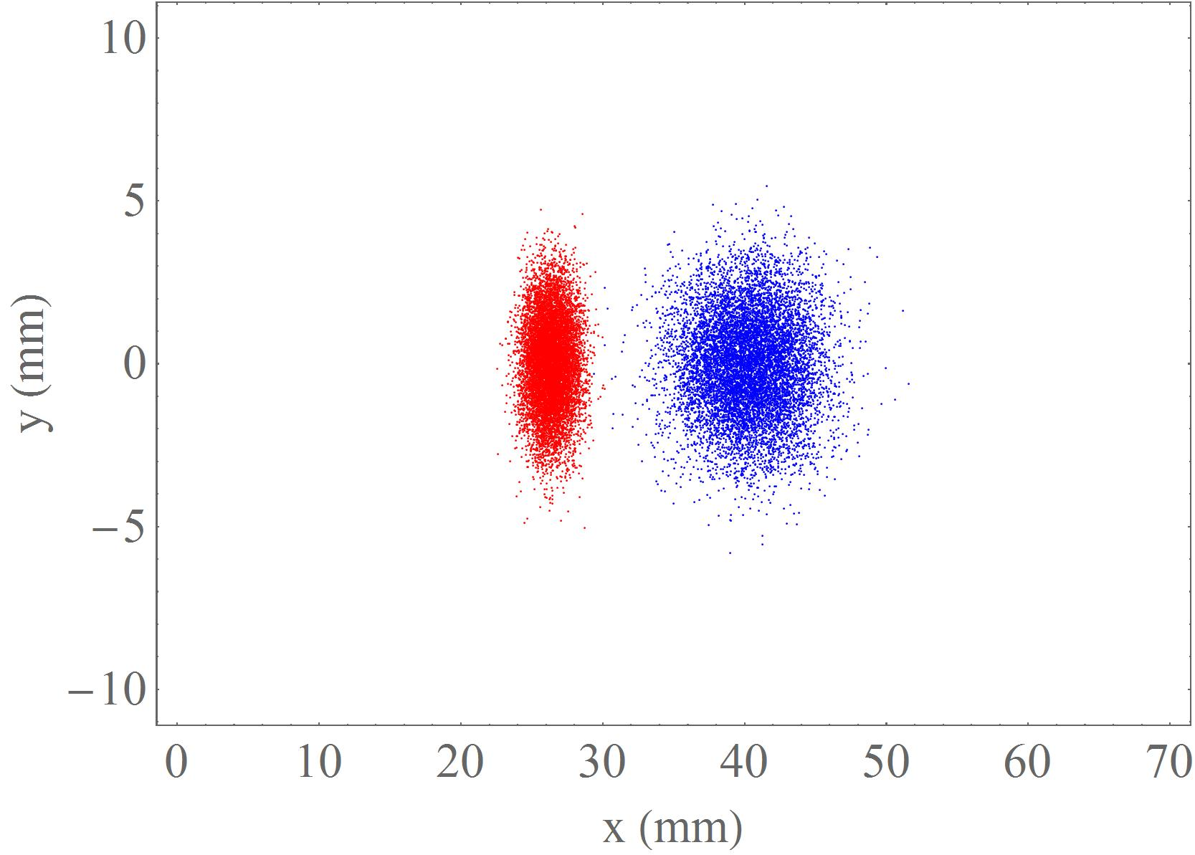
Detailed Geant 4 simulations: separation of beam-like residues
Fission-
fragment
detectors
Target-like
detectors
Dipole
Gas-jet
20°
Dipole
²³⁸U+d→²³⁸U*+d’ @ 14 A MeV
γ emission
neutron
emission
²³⁸U⁹²⁺
²³⁷U⁹²⁺
Full separation and
full transmission:
~100% efficiency!
Unreacted
beam
Detectors for
beam-like
nuclei
100%
97.3%

Slide 52
High-precision decay-probability measurements at CRYRING
positive
negative
Strengths
First time ever simultaneous measurement of fission, gamma- and neutron-emission probabilities with very good E* resolution
High precision in the probabilities due to the absence of target contaminants/windows and the unambiguous separation of the reaction products, which can be detected with very large efficiencies
Cutting-edge technology
Synergy with atomic physics methods
Weaknesses
The detection system has to be compatible with the ultra-high vacuum (UHV) of the ring. This is challenging and we are on the way to acquire the required expertise on UHV technology
internal
Opportunities
Our developments are beneficial for proton
and e- capture cross-section measurements of heavy nuclei at CRYRING
Pioneering work: the study of nuclear reactions at rings is only possible since a few years
Our project can be the seed for a future high-level program on nuclear structure and astrophysics with transfer or inelastic scattering reactions at rings
Our solar-cell studies can be the seed for developing new monitoring methods in RIB facilities
Threats
• Funding necessary to build the set-
up not yet available
• Beam availability
external

Slide 53
Back-up slides
L. Audouin

Slide 54
SOFIA: perspectives and risk/opportunity assessment
Coupling to the CALIFA array:
-> (p,2pf) measurement: study the influence of excitation energy on yields
Coupling to the NeuLAND neutron wall:
-> Neutron assignation for in-depth test of the energy partition
²⁴²Pu primary beam
-> High-precision nuclear data for energy application (yields of ²⁴⁰Pu* !)
(long-term) Super-FRS beams:
-> New range of exotics systems, including neutron-rich nuclei (astrophysical interest)
Successful first experiments
Cutting-edge technologies
IN2P3 contribution: specific and visible
Short, mid and long-term program
Key position of CEA-DAM in the collaboration
Harsh competition for beam time
Lack of physicist manpower on IN2P3 side

Slide 55
Back-up slides
N. Lecesne

Slide 56

High-resolution Laser spectroscopy of super-heavy nuclei
positive
negative
Strengths
Unique set-up and knowhow
High scientific impact and discovery potential
Synergies: atomic physics methods
and nuclear structure studies
Strong visibility of IN2P3
weaknesses
Not yet strongly involved in technical development and tests
(Investment budget…)
Manpower for supporting experiment and
for analysis
(PhD funding…)
internal
opportunities
Complementary access to basic features
of the heaviest nuclei
Set-up the course for future program
at S3 Low Energy Branch
Strengthen IN2P3-NUSTAR collaboration
threats
• Beam time / accepted exp.
• Beam availability
external

Slide 57


Slide 58



In-Cell vs In-Jet Spectroscopy of ²¹⁵Ac
R. Ferrer · IKS Seminar January 13th, 2016 ·
R. Ferrer. et al., Nat. Commun. 8 (2017) 14520
LISOL experiment @ UCL in 2014
8
Notes:
The In-Gas Jet laser spectroscopy has been demonstrated in 2014 in a LISOL experiment in Louvain la Neuve where we compared the in cell laser and in jet laser spectroscopy of Radioactive isotopes of Ac

