Slide 1







expand
“explorations across the neutron dripline” lpc-Caen, irfu/cea-saclay, ipn-orsay tokyo institute of technology, riken nishina center
And the “SAMURAI Collaboration”
NAO – CS-IN2P3 26/06/19

Slide 2
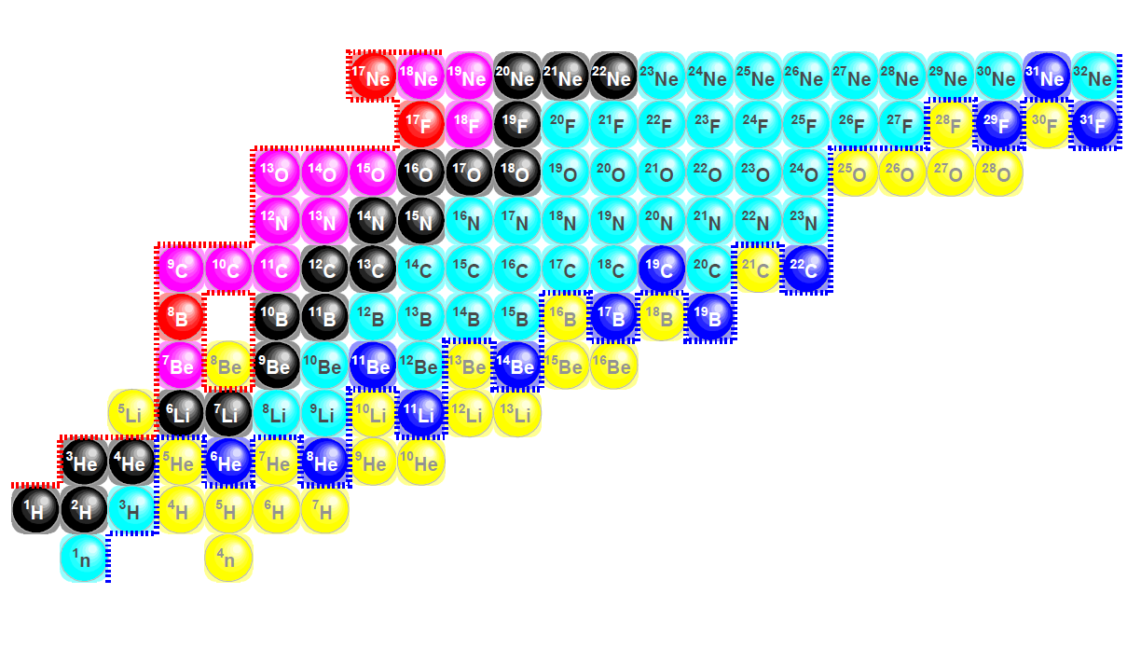
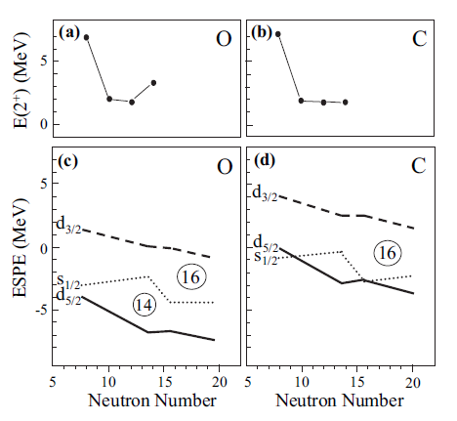
Expand - physics: structure & correlations at and beyond the neutron dripline (A<50)
~
LOI NPAC12 RIBF
Orr, Kondo, Obertelli, Nakamura et al.
EXPAND – Explorations Across the Neutron Dripline

Slide 3
Invariant mass spectroscopy of unbound states / systems …
… nucleon “knockout”, breakup (β ≈ 0.6) + in-flight decay
⇒ fragment – n FSI
V_{f}
RNB
V_{f} - V_{n}
target
f + n
V_{n}
E_{d} = 1 m (v_{f} - v_{n})²
2
NOTE: very thick target (~1 g/cm²) and very forward focussing of reaction products

Slide 4
Samurai + NEBULA @ RIBF-RIKEN …
BigRIPS + ⁴⁸Ca @ 345 MeV/nucleon (~800* pnA) ⇒ “intense” light neutron dripline beams
²²C @ ~60 pps, ³¹Ne @ ~1500 pps …
* “DayOne” 2012 ~80 pnA … 2016/17 ~600 pnA
SAMURAI+NEBULA Commissioning - 2012
EXPAND – Explorations Across the Neutron Dripline

Slide 5
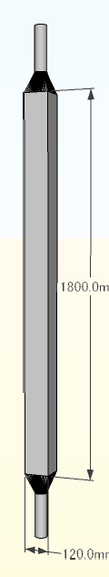
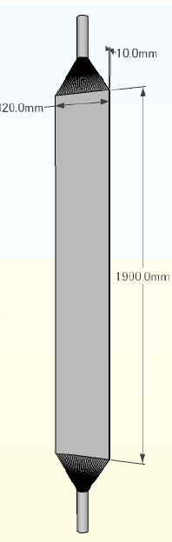
Nebula …
120 modules
2 x 2 layer walls
MODULE
VETO PADDLE
EXPAND – Explorations Across the Neutron Dripline

Slide 6
Nebula detection efficiency @ 200 MeV/nucleon …
Nebula:
120 modules
2 x 2 layer walls
EXPAND – Explorations Across the Neutron Dripline

Slide 7
“Nebula-Plus” …
Upgrade nebula with addition of 90 new modules + electronics + HV
⇒ 4 Walls each of 44 / 46 / 60 / 60 modules
EXPAND – Explorations Across the Neutron Dripline

Slide 8
Nebula-Plus vs Nebula vs Neuland-Nebula detection efficiency
@ 200 MeV/nucleon …
EXPAND – Explorations Across the Neutron Dripline

Slide 9
Nebula-Plus resolution @ 200 MeV/nucleon …
→
Nebula-Plus resolution slightly degraded compared to nebula
owing to shorter distance to new walls.
Neuland+nebula – contribution of superior neuland granularity.
→
EXPAND – Explorations Across the Neutron Dripline

Slide 10
Nebula-plus …
Original goal to double number of nebula modules / walls …
… deemed too costly by ANR.
Resubmission accepted for 90 modules …
However … grant awarded 100 k€ less than requested + $ vs € exchange rate drop + at tendering price scint. modules [st gobain] x1.5
Neuland-type wall(s) investigated: too costly + electronics-daq issue
… demonstrator used (2015-2017) for part of physics programme.
Strategy: acquire 90 scintillator modules (nebula design, including light guides + pmts) & equip as many as possible (60) with readout electronics & hv.
After installation & commissioning upgrade to equip remaining 30 scint. modules –
        supplementary financing required ~60 k€*.
* Essentially owing to increased cost of scintillator modules
EXPAND – Explorations Across the Neutron Dripline

Slide 11
Nebula-plus …
Status & Calender:
scintillator bars (90) + light guides: eljen (usa) – final batch delivered mid-may
pmts : H22184 hamamatsu – 80 delivered (40 tested), remaining 100 by early-sept
acceptance testing of scint. modules cosmic rays + sources (80 tested) – april-aug 2019
faster readout electronics & 180 channel HV system – oct-nov 2019
ship nebula-plus to japan – nov-dec 2019 [VAT~50-60k€]
installation & source + cosmic ray tests – jan-april 2020
commissioning (beam) – may-july 2020 … to be confirmed
first experiment – oct-nov 2020 … to be confirmed
complete readout electronics instrumentation (30 scint. modules) – 2020-21
EXPAND – Explorations Across the Neutron Dripline

Slide 12
Selected highlights physics programme (2012-18) * …
Spectroscopic study of the unbound systems (Z=5 & 6) in the region of N=14-16
Determination of the total interaction cross section of ²²C
First observation of ^{20,21}B (N=15,16)
First observation of ^{24,25}N (N=17, 18) and the spectroscopy of ²³N (N=16)
Investigation of two-neutron unbound system ²⁶O
Search for ^{27,28}O and the investigation of the very neutron rich F isotopes near N=20
[analyses in final stages]
An investigation of the two-neutron unbound system ¹⁶Be [analyses in progress]
A search for the ⁴n system and the investigation of ⁷H [analyses in progress]
Investigation of clustering in the neutron-rich Be isotopes: ^{10,12,14}Be(p,pα) quasi-free knockout
[analyses in progress]
* in2p3 spokespersons/groups played major/key role

Slide 13
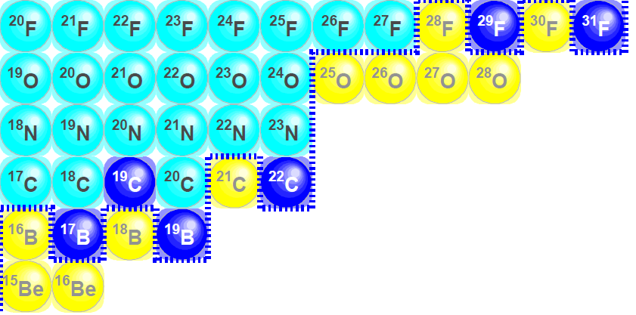
Z=6: Structure in the region of N~14 – 16 (ν2s_{1/2} – ν1d_{5/2}) …
•
•
N=14
16
WBT Shell Model Interaction: M Stanoiu et al., PRC (2008)

Slide 14
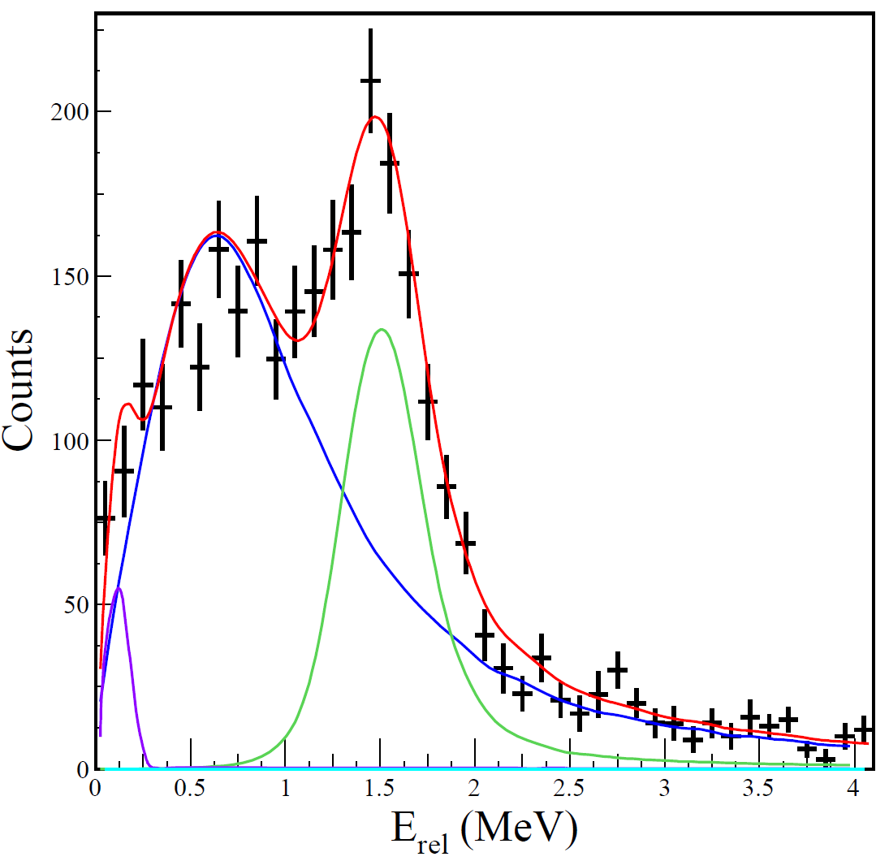
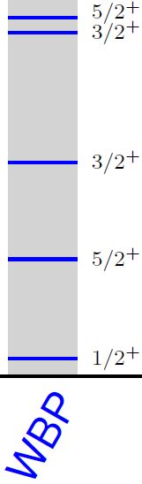

First observation & spectroscopy of ²¹C:
C(²²C,²⁰C+n) @ 245 MeV/nucleon
E_{r}=0.75±0.20 MeV
E_{r}=1.50±0.10 MeV
l=0
l=2
E_{x}
E_{x}
Eikonal + shell model C²S
JA Tostevin
S Leblond et al., NP1106-SAMURAI04

Slide 15
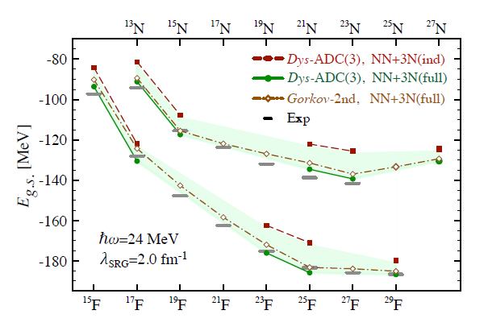
Z=7: Structure in the Region of N~16 …
N=14
16
N=14 16 18 20
Binding E wrt ^{A}O : N isotopes with SCGF - Cipollone et al., PRC (2015)

Slide 16
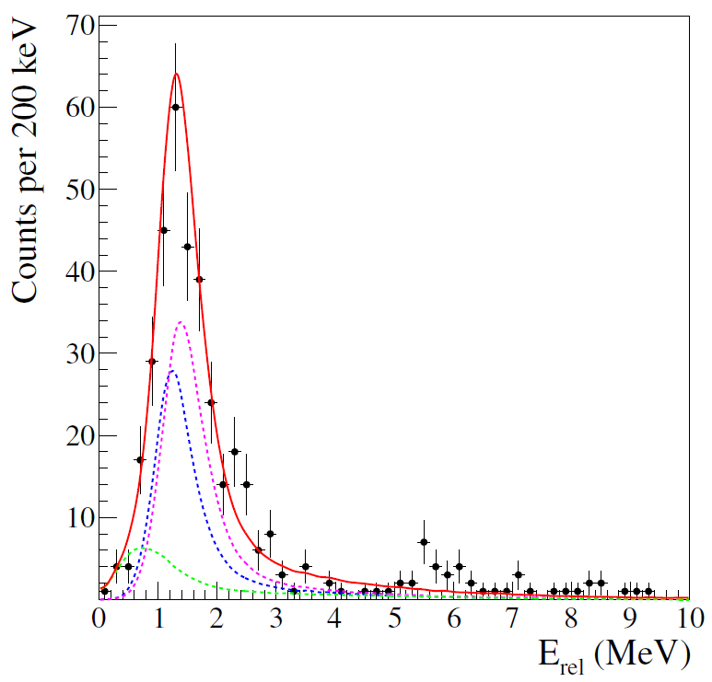
First observation of ²⁴N: C(²⁶F,²³N+n) @ 200 MeV/nucleon …
C
J^{π} = 2⁻,1⁻
π(1p_{1/2})⁻¹ ⊗ ν1d_{3/2} [²⁵O_{gs}]
²⁴N
²⁴N
N=14
16
AME2012: S_{n} (²⁴N) = -2.15±0.58 MeV ##
Q Deshayes et al. NP1106 SAMURAI02

Slide 17
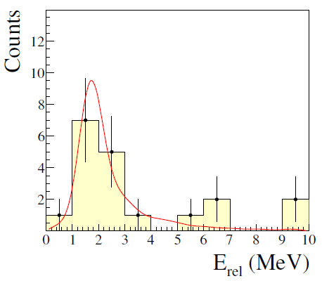
evidence for ²⁵N: C(²⁷F,²³N+n+n) @ 200 MeV/nucleon …
C
J^{π} = 1/2⁻
π(1p_{1/2})⁻¹ ⊗ (ν1d_{3/2})² [²⁶O_{gs}]
²⁴N
²⁴N
²⁵N
²⁵N
N=14
16
AME2016: S_{2n} (²⁵N) = -3.12±0.66 MeV ##
Q Deshayes et al. NP1106 SAMURAI02

Slide 18
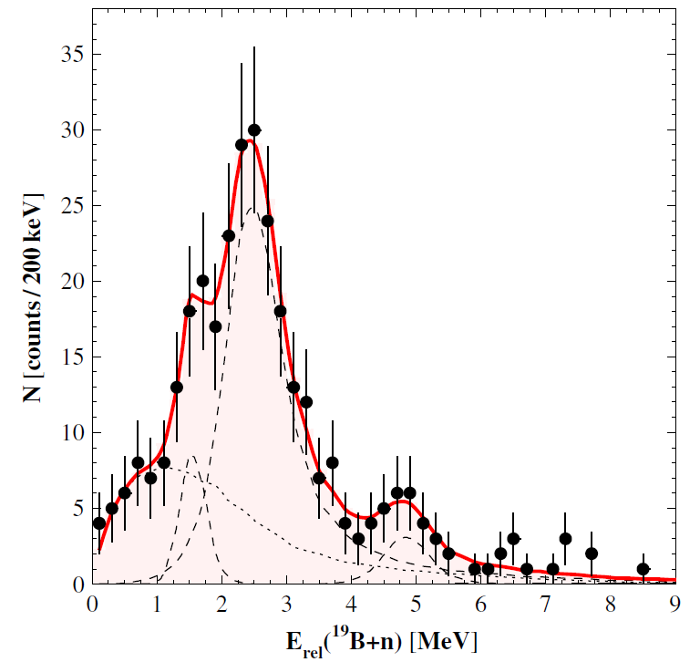
First observation of ²⁰B : C(²²N,¹⁹B+n) @ 230 MeV/nucleon …
C
J^{π} = 1⁻,2⁻
π(1p_{3/2})⁻¹ ⊗ ν1s_{1/2}
²⁰B
N=14
16
AME2016: S_{n} (²⁰B) = -0.61±0.96 MeV ##
S Leblond et al., PRL (2018)

Slide 19
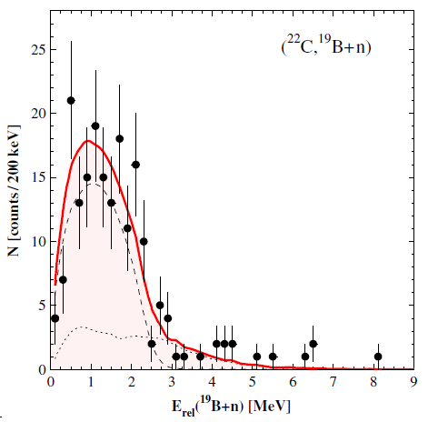
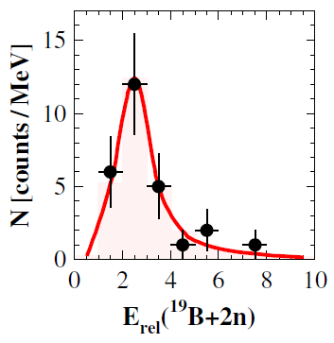
First evidence for ²¹B : C(²²C,¹⁹B+n+n) @ 240 MeV/nucleon …
C
²⁰B
²¹B
Direct two-neutron decay (?)
N=14
16
AME2016: S_{2n} (²¹B) = -1.42±1.04 MeV ##
S Leblond et al., PRL (2018)

Slide 20
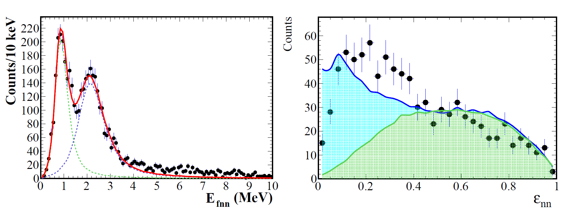
Spectroscopy & neutron-neutron correlations in ¹⁶Be:
H(¹⁷B,¹⁴Be+n+n)2p @ 250 MeV/nucleon
(0⁺)
“Full” calculation
(2⁺)
J Casal et al., PRC (2019)
No n-n interaction
B Monteagudo et al., NP1306 SAMURAI18

Slide 21
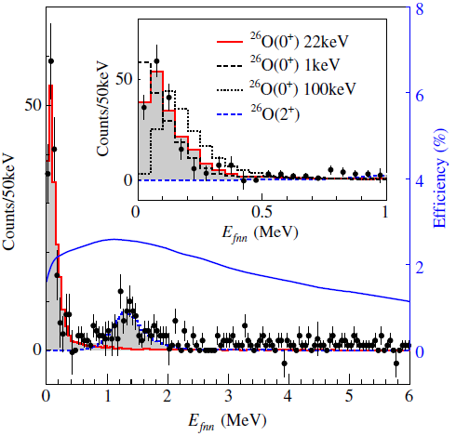
Investigation of ²⁶O: C(²⁷F,²⁴O+n+n) @ 200 MeV/nucleon …
C
N=14
16
Y Kondo et al. PRL (2016)

Slide 22
Physics programme with nebula-plus: near future (2020-23) …
Search for excited (continuum) states of ²²C – 2⁺ (n=16 sub-shell closure)
Investigate two-neutron decay of ²¹B & search for ²¹B* (n=16) & 3-neutron decay of ²⁰B
Search for ²³C (N=17) – possible application of (¹²C,¹²N)
Spectroscopy of ³⁹Mg (N~28)
Projet “Strasse” (~2020-22) …
Improved vertex detection for minos-type
thick liquid H₂ target – (p,xp), …
Si microstip dets for tracking protons
LPC ~150k€ via normandy region
[chaire d’excellence - f flavigny]
EXPAND – Explorations Across the Neutron Dripline

Slide 23
Financal resources (in2p3) …
2012-2018: AP in2p3 ~20k€/year + LIA ~3-6 k€/year - essentially travel (japan)
Increased commitment with nebula-plus & strasse + FTE increase …
request (travel) 2020-2023: AP in2p3 ~30k€/year + LIA ~5 k€/year
request (equipment-electronics nebula-plus) 2020-2021: AP in2p3 15k€/year
matching funds – lpc (under discussion)
Manpower (in2p3) …
2012-2018: ~5-6 FTE^{ǂ} [physicists]
lpc - marian parlog - retired (jan 2018), franck delaunay - sabbatical (2018-19)
in2p3/cnrs funded postdoc - oct 2019 (lpc)
“chaire d’excellence” normandy region – freddy flavigny* (oct 2019)
2020-23: ~6-7 FTE^{ǂ} [physicists] + ~0.2 - 0.5 FTE [IR/IT] in2p3
* Research project: RIBF (Strabe - EXPAND) & GRIT
^{ǂ} Including graduate students
EXPAND – Explorations Across the Neutron Dripline

Slide 24
SWOT Analysis …
Strengths
RIBF’s unequalled secondary beam intensities for light (A<50) neutron-rich beams.
State of the art setup and instrumentation.
Collaboration very experienced in the simulation and analysis of complex experiments, including multi-neutron detection and cross talk analyses.
French collaborators play key role in collaboration – reinforced with NEBULA-Plus.
Weaknesses
Shortfall in ANR funding.
SAMURAI electronics and DAQ not state of the art.
Limited beam time at RIBF (maximum of 4 months/year).
Recent difficulties in procuring 48Ca source material (Nishina Centre/RIBF).
Very limited theory support (France).
Travel funds.
Opportunities
With successful commissioning of NEBULA-Plus the SAMURAI collaboration will be ideally positioned to play a leading role in neutron dripline physics for the next decade.
Improvements possible with the Straβe active target.
Threats
FRIB (>2022) and to a lesser extent FAIR (>2025) – but long lead times in ramping up primary beam power.

Slide 25
Supplementary slides …

Slide 27
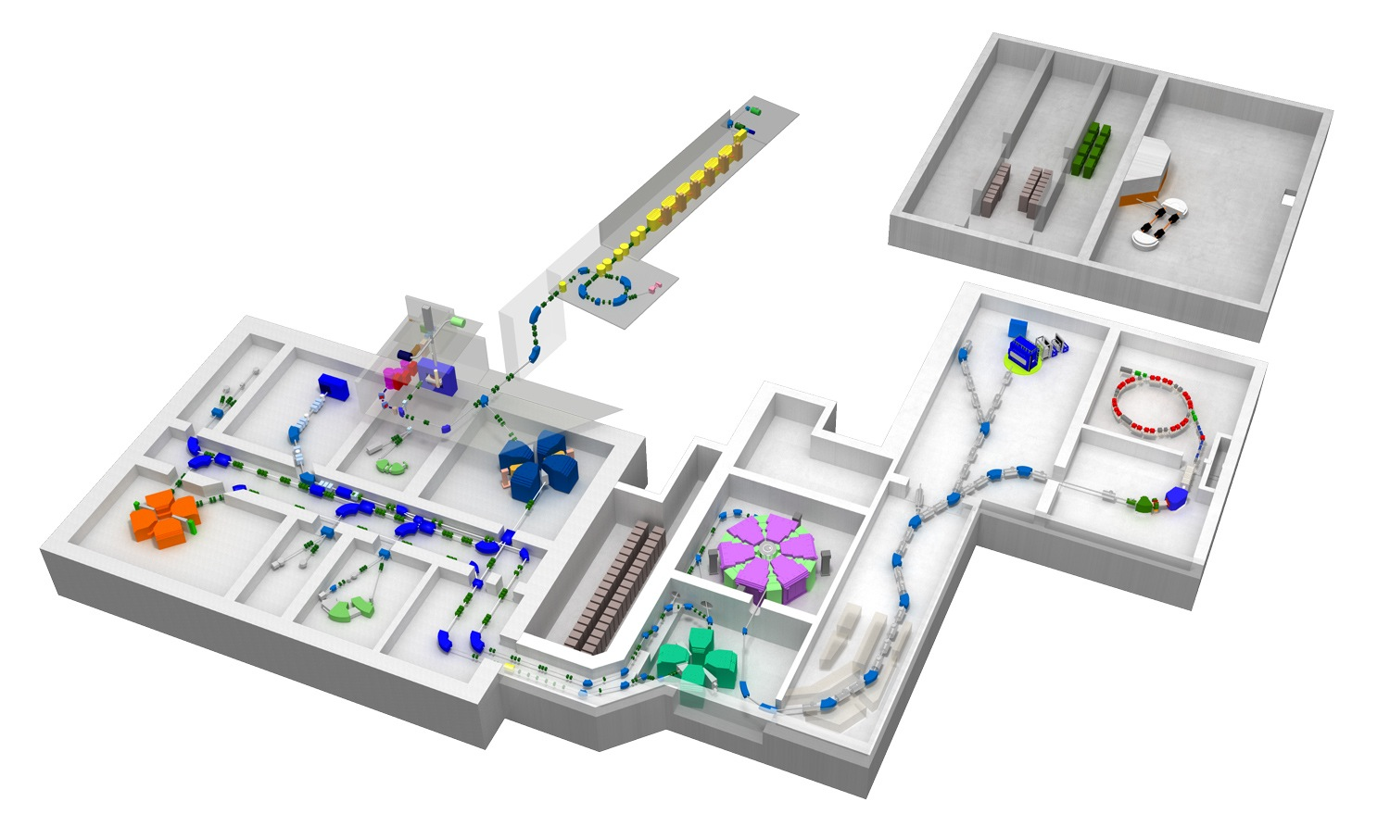
RIBF: Radioactive Isotope Beam Factory (RIKEN) …
ECR
RILAC
CSM
GARIS
SCRIT
RILAC2
SAMURAI
AVF
RIPS
ZDS
Rare RI Ring
RRC
SRC
K2500
SLOWRI
SHARAQ
fRC
KISS
BigRIPS
IRC
Heavy-Ion Beams up to ²³⁸U @ 345 MeV/nucleon (light lons up to 440 MeV/nucleon)
eg. ⁴⁸Ca: ~800pnA (~5x10¹²pps)

Slide 28
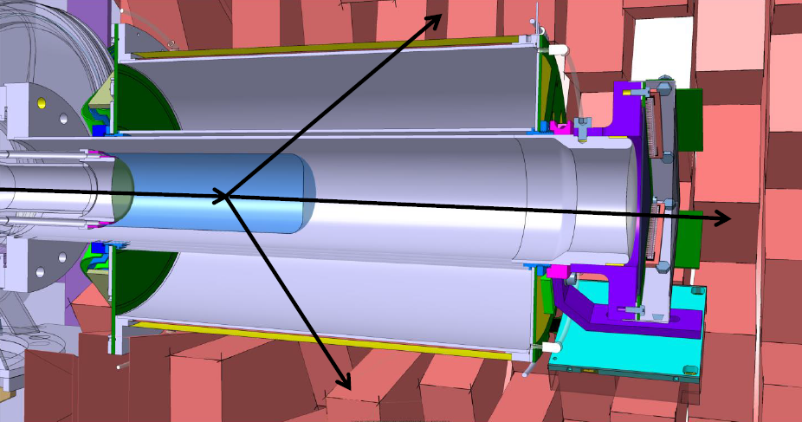
MINOS: liquid H₂ target + vertex detection (p,xp) (p,xn) …
p
p
liquid H₂ ~15cm ⇒ gain in luminosity x5
A Obertelli et al., Eur Phys J A (2014) 50: 8

Slide 29
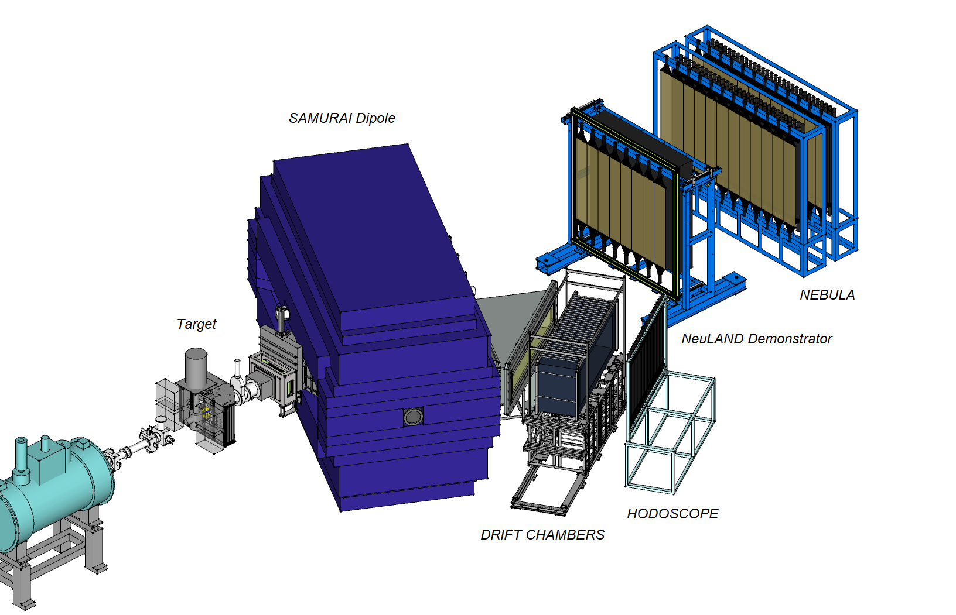
Samurai + NeuLAND+NEBULA @ RIBF-RIKEN (11/2015 – 7/2017) …
Search for ^{27,28}O & spectroscopy of very neutron-rich f-isotopes, investigation of ⁷H
& search for the ⁴n system in the continuum, spectroscopy beyond the dripline N~16, ……
EXPAND – Explorations Across the Neutron Dripline

Slide 30
NeuLAND+NEBULA …
EXPAND – Explorations Across the Neutron Dripline

Slide 31
Nebula vs Neuland+Nebula detection efficiency @ 200 MeV/nucleon …
EXPAND – Explorations Across the Neutron Dripline

Slide 32
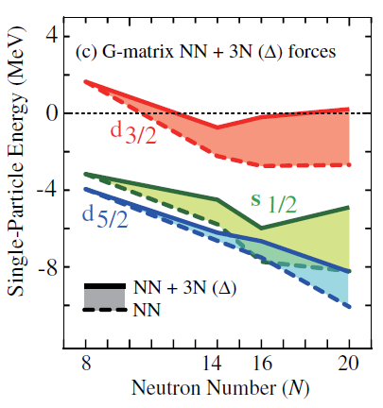
Structure in the region of N~14 – 16 (ν2s1d) …
N=14
16
Z=8
… influence of 3-body forces
ESPE O isotopes - Otsuka et al., PRL (2010)

Slide 33
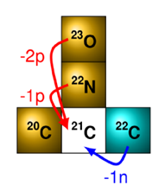
Structure of unbound systems:
high-energy direct reactionS …
Example: ²¹C
Neutron removal *
⇒ halo “hole” states core ⊗ν nlj² → core ⊗ ν nlj
p(core+n) distribution ⇒ l_{n} halo
Proton removal
⇒ projectile valence νnlj unperturbed
[ Δl_{n} ≈ 0 ]
* ~10% of observed yield via 3-body continuum: eg., (²²C,²²C*→ ²⁰C+n+n)

Slide 34
¹⁹C*: C(²⁰C,¹⁸C+n) @ 280 MeV/nucleon …
SAMURAI Collaboration: J Hwang et al., PLB (2017)

Slide 35
¹⁹C: level scheme …
SAMURAI Collaboration: J Hwang et al., PLB (2017)

Slide 36
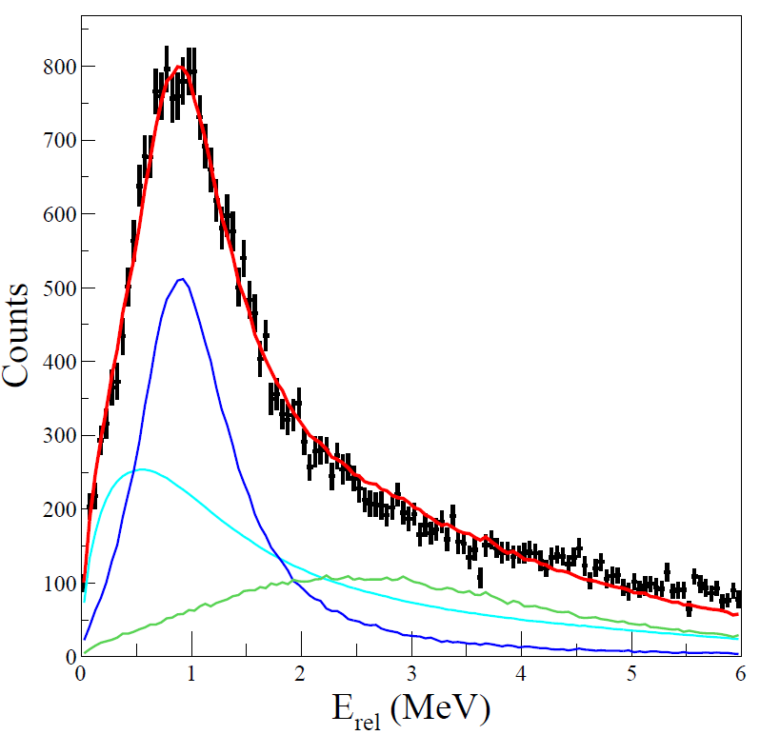
²¹C: C(²²N,²⁰C+n) @ 245 MeV/nucleon …
l=0
l = 0 (R-Matrix) E_{R} =0.90±0.10 MeV; Γ = 0.80 ±0.50 MeV + non resonant continuum
S Leblond et al., NP1106-SAMURAI04

Slide 37
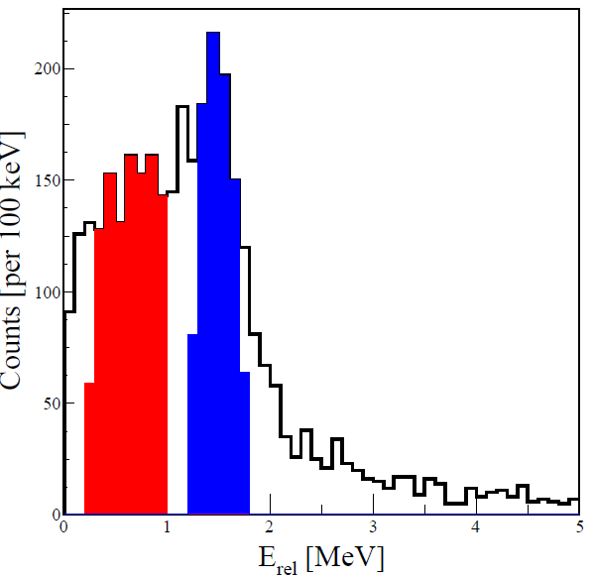
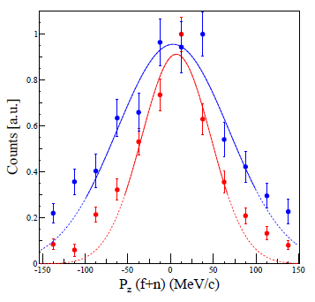
²¹C: C(²²C,²⁰C+n) – ²⁰C+n MOMENTUM DISTRIBUTIONS …
l=2
l=0
S Leblond et al., NP1106-SAMURAI04

Slide 38
²⁵O: structure in the region of N~16-20 …
N=14
16
SAMURAI Collaboration: Y Kondo et al., PRL (2016)

Slide 39
Perspectives: charge-exchange beyond the dripline …
C(²¹N,²⁰C+n)
C(²²C,²⁰C+n)
l=0
l=2
J Gibelin et al (LPC)

Slide 40
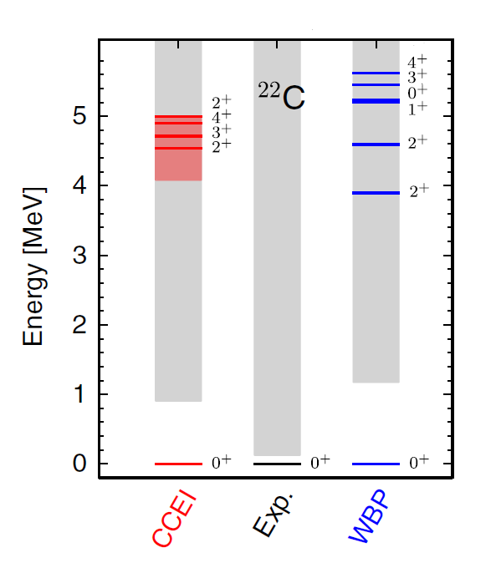
Magicity of N=16 below ²⁴O: ²²C(2⁺) …
N=14
16
WBP Shell Model & Coupled Cluster [ GR Jansen et al., PRL (2014) ]

Slide 41
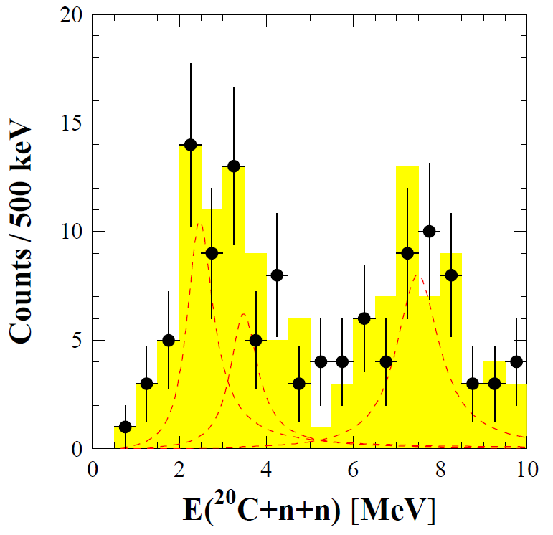
N=16 ²²C(2⁺) : C(²³N,²⁰C+n+n) …
<²³N|²²C>
Shell model- WBP
E_{x} [MeV] J^{π} C²S
0.0 0⁺ 0.86 [Bound]
3.9 2⁺ 0.22
4.6 2⁺ 0.51
8.0 2⁺ 1.4
9.6 1⁺ 0.85
J Gibelin et al., NP1106-SAMURAI04

