Slide 1

AGATA – phase 2
Prepared by the AGATA-France community (in2p3,GANIL,CEA)

Slide 2
Outline
Nuclear science & γ-ray emission
AGATA
Organisation, Milestones & achievements
Phase 2: upgrade of AGATA to a 4π array

Slide 3
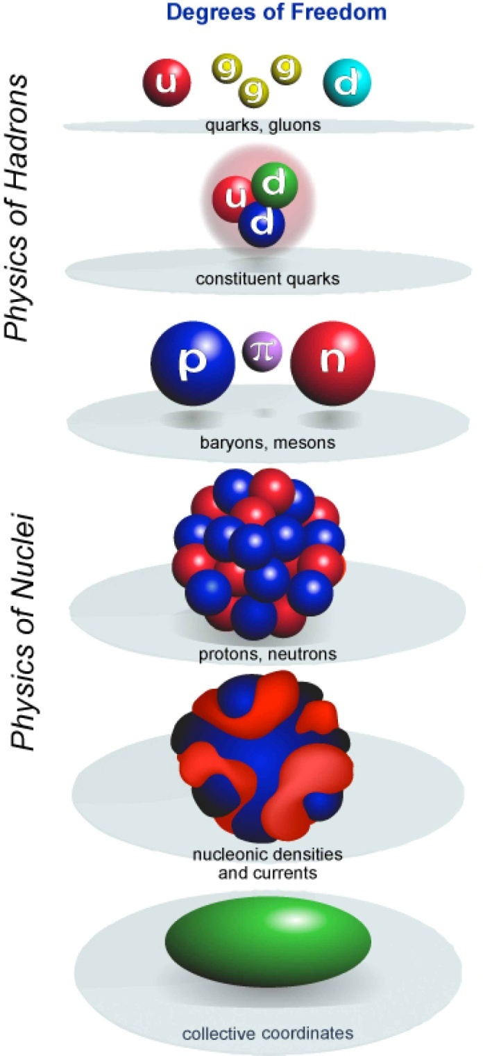
The nucleus: a complex system
How to understand the rich structure of the atomic nuclei in terms of interactions between nucleons
How to relate the strong nuclear interaction to the underlying QCD that governs the physics of quarks and gluons.
Physics of Nuclei
Notes:
The strong nuclear interaction is at the crossing point between ”High energy” nuclear physics dedicated to quarks and how they organize into nucleons and ”Low energy” nuclear physics dedicated to nucleons and how they organize into nuclei.
Recent advances in the theory of nuclear forces, thanks to chiral perturbation and effective field theories, have led to a new generation of strong nuclear interaction particularly suited to low energy nuclear physics
In nucleons, how do quarks and gluons interacting through QCD produce their observed mass, size, and spin? Similar questions remain unanswered about the exact nature of the strong nuclear force and its lineage from QCD. For example, what is the nature and origin of the nuclear spin-orbit interaction? How does the three-neutron force emerge from QCD? Even partial answers to these questions will help illuminate long-standing issues in nuclear physics and ultimately provide a deeper understanding of how protons and neutrons combine to form nuclei,

Slide 4
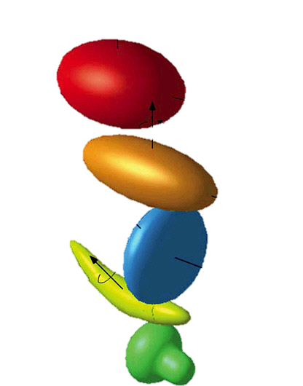
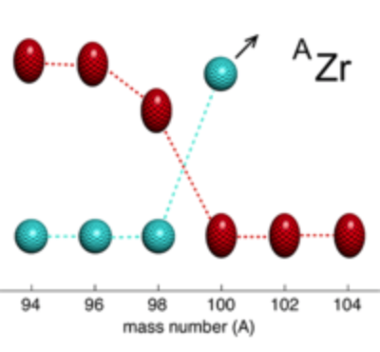
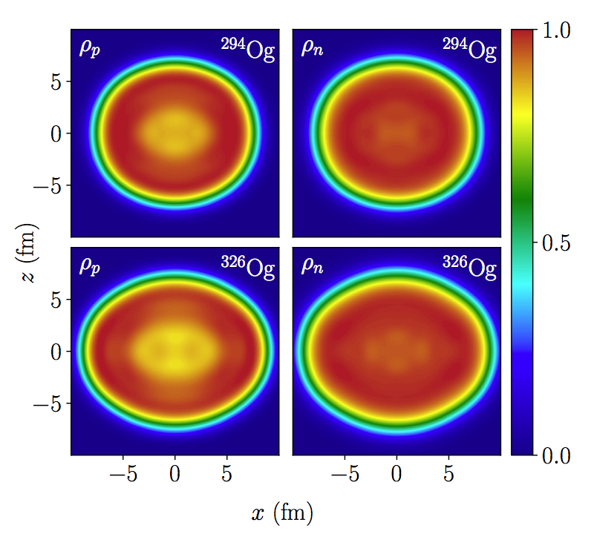
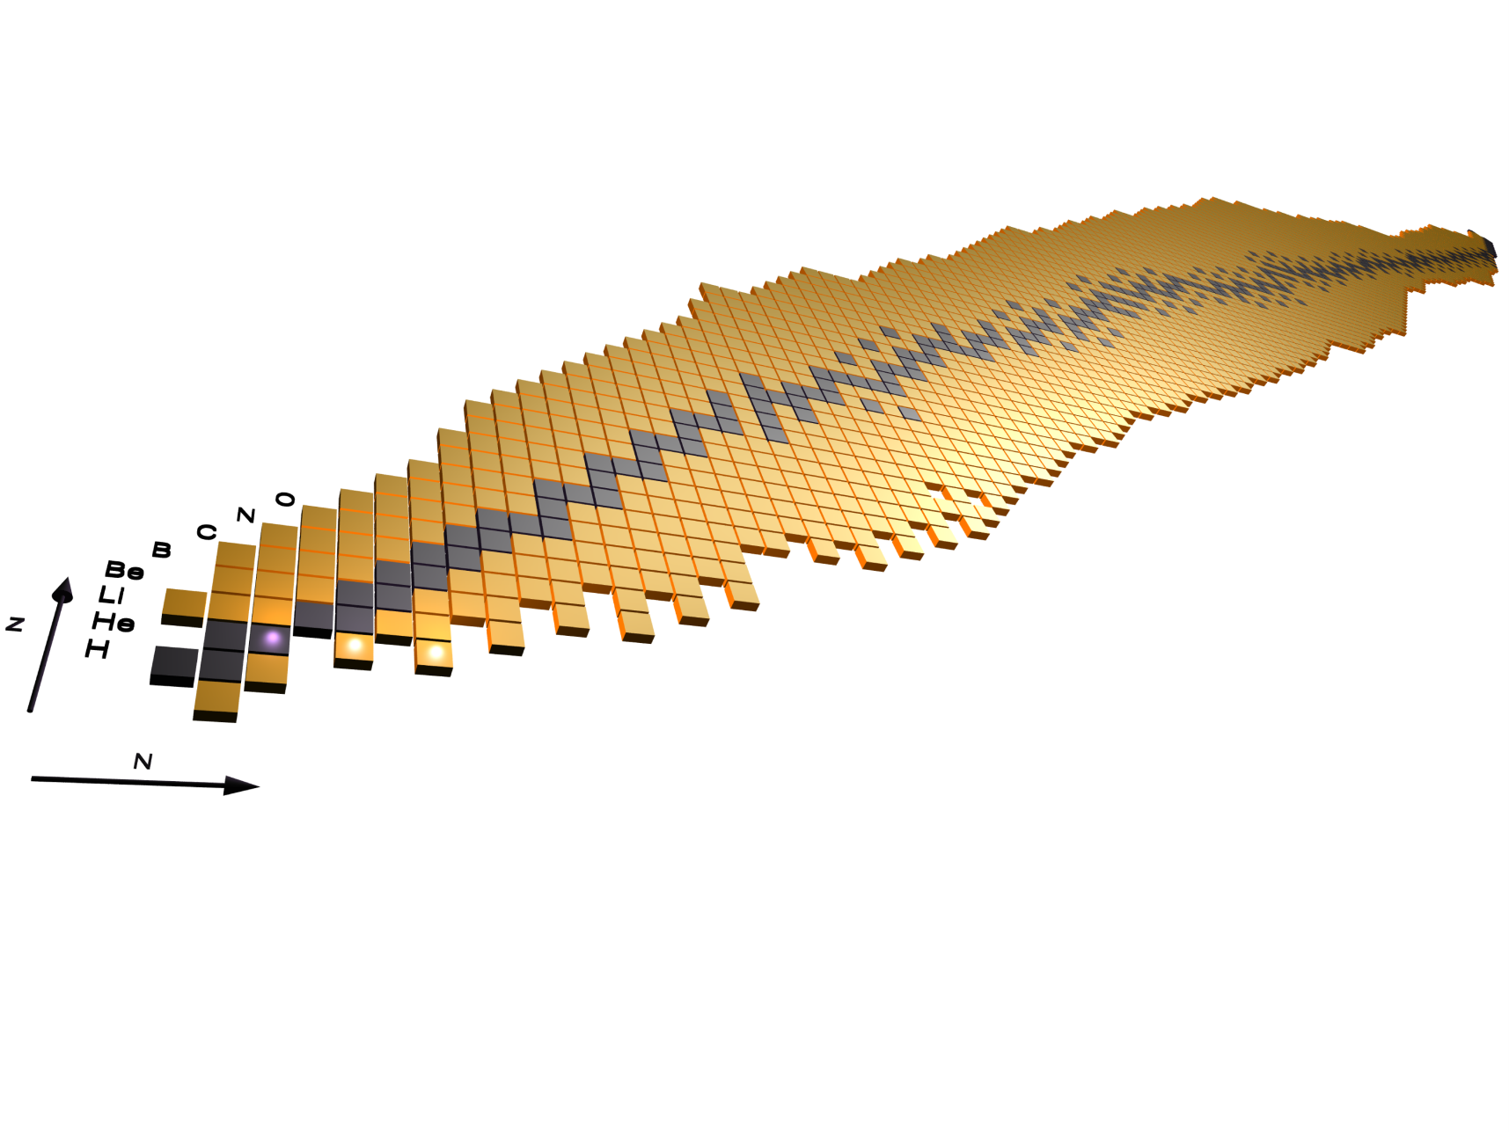
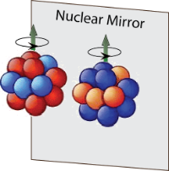
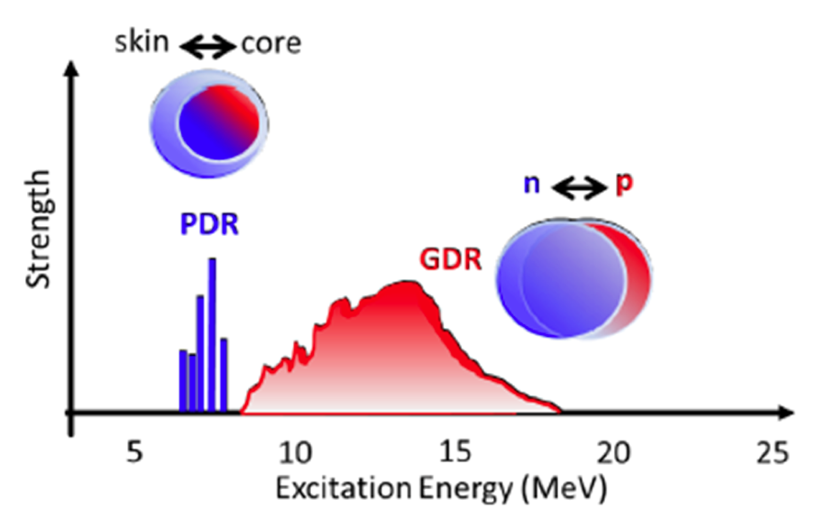
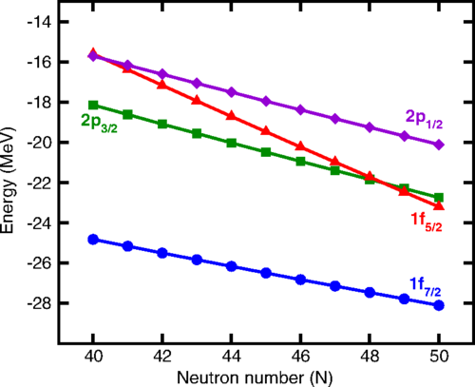
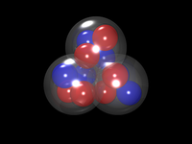
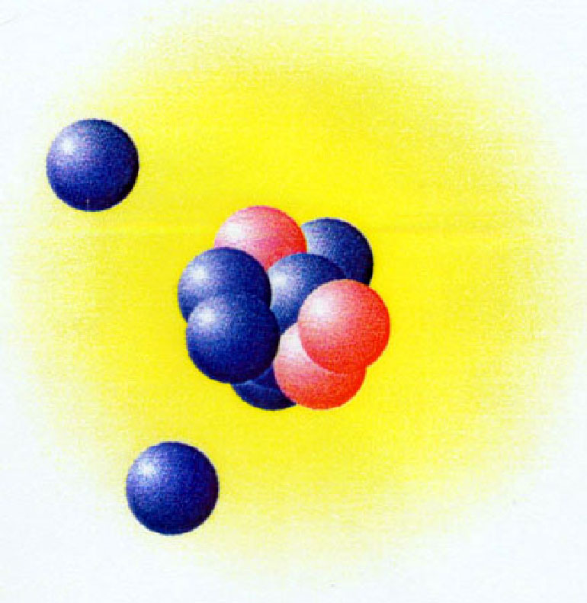
A variety of different phenomena
Z=28

Slide 5
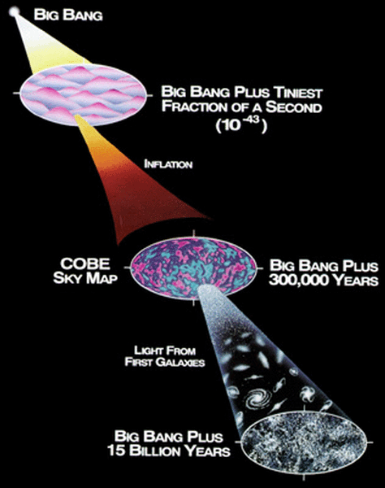

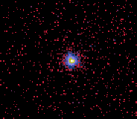
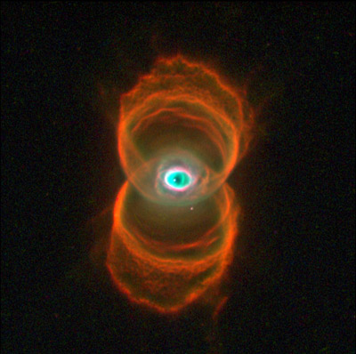
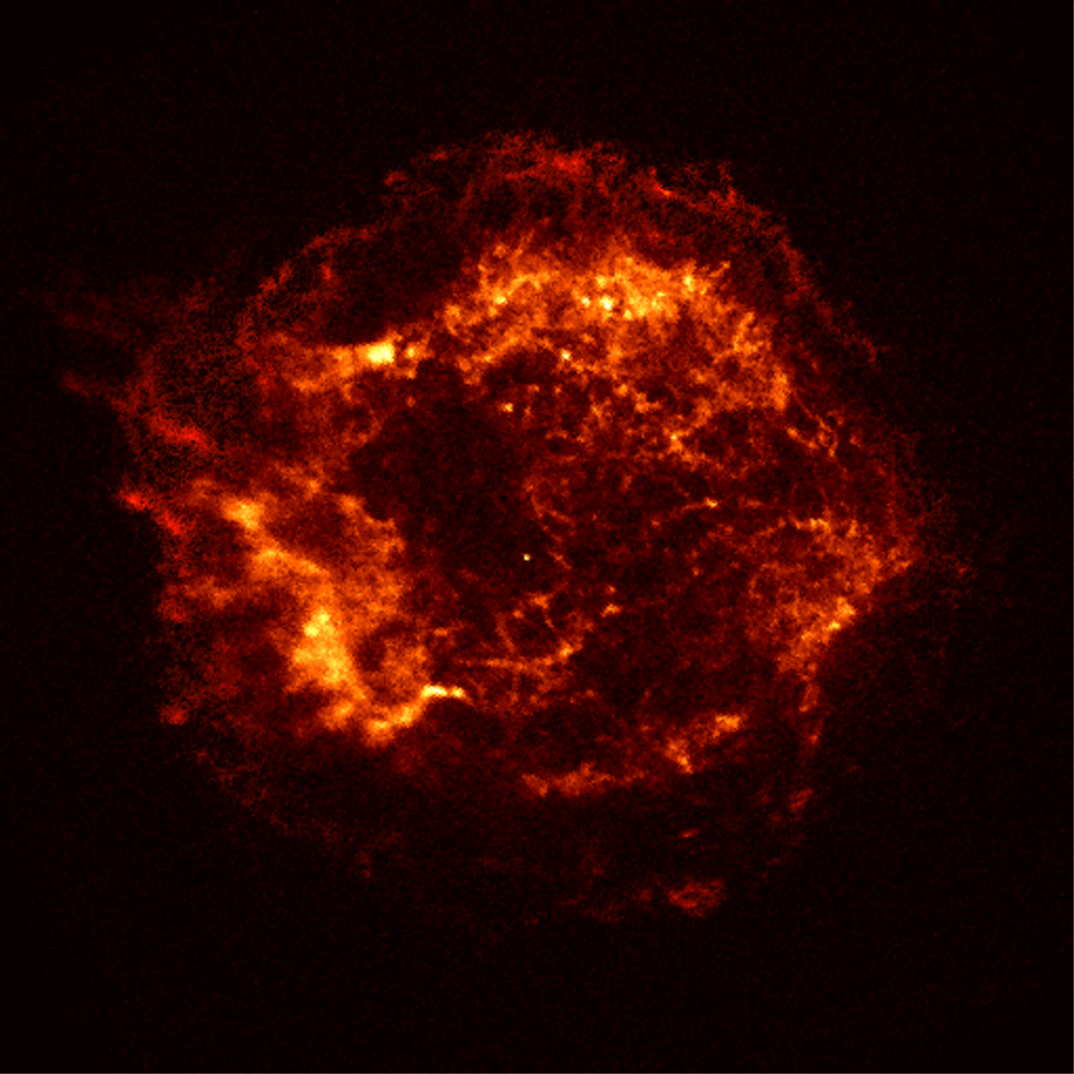
From nucleons, to nuclei, to stars…
cataclysmic binaries
stellar evolution
the 3rd minute
Nuclear Astrophysics
AGB stars
Supernovae
Origin & fate of the elements in our universe ?
Notes:
Nuclear physics plays a fundamental role in astrophysics. From the primordial nucleosynthesis starting at the 3rd minute to stellar & cataclysmic nucleosynthesis of the heavier elements .The precise masses of nuclear states, their half-lifes, and key nuclear reaction rates as well as the equation of state of nuclear matter are all important ingredients in stellar models.
Primordial nucleosynthesis (protons and neutrons begin to fuse to form uncueli of the light elements H, He, Li with not too hot and not too cold conditions so that fusion can happen and fused system survives) atsrts at the 3rd minute and ends at the 20th minute

Slide 6

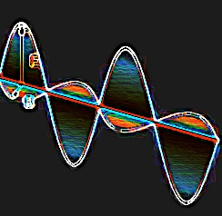
The most sensitive probe of the nuclear wavefunction: its EM radiation
γ
Angular distribution/correlation ⇨ spin, multipole mixing ratios
Doppler shift ⇨ lifetime
Linear polarization ⇨ parity
Intensity ⇨ branching ratios, BE(λ), cross sections
Coincidence relation ⇨ level scheme
…

Slide 7
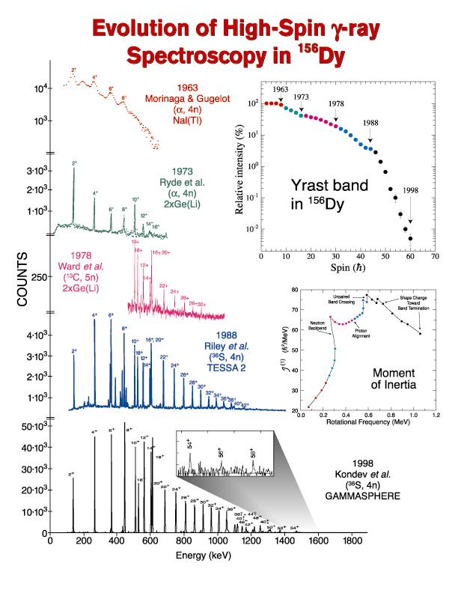
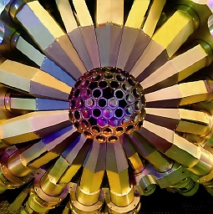
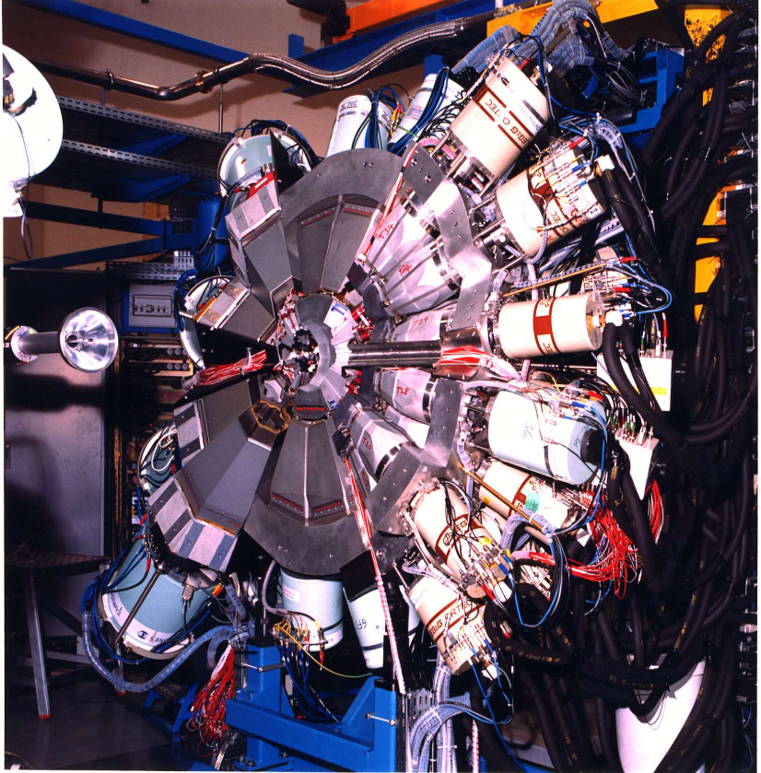
Evolution of γ-ray spectroscopy:
Arrays of Compton-suppressed Ge detectors
NaI -> Ge
Heavy-ion
beams
GAMMASPHERE
6 Ge detectors +
AC shields
~100
Compton-suppresed
Ge detectors
EUROBALL
Optimized for high γ-ray multiplicities
Efficiency ~10%

Slide 8
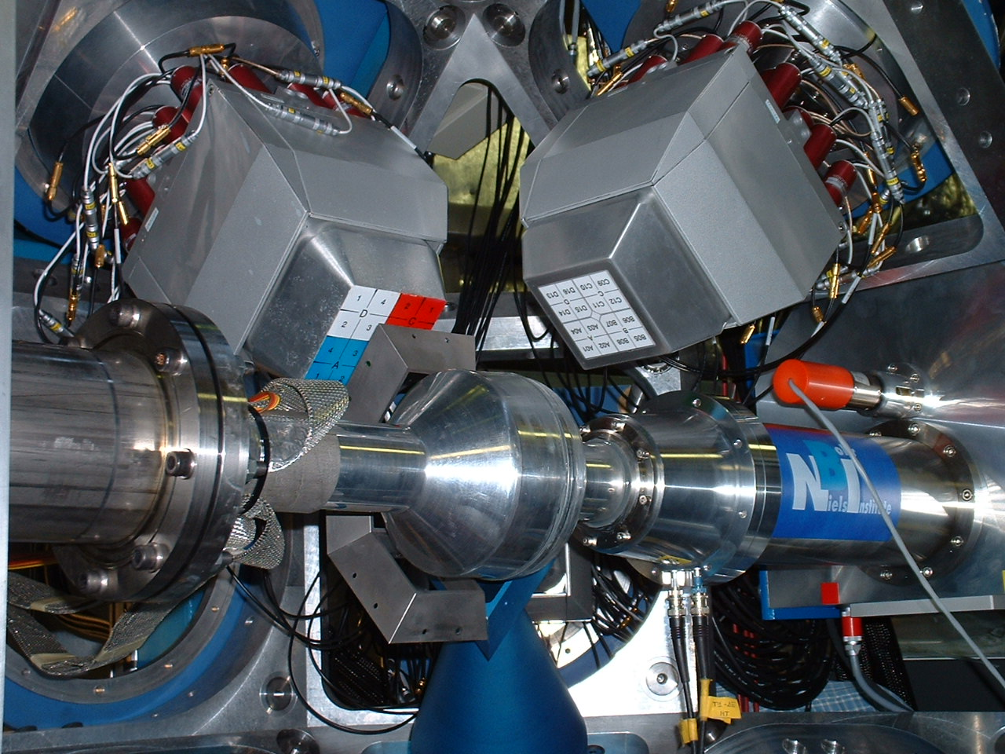
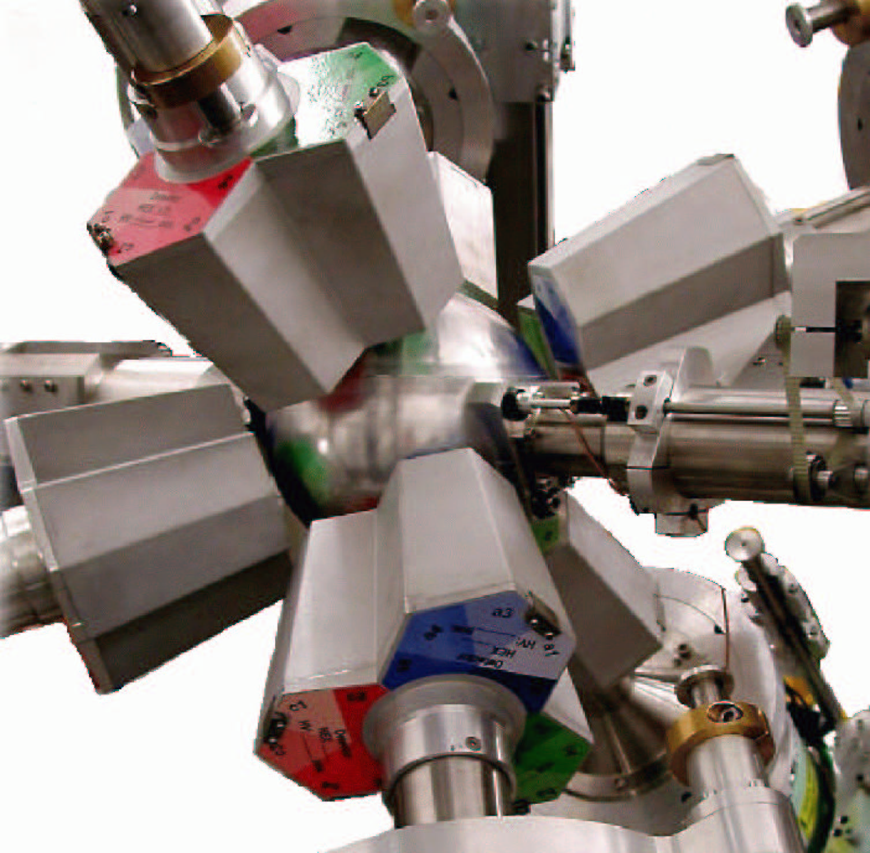
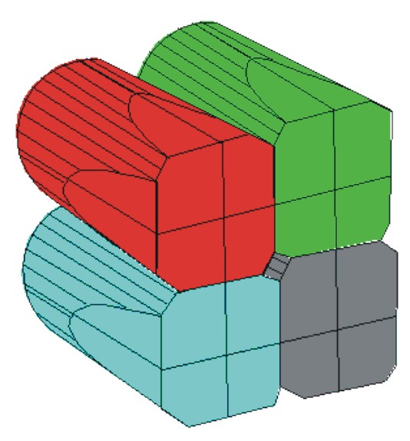
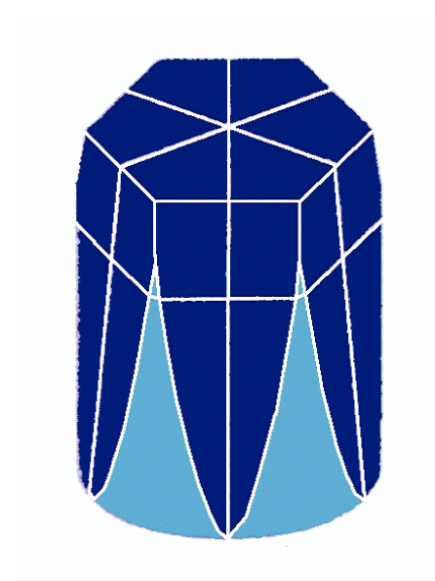
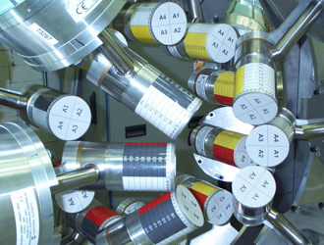
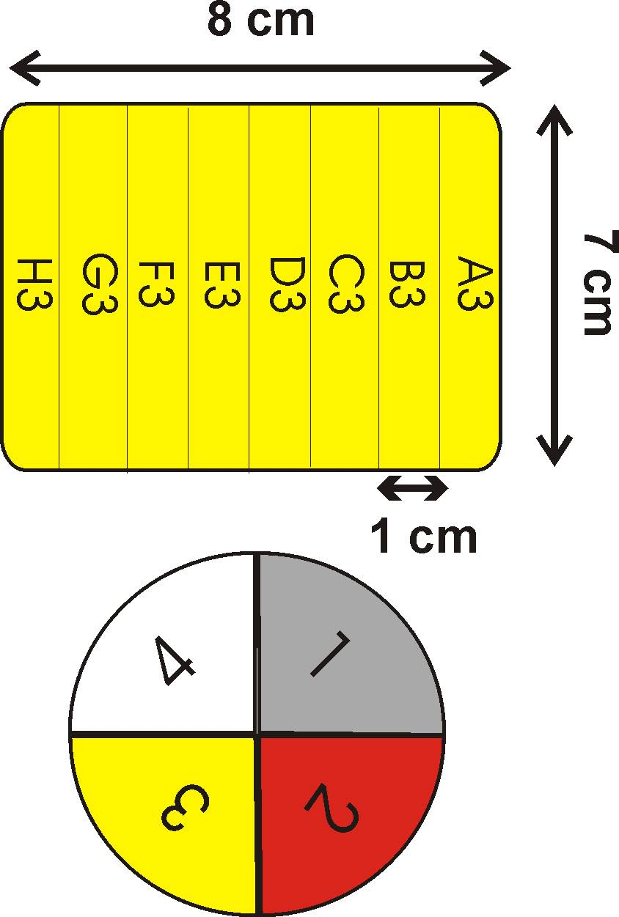
Evolution of γ-ray sectroscopy:
Arrays of segmented Ge detectors
EXOGAM
MINIBALL
2⁺→0⁺
4⁺→2⁺
2₂⁺→2⁺
6⁺→4⁺
2₂⁺→0⁺
Optimized for Doppler correction at low γ-ray multiplicities: Efficiency ~ 20%
SeGA

Slide 9
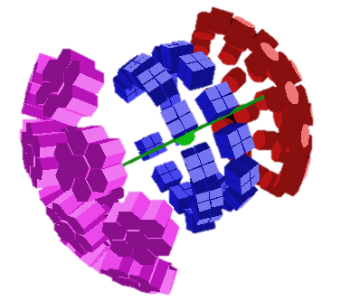
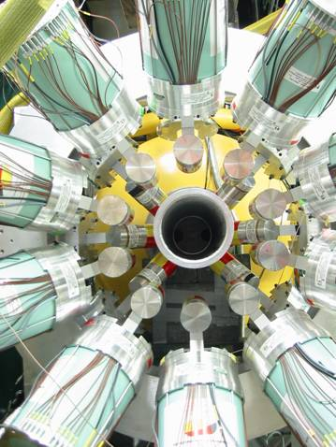
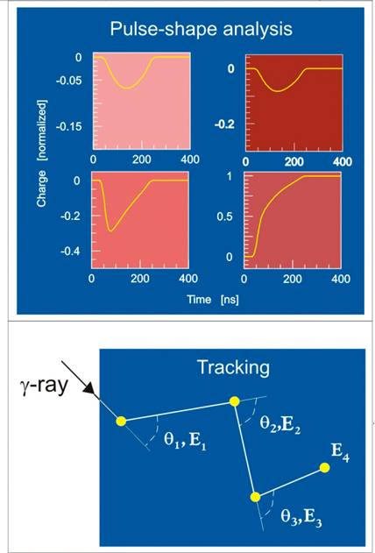
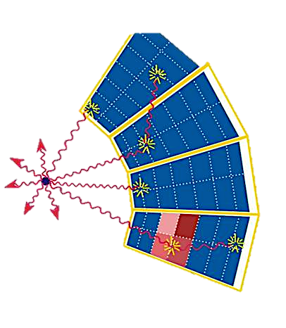
How to combine the properties of both types of arrays & enhance the overall performance ?
Segment further to determine the interaction points and track the photons
Remove the BGO shields
Increase count rate capability

Slide 10
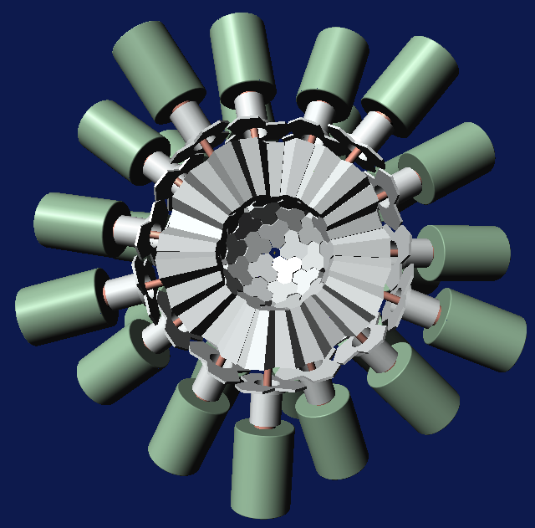
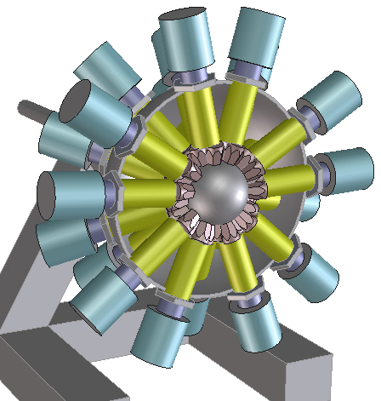
γ- tracking arrays
AGATA
GRETINA/GRETA
High position resolution
High efficiency
High resolving power
High counting rate
Background rejection
Large recoil velocitites
Low beam intensities
Rare events
Large background

Slide 11
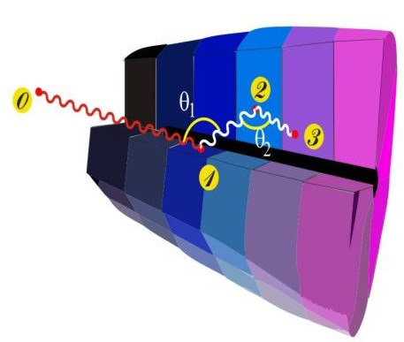
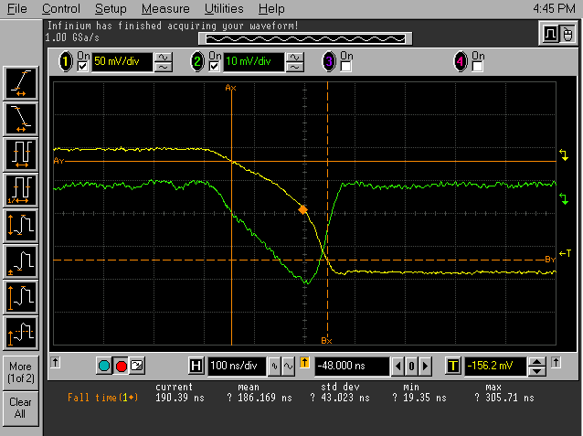
Tracking ingredients
4
1
Identified
interaction points
Reconstruction of photon trajectories by tracking algorithms
36-fold segmented
HPGe detectors
(x,y,z,E,t)_{i}
Pulse Shape Analysis
to decompose
recorded waves
3
2
100 Mhz, 14 bit sampling of segment and central contact signals
reconstructed γ-ray energies,
emission & scattering directions

Slide 12

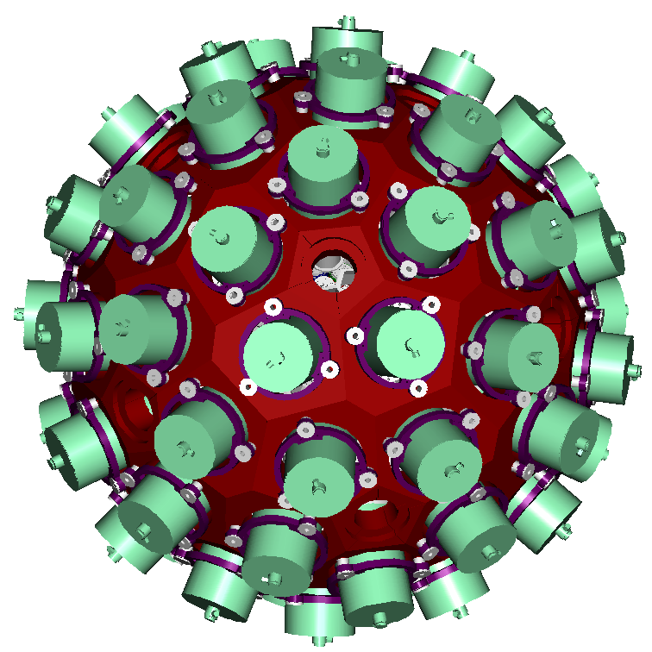











AGATA project
http://www.agata.org
180 segmented crystals (60 triple units)
362 kg of Ge
82 % solid angle
50 kHz Ge crystal counting rate
Angular resolution : ~1º
Efficiency: 35 % (M_{γ}=1) , 20% (M _{γ} =30)
Pic/Total: ~40-50%
Large inner radius to accommodate ancillary devices

Slide 13
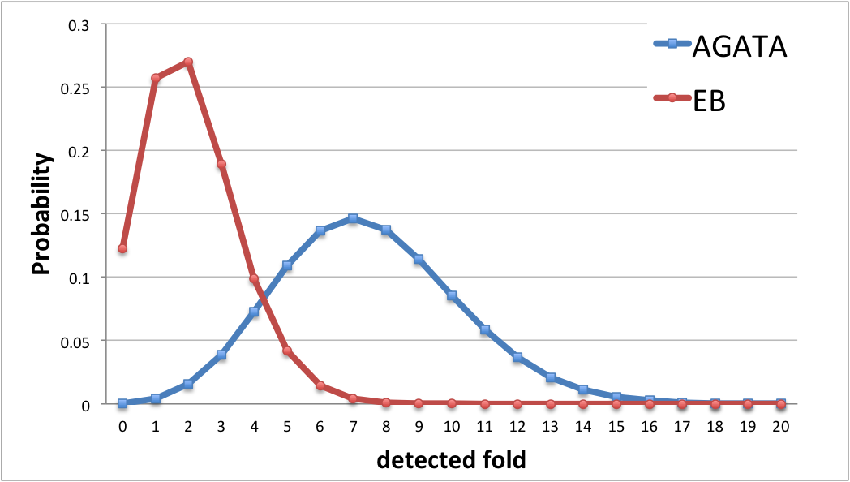
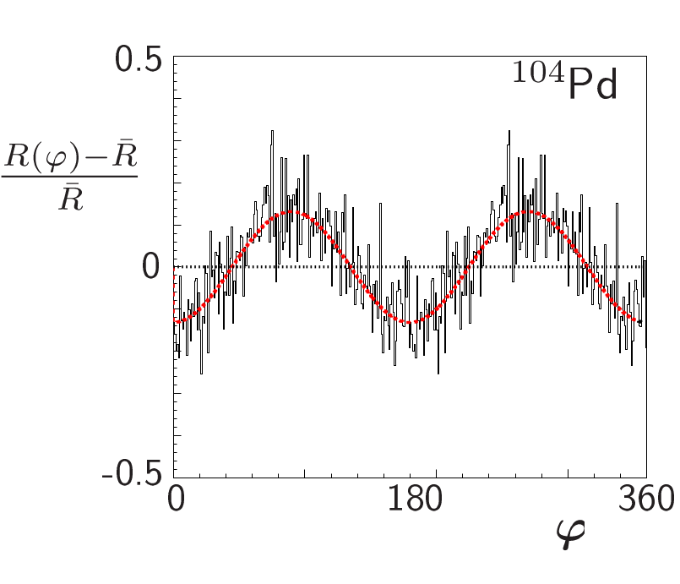
Powers of AGATA
Response to high-multiplicities (Mγ=30)
P.G. Bizzeti, Eur. Phys. J. A51 (2015) 49
Polarization sensitivity
Doppler correction capability (⁹⁸Zr, v/c~10% )
Notes:
Manip avec 2 ATC à 90 degrés
Analyszing power of ~0.5 at ~500 keV
Clover ~ 0.2
3 Ge polarimeter: 0.6

Slide 14
Agata Management Board (AMB)
A. Gadea (Project Manager)
Boston, B. Million, A. Korichi, H. Hess, F.Recchia, P. Reiter (ASC) and W.Korten (ACC).
J. Gerl (LCM-GSI), E. Clement (LCM-GANIL)
AGATA Working Groups
AGATA Teams
Detector
Module
H. Hess
Detector &
Cryostat
H. Hess
R & D on gamma
Detectors &
Applications
Front-end
Electronics
(A.Gadea)
Pre-Amplifier
Digitizer
A. Pullia
Global Trigger &
Synchronization
M. Bellato
Pre-processing
I. Lazarus
AMB Chairman
Project Manager
A.Gadea
Data Flow
A.Korichi
Hard/Software
DAQ support
G. Lalaire
Slow control &
FEE Monitoring
E. Legay
Data Analysis
& TRACKING
O. Stézowski
A. Lopez-Martens
Data distribution and re-processing
F. Crespi,
J. Dudouet
Resource Manager
B. Million
Characterisation
PSA
A.Boston
Detector Characterisation
J. Simpson
PSA Algorithm Development
L.J Harkness
Infrastructure.
Comp. Det.
B.Million
Detector array
Infrastructure
R. Menegazzo
Complementary
Detectors
J.J. Valiente
Mechanical
Infrastructure
A. Grant
Performance
and Simulation
F.Recchia
AGATA
Performance
C. Michelagnoli
J. Ljungvall
AGATA
Commissioning
P.R. John
AGATA Physics & exp. Simulation
M. Labiche
Technical
Coordinator
(Engineering Advi.
Compatibility
EMC, Interfacing
Specification
control
Quality
Control
Documentation & Security Issues
INFN-LNL
Legnaro
GSI
Darmstadt
J.Gerl
GANIL-SPIRAL2
Caen
E.Clement
Notes:
AMB is responsible for the execution of the Project along the lines defined by the ASC.
The local campaign managers are invited to attend

Slide 15
AGATA France
Coordinateur Scientifique
A. Lopez-Martens
Coordinateur Technique
E. Legay
http://agata.in2p3.fr
CSNSM
A. Korichi
IPHC
G. Duchêne
IPNL
N. Redon
IPNO
D. Verney
GANIL
G. De France
CEA
M. Zielinska
FTE (man.months)

Slide 16
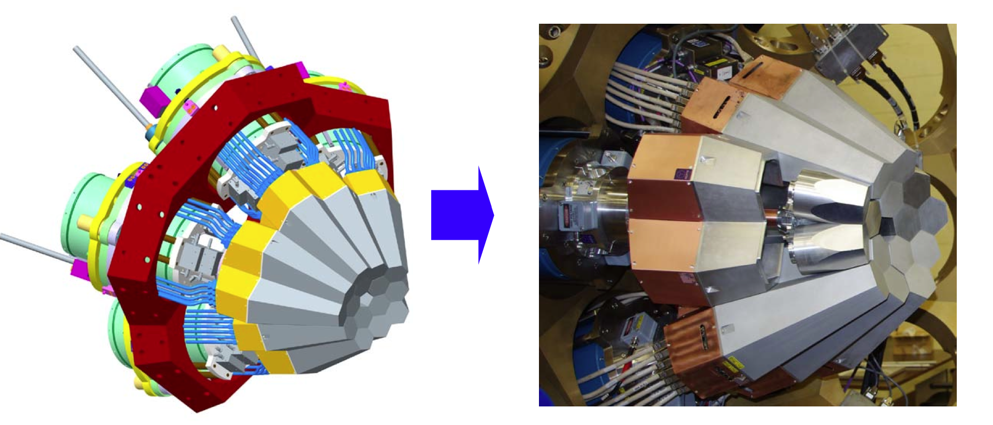
Demonstrator Phase (2003-2008)
Positive feedback from the Scientific Council of in2p3 in 2001
MoU signed in 2002 by 12 european countries
5 triple clusters , online PSA & tracking, in-beam commissioning at Legnaro
Agata Technical Design Report (2008, http://npg.dl.ac.uk/agata_acc/publications_documentation/TDR_EUJRA.pdf)
AGATA – Advanced GAmma Tracking Array: S. Akkoyun et al., Nucl. Instr. Meth. A 668 (2012) 26–58
Notes:
Under the auspices of EURONS (6th framework)

Slide 17
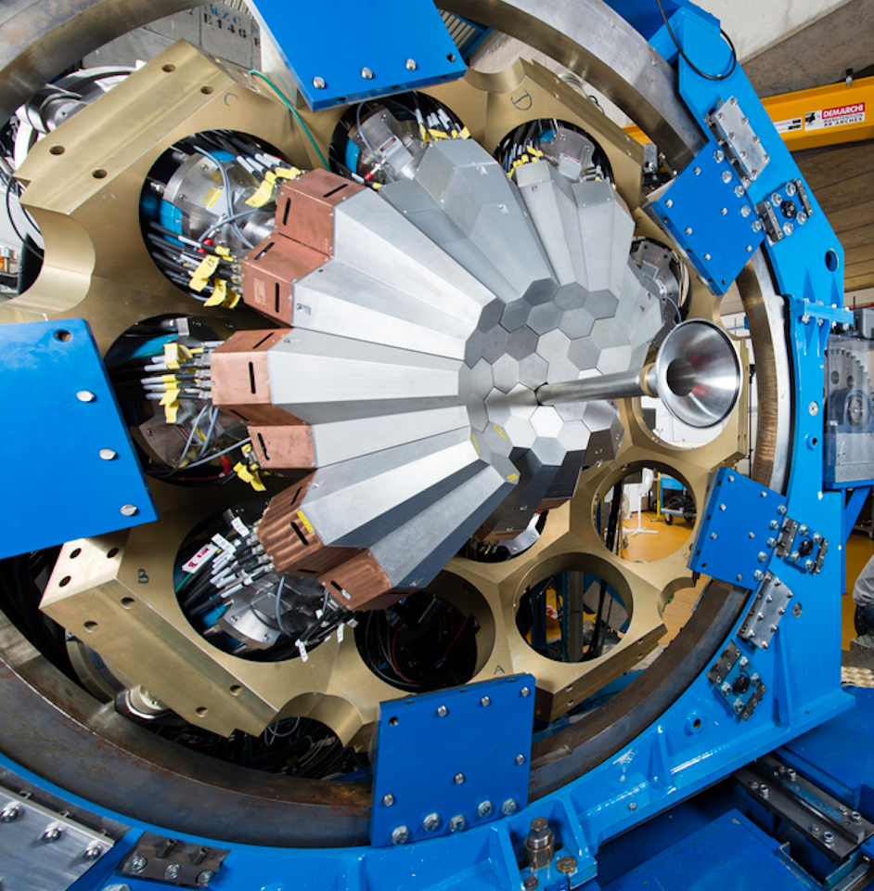
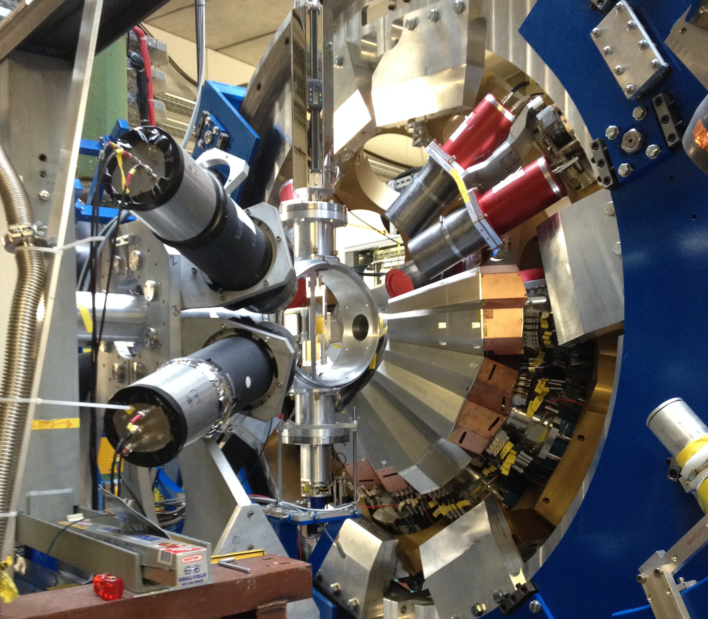
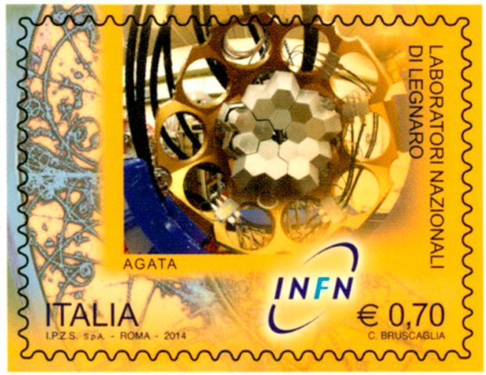
Construction phase 1 (2009-2020) ➔ 4/3π
Positive recommendations from the Scientific Council
of in2p3 in 2009
MoU signed in 2009 and renewed in 2015
41 detectors (2019)
GANIL
Coupled to VAMOS,
NEDA/N-Wall, DIAMANT, FATIMA, PARIS, MUGAST
22 detectors
15 detectors
GSI
Fast radioactive beams coupled to Lycca
LNL
Coupled to the magnetic spectrometer PRISMA
LNL 2010-2011
GSI 2012-2014
GANIL 2015-2021
~60 weeks of beam on target, 57 scientific and 40 technical papers since 2010
Notes:
Photo of GANIL fall 2016 with 32 detectors – procurement of ~60 capsules by 2022. Already 47 in 2019 (Finalnd and Hungary have ordered – delivery 2019 of 4 capsules + UK should order 2 ATC if successful grant…)

Slide 18
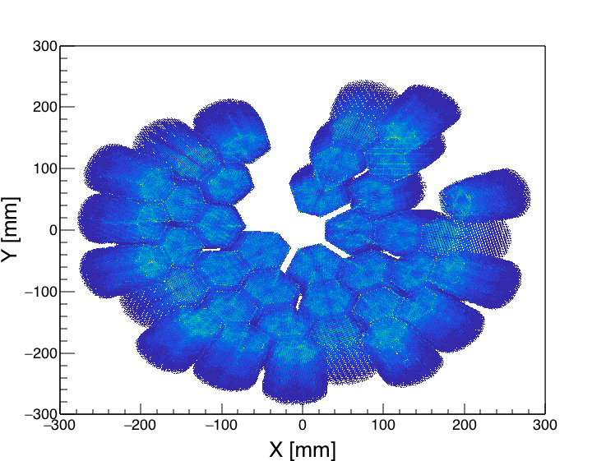
Achievements
Data accumulation at GANIL
γ−γ coincidences
Tbyte
Time
Hit patterns from PSA analysis
Notes:
Maybe add numbers ? Crystal rate, PSA rate, event rate…number of instrumented channels , TB of disk ? Or what other pretty picture ?

Slide 19
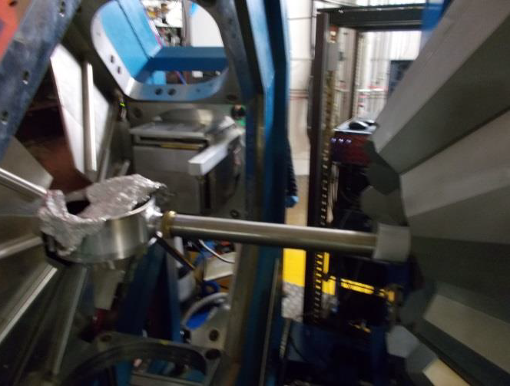
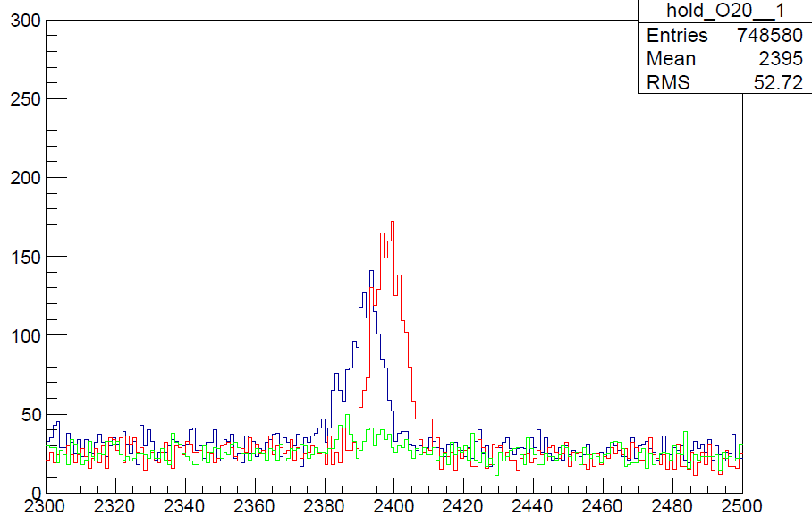
Achievements
M. Ciemala, S. Leoni, B. Fornal et al.
Unique lifetime measurements
¹⁸¹Ta(¹⁸O, ²⁰O)
EXOGAM-VAMOS (simulated)
AGATA-VAMOS++ (measured)
AGATA-VAMOS++ (simulated for τ> ps)
AGATA+PARIS @ VAMOS++
2⁺₂→2⁺₁
Counts/keV
Transition energy (keV)

Slide 20
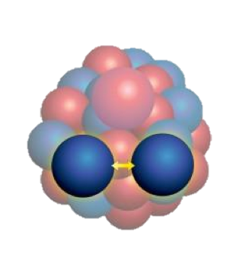
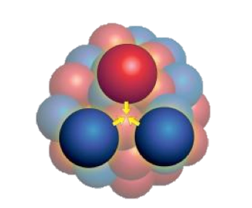
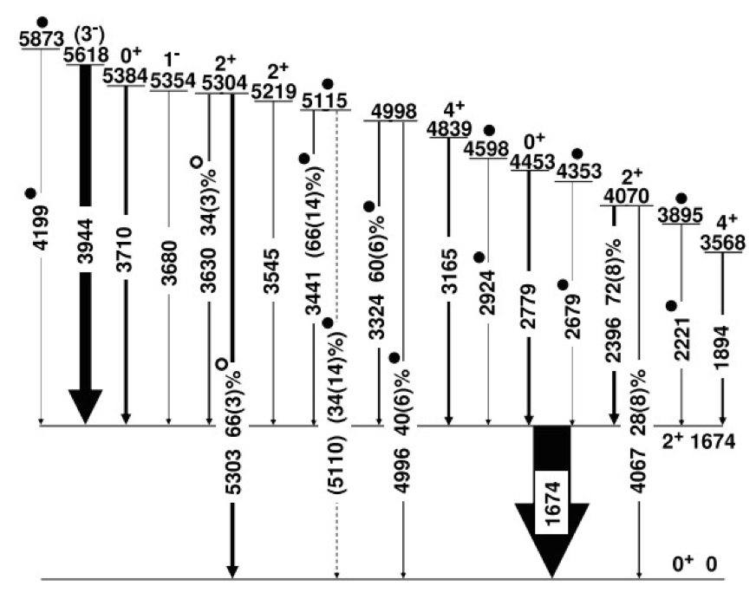
Some highlights
M. Ciemala, S. Leoni, B. Fornal et al.
¹⁸¹Ta(¹⁸O, ²⁰O)
t_{1/2}=0.32 ps t_{1/2}=0.20 ps
δ(E2/M1) =0.24 δ(E2/M1)=0.04
AGATA+PARIS @ VAMOS++
+80
-30
Preliminary result:
τ = 150 fs
M. Ciemala et al., Letter in preparation
This result is not compatible with theoretical lifetimes calculated including 2-body terms only
Notes:
2 paris clusters + 2 large voluem Labr3 detectors
Ab initio results: many body perturbation theory method with interactions built from chiracl effective field theory where the most general Lagrangian consistent with the symmetries of QCD is considered. In the case of the nuclear interaction, chiral EFT quark degrees are frozen and pions mediate the strong force. Therefore, pions and nucleons are the effective degrees of freedom instead of quarks and gluons

Slide 21
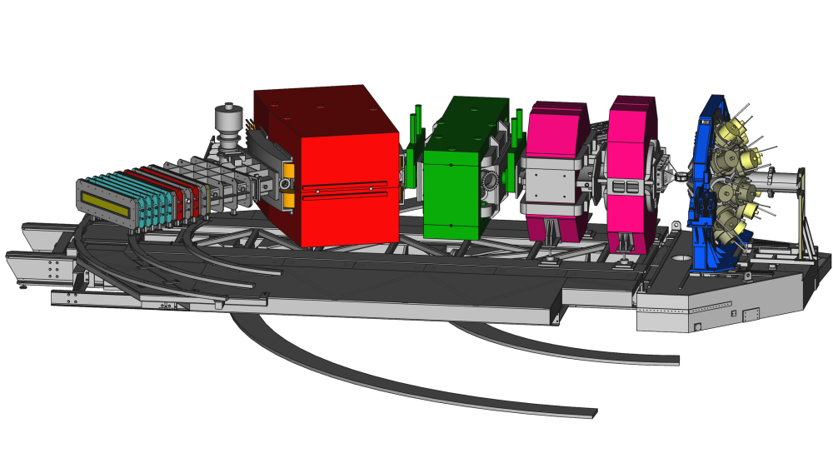
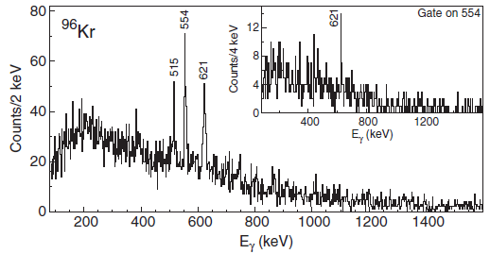
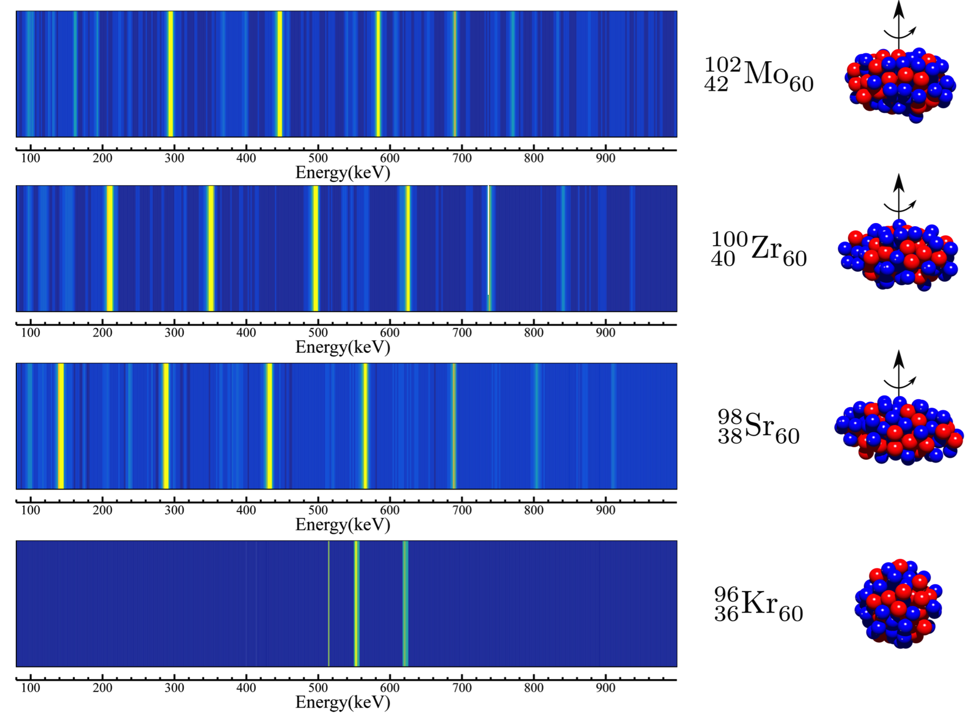
Some highlights
J. Dudouet et al, PRL 118, 162501 (2017)
²³⁸U @ 6.2 MeV/u on ⁹Be
AGATA @ VAMOS ++
Sharp shape transition at N=60 when moving from Sr to Kr
Challenge for theory to reproduce all the observables in this region, which is important for the r-process

Slide 22
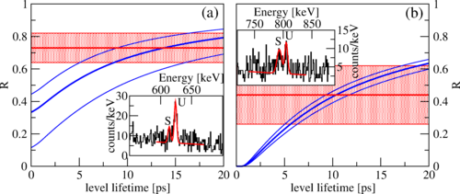
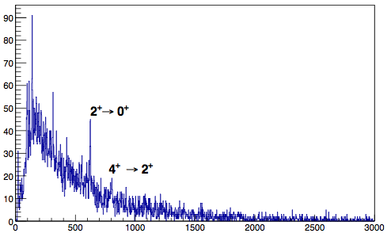

Some highlights
AGATA+OUPS @ VAMOS++
Be
production target
Mg
degrader
⁸⁴Ge
²³⁸U
VAMOS
β
β’_{measured}
D
γ
_{Shifted S}
γ
_{Unshifted U}
C.Delafosse et al., PRL 121, 192502 (2018)
TH. Shell model, inert ⁷⁸Ni core
Sieja et al. PRC 88, 034327 (2013)
First lifetimes measured in very exotic ⁸⁴Ge
Sudden rise of collectivity at Z=32
Effect understood as the manifestation of pseudospin symmetry
Notes:
1st lifetime measurement

Slide 23
AGATA upgrade: Physics Program
Nuclei at the highest spins
Super Heavy nuclei
N~Z nuclei
Neutron rich nuclei
Drip-line nuclei
Nuclei around double shell closures

Slide 24




Pushing the limits of Z & A
Z
²⁹⁴Og
²⁵⁶Rf
Z=103
Jurogam
Z=104
N
SAGE + RITU
Cascade / pnA / day
²⁵⁶Rf
Z=105
AGATA 1π + VAMOS GFS
Z=106
Z=107
AGATA 3π + VAMOS GFS
Hs
Ds
+ huge gain in γ^{n} statistics
P.T. Greenlees, Phys. Rev. Lett. 109 (2012) 012501
Notes:
For 2 weeks
Limit = 100 (counts)
× 1/14
× 1 / I (pnA)
× 1 / Nγ
× 1 / ε_{r}

Slide 25

Pushing the limits of Z & A
²⁵⁴No, σ~ 2μb
Gated spectrum
JUROGAM2 in 2015
(40 000 ²⁵⁴No detected)
AGATA 4π
(40 000 nuclei)
²⁵⁵Lr, σ ~ 0.4 µb
γγ 1/2-
Enhanced resolving power gives acces to detailed sub-μb spectroscopy
γγ 7/2-
S. Ketelhut et al., Phys. Rev. Lett. 102, 212501 (2009)

Slide 26

Pushing the limits of isospin
From 1st spectroscopy to high-precision measurements north & south east of ¹³²Sn: particle-hole excitations and transition probabilities
Knockout with
DALI2 @RIKEN
Knockout with
AGATA@FAIR
Coulex with
AGATA@FAIR
Notes:
Kockout sur 136Te et coulex de 132Cd
probabilitiesThe resolving power of AGATA will allow to study the structure of odd and odd-odd nuclei around ¹³²Sn and measure lifetimes from lineshapes

Slide 27



Pushing the limits of isospin
Access to heavier N~Z systems than currently accessible
AGATA
+ 1π neutron array
+ charged-particle detector
N=Z
AGATA + GRIT + VAMOS
Notes:
Fusion evaporation au GANIL ou LNL
Transfer is proportionnal to the number of pairs
sigma (0+)/aigma (1+)= gives the relative strength of T=0/T=1 pairing
Pour faire cette figure, je me suis basé sur les manip de 2018 qui, en position approchée, couvraient ~1Pi : Spectroscopie du 88Ru et plunger de 112Xe dont on connait la section efficace de production. Ces manip ne sont pas des manip de hauts spin. Ce n'est pas le cadre de la figure. Je considère des schéma de niveaux similaire au 88Ru et 112Xe avec des gamma entre 500 et 2 MeV. Je génère dans GEANT4 une cascade de 6 gamma du schéma de niveau du 88Ru typiquement. Je sais combien de coïncidence triple on a eut besoin pour faire un schéma de niveaux du 88Ru, avec DIAMANT+NEDA, qui est "clean" en ligne. Pareil pour la mesure du temps de vie du 2+ dans le 112Xe en Juillet. Ensuite je scale aux sections efficaces et à des simulations GEANT4 avec 2Pi et 3Pi. Je regarde si le triple gated obtenu est dans l'ordre de grandeur de ce qu'on a obtenue pour 88Ru et 112xe en 2018 respectivement. L'idée est que c'est difficile de dire si tu as une spectroscopie parce que tu as 20 coups, 30 coups dans une simulation où il n'y a pas de fond..... ? Dure à dire ...
J'ai pris le partie d'utiliser les data qu'on a mesuré. A la fin, ce n'est pas débile. On est à la limite pour 100Sn mais vu la précision sur la section efficace .... On est dans l'ordre de grandeur. Pour moi, cela veut dire qu'on ne pourra pas faire un plunger de 100Sn, mais uniquement avec au moins 3pi + NEDA, on serait dans la possibilité de la spectroscopie.

Slide 28


Exotic shapes
‘Top unexpected physics discoveries of the last five years’
(D. Kleppner, Physics Today, 1991)
High Tc superconductivity
Atom cooling and atom optics
Large-scale structure of the universe
Supernova 1987A
Superdeformed Nuclei
Buckyballs
¹⁵⁸Er
Many questions remain unanswered:
Decay-out from superdeformed states ?
Clusterisation & exotic decays in light nuclei ?
Superdeformation in neutron-rich nuclei ?
High-K superdeformed states ?
Population mechanism ?
Notes:
10 g evt avec une bande SD de faible intesité (10-4) et link 10-6

Slide 29


Exotic shapes
Can we observe the signatures of more exotic shapes of the nucleus?
Energy
Tetrahedral deformation
Octupole deformation
Hyperdeformation ?
Deformation
Energy
fission
Jacobi shape transition ?
Low-energy component of
the GDR ?
Angular momentum
Notes:
Tetahedral gap predicted for N=Z=40 (Zr) stable and exotic
Octupole in heavy Rn – agata coupled to SPEDE
HD with intense stable beams or RIB to push the fission limit

Slide 30






AGATA upgrade:
Timeline & Host Laboratories
2π
3π
4π
Stable beams & accelerated ISOL beams
Radioactive ion beams
(projectile fragmentation & fission)
Stable beams & accelerated ISOL beams
LNL 2022-2025
FAIR/ISOLDE 2026-2028 ?
JYFL/GANIL 2029-2030 ?
Notes:
Procurement of 12 capsules/y -> 3pi at the end of GSI, 4 pi at the end of JYFL (other labs: ISOLDE & GANIL)

Slide 31




AGATA upgrade – Technical Details
Upgraded
DAQ based
on NARVAL/
DCOD
&
improved
Algorithms
New honeycomb holding & detector-mounting structures
New Detector Support System
New Electronics with 10 GB ethernet readout
Notes:
Red boxes: french implication – maybe need input from technical definition group….with the + brought to the system with the various developments ? Maybe different figures ?

Slide 32

Estimated capital investment
In2p3 contribution is calculated on the basis of the actual sharing between French partners
An application to become Infrastructure de Recherche will be made in 2020

Slide 33

Estimated Operation Costs
French contribution should be ~17% of the total
In the present MoU, the In2p3 share is 2/3 of the French contribution
Notes:
As a function of the # of capsules present in the setup: in2p3 would have to pay ~ 63kE in 2021 -> 220 kEuros in 2034

Slide 34
Upgrade manpower
FTE (man.months)
Falling ETPs up to 2022 are due to end of phase 2 development (DSS, electronics, DAQ) and start of maintenance regime
From 2025->2030, the expected manpower should stay stable
The numbers do not include the manpower to perform & analyze experiments, which also involve physicits from many other collaborations

Slide 35

Conclusion & Perspectives
AGATA is a successful collaboration
AGATA is a precision tool to be used in conjunction with other state-of-the-art detectors at European RIB and stable beam facilities
Broad program of studies
Of interest to a large community
http://www.nupecc.org/lrp2016/Documents/lrp2017.pdf

