Slide 1




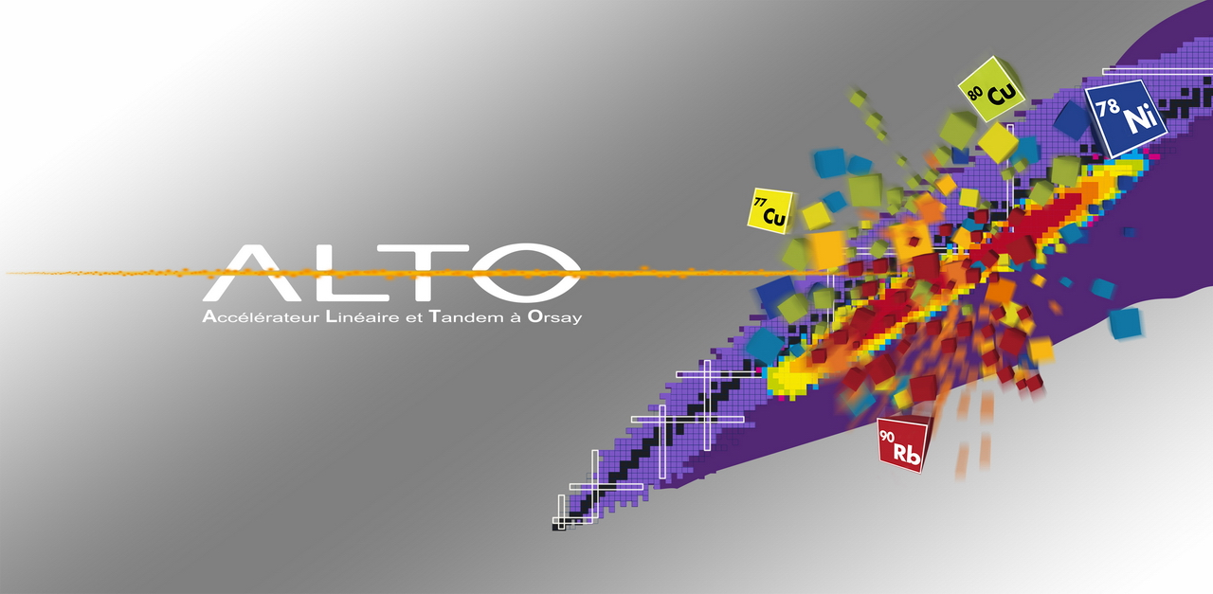
The ν-ball project at ALTO
Jonathan Wilson, Matthieu Lebois,
Nikola Jovancevic, Liqiang Qi, Damien Thisse
IPN Orsay

Slide 2
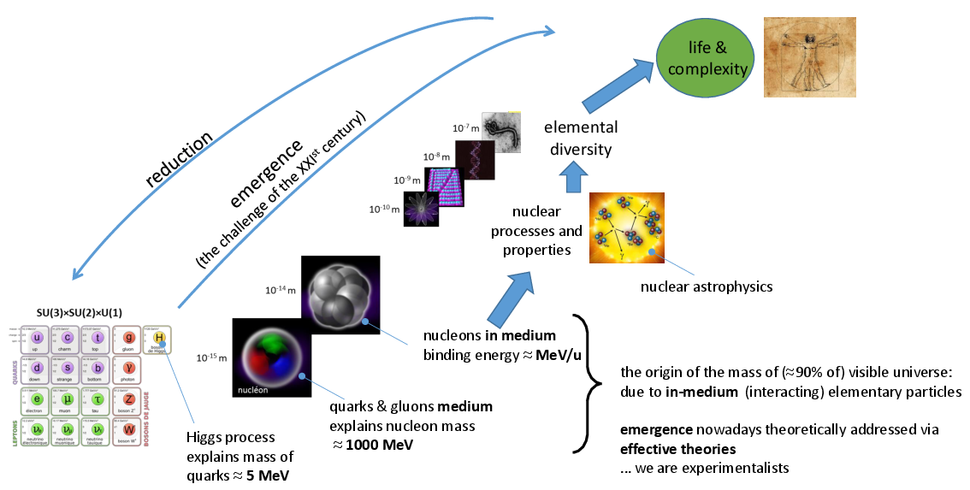
Why study atomic nuclei?

Slide 3
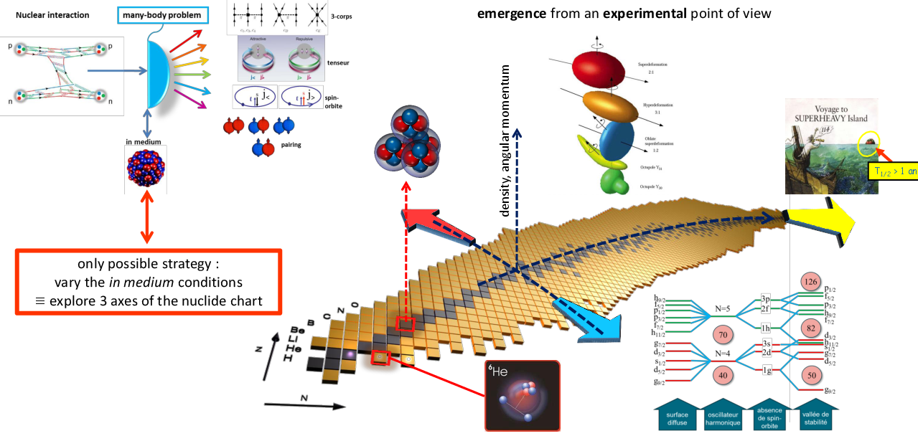
Experimental study of emergent phenomena at 10⁻¹⁴m

Slide 4
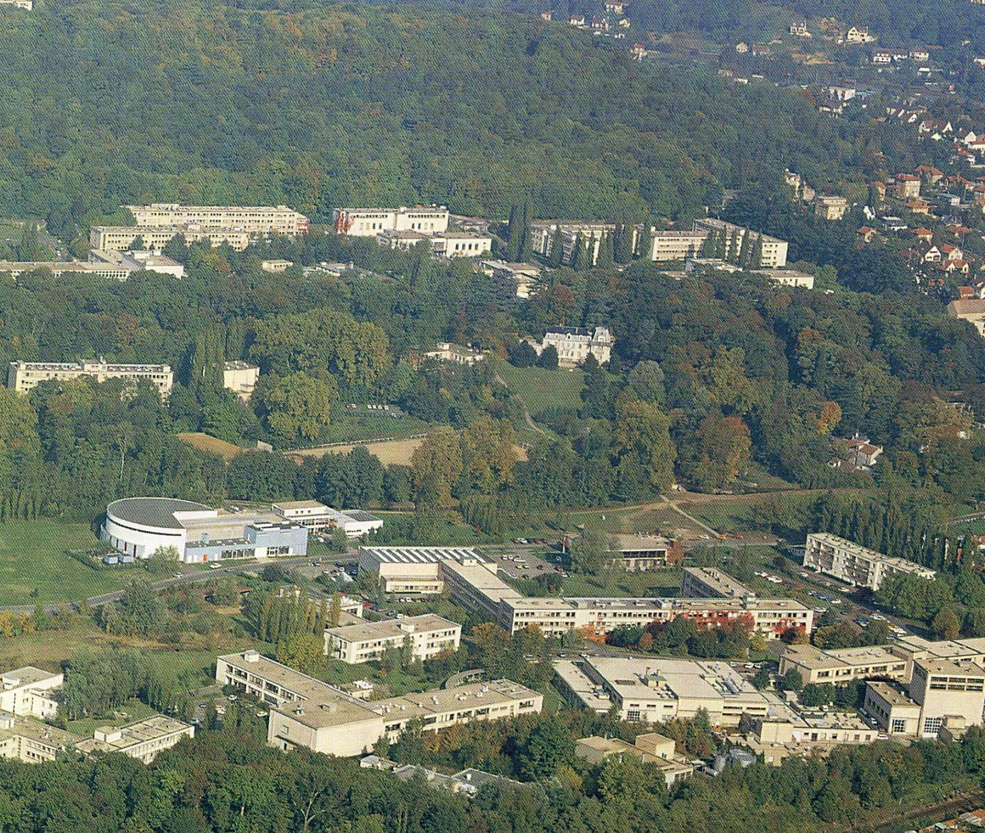
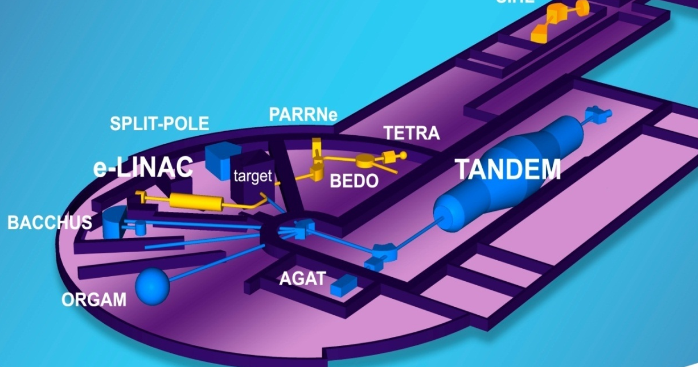


The ALTO facility
15 MV
ALTO typically delivers ~3000 hours of beam time per year
Trans National Access Facility
(ENSAR2, ARIEL)
ALTO international PAC

Slide 5

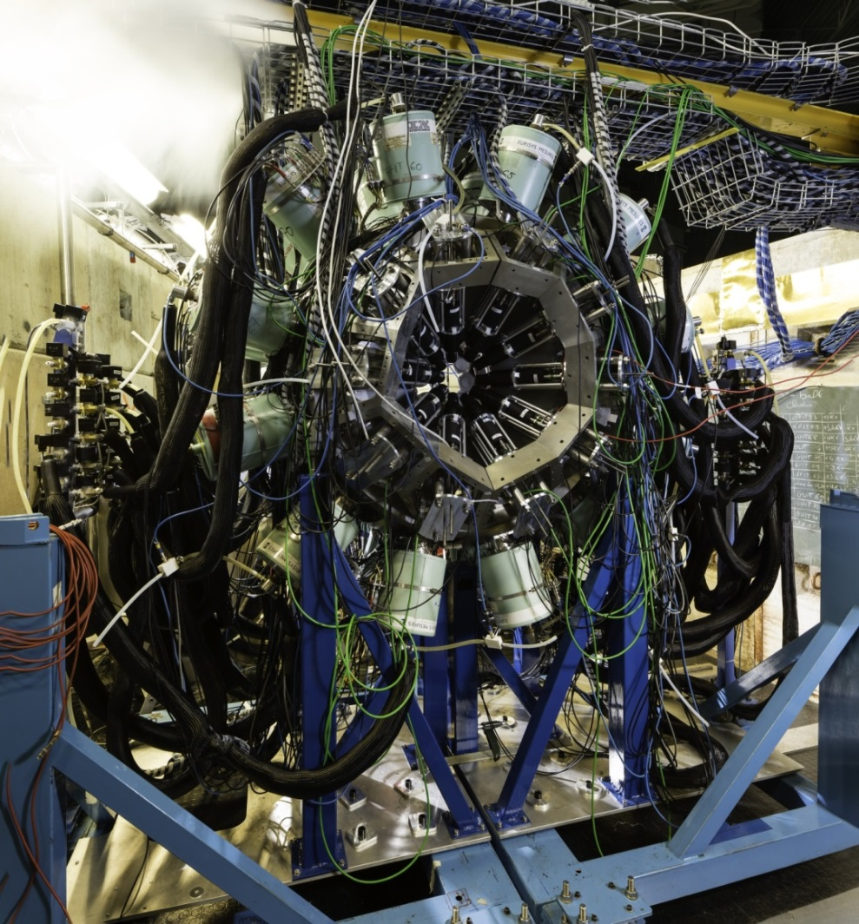
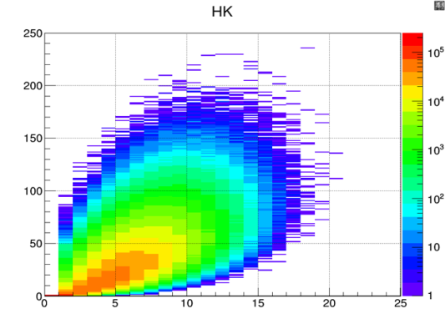
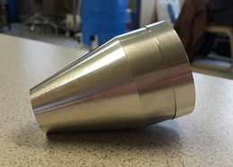
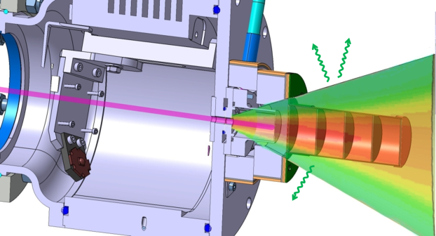
The ν-ball spectrometer @ ALTO
v-ball international collaboration
153 researchers from 16 countries and 37 institutes, including 80 Ph.D students
ν-ball experimental campaign
Nov. 2017-June 2018. 10 experiments 3000 hours of beam time
Innovations
Hybrid Spectrometer (Ge/BGO/LaBr3)
high resolution, high efficiency
Coupling with the LICORNE directional neutron source
Calorimetry for reaction studies/selection
Fully digital, 200 channels, including BGO
Modes Triggered or Triggerlesss
24 Clover Ge + BGO
10 Coaxial Ge + BGO
20 LaBr3
or 36 PARIS phoswich

Slide 6
What physics questions does ν-ball address?
To understand the detailed nuclear structure of very neutron-rich isotopes far from nuclear stability
To study precisely fast-neutron-induced nuclear fission using new techniques to extract new observables and new correlations
To further develop state-of-the art fast timing techniques to measure sub nanosecond lifetimes, study nuclear isomerism, extract nuclear moments
To facilitate diverse spectroscopy experiments proposed by the national and international users of the ALTO facility

Slide 7
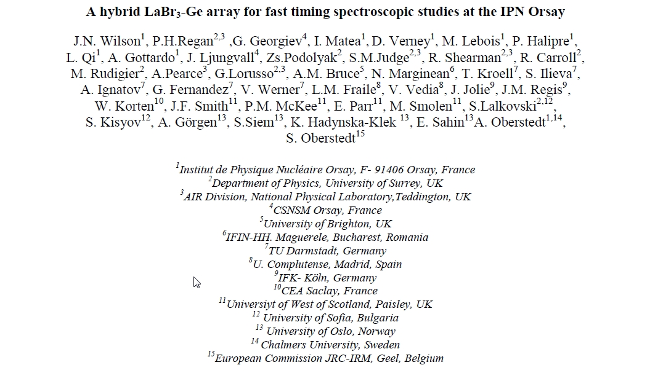
The ν-ball Letter of Intent (2015)

Slide 8
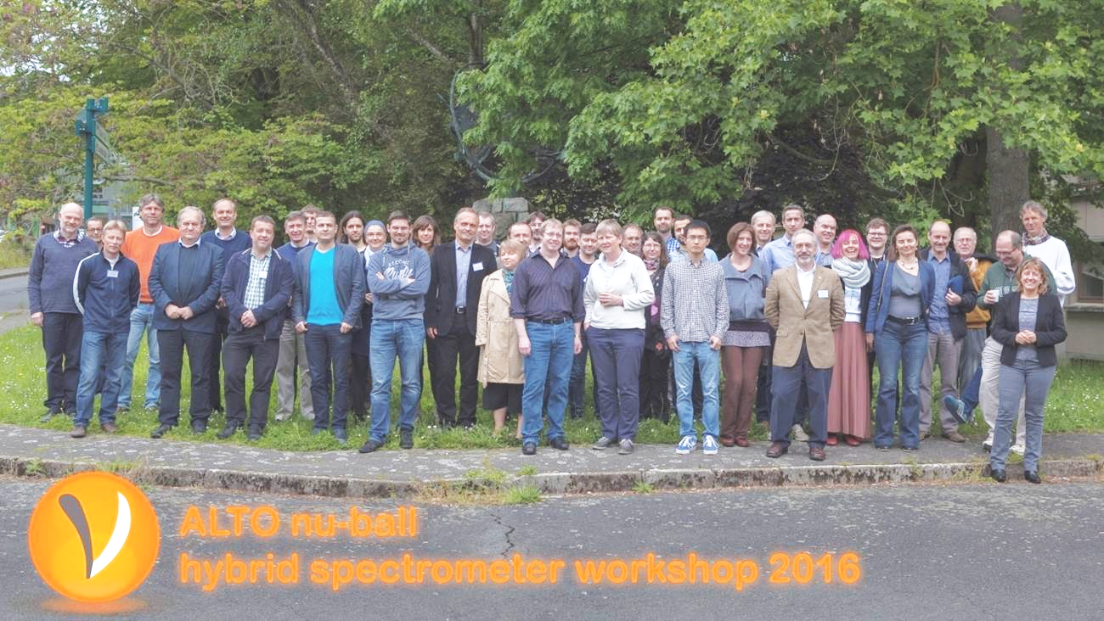
The first nu ν-ball workshop, May 2016
- building the ν-ball international collaboration

Slide 9
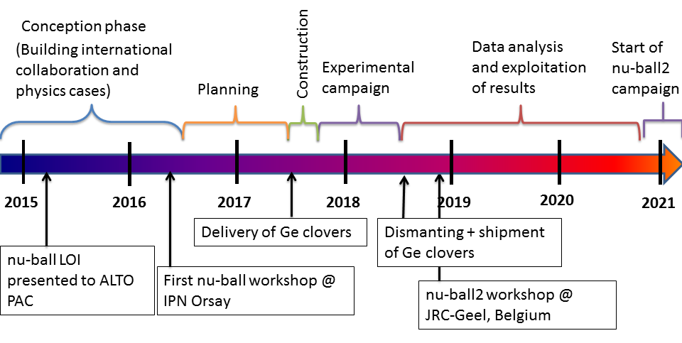
ν-ball time line

Slide 10
















153 researchers from 16 different countries, 37 instutitues, including ~80 thesis students
The ν-ball International Collaboration
France(44)
IPN Orsay (16)
CSNSM Orsay (6)
CEA DAM/CEA Saclay (5)
Subatech, Nantes (3)
CENBG Bordeaux (6)
IPHC Strasbourg (3)
GANIL (2)
LPC Caen (2)
ILL (1)
UK(29)
University of Surrey (13)
National Physical Laboratory (5)
University of Brighton (2)
University of West Scotland (4)
University of Manchester (3)
University of York (2)
Germany(16)
TU Darmstadt (7)
IFK- Koln (9)
Poland(14)
IFJ-PAN Krakow (8)
University of Warsaw (6)
Italy(8)
University of Milano(6)
University of Padova(1)
Legnaro(1)
Finland(2)
Jyvaskyla(2)
Spain(6)
Madrid (4)
IFIC Valencia (2)
Belgium(4)
JRC-Geel (3)
Leuven (1)
Bulgaria(8)
University of Sofia (8)
Romania(7)
IFIN-HH, Bucharest (1)
ELI-NP, Bucharest (6)
Norway(6)
University of Oslo (6)
India(1)
Tata Institute (1)
Canada(4)
University of Guelph (4)
Serbia(2)
University of Novi Sad (1)
University of Belgrade (1)
South Africa(1)
iThemba (1)
Japan(1)
Riken(1)

Slide 11
ν-ball management and human resources
Scientific
Jonathan Wilson – DR2 (Responsable)
Matthieu Lebois – MdC (Responsable)
Nikola Jovancevic – Postdoc CNRS
Liqiang Qi - Thesard
Damien Thisse – Thesard
Guillaume Mavilla - Technican NESTER
Rhiann Canavan (Surrey) - Thesard
Rosa-belle Gerst (Köln) - Thesard
Joseph Nemer – Stagiaire
Yannick Popovitch - Stagiaire
Technical staff
Bernard Genolini – IR1 (Responsable)
Mechanics
Christine Legalliard – IR1 (Responsable)
Ge Detector Maintenance
Gabriel Charles – IR2 (Responsable)
Nourredine Hammoudi - AI
DAQ and Informatics
David Etasse (LPC Caen)
Patrick LeJeannic (IPNO)
Eric Legay (CSNSM)
Administration
Pascale Pichot
Celine Gaubert
ALTO technical staff
Abdelhakim Said (Responsable ALTO)
Robert Leplat
Alain Semsoum
Estimated FTE = 6 person.years

Slide 12
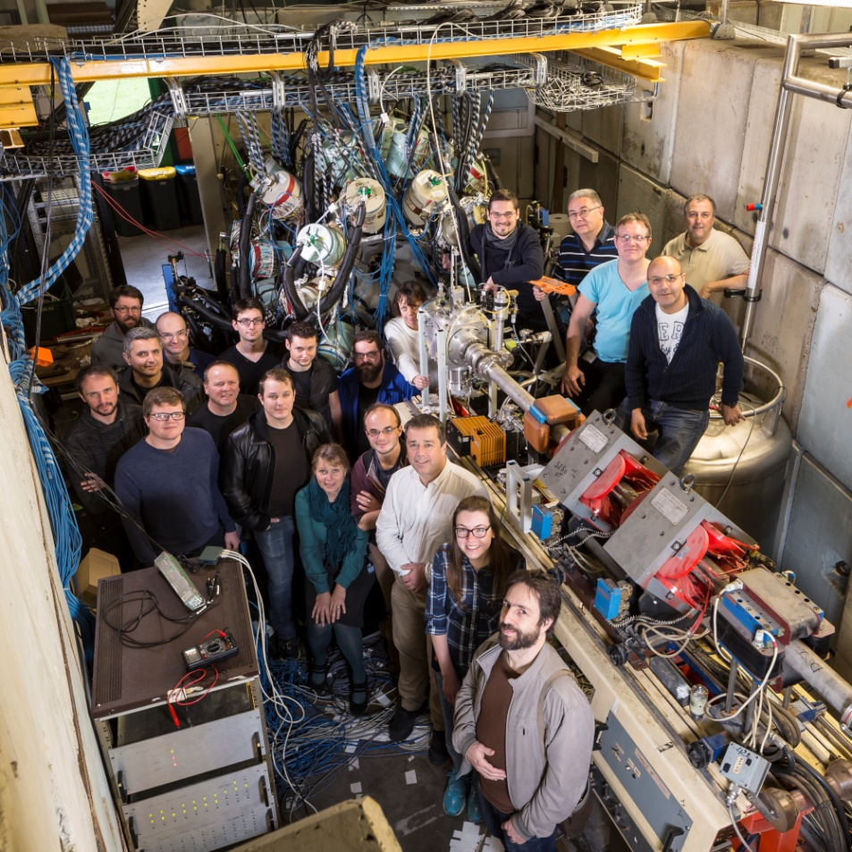
The ν-ball core team

Slide 13
ν-ball financing + equipment resources
Financing
2017 – AP in2p3 80 k euro
2018 – AP in2p3 72 k euro
2019 – AP in2p3 42 k euro
Total: 194 k euro
Renewal of ALTO DAQ
with ~180 channel state-of-the-art digital system
Essential equipment borrowed from:
24 Ge Clover detectors + holding frame + some cables (Gammapool, MOU 2017)
10 Ge Phase I detectors (Loan pool)
26 LaBr3 – Surrey + Madrid + Manchester Universities, UK
4 PARIS clusters – The PARIS collaboration (MOU 2018)
BGO HV supplies – Jyvaskyla University, Finland
²⁵²Cf fission chamber – CEA DAM
Extra DAQ cards (coupling with PARIS) – LPC CAEN
100Tb data acquisiton and buffer disk– CSNSM/P2IO Big data
Clover HV supplies – GANIL
Extra cables – Madrid University, Spain, Manchester University, UK

Slide 14

ν-ball project positive side effects
Nu-ball
Renewal of the obsolete ALTO DAQ system
Renewal of the IPN Ge detector laboratory
Increase in the international visibility/attractivity of the ALTO facility

Slide 15
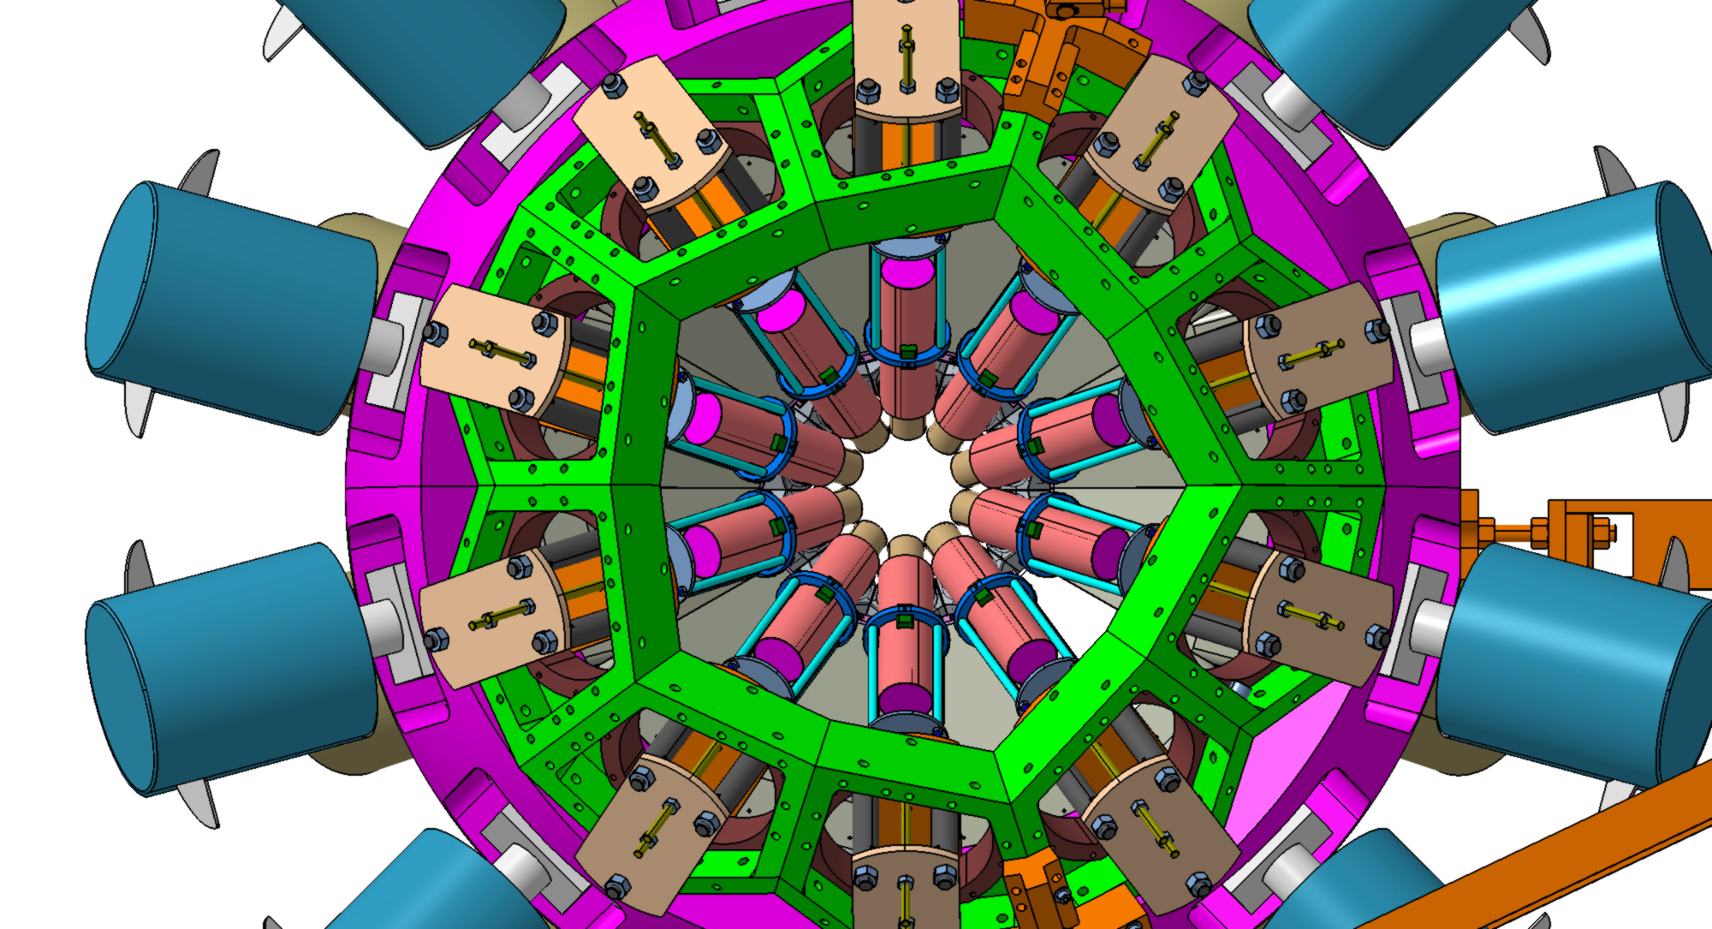
ν-ball experimental campaign (Nov. 2017-June 2018)
3200 hours of beam time delivered
Heavy Ion Reaction γ spectroscopy:
Half-life measurement and isomer spectroscopy in the neutron-rich deformed nucleus ¹⁶⁶Dy (1 week)
Electromagnetic transition rates in the nucleus ¹³⁶Ce (1 week)
Pinning down the structure of ⁶⁶Ni by 2n- and 2p-Heavy-Ion transfer reactions and g-factor measurement (2 weeks)
A study on the transition between seniority-type and collectivity excitations in the YRAST 4⁺ state of ²⁰⁶Po (1 week)
Measurement of the super-allowed branching ratio of ¹⁰C (2 weeks)
Feeding of low-energy structures of different deformations by the GDR decay: the nuBall array coupled to PARIS (1 week)
Neutron induced reaction γ spectroscopy:
Spectroscopy of the neutron-rich fission fragments produced in the ²³⁸U(n,f) and ²³²Th(n,f) reactions (5 weeks)
Spectroscopy above the shape isomer in ²³⁸U (2 weeks)

Slide 16
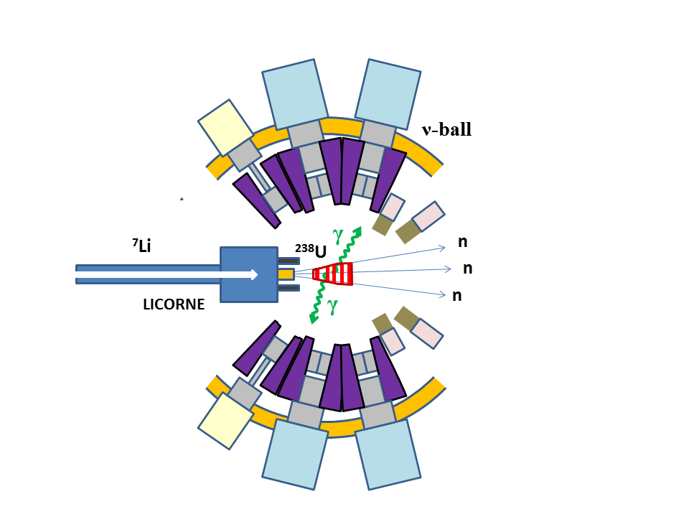
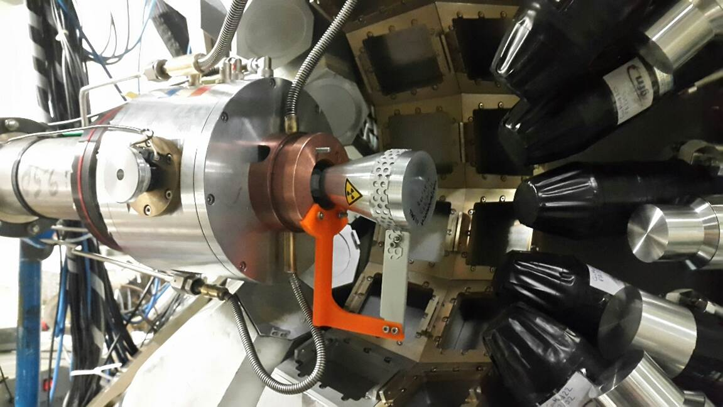
LICORNE/ν-ball coupling principle

Slide 17
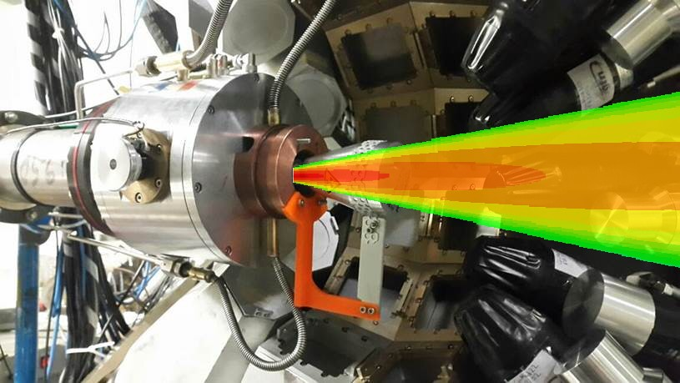
LICORNE/ν-ball coupling principle
Primary beam
2 x 10¹¹ /s
Target
Secondary beam
2 x 10⁷ /s
Sample
10⁵ fissions/s
⁷Li (16 MeV)
H₂
1.5 MeV neutrons
²³⁸U
²³²Th
3 x 10²⁰ atoms/cm²
~100 g

Slide 18
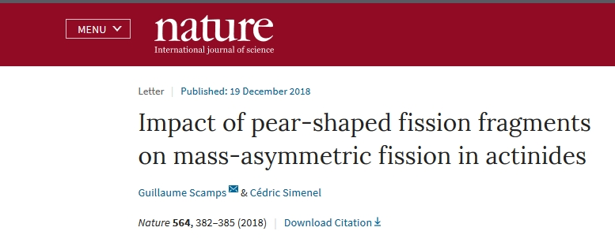
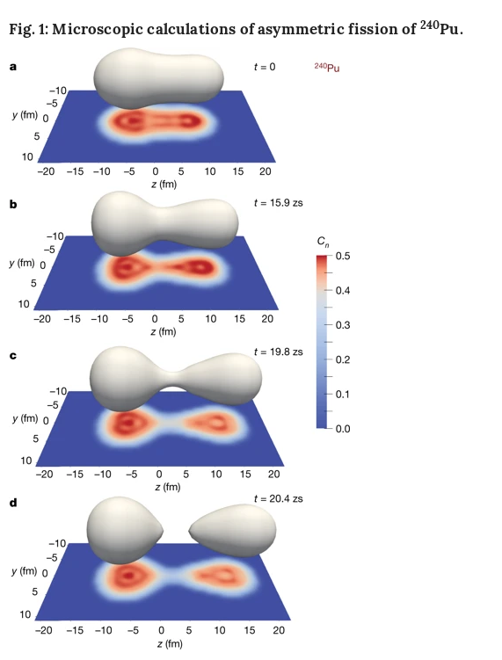
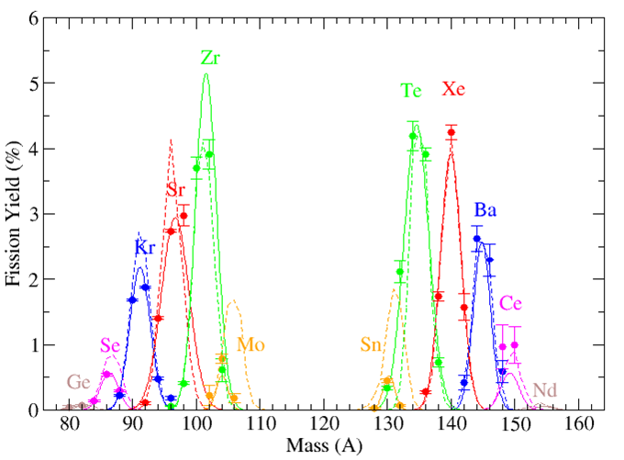
Anomalies in the charge yields of fission fragments from the ²³⁸U(n,f) reaction
J.N. Wilson, M. Lebois, L. Qi et al.,
Phys. Rev. Lett. 118, 222501 (2017)

Slide 19
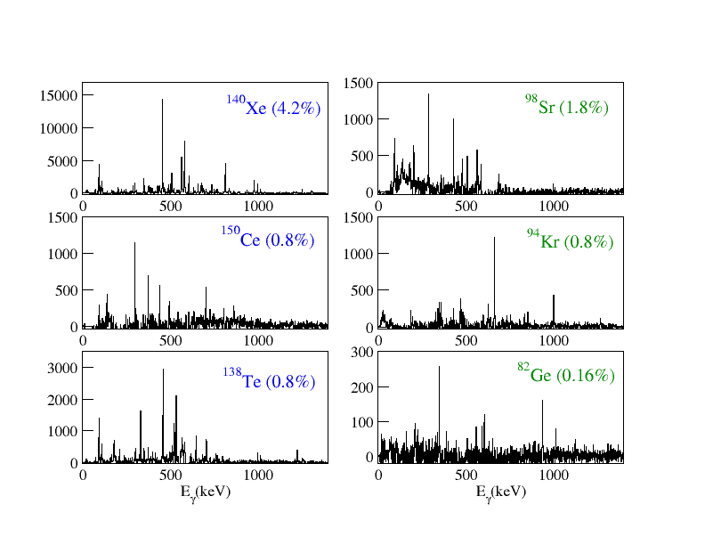
²³⁸U(n,f) Fission Fragment Selection

Slide 20
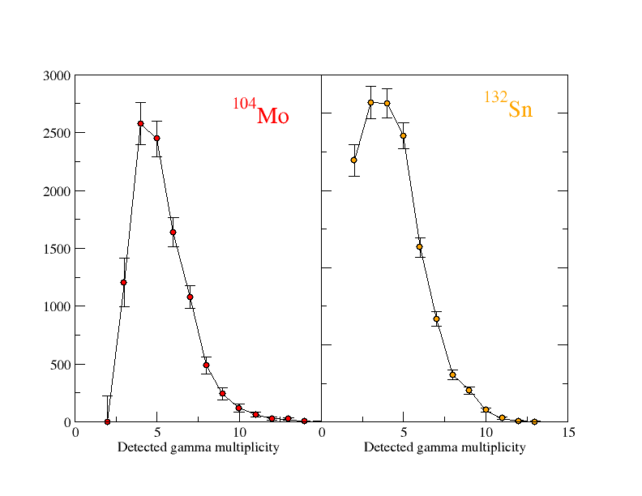
²³⁸U(n,f) Gamma Multiplicity Distributions correlated with A/Z

Slide 21
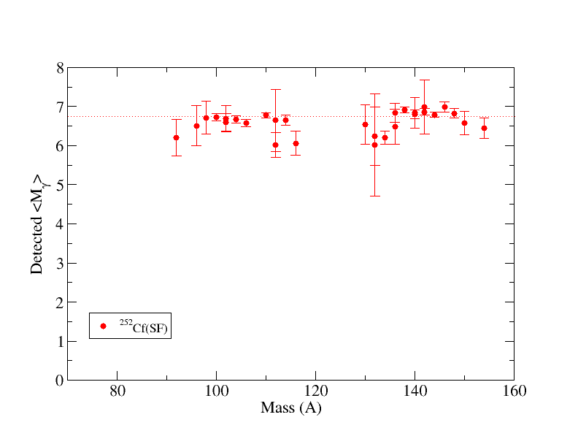
Average gamma multiplicities

Slide 22
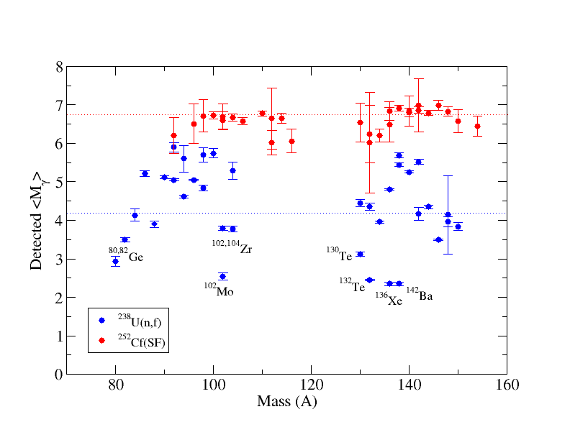
Average gamma multiplicities

Slide 23
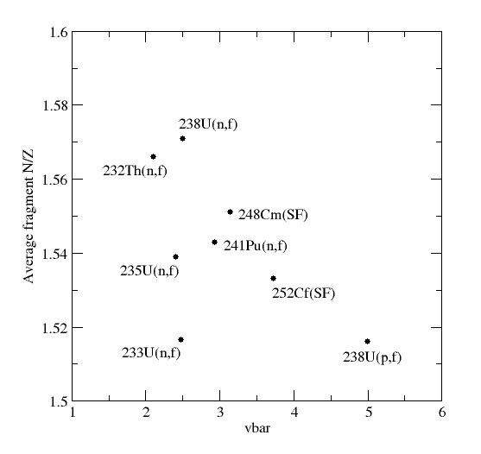
Exotic Nuclei Production/Study from Fission Reactions
Spontaneous Fission
²⁵²Cf(SF), ²⁴⁸Cm(SF)
(Gammasphere, Euroball)
Exoticity
Fission induced by thermal neutrons
²³⁵U(n_{th},f) ²⁴¹Pu(n_{th},f) (EXILL Exogam@ILL)
Fission induced by fast ~2 MeV neutrons
²³⁸U(n,f), ²³²Th(n,f)
(LICORNE @ IPN Orsay)

Slide 24
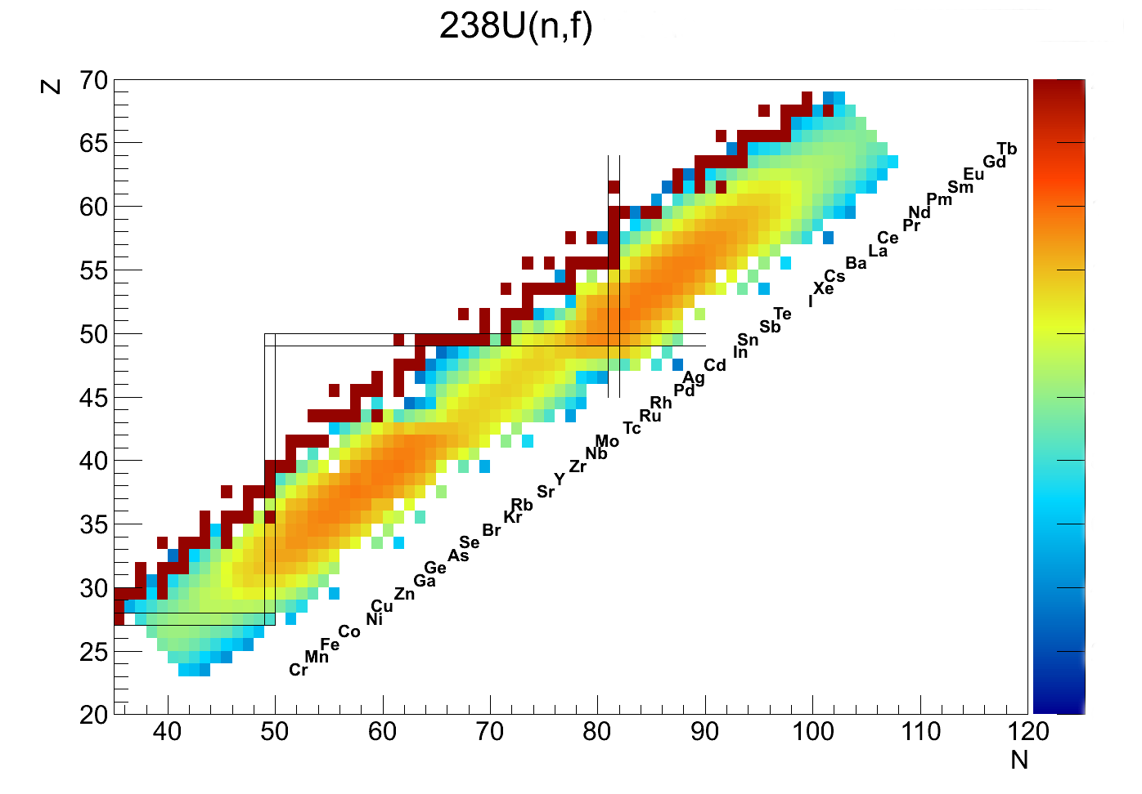
Onset of deformation
T. Kroll (Xe)
G. Benzoni (Ba,Ce,Nd)
Neutron-rich nuclei around ¹³²Sn
S. Leoni (Sn,Sb)
L. Fraile (Sn,Sb,Te)
R. Lozeva (Sb,Te,I)
Shape coexistence around N=60
Blahzev (Kr)
G. Georgiev (Rb)
D. Ralet (Sr)
L. Iskra (Y)
S. Bottoni (Sr,Zr)
P. Regan (Zr)
Spectroscopy above ⁷⁸Ni
M. Lebois (Zn, Ge, Ga)
B. Fornal (Ge,Ga)
A. Korgul (Ge,Se)
C. Schmitt (All)
M. Fallot (Many)
C. Schmitt and J.N. Wilson (All isotopes)

Slide 25
Production and study of neutron-rich nuclei above ⁷⁸Ni with LICORNE/nu-ball
²³²Th(n,f) reaction products
⁹⁵Kr
2
⁹⁶Kr
⁹⁴Kr
2
5
3
⁹³Kr
⁸⁹Br
0
⁹⁰Br
0
⁹¹Br
0
⁹²Br
8
⁸⁶Se
3
⁸⁷Se
0
⁸⁹Se
0
⁹⁰Se
0
⁹¹Se
⁸⁸Se
0
1
Yield
⁸⁵As
0
⁸⁸As
⁸⁴As
0
6
⁸⁶As
0
⁸⁷As
0
> 1%
⁸⁴Ge
3
⁸⁵Ge
1
⁸⁶Ge
⁸²Ge
0
5
⁸³Ge
5
0.1 – 1 %
⁸⁰Ga
13
⁸¹Ga
4
⁸²Ga
1
0.01% - 0.1%
Number of known excited states
1
⁷⁸Ni
2
“⁷⁸Ni revealed as a doubly magic stronghold against nuclear deformation”
R. Taniuchi, et al. Nature, volume 569, pages 53–58 (2019)

Slide 26
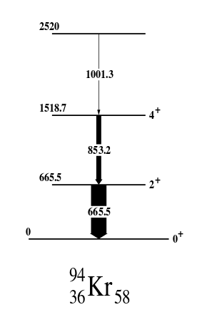
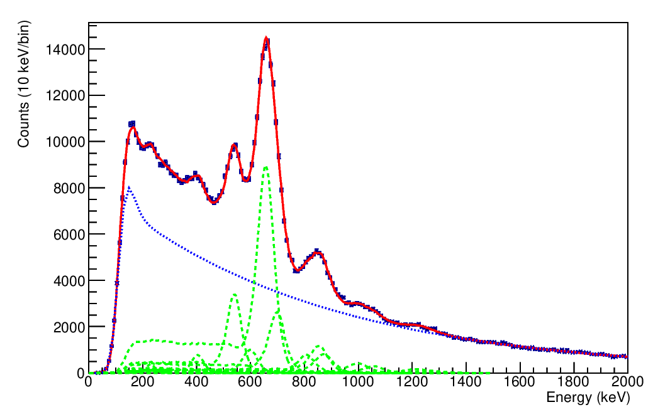
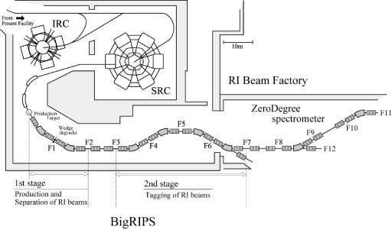
⁹⁴Kr recent RIKEN Big RIPS data
666
v/c = 0.6
854
1001
Previous results confirmed
(courtesy of R-B. Gerst)
T. Rzaca-Urban et al.
Eur. Phys. J. A9, 165–169 (2000)
²⁴⁸Cm(SF)
²³⁸U + Pb @ 350 MeV/A

Slide 27
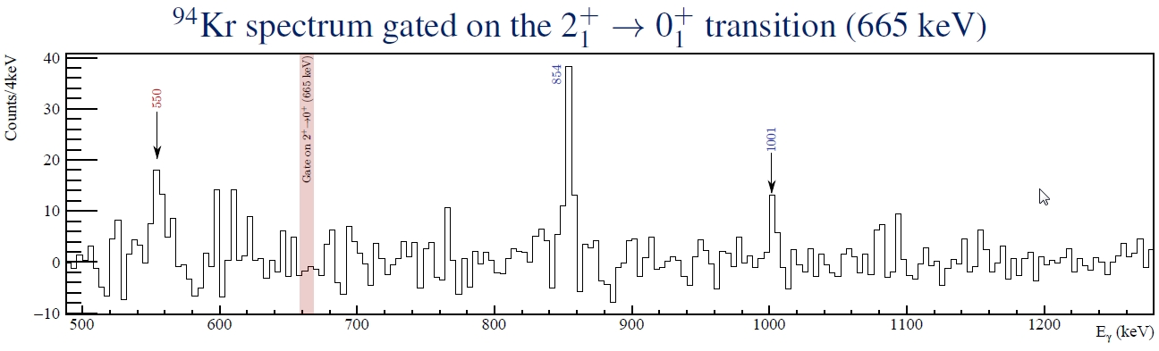
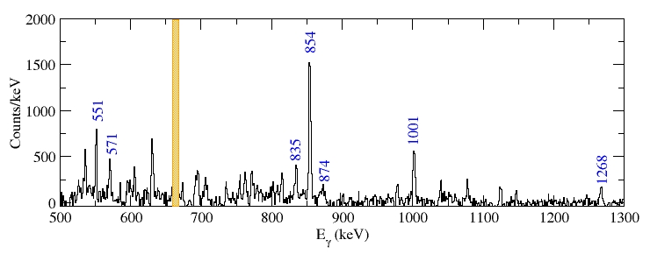
AGATA/VAMOS@GANIL
⁹Be(²³⁸U,f)
(courtesy of J. Dudouet)
v/c = 0.1
ν-ball/LICORNE@ALTO
²³⁸U(n,f)

Slide 28
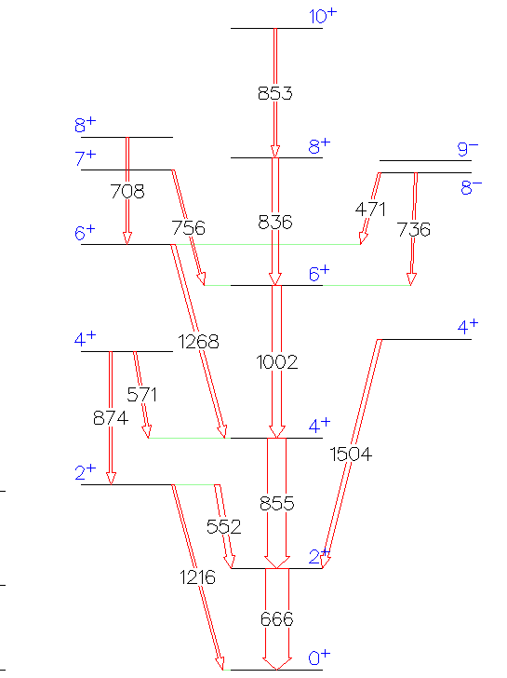
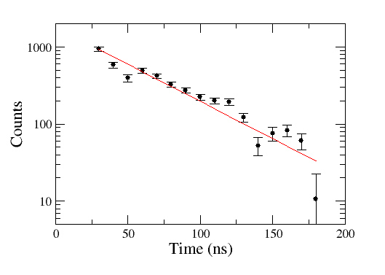
nu-ball/LICORNE ²³⁸U(n,f) data
T_{1/2} = 31 (3) ns
⁹⁴Kr
(preliminary)

Slide 29
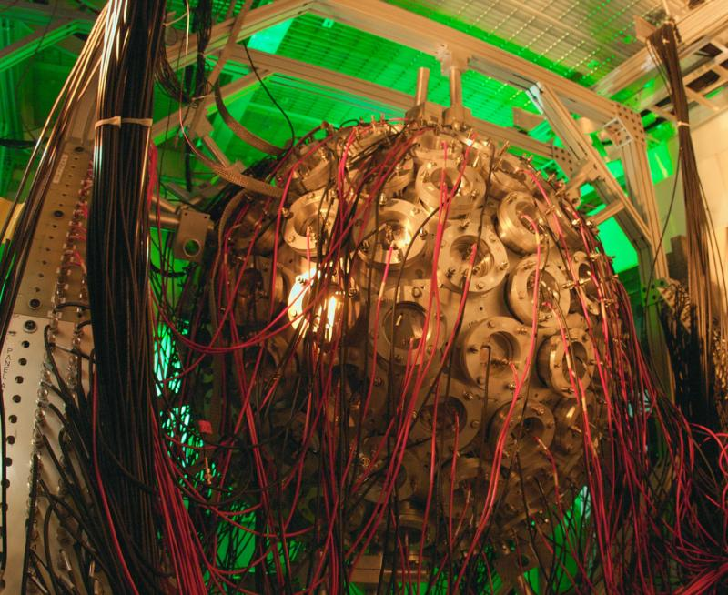
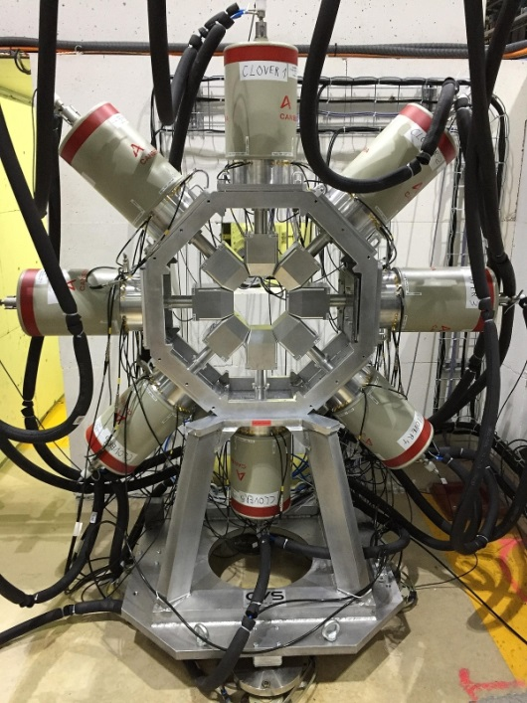

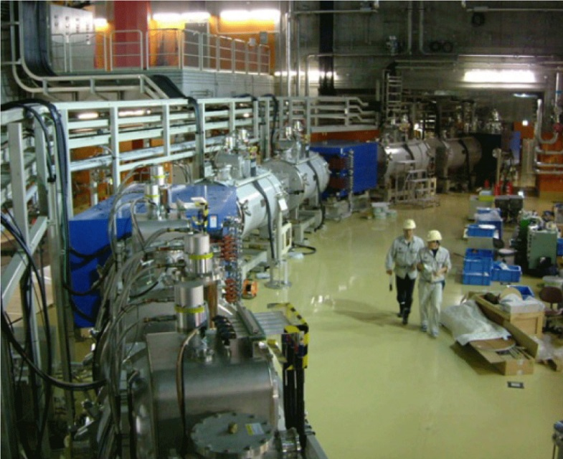
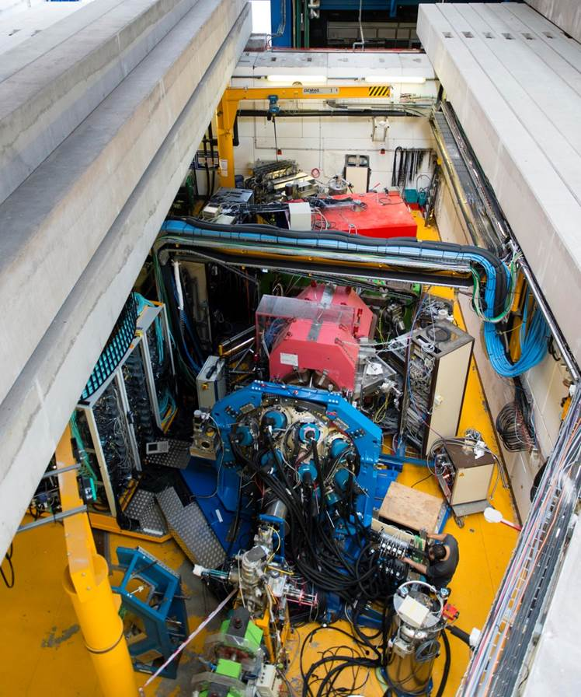
ν-ball in context
Fission studies
DANCE @ Los Alamos
(neutron-induced fission calorimetry)
FIPPS @ ILL
235U(n,f) 241Pu(n,f)
AGATA/VAMOS@GANIL
9Be(238U,f)
Big RIPS @ RIKEN (Pb(238U,f))
nu-ball @ ALTO
232Th(n,f), 238U(n,f)
The structure of neutron-rich nuclei

Slide 30
Threats:
• The heavy dependence of the project on mutualized, internationally-used, resources gives an inherent lack of predictability about the future development of the project, and introduces extra unnecessary and preventable risks to the project timeline.
Strengths
Excellent new scientific opportunities, unique (worldwide) to the ALTO facility
High impact scientific production potential, but with low cost
Correctly dimensioned for ALTO facility. Internationally attractive. Lots of available beam time
Excellent technical support from IPN Orsay and LPC Caen (DAQ)

Slide 31
Weaknesses
Poor local informatics infrastructure (data transfer bandwidth, local data storage, etc.) lags behind current needs. Informatics support for longer-term data storage at CC-Lyon is practically inexistent
The nu-ball project has far too much dependence on mutualized resources (e.g. Gamma Pool detectors) that maximizes the amount of work (for IPNO) and minimizes the availability of the device

Slide 32
Opportunities
nu-ball coupled to the LICORNE directional neutron source presents clear and unique opportunities to perform precision in-beam spectroscopy of fast neutron-induced reactions.
When nu-ball/LICORNE is fully optimized, it can (or has already) become a world-beating device in three separate domains:
Research into new fission process observables and their correlations
The detailed study of the nuclear structure of very neutron-rich nuclei (high spin)
Sub nanosecond fast timing to study nuclear isomerism and nuclear moments

Slide 33
Threats
ν-ball is vital instrumentation for the ALTO facility
The heavy dependence of the project on mutualized, internationally-used, resources gives an inherent lack of predictability about the future development of the project, and introduces extra unnecessary and preventable risks to the project timeline and future campaign(s)

Slide 34
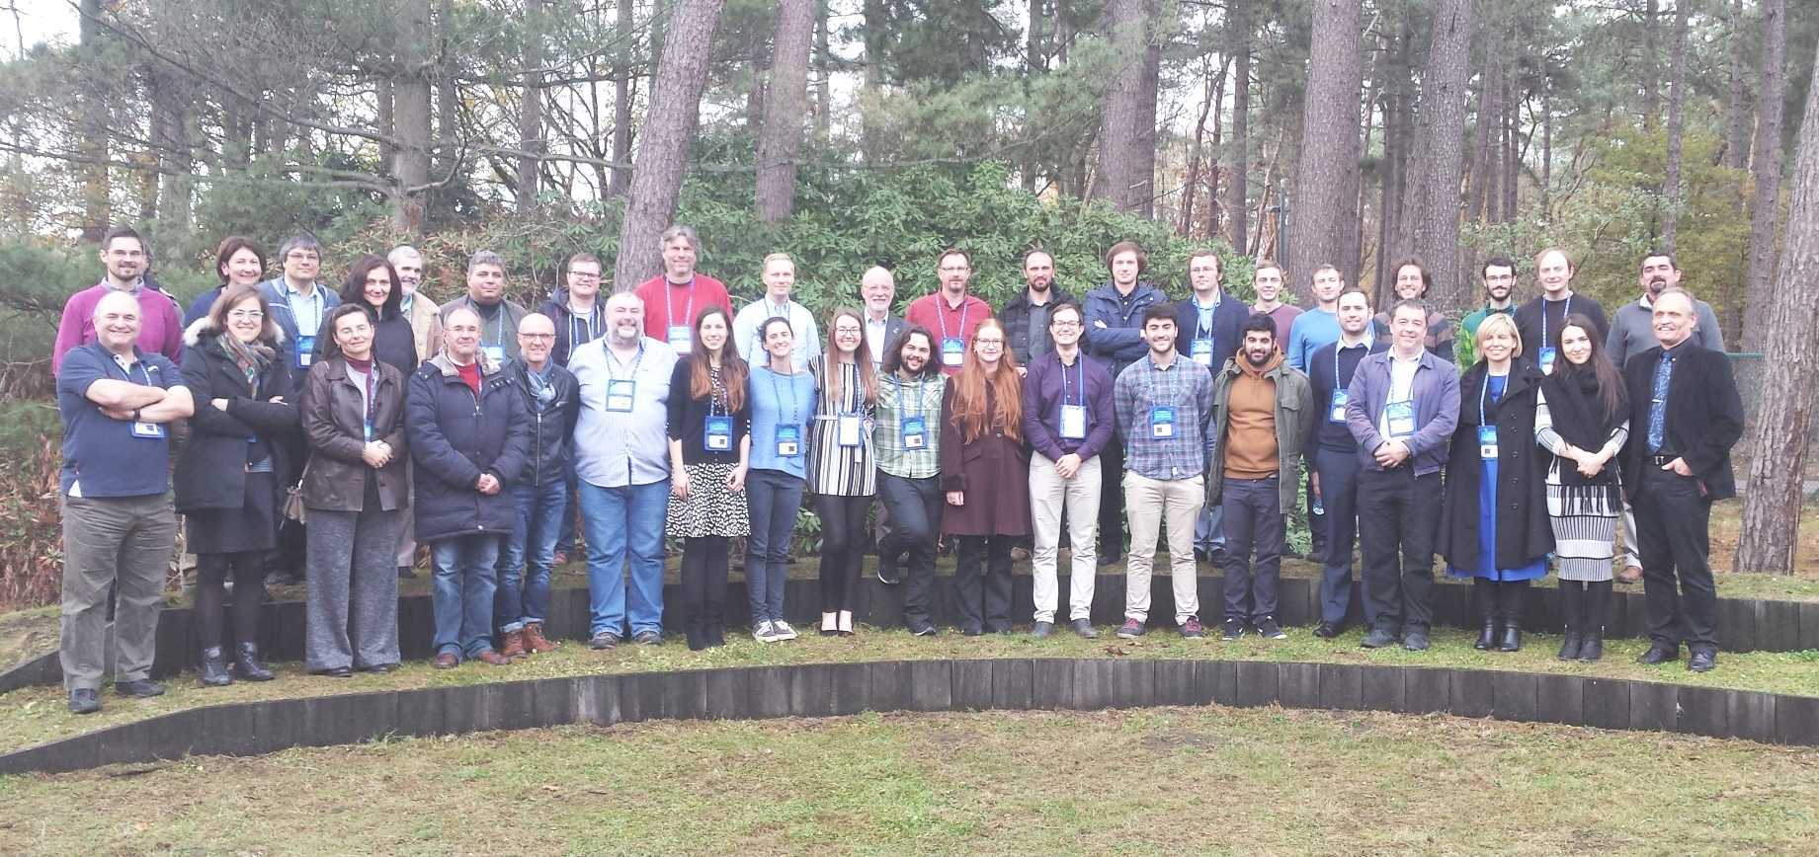
The ν-ball2 International Workshop
JRC-Geel, European Commission, Belgium, November 2018
We envisage asking for in2p3 support for a ν-ball2 campaign in 2021 and 2022

Slide 35
Backup Slides

Slide 36
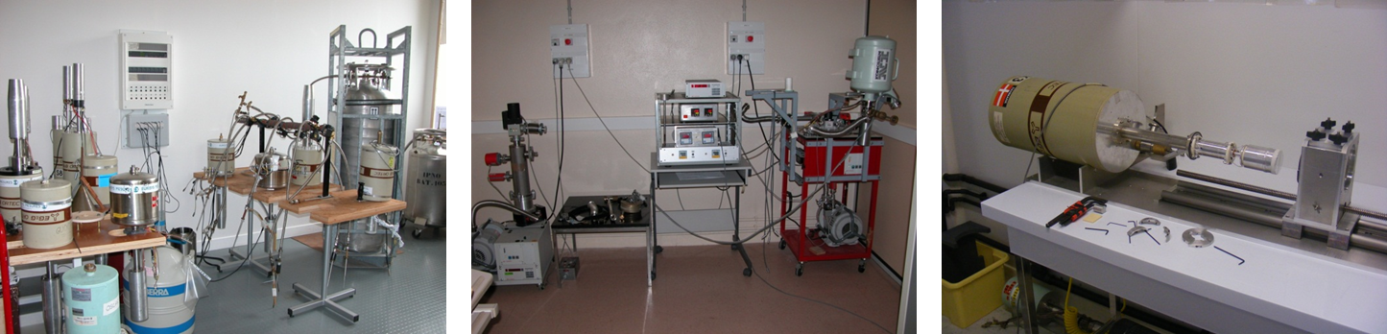
ν-ball Ge detector maintenance
Operations
11 detectors were repaired during the campaign. 25 FET’s replaced.
Components are expensive
HV Filter - 860 euros
FET - 180 euros
Preamplifier - 1600 euros
Failure diagnostic
Pumping
Annealing (80°C)
FET replacement (Clean room required)
HV Filter replacement
Charge preamplifier test and replacement
Replace ORTEC’s obsolete preamplifier by Canberra material
Timeline was very tight
New technique developed in
2018 to replace Preamplifier
components rather than whole board

Slide 37
Gammapool Problems
International committee of 12 members existing since 2002
Deployment of ~20M euros of ex-Euroball detector resources
Conflicts of Interest (e.g. Members voting themselves equipment for their own research)
Committee members from non-French countries unnacountable to their funding agencies
Seats for life. No obligation to sit for fixed term mandates
Lack of French representation (only 8% or 16% of committee)
(Over 50% of nu-ball equipment was originally financed by France)
Poorly written MOU with no end-of-life clause. Resources and MOU are considered eternal
Countries who contributed nothing to Gammapool and borrow equipment are not required to pay any rental costs

Slide 38
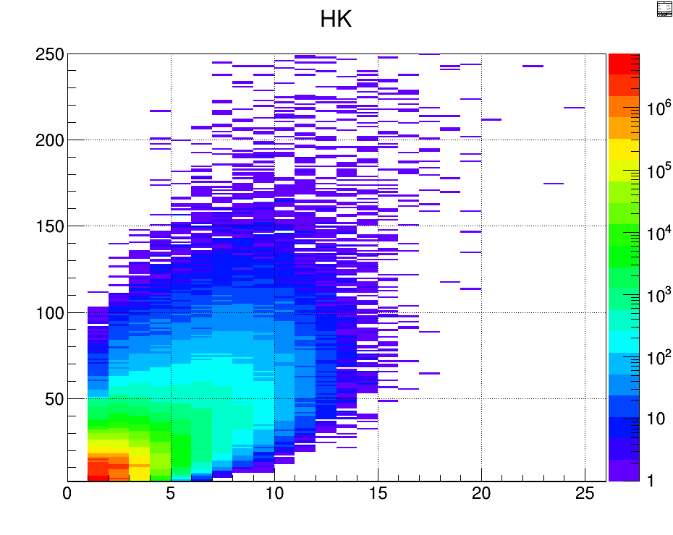

First preliminary results: ²⁵²Cf ionisation chamber + ν-ball
ν-ball calorimetry
¹⁵²Eu beta decay events
²⁵²Cf fission events
Sum Energy
γ multiplicity
γ multiplicity

Slide 39
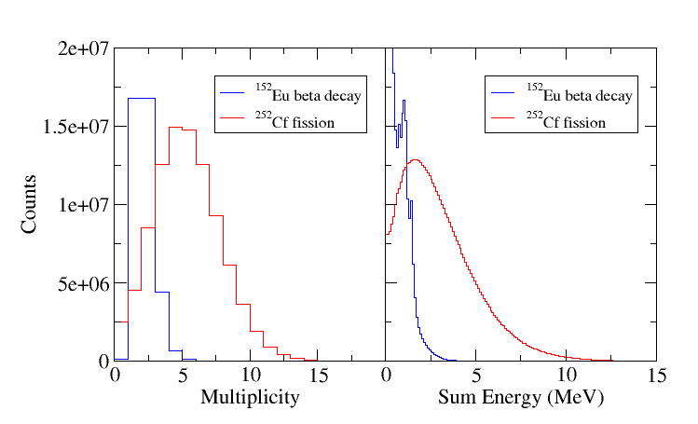
First preliminary results: ν-ball calorimetry

Slide 40
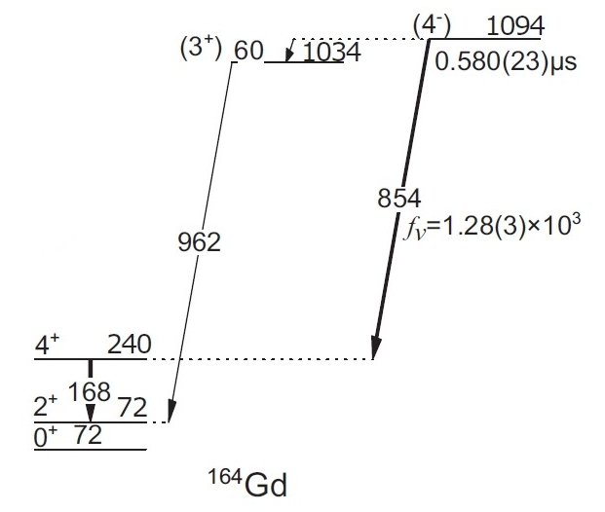
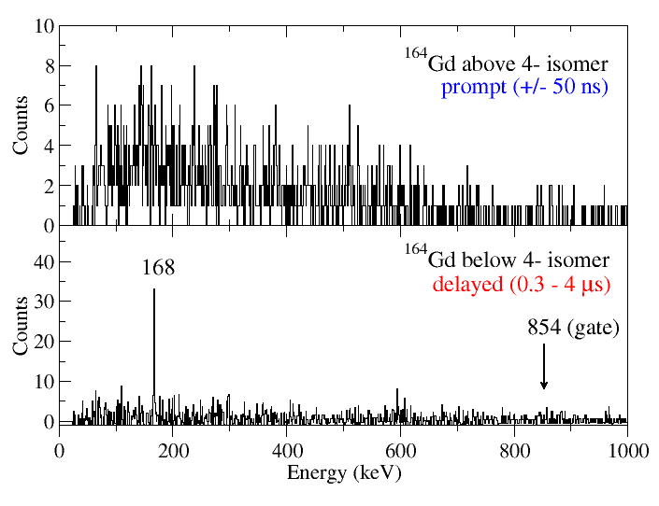
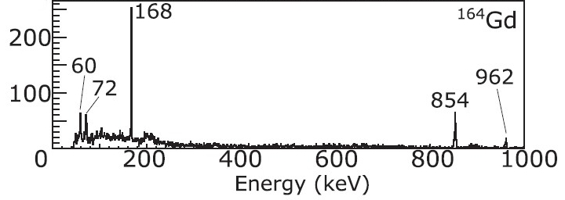
First preliminary results:
²⁵²Cf ionisation chamber + ν-ball
RIKEN
ν-ball
Isomer in ¹⁶⁴Gd discovered at BIGRIPS focal plane in 2017
¹⁶⁴Gd isomer identified after only 48 hours of data
< 0.01% of the total yield
Decays from states above the isomer observed for the first time
Prompt decays impossible to observe

Slide 41
Summary of nu-ball/LICORNE fission experiments:
Expt. | Target mass | ⁷Li Current | E_{n} | Fission Rate | Time | Data | Total Fissions
²⁵²Cf(SF) | - | - | - | 3 kHz | 2 days | 50Gb | 5.2×10⁸
²³⁸U(n,f) | 81 g | 30 nA | 1.7 MeV | 23 kHz | 9 days | 11Tb | 1.8×10¹⁰
²³²Th(n,f) | 129 g | 80 nA | 1.7 MeV | 26 kHz | 19 days | 80Tb | 4.2×10¹⁰
²³⁸U(n,f) | 81 g | 100 nA | 3.4 MeV | 28 kHz | 7 days | 25Tb | 1.7×10¹⁰

Slide 42
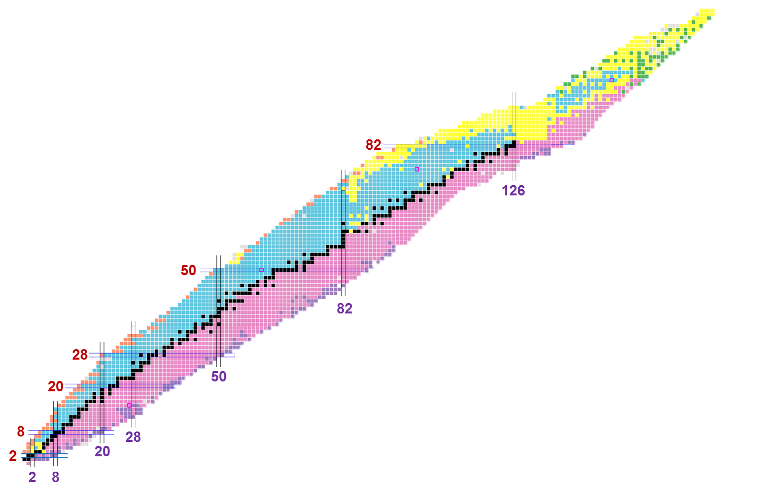
The search for neutron radioactivity
V
Proton
radioactivity
Neutron
radioactivity
(?)
Coulomb barrier
Centrifugal barrier
distance
distance
protons
neutrons

Slide 43
Neutron radioactivity
n
high-spin isomer
neutron-emission
threshold
^{A-1}X
γ decay
g.s.
^{A}X

Slide 44
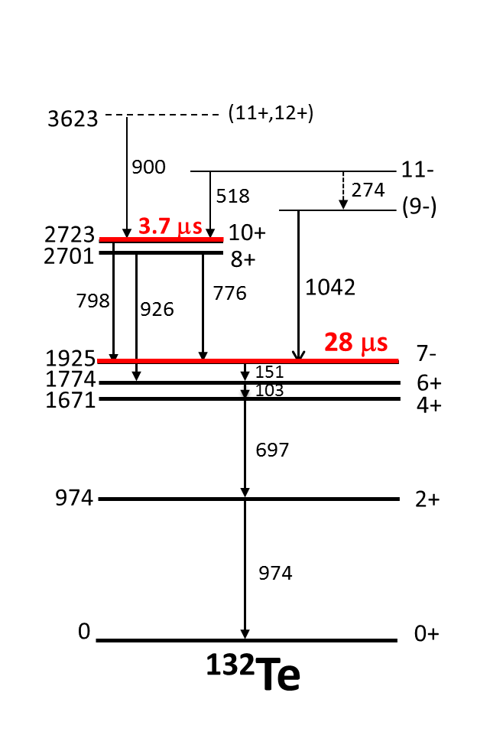
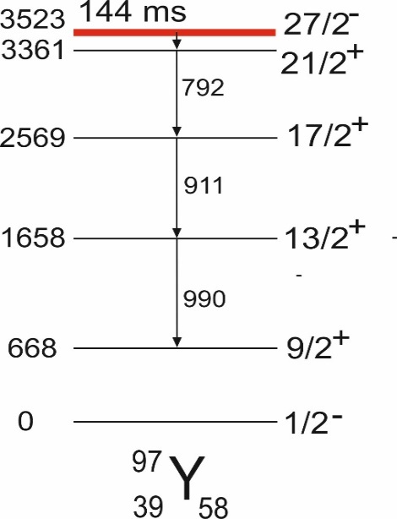
MeV
MeV
8
neutron separation
energy
8
6
neutron separation
energy
6
126
4
4
terra incognita
82
2
50
2
0
0

Slide 45
A.K. Jain, B. Maheshwari, S. Garg, M. Patial, and B. Singh
ATLAS OF NUCLEAR ISOMERS
Nuclear Data Sheets 128 (2015) 1–130
Occurrence of microsecond isomers
in the known nuclei
²⁰⁸Pb
Proton number
¹³²Sn
Potential existence of isomers
lying above neutron-separation energy
⁷⁸Ni
Neutron number

Slide 46
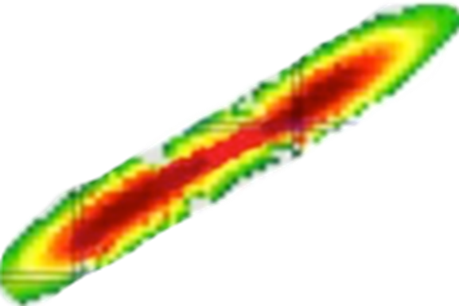
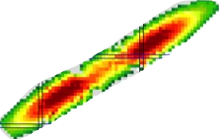
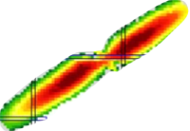
Yields of products
from the fast-neutron
induced fission of ²³²Th
²³²Th
Thermal neutron induced fission
of ²³⁵U
Spontaneous fission of ²⁴⁸Cm

