Slide 1
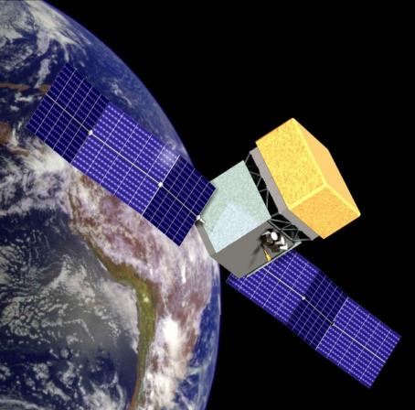
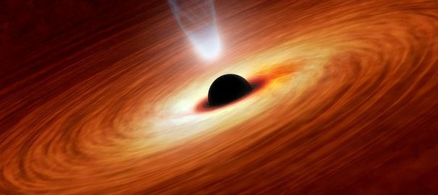
Masterclass in Astroparticle Physics
“Black Holes seen in Gamma Rays”
The Fermi-LAT collaboration 2016

Slide 2
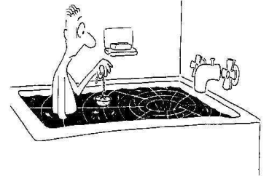
Agenda
Introduction
Background on black holes (blazars, gamma-ray bursts)
Background on gamma-ray astronomy
Notions of flux and luminosity
The Fermi-LAT telescope
The Fermi-LAT data
Creation of sky maps
Study of a blazar outburst
Study of a gamma-ray burst
Video connection

Slide 3
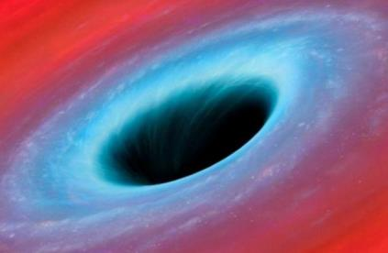
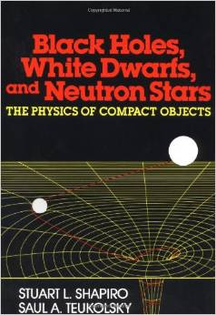
Black holes in the Universe
Introduction to black holes
The black holes at play: the active galactic nuclei
and blazars
The birth of a black hole: a gamma-ray burst

Slide 4
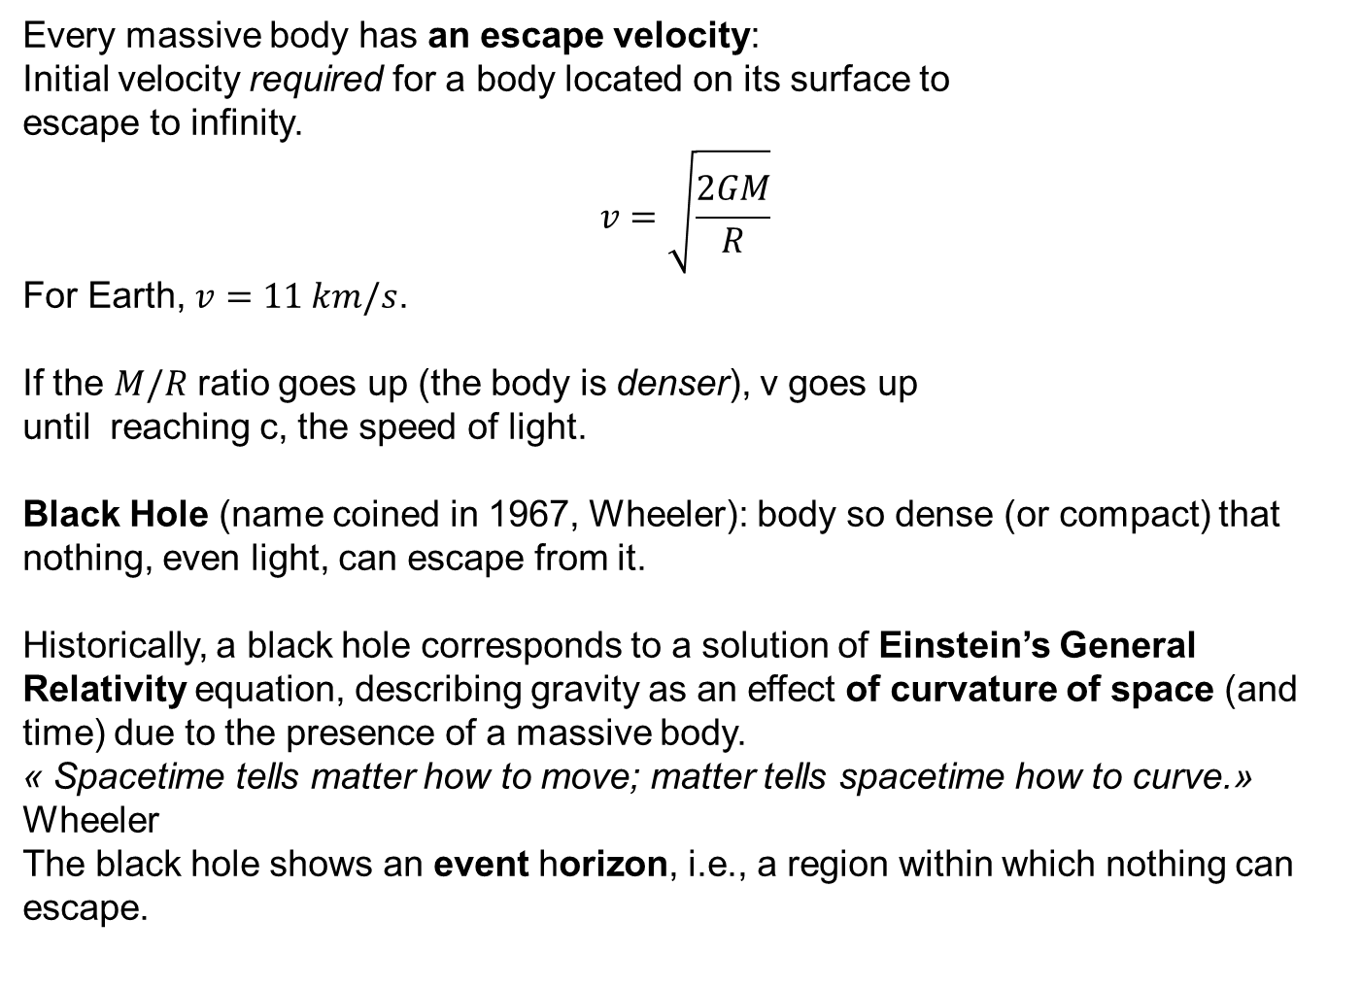
Introduction to black holes
Every massive body has an escape velocity:
Initial velocity required for a body located on its surface to
escape to infinity.
$$v=\sqrt{\frac{2GM}{R}}$$
For Earth, $v=11 km/s$.
If the $M/R$ ratio goes up (the body is denser), v goes up
until reaching c, the speed of light.
Black Hole (name coined in 1967, Wheeler): body so dense (or compact) that nothing, even light, can escape from it.
Historically, a black hole corresponds to a solution of Einstein’s General Relativity equation, describing gravity as an effect of curvature of space (and time) due to the presence of a massive body.
« Spacetime tells matter how to move; matter tells spacetime how to curve.» Wheeler
The black hole shows an event horizon, i.e., a region within which nothing can escape.

Slide 5
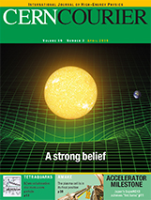
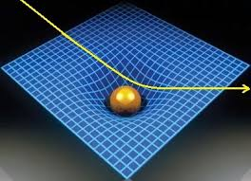
Spacetime curvature

Slide 6
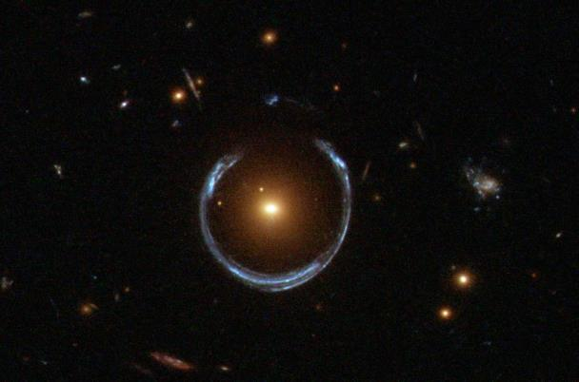
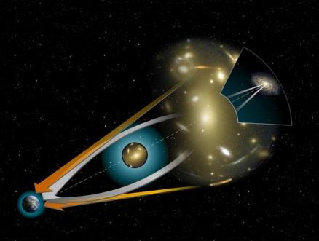
Examples of space curvature:
gravitational rings
A foreground galaxy acts as a converging lens for light rays emitted from a background galaxy. The image of the latter is distorted and appears as rings (« Einstein rings »).

Slide 7
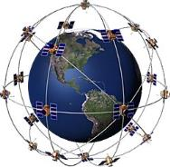
Effect of gravitation on time
Time is affected as well by gravitation. A clock placed close to a massive object runs slower than another one placed far away.
« Gravitational time dilation »
If this effect were not taken into account, the GPS system would not work accurately.

Slide 8
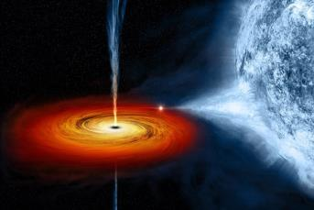
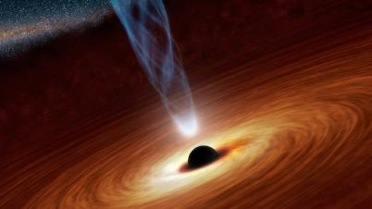
Black Holes of all sizes
Micro black holes: produced in the Big Bang, but have « evaporated » since? Never detected, but could be produced on Earth with accelerators?
Mass simillar to the Sun’s; : ex: X-ray binaries,
gamma-ray bursts, LIGo detection of GW
Supermassive (10⁶-10¹⁰ more massive than
the Sun) in the center of galaxies.

Slide 9
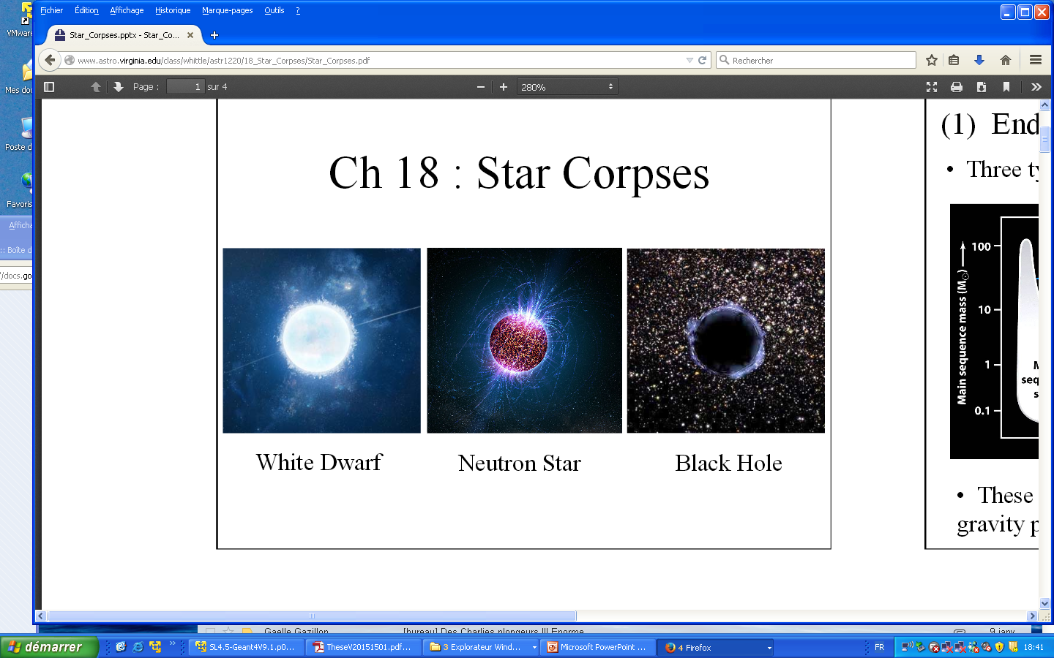
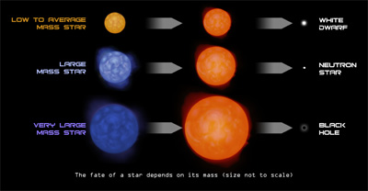
End-points of stars
Estimation: tens of million of stellar-sized black holes in the Milky Way
Only the existence of about twenty of these black holes (found in binary systems)
have been established,

Slide 10
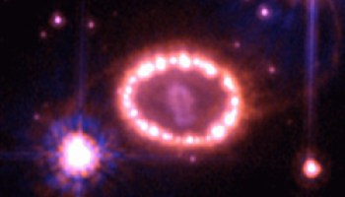
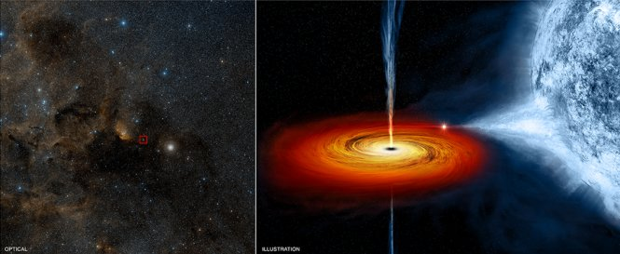
Two stellar-mass black-hole candidates
SN1987A
Cygnus-X1

Slide 11
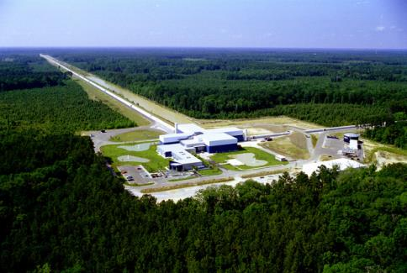
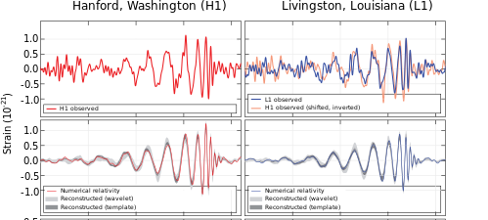
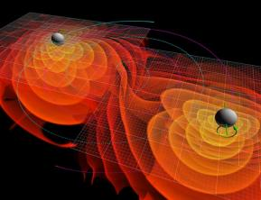
Fusion of black holes- Gravitational waves
The spacetime can be made to vibrate when two massive bodies fuse together and emit "gravitational waves".
The discovery of these waves, produced by the fusion of two 30-solar-mass black holes into a bigger one, was announced in last February by the LIGO team.
The relative length variation is extremely small: 10⁻²¹

Slide 12
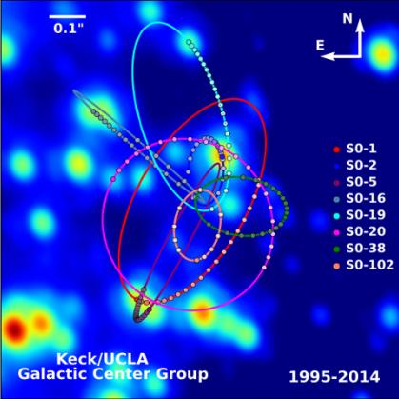
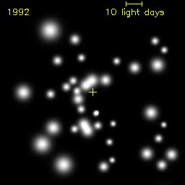
The Sagitarus A* black hole
Black hole sitting at the center of the Milky Way (~4 millions solar masses)
0.1’’

Slide 13
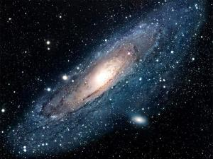
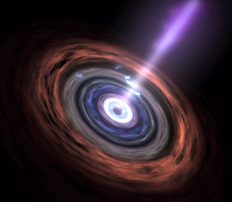
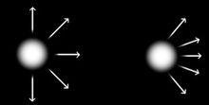
Galaxy, active galaxies
Galaxy:
Group of hundreds of billions stars
About 100 billions galaxies in the Universe
Active Galaxy: galaxy with a very luminous inner part.
« Supermassive » black hole pulling in matter (gas,
dust) from a surrounding disk.
Part of the infalling matter can be ejected via a
high-speed jet detectable in radio (« radiogalaxies »)
Blazar: radiogalaxy whose jet is directed to Earth.
Amplification of the galaxy luminosity and the energy
of its radiations.
Crédit: NASA

Slide 14
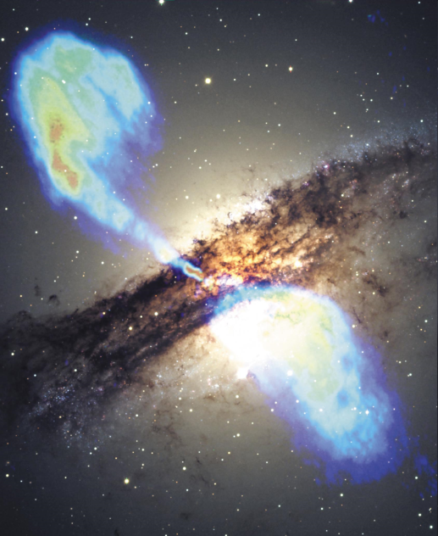
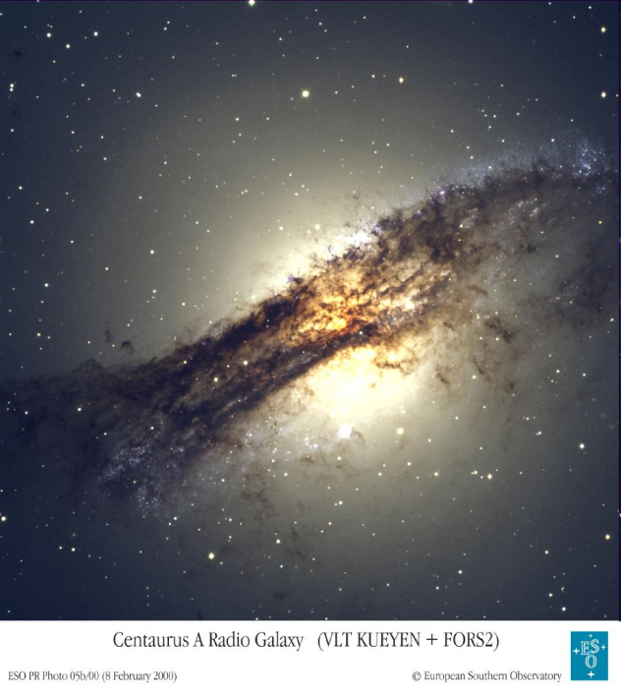

Slide 15
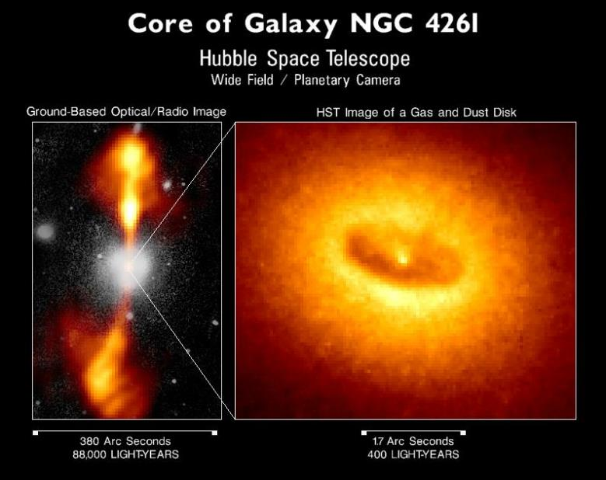

Slide 16
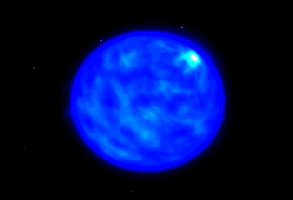
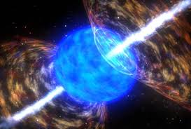
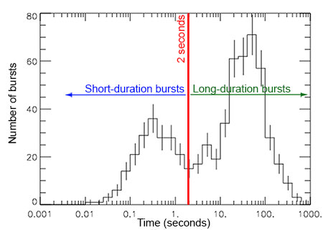
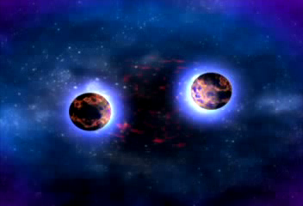
Gamma-ray bursts (GRB)
Very massive stars die in gigantic explosions giving birth to a black hole and ejecting a very fast « jet » of matter: this is a (long) gamma-ray burst (detectable as a flash of gamma-rays). A tremendous amount of energy is released during this event.
Note: There is another type of GRBs: short ones, corresponding to the fusion of two neutron stars.
longs: hypernova/collapsar
courts: coallescence d’objets compacts
Crédit: NASA

Slide 17
Gamma- ray astronomy and cosmic accelerators
In blazars and gamma-ray bursts, particles (electrons or protons) are
accelerated to very high energies ( ~TeV).
These particles emit radiations, including gamma rays by interacting with
matter,
other radiations,
and magnetic fields.
Gamma-rays can only be produced by high-energy particles. Their detection
allow the study of the cosmic accelerators in the Universe:
Active galactic nuclei (as blazars, very time variable)
Gamma-ray bursts (explosions lasting a few seconds)
Pulsars (fast-spinning neutron stars)
Supernova remnants, some of them accelerating the cosmic rays
that bombard the Earth.

Slide 18
Gamma-ray astronomy (2)
The gamma-rays are blocked by the atmosphere: a telescope on board a satellite is required to detected them.
The radiation is so faint that one detects one light particle (a photon) at a time.

Slide 19
A measurement with a telescope
Collecting area: Telescopes collect more light than the human eyes thanks to a larger area. This area is not usually exactly the geometric area: slanting effect + non-perfect « efficiency ».
Collecting time: By using photographic plates or electronic sensors (CDD), one can collect light over a long time.
Magnification: By combining diverging and converging lenses or mirrors, a magnified image can be obtained. Unfortunately, gamma-rays cannot be deflected.

Slide 20
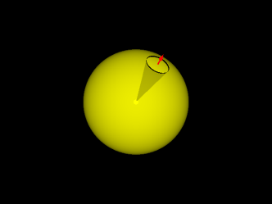
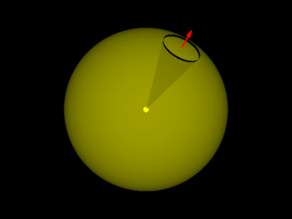
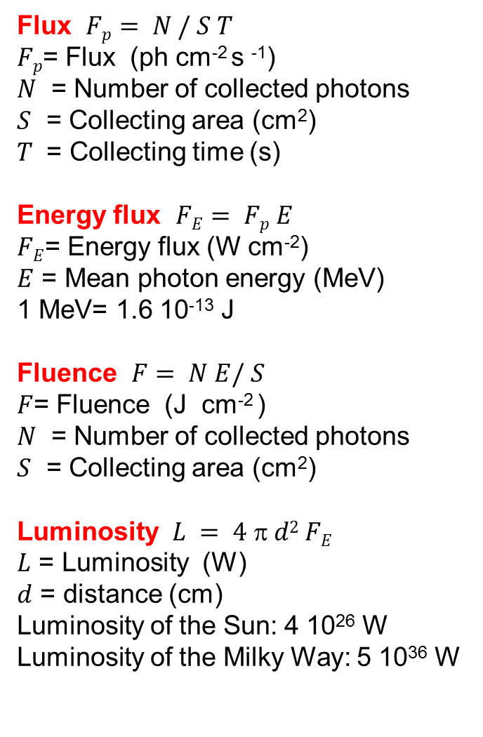
Flux and luminosity
Flux $Fp= N / S T$
$Fp$= Flux (ph cm⁻² s ⁻¹)
$N$ = Number of collected photons
$S$ = Collecting area (cm²)
$T$ = Collecting time (s)
Energy flux $FE= Fp E$
$FE$= Energy flux (W cm⁻²)
$E$ = Mean photon energy (MeV)
1 MeV= 1.6 10⁻¹³ J
Fluence $F= N E/ S$
$F$= Fluence (J cm⁻² )
$N$ = Number of collected photons
$S$ = Collecting area (cm²)
Luminosity $L = 4$π$d2 FE$
$L$ = Luminosity (W)
$d$ = distance (cm)
Luminosity of the Sun: 4 10²⁶ W
Luminosity of the Milky Way: 5 10³⁶ W
The number of photons emitted in a cone per second remains constant and thus is independent of the distance to the source.
At a given distance, the area of a sphere intercepting the cone scales as the square of the distance.
So the number of photons per square cm and second (= the flux) is inversely proportional to the distance squared ("inverse-square law").

Slide 21
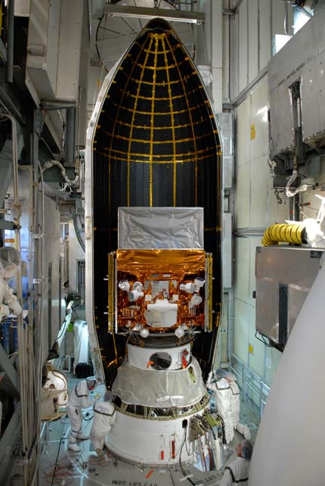
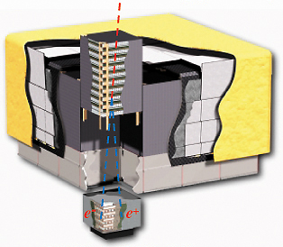


The Large Area
Telescope on board the Fermi
satellite
(launch: June 11, 2008)
γ incoming gamma ray
Crédit: NASA
e⁻ e⁺ pair

Slide 22
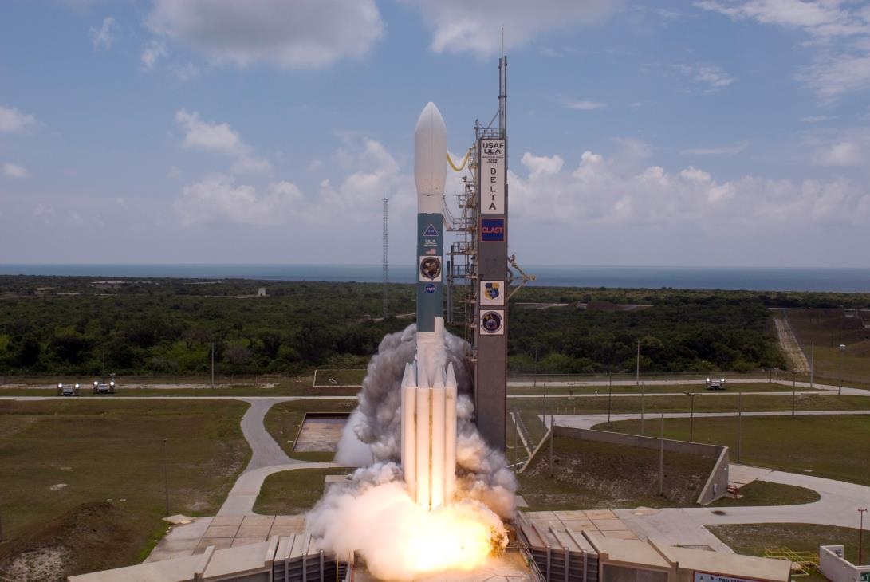

Slide 23
The Fermi Large Area Telescope (LAT)
γ
Pair-Conversion Telescope
Anticoincidence
Detector (background rejection)
Conversion Foil
Particle Tracking Detectors
e⁺
e–
Calorimeter
(energy measurement)
The gamma-ray photons interact with matter and produce an electron-positron pair photons (“E=mc^{2”}). The LAT is a detector similar to those used in particle physics at CERN.

Slide 24
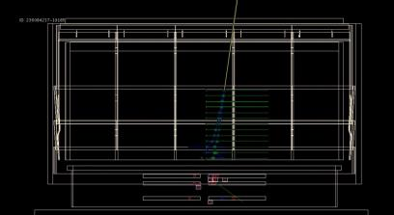
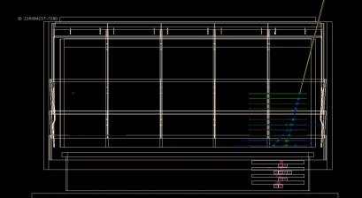
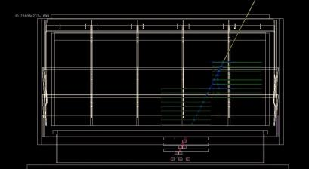
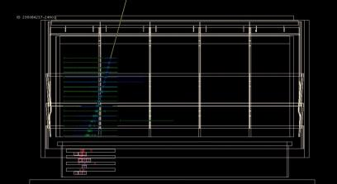
Gamma-ray photons detected by the LAT
Green crosses show the positions of the detected charged particles, blue lines represent the reconstructed trajectories using the tracks and the yellow line indicates the estimated gamma-ray direction. Red crosses show the energy deposited in the calorimeter.
Notes:
24

Slide 25
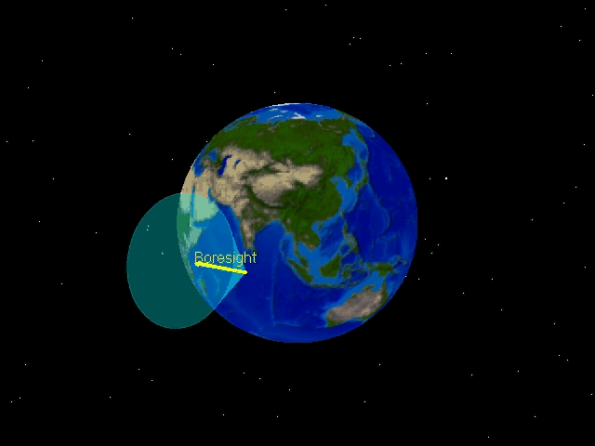

Slide 26
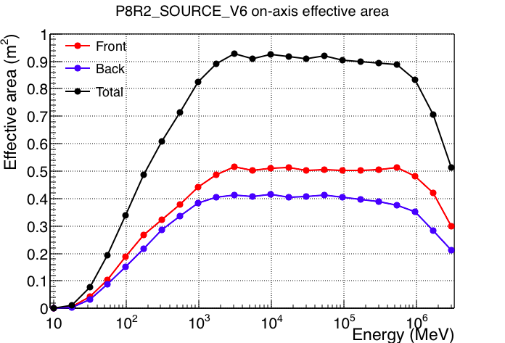
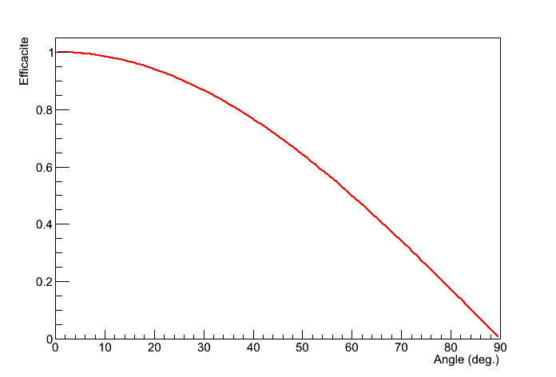
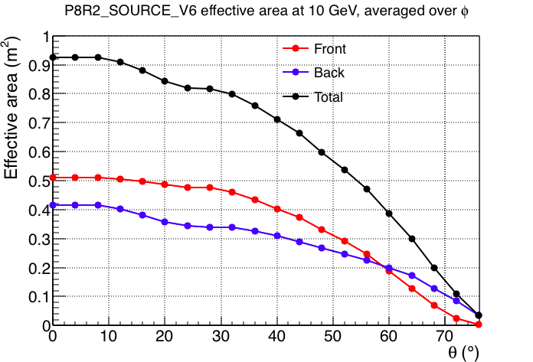
LAT performance
Collecting area
It depends on the energy (why?) and the angle between the gamma-ray direction and the detector
Axis. If the detector was infinitely thin and recorded all particles hitting it, the collecting area would
scale as the angle cosine.
Angular resolution
A point source in the sky does not show up as a point in the data, but as more or less extended
spots. The telescope has a limited precision when measuring the photon arrival direction
(« angular resolution»). This precision is about 1 degree for a 100 MeV photon but improves at
higher energies.

Slide 27
Background rejection
Goal: After a quick training, try to tell from the event displays whether
the primary particles are most likely photons or charged cosmic rays.
Guess the energy: low, medium, high?
( Do it for 20 events. What is your score?)

Slide 28
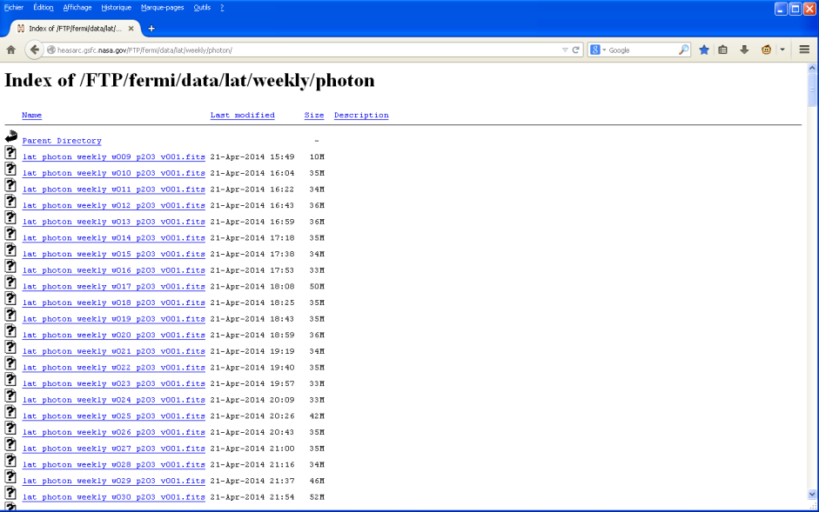
Public NASA’s Fermi-LAT data server

Slide 29
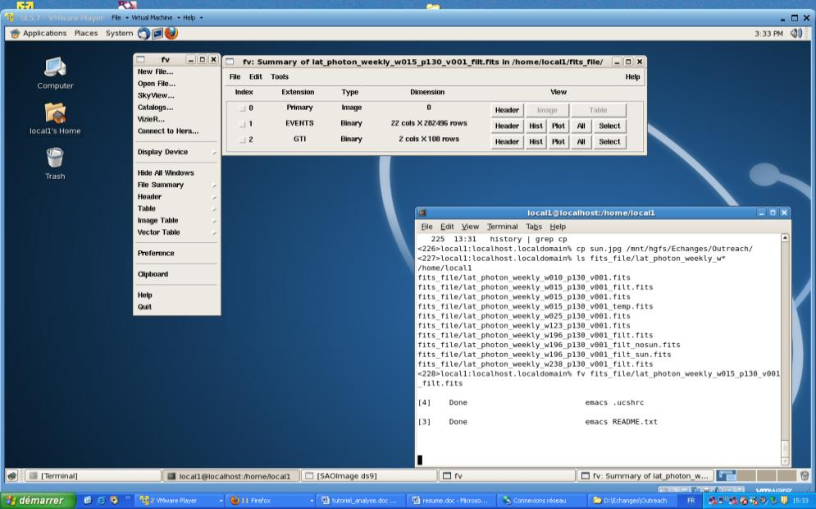
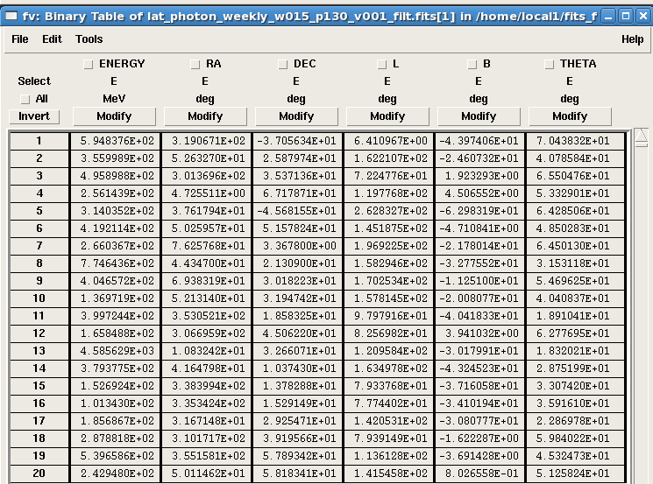
The Fermi-LAT data
Explore a weekly data file with the command fv (fits viewer)
fv fits_file/lat_photon_weekly_w074_p302_v001_filt.fits

Slide 30
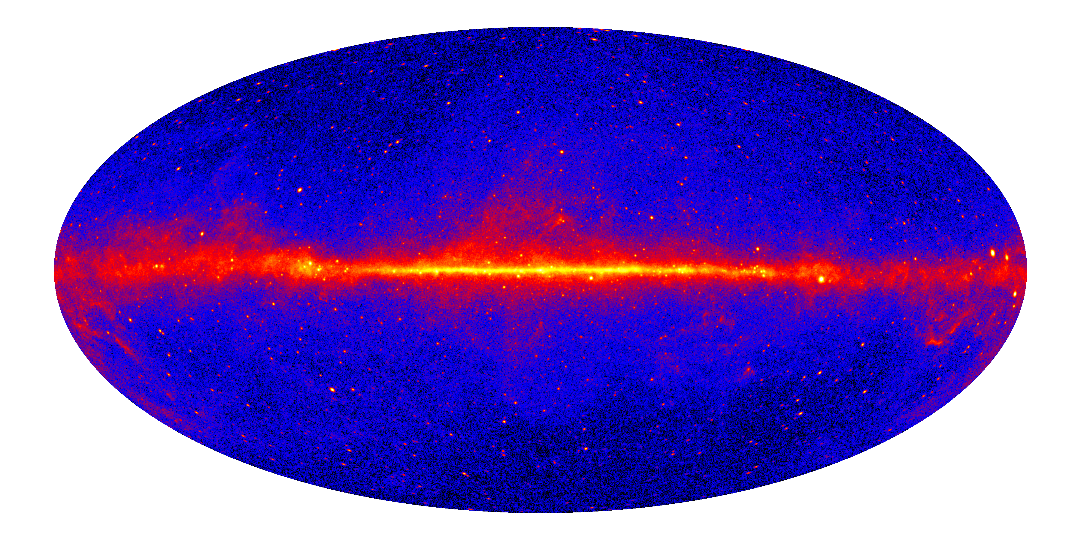
The sky seen by Fermi
Sky map using E>1 GeV photons collected in 4 years
The diffuse background is made of photons coming from the interaction of cosmic rays
with matter (dust, gas) present in the Milky Way. Point sources are also visible.

Slide 31

Create a sky map
> create_map #week (option)
option= cel, gal, ait
Ex: create_map 129 ait

Slide 32
The blazar 3C 454.3
It is the brightest active galactic nuclei (blazar) detected by le LAT, with spectacular outbursts.
It hosts a 4-billion solar mass black hole.
It is located 7.2 billion light year away.
(redshift=0.859).
Its coordinates are:
(RA, DEC)=(343.5°,16.15°)

Slide 33




week 78
week 74

Slide 34


The blazar 3C 454.3
Different parameters characterize a celestial object emitting radiations:
Its sky position (two coordinates, which are angles similar to the longitude and
latitude on Earth).
its flux (possibly variable in time): photon/cm²/s
its «flux density» also called « spectrum », representing the weight of the
different detected radiations as a function of their energy. It is a flux per energy unit.
In the gamma-ray energy domain, the flux density can often be modeled by a power-law
function N(E)=k E^{-α} where k and α are constants. α is called the spectral index.
Creation of a map with selection (time and position)
Options: Explanation of the photon spread (angular resolution)
Using data in format csv to make a map with Excel or other spreadsheet
applications known to the students:
Scatter plot
2D histogram

Slide 35


Light curve
> create_light_curve 128-129 lc_3454.txt 0 0 86400 343.5 16.15 5
We will try to estimate the source luminosity during
the 3 brightest days.

Slide 36


The blazar 3C 454.3
> create_map 129 ait 311731200 311990400 343.5 16.15 15
$Fp= N /( S$x $T)$
$N$ = Number of collected photons
$S$ = Collecting area (cm²)
$T$ = Collection time (s)
The product S x T is called exposure.
> create_exposure 129 map 200
Number of photons: 10215
Exposure (S x T): 1.65 x10 ⁸ cm² s
Photon flux : 6 x 10⁻⁵ ph cm⁻² s⁻¹

Slide 37

Energy spectrum
fit_spectrum 129
Adjust the flux and spectral index of a power law function so as to best match the data.
The right-hand panel displays the function used (top) and the exposure as a function of energy
(bottom) whose product yields the number of photons as a function of energy (left-hand panel).

Slide 38

Luminosity of the flaring blazar 3C 454.3
$$Fp= N / S T$$
$N$ = Number of collected photons
$S$ = Collecting area (cm²)
$T$ = Collecting time (s)
$$FE= Fp E$$
$FE$= Energy flux (W cm⁻²)
$E$ = Mean photon energy
1 MeV= 1.6 10⁻¹³ J
$L = 4$π$d2 FE$
$L$ = Luminosity (W)
$d$ = distance (cm)
Sun Luminosity: 4 10²⁶ W
Milky Way Luminosity: 5 10³⁶ W
Photon flux : 6.5 10⁻⁵ ph cm⁻² s⁻¹
Spectral Index (α) : 2.3
Mean Energy : 433 MeV
Energy Flux : 4.5 10⁻¹⁵ W cm⁻²
Distance : 1.7 10²⁸ cm
Luminosity : 1.6 10⁴³ W (=1.6 10⁵⁰ erg s⁻¹)
As much as 3 million galaxies like the
Milky Way!
In reality, the source does not radiate
uniformly in all directions, but only in
a cone of about 5-degree opening along
the jet.

Slide 39


The gamma-ray burst 080916C

Slide 40


The gamma-ray burst 080916C
http://www.sciencemag.org/cgi/rapidpdf/323/5922/1688?ijkey=FM8C.rv8K96z2&keytype=ref&siteid=sci

Slide 41

080916C map
create_map 15 ait 243216747 243216870 120 -56 20
GRB 080916C. redshift=4.35. distance traveled by the light:
12.2 billion years. Luminosity distance: d_{L} = 1.25×10²⁹ cm

Slide 42

Creating an animation
Ex: python create_movie_scat.py
file_fits/lat_photon_weekly_w015_p203_v001_temp.fits 20

Slide 43
080916C lightcurve

Slide 44

080916C lightcurve
hist fits_file/lat_photon_weekly_w015_p302_v001_temp.fits TIME 246

Slide 45

080916C fluence
1 erg = 10⁻⁷ J

Slide 46


080916C fluence (2)
> fluence 15
Fluence: 80000 MeV/3000 cm²
=4.3 10⁻¹² J cm⁻²
E_{tot}= $4$π$d2$Fluence /(1+z)
= 1.6 10⁴⁷ J
Note:
Solar mass: 2 10³⁰ kg
E=Mc² = 2 10⁴⁷ J (= 2 10⁵⁴ erg)
The energy released in gamma-rays
during this GRB corresponds to a
solar mass converted into energy!
(Note: the yearly french electric energy production
corresponds to a mass of 20 kg, the total worlwide
energy production to about 6 tons)

Slide 47
The end
Congratulations
for completing this class!

Slide 48


How does a black hole like really close?
« Gargantua » in the movie « Interstellar »

Slide 49





Special Relativity (1905)
Abandon des notions de temps et d’espace absolus.
« Dilatation du temps, contraction des longueurs »
La vitesse de la lumière ne peut être dépassée. 300000 km/s
Equivalence entre énergie et matière. E=mc²
Toute théorie doit être « relativiste » sinon elle est incomplète. Ce n’est pas le cas de la loi de gravitation de Newton!
avant Einstein | après
(x,y,z), (x’,y’,z’) t | (x,y,z,t), (x’,y’,z’,t’)
Espace et temps | « Espace-temps »

Slide 50




Gravitation de Newton
m
R
M
R_{ISS}=1.09 R_{Earth}
Γ=0.85 G
« weightlessness » = free fall
Une vitesse latérale par rapport à la direction du centre de la Terre entraine une trajectoire évitant le centre.

Slide 51

The Equivalence Principe (1)
Observation: Gravity produces the same effect as a continuous accelearation..
Crédit: Sciences et Vie Junior
The equivalence principle: No physical measure allows one to tell whether one is subject to gravity or to a continuous acceleration.

Slide 52

The Equivalence principle (2)
Crédit: Sciences et Vie Junior
Conséquence: Si une accélération conduit à une courbure apparente du rayon lumineux, la gravité doit faire de même.
La gravité courbe l’espace-temps!

