Slide 1

B-field measurement
Dinko Atanasov
dinko.atanasov@cern.ch
CERN, Experimental Physics department
on behalf of
the WISArD collaboration
WISArD Collaboratin Meeting!
26 February 2021

Slide 2
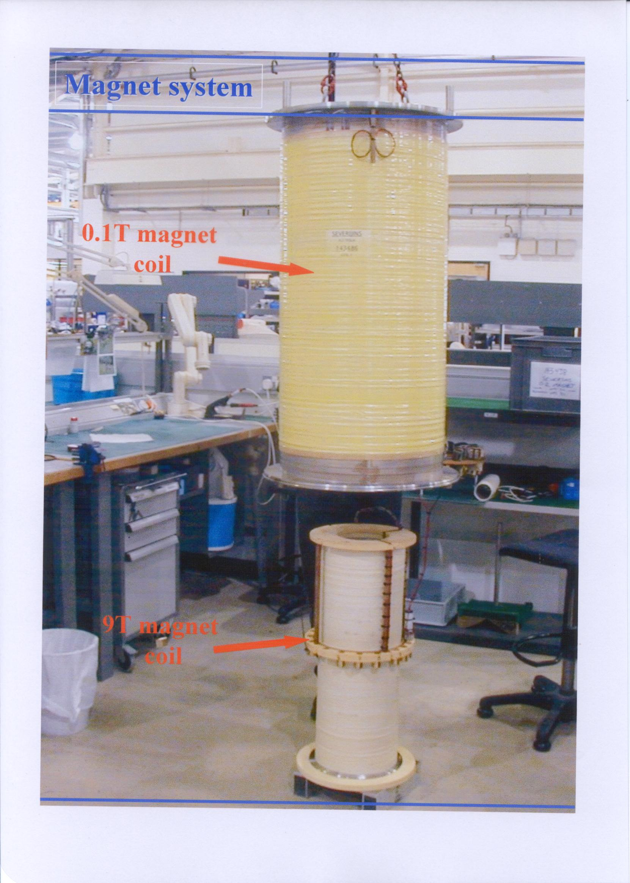
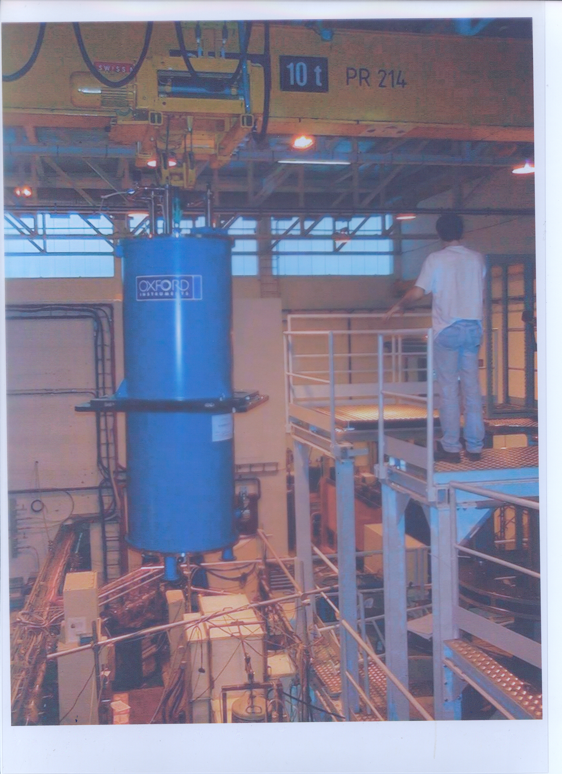
WISArD magnet system
Marcus Beck - https://fys.kuleuven.be/iks/wi/WITCH/witch-presentations#pascos99

Slide 3
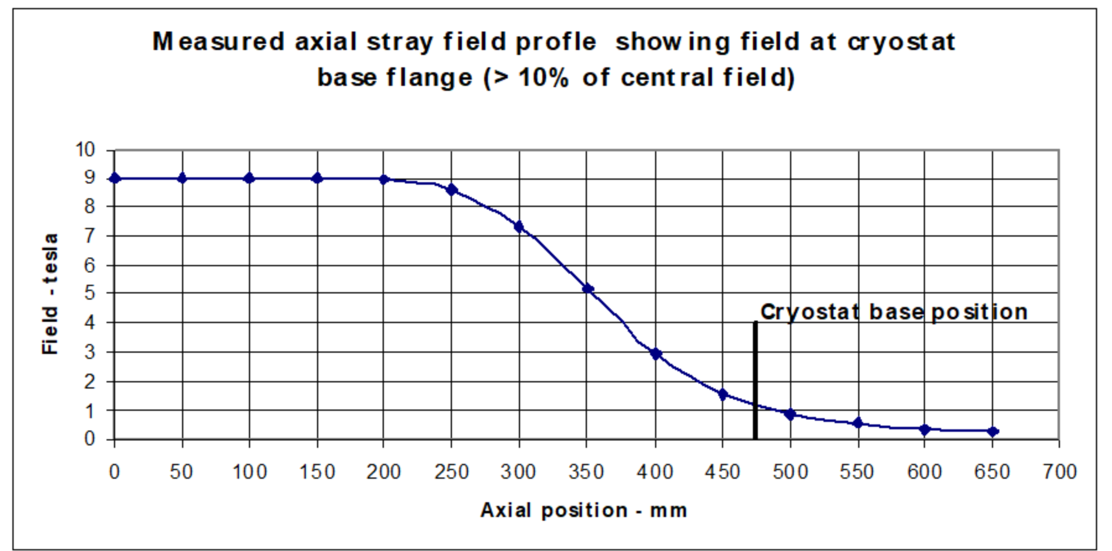
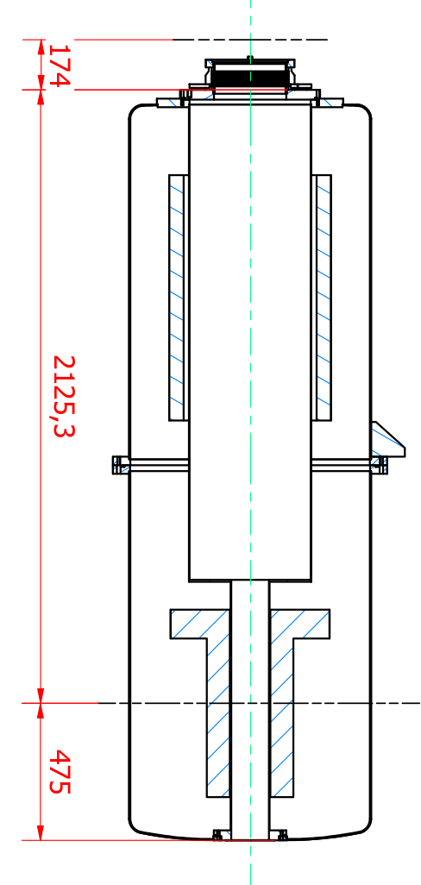
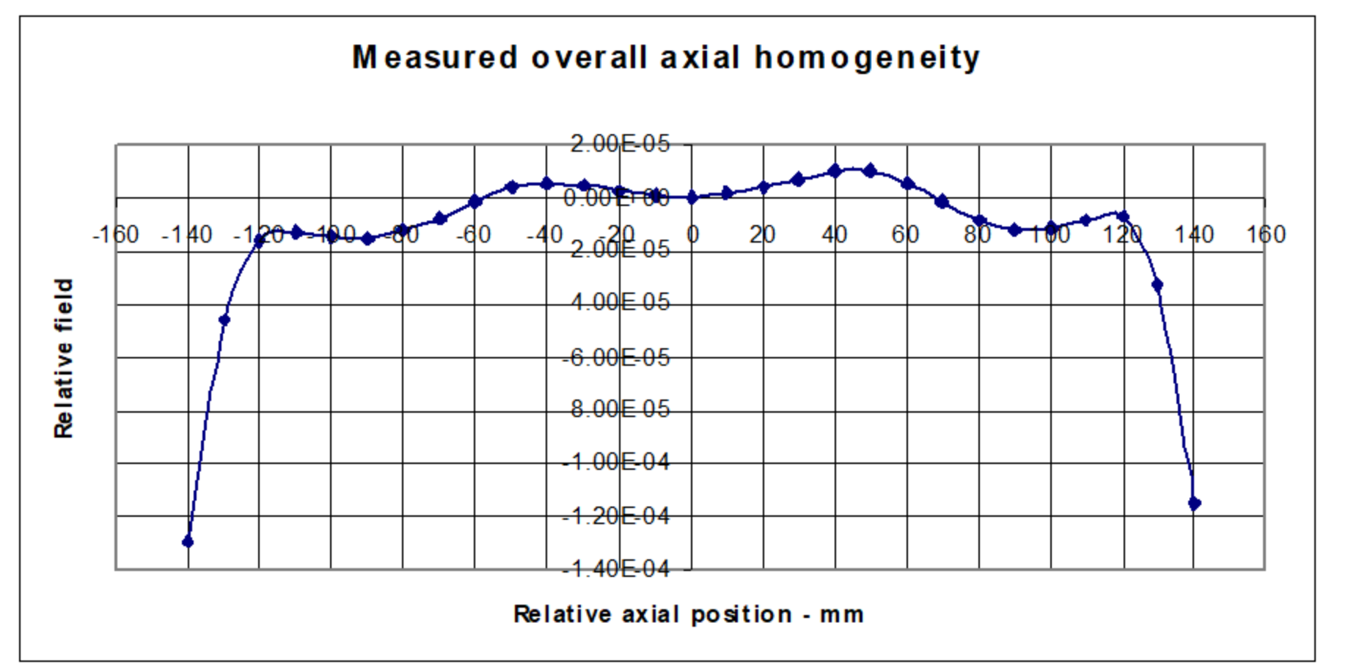
Oxford measurements
9T set point
Hall probe
Date : 14/09/01
NMR probe map*
*the stray field profile in a region (40 mm long x 10 mm diameter positioned 100 mm from the mid plane).

Slide 4
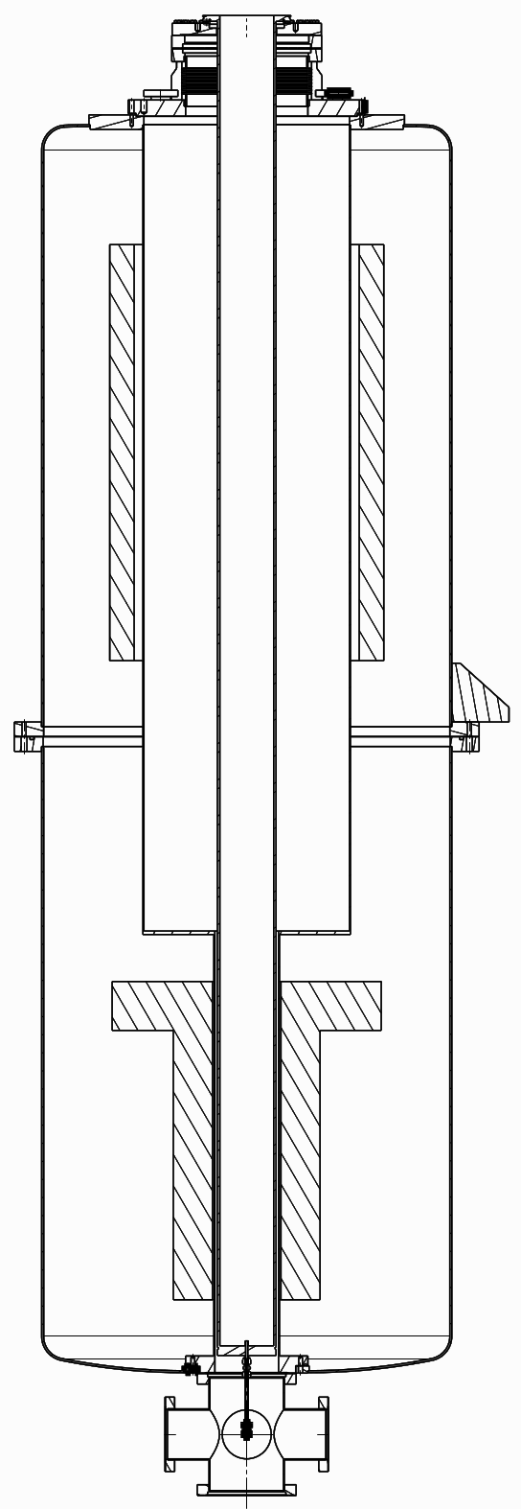
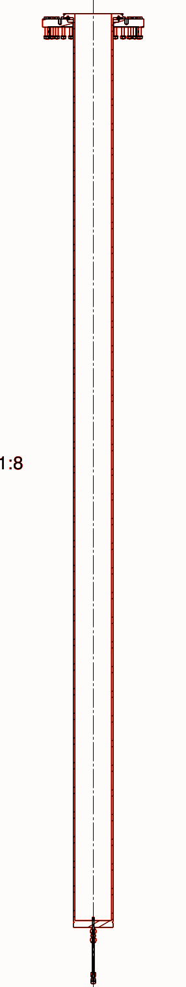
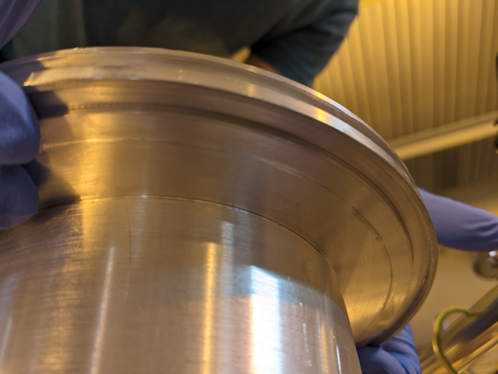
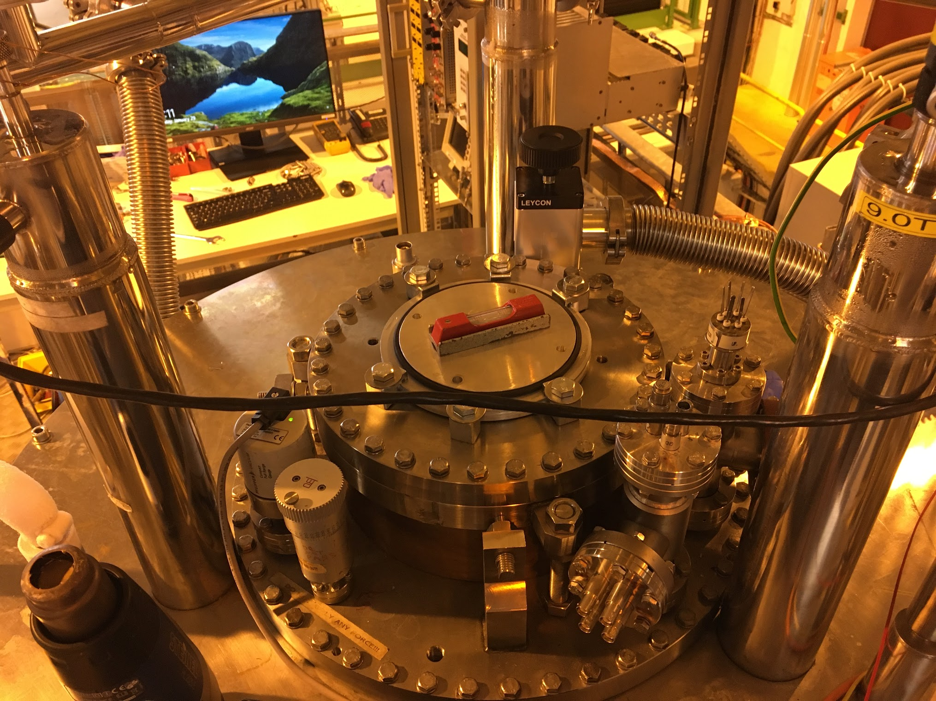
Anticryostat
Removed DN250CF T-piece with SPTURBO02 and SPUHV02
Removed feedthrough FC4 (for access to the gas tube)
Install 250CF to 160ISO-K adapter flange
Installed anticryostat with a special viton gasket
Added scroll pump and angle valve on side inlet
Flange with gas feed through at position of FC4

Slide 5
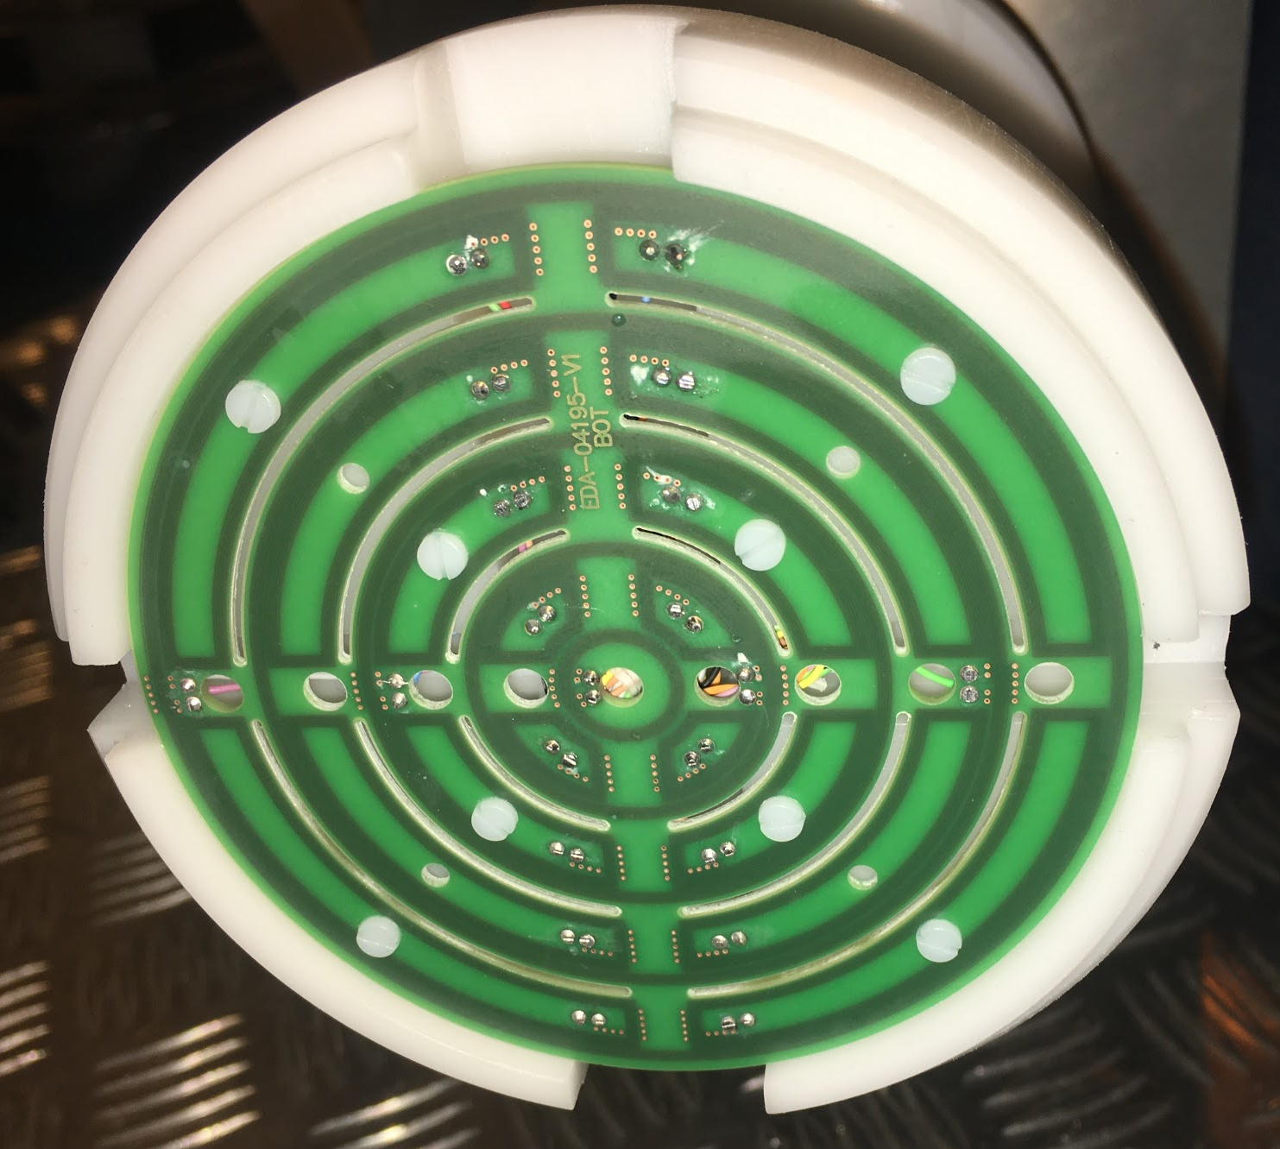
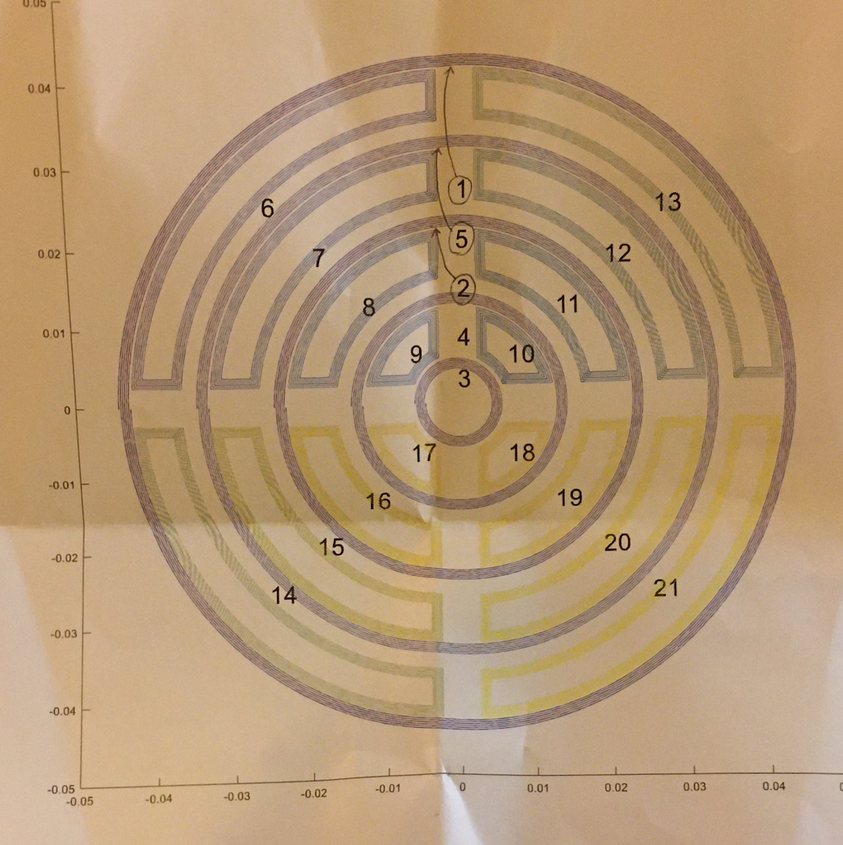
Transducer
Determine the magnetic flux (V/s) with coil moved through the magnetic field (constant speed)
Multiple induction coils forming concentric discs with increasing radius.
Disks split into quadrants (segments).
The largest disk has a radius close to 42mm (diameter of 84mm).
Signal of one coil is integrated between two adjacent trigger points
C. Petrone et al. IEEE TRANSACTIONS ON APPLIED SUPERCONDUCTIVITY (TAS), 2019

Slide 6
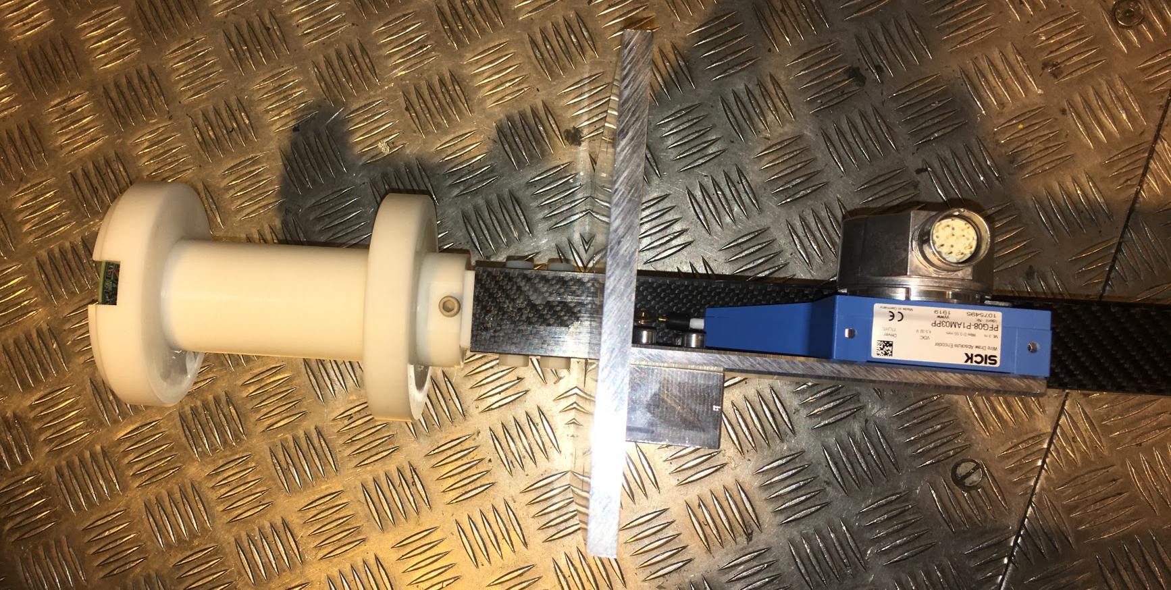
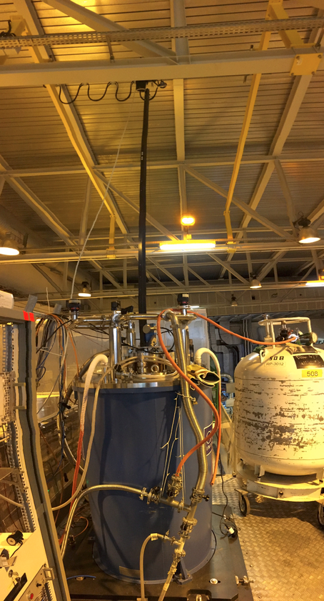
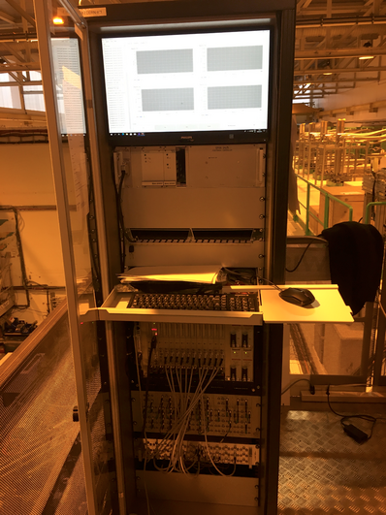
Transducer installation
Longitudinal position encoder
Movement system
Measurement system

Slide 7
Measurements
Checked several scenarios for consistency in the reached field.
from 0T go to 6T
from 4T go to 6T
from 9T go to 6T
Measured fields(current):
0T(0A), 1T(11.5344A),
1.5T(17.3016A), 2T(23.0687A),
2.5T(28.8359A), 4T(46.1375A),
6T(69.2062A), 7.5T(86.5077A),
9T(103.8093A)
Each measurement is composed by 3 complete travels of the transducer.
Set point adjusted by OI software.
Higher precision on the set current!

Slide 8
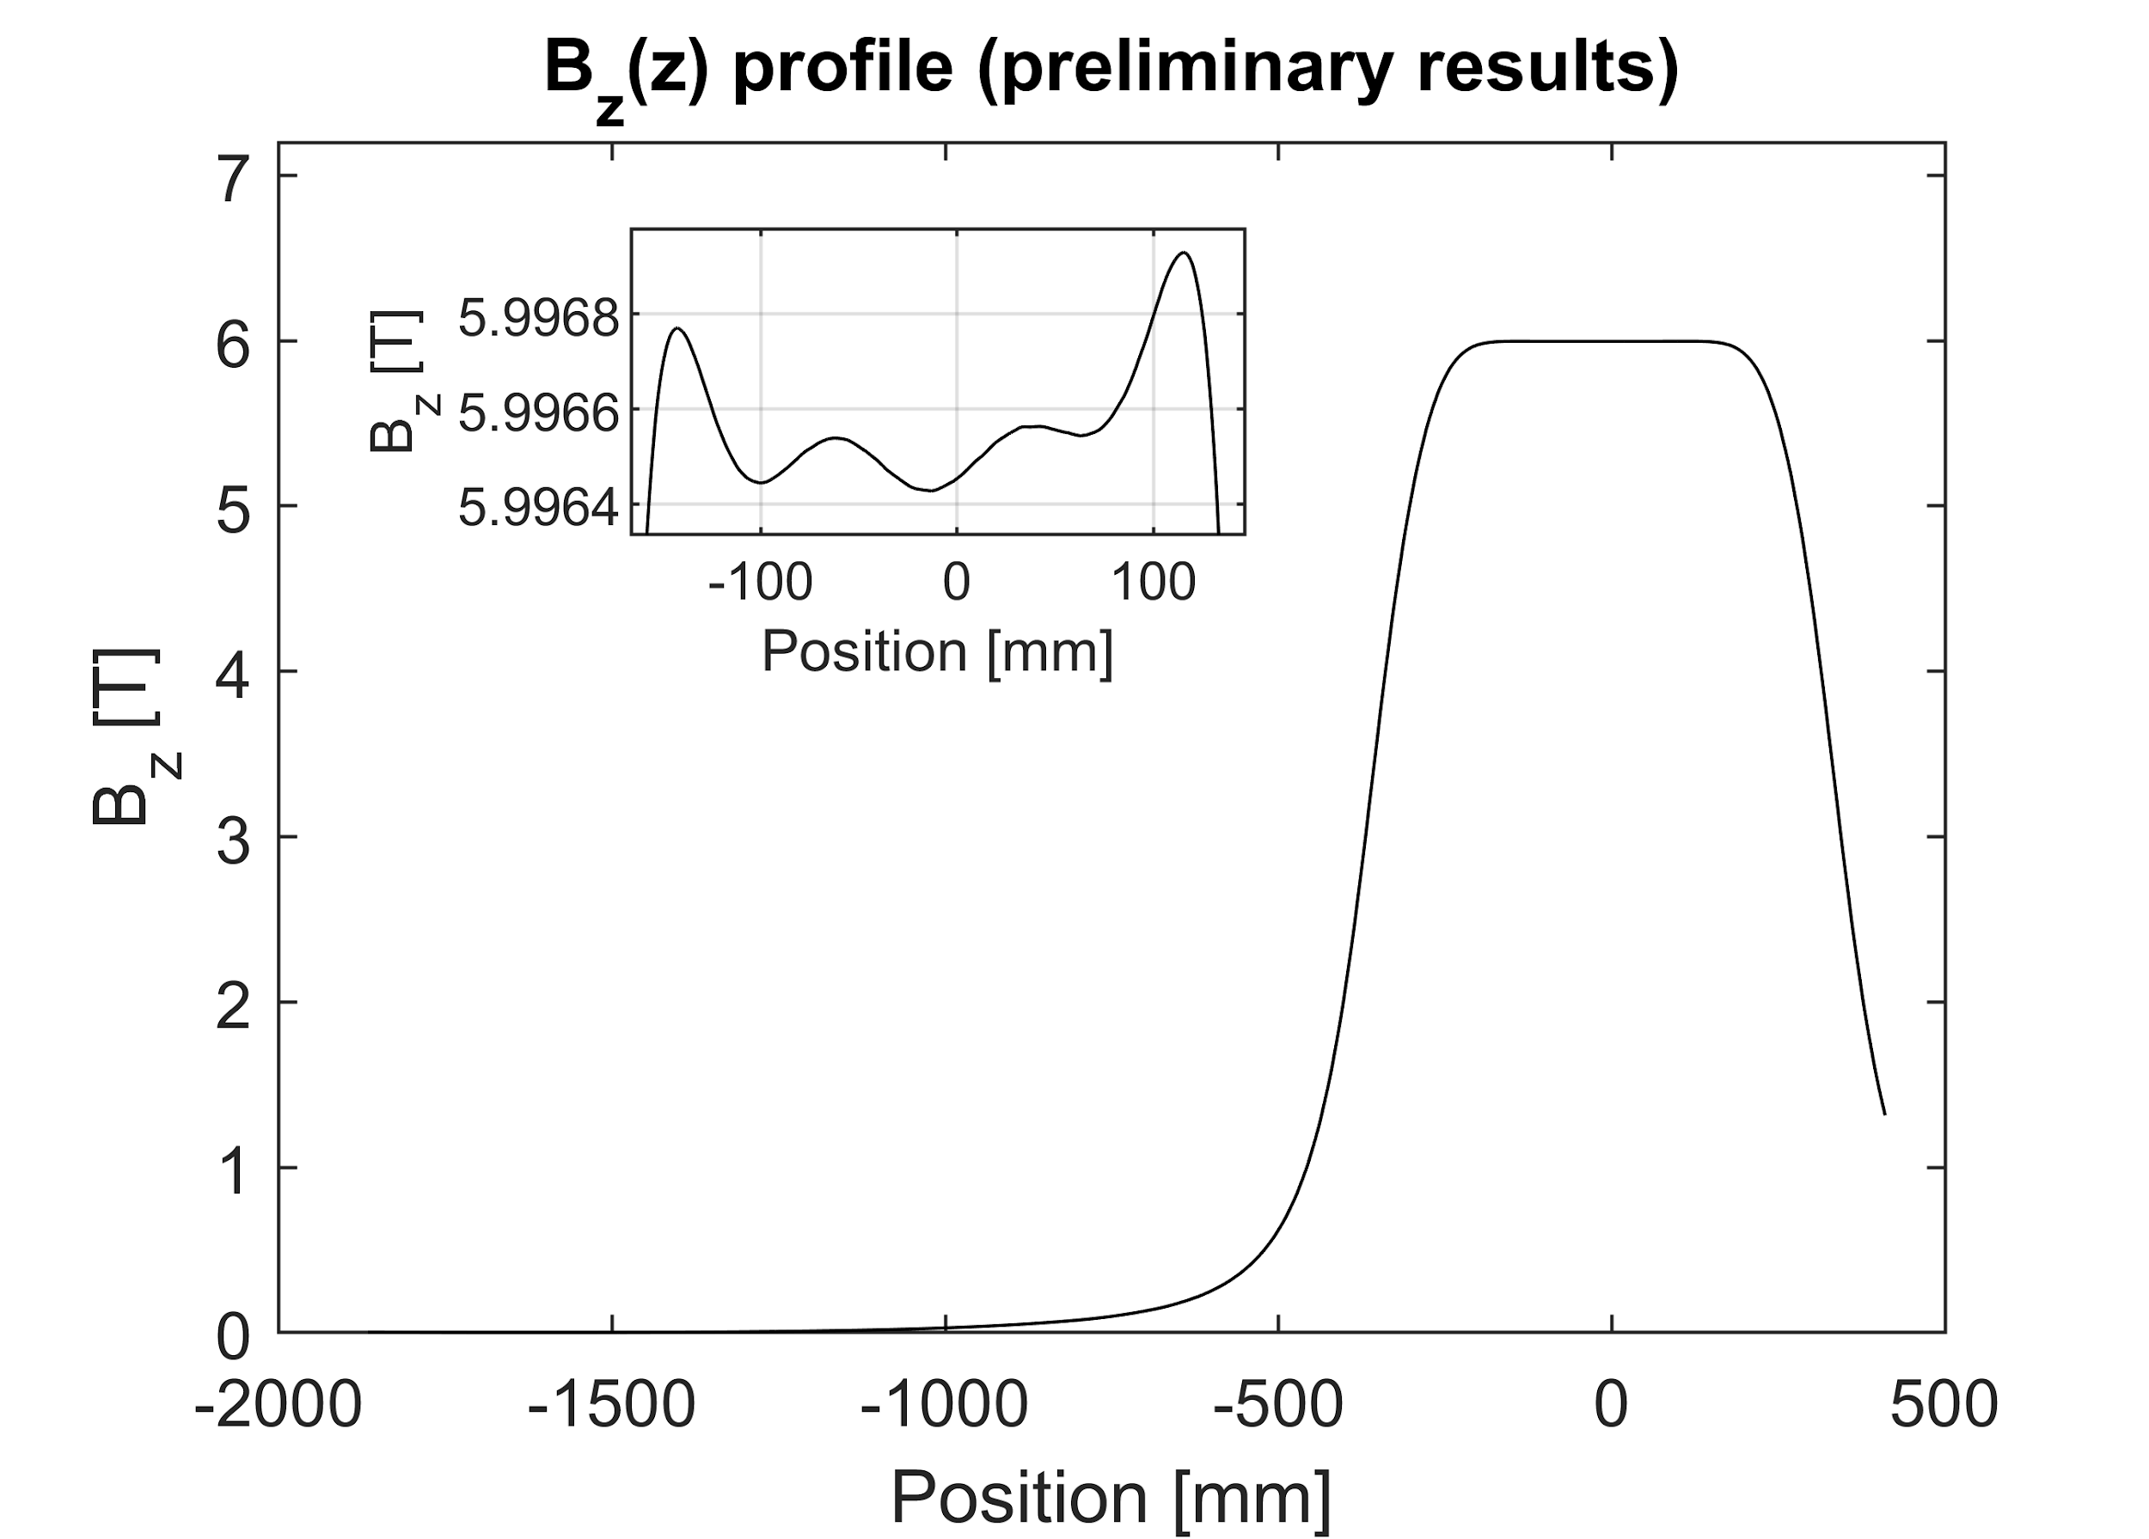
B_{z} preliminary results at 6T
Homogeneity = 2.7e-4
with biggest induction coil probed surface
~80mm in diameter

