Slide 1

Status of WISArD upgrades
Dinko Atanasov
dinko.atanasov@cern.ch
CERN, Experimental Physics department
on behalf of
the WISArD collaboration
WISArD Collaboration Meeting
22 March 2021

Slide 2
Timeline - 2020
¹¹⁴In scheduling
Hoist installation
Bfield measurements
Equipment procurement and installation
In-vacuum inspection
Mechanical design and manufacturing
b275 arrangements

Slide 3





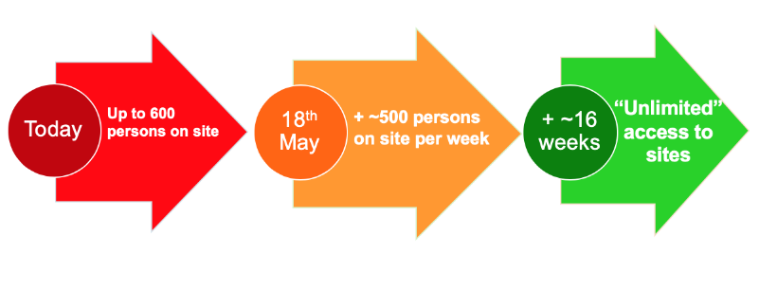
Timeline - 2020
Phase 1
Phase 2
Mid-March
Safe-mode and other
urgent activities
Resume gradually, starting
with LS2, accelerator and
detector upgrades, urgent
site and building work
Ramp-up to “unlimited”
access may be completed
by mid-September

Slide 4
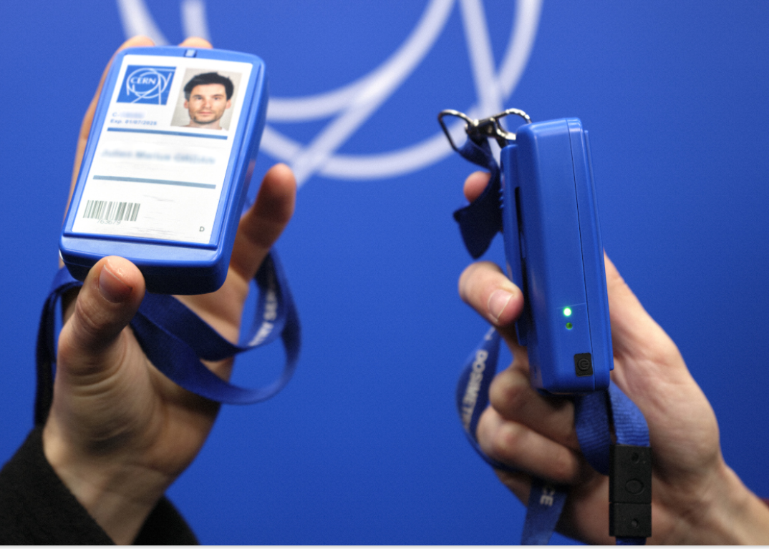
ISOLDE operation
While on site mask are obligatory
Proximeter was introduced and is
mandatory starting 1st March 2021
Teleworking is advised as much as possible
(reduced lab activities)
The quarantine period for users coming to CERN was reduced to 7 days and a negative PCR test is required at the end of the isolation period. (updated 4th of March 2021)
more recent updates at:
https://hse.cern/covid-19-information

Slide 5
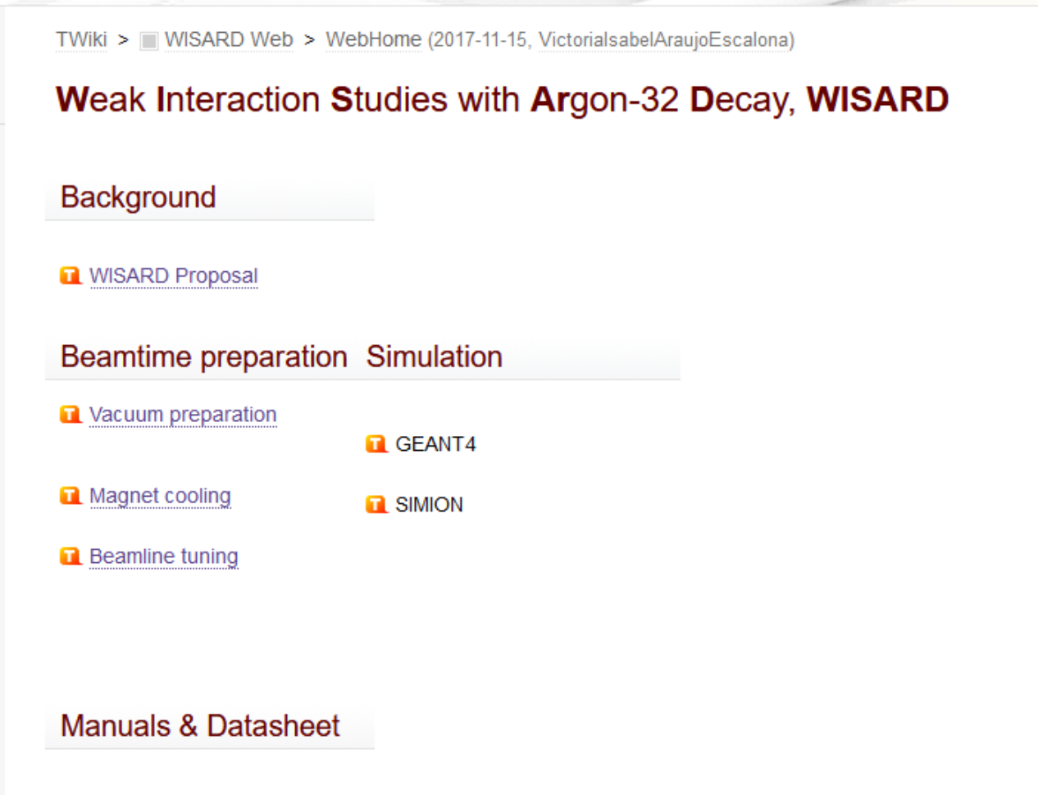
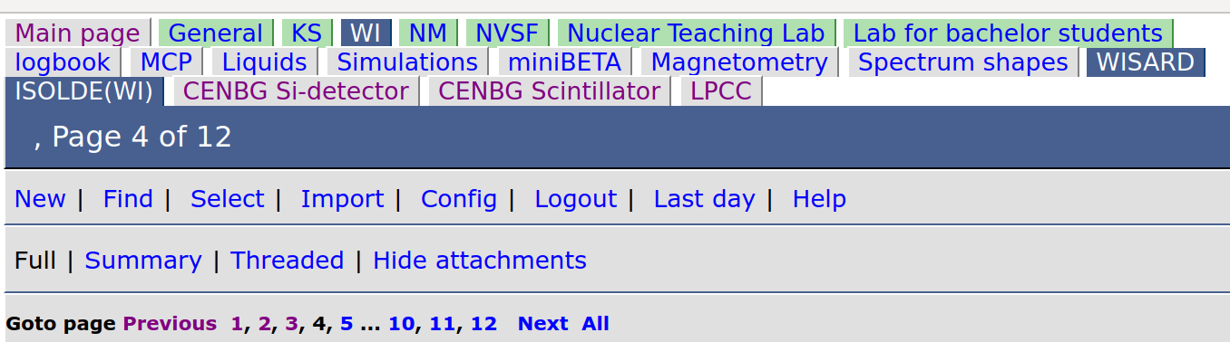
CERN TWiki & IKS ELog
https://twiki.cern.ch/twiki/bin/viewauth/WISARD/WebHome
TWiki page of WISArD (restarted!)
Adjust Elog to cover work at other institutes (ISOLDE, CENBG, LPC CAEN)
https://w.fys.kuleuven.be/elog/ISOLDE(WI)/

Slide 6
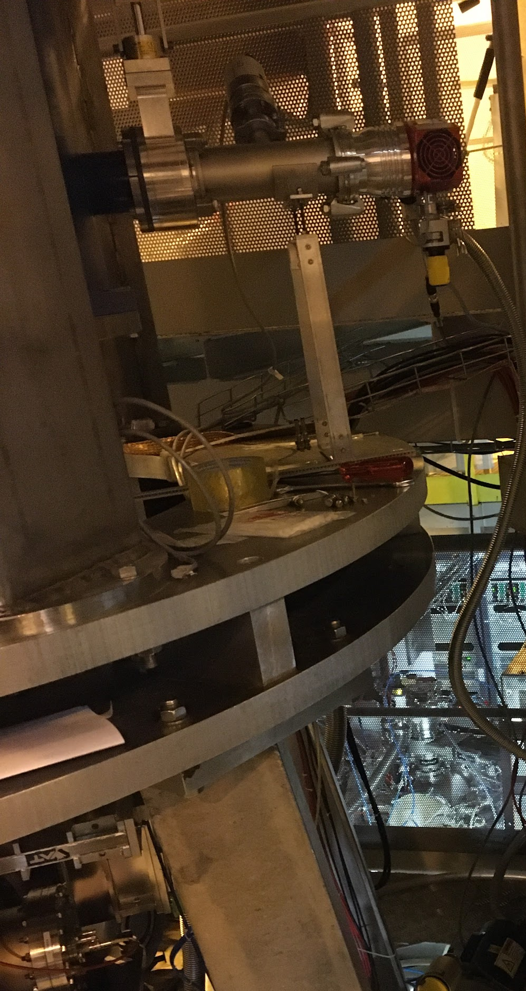

Vacuum
OVC turbo pump exchanged HiPace-80
ISO-K T-piece installed with proper support
Before next restart
maintenance of all full range gauges is needed.
6 turbo pumps sent for maintenance

Slide 7
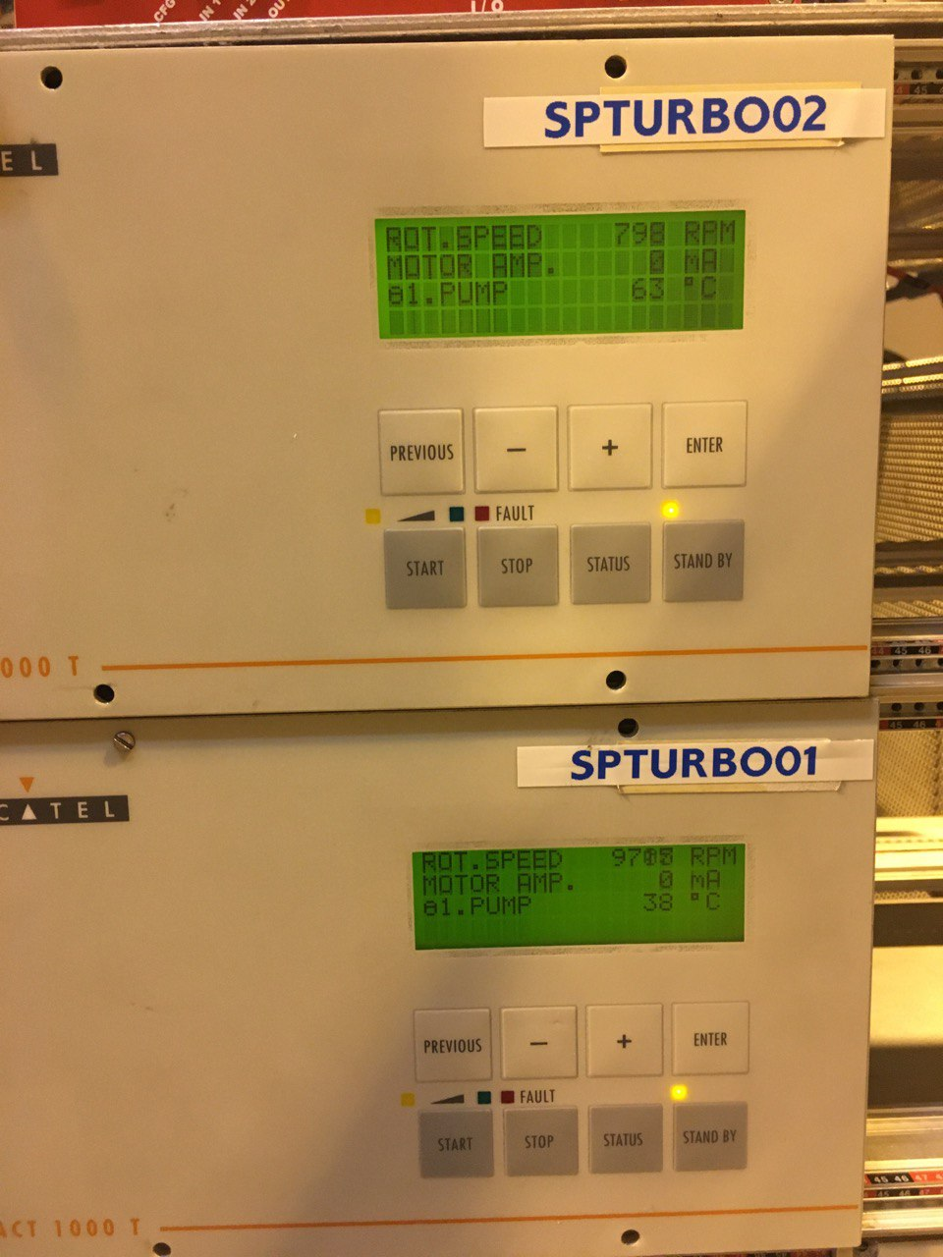
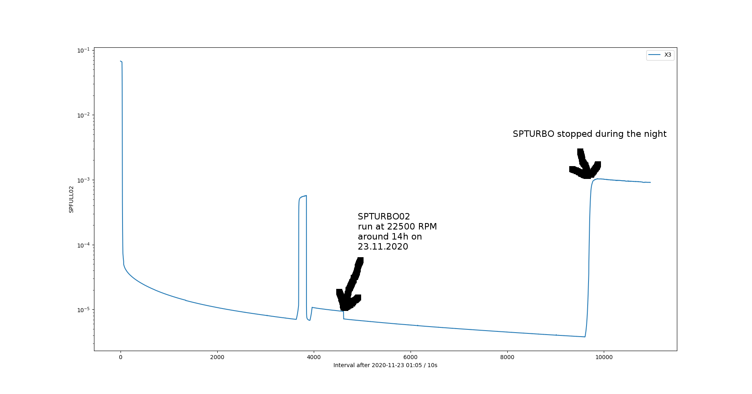
Vacuum
UPS load is not balanced: PLC delivers power to all primary pumps → Only one line supplies power to PLC.
Incident while preparing for ¹¹⁴In → pumps overheated and reached ~40 and 60 deg
11 Nov 2020

Slide 8
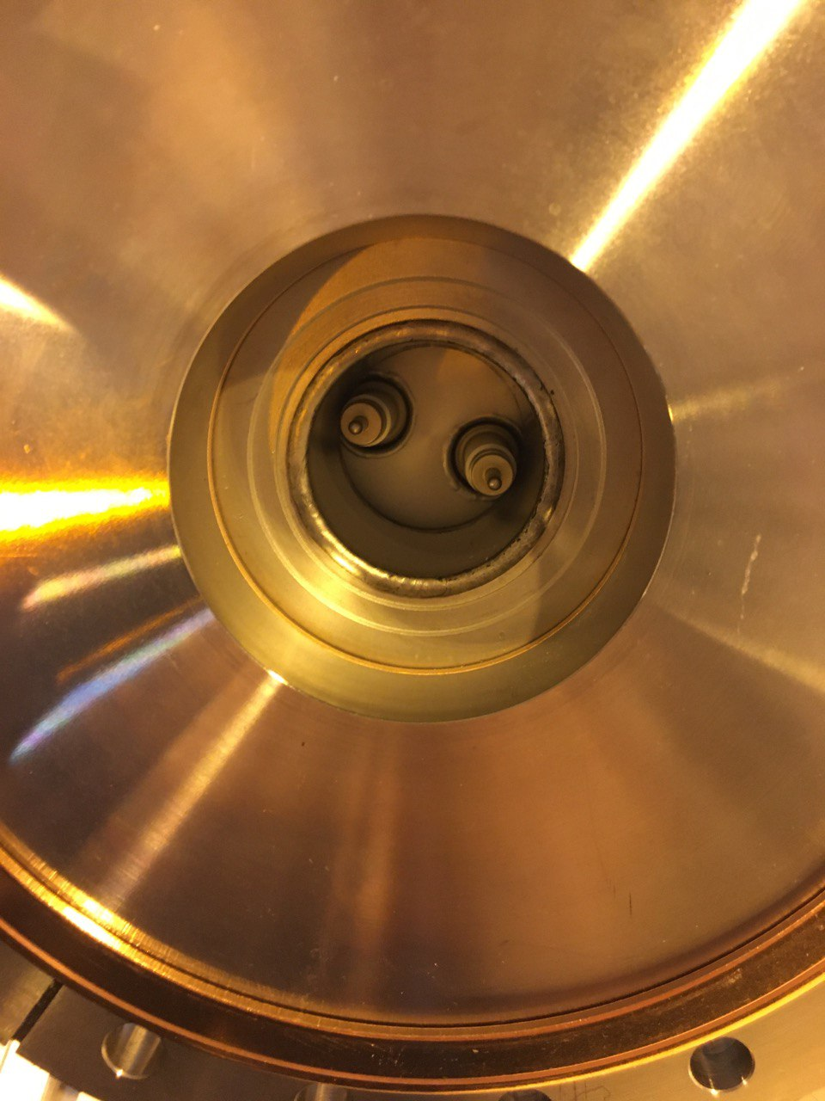
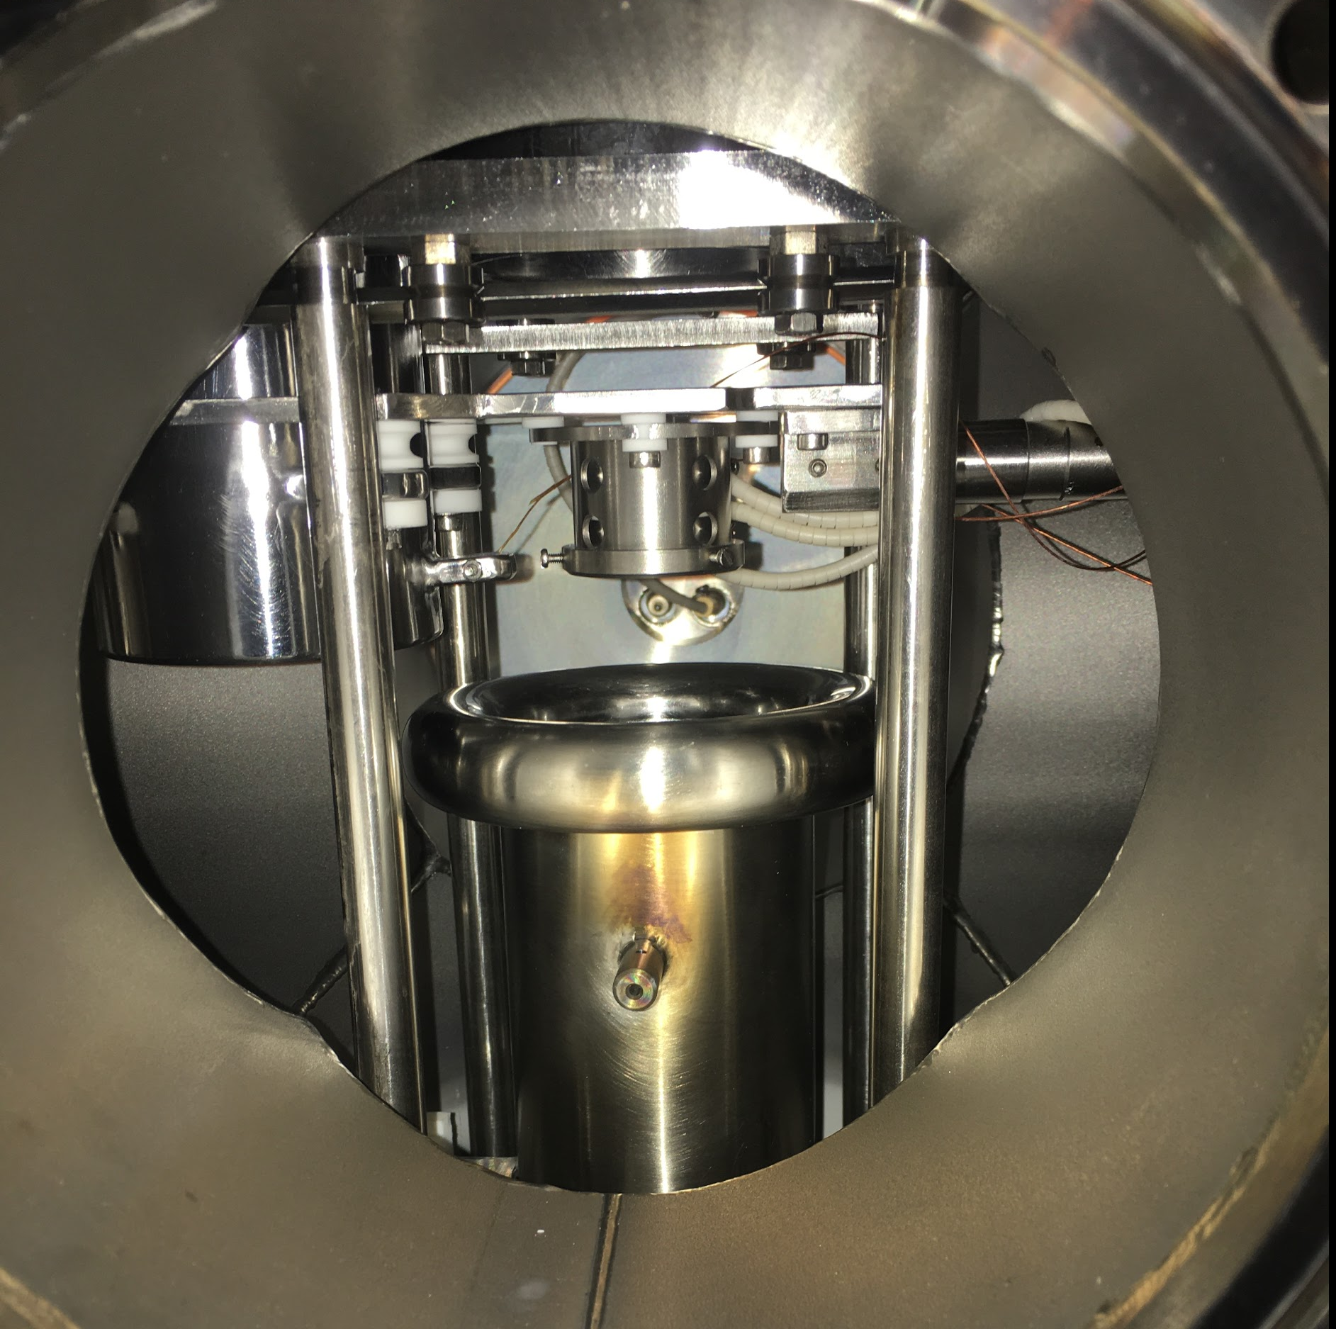
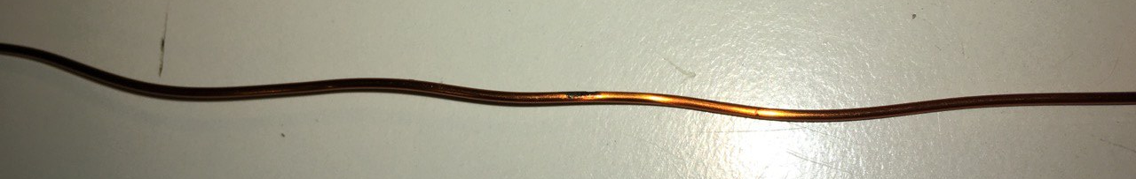
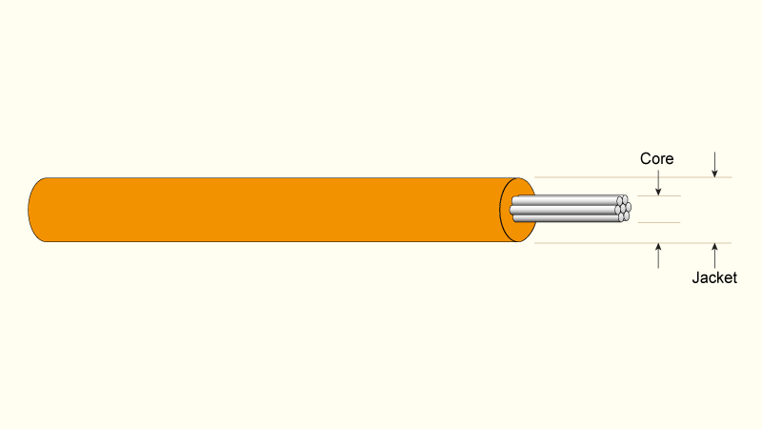
HV upgrades
Feedthroug PDT
In-vacuum cabling was
not rated for HV > 10kV
Installation of Kapton
isolated 7 stranded core
Re-location of Feedthroughs
PDT
Burned marks
from sparking

Slide 9
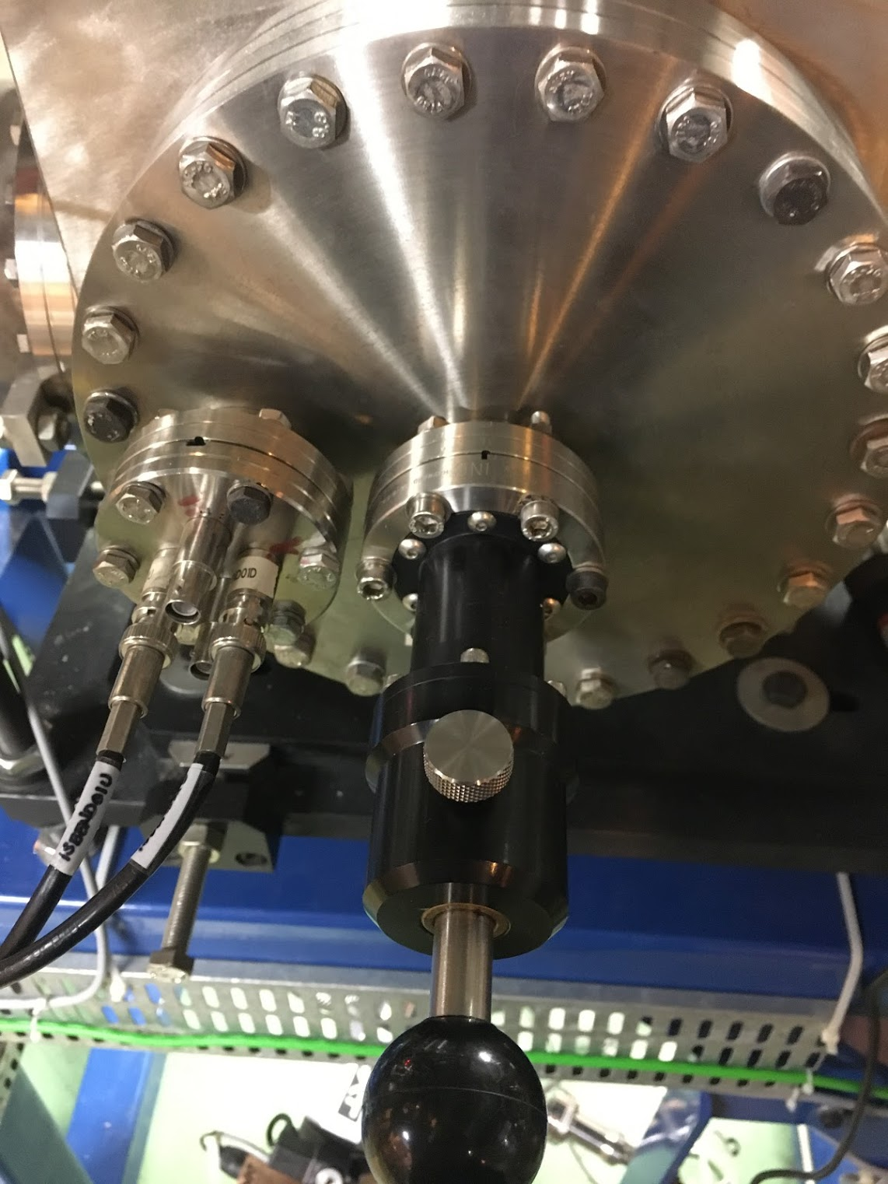
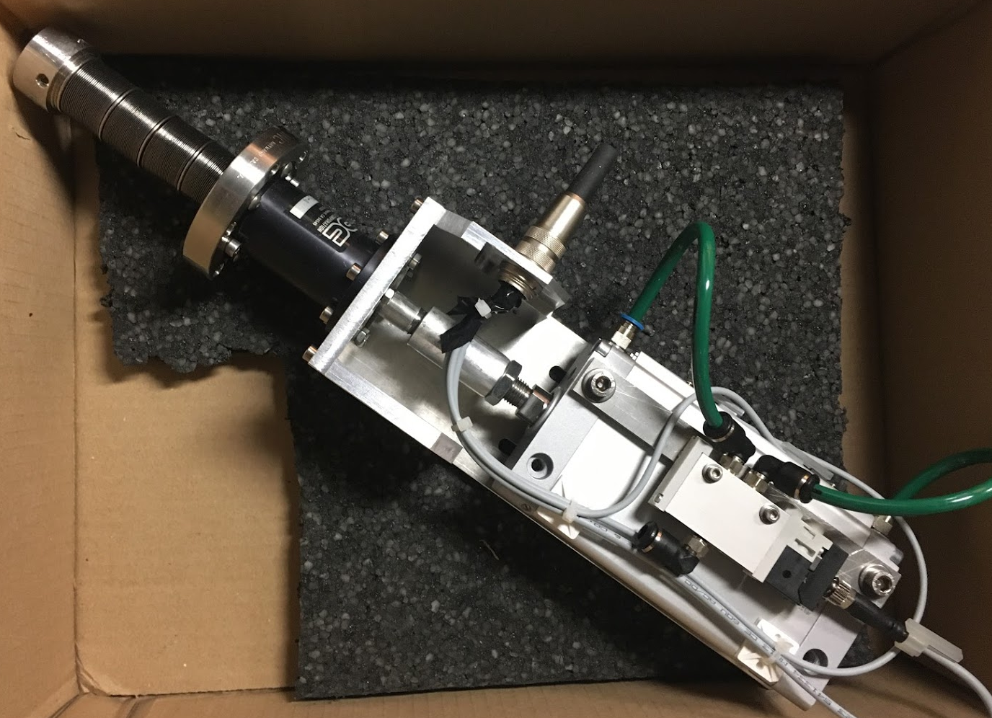
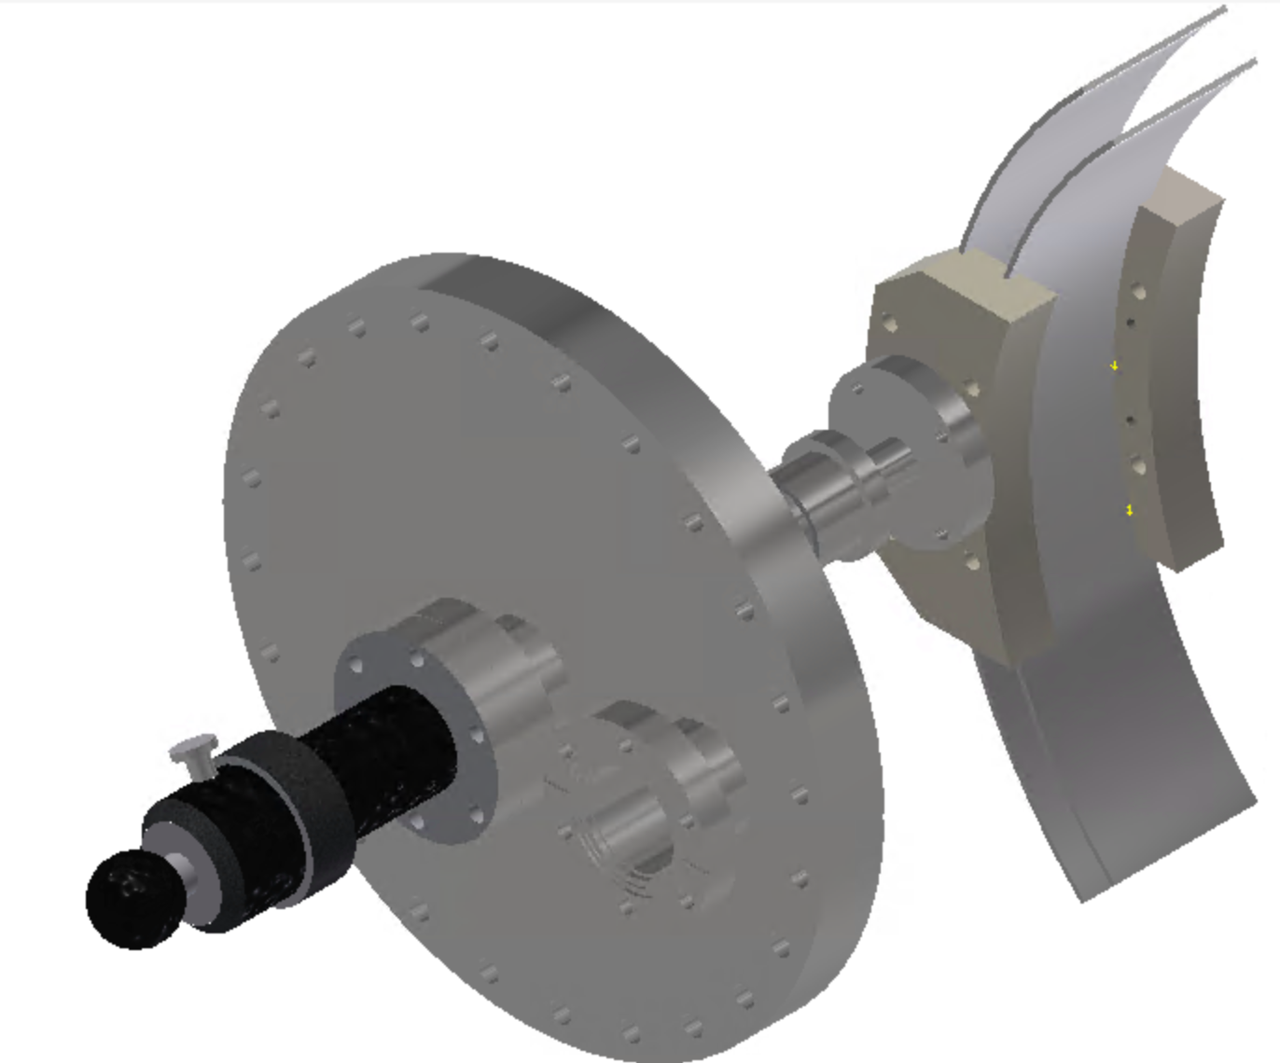
IS-Bender
Pneumatic feedthrough from FESTO
Integrated in the MDC push-pull translator
PLC controlled (C/C Labview)

Slide 10
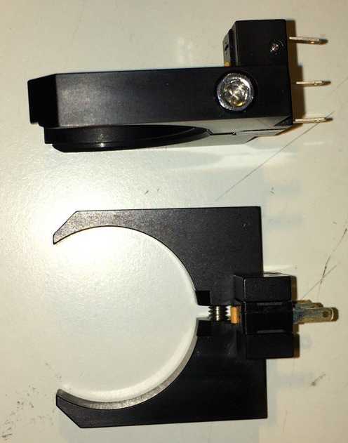
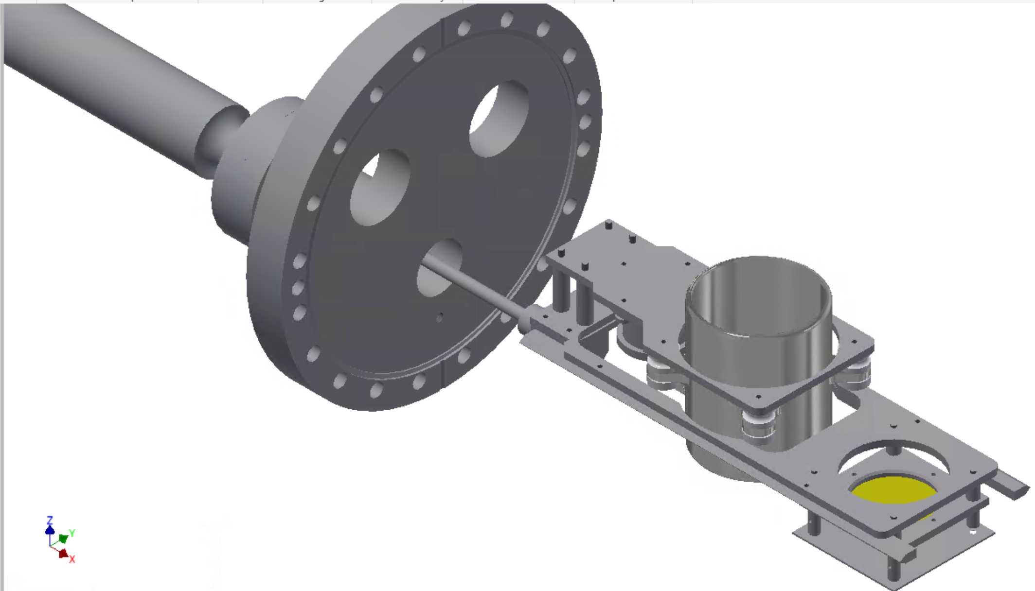
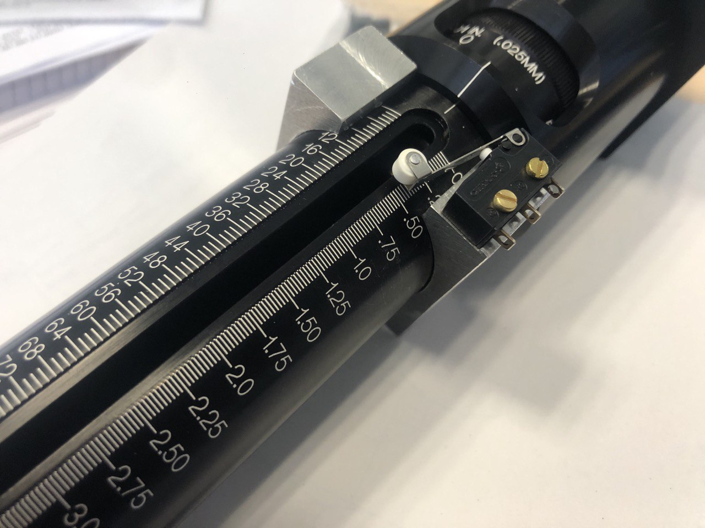
Motorization kit tests
Installation progressing well
Tests motion with load found friction in VBL
Design and manufacture cheap “kit upgrade”
MDC solution
CENBG solution
Sliding edges

Slide 11
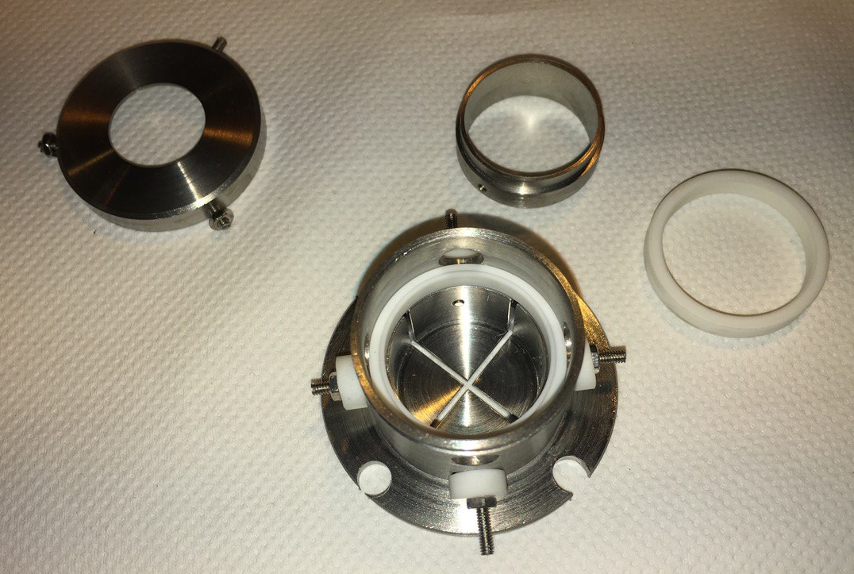
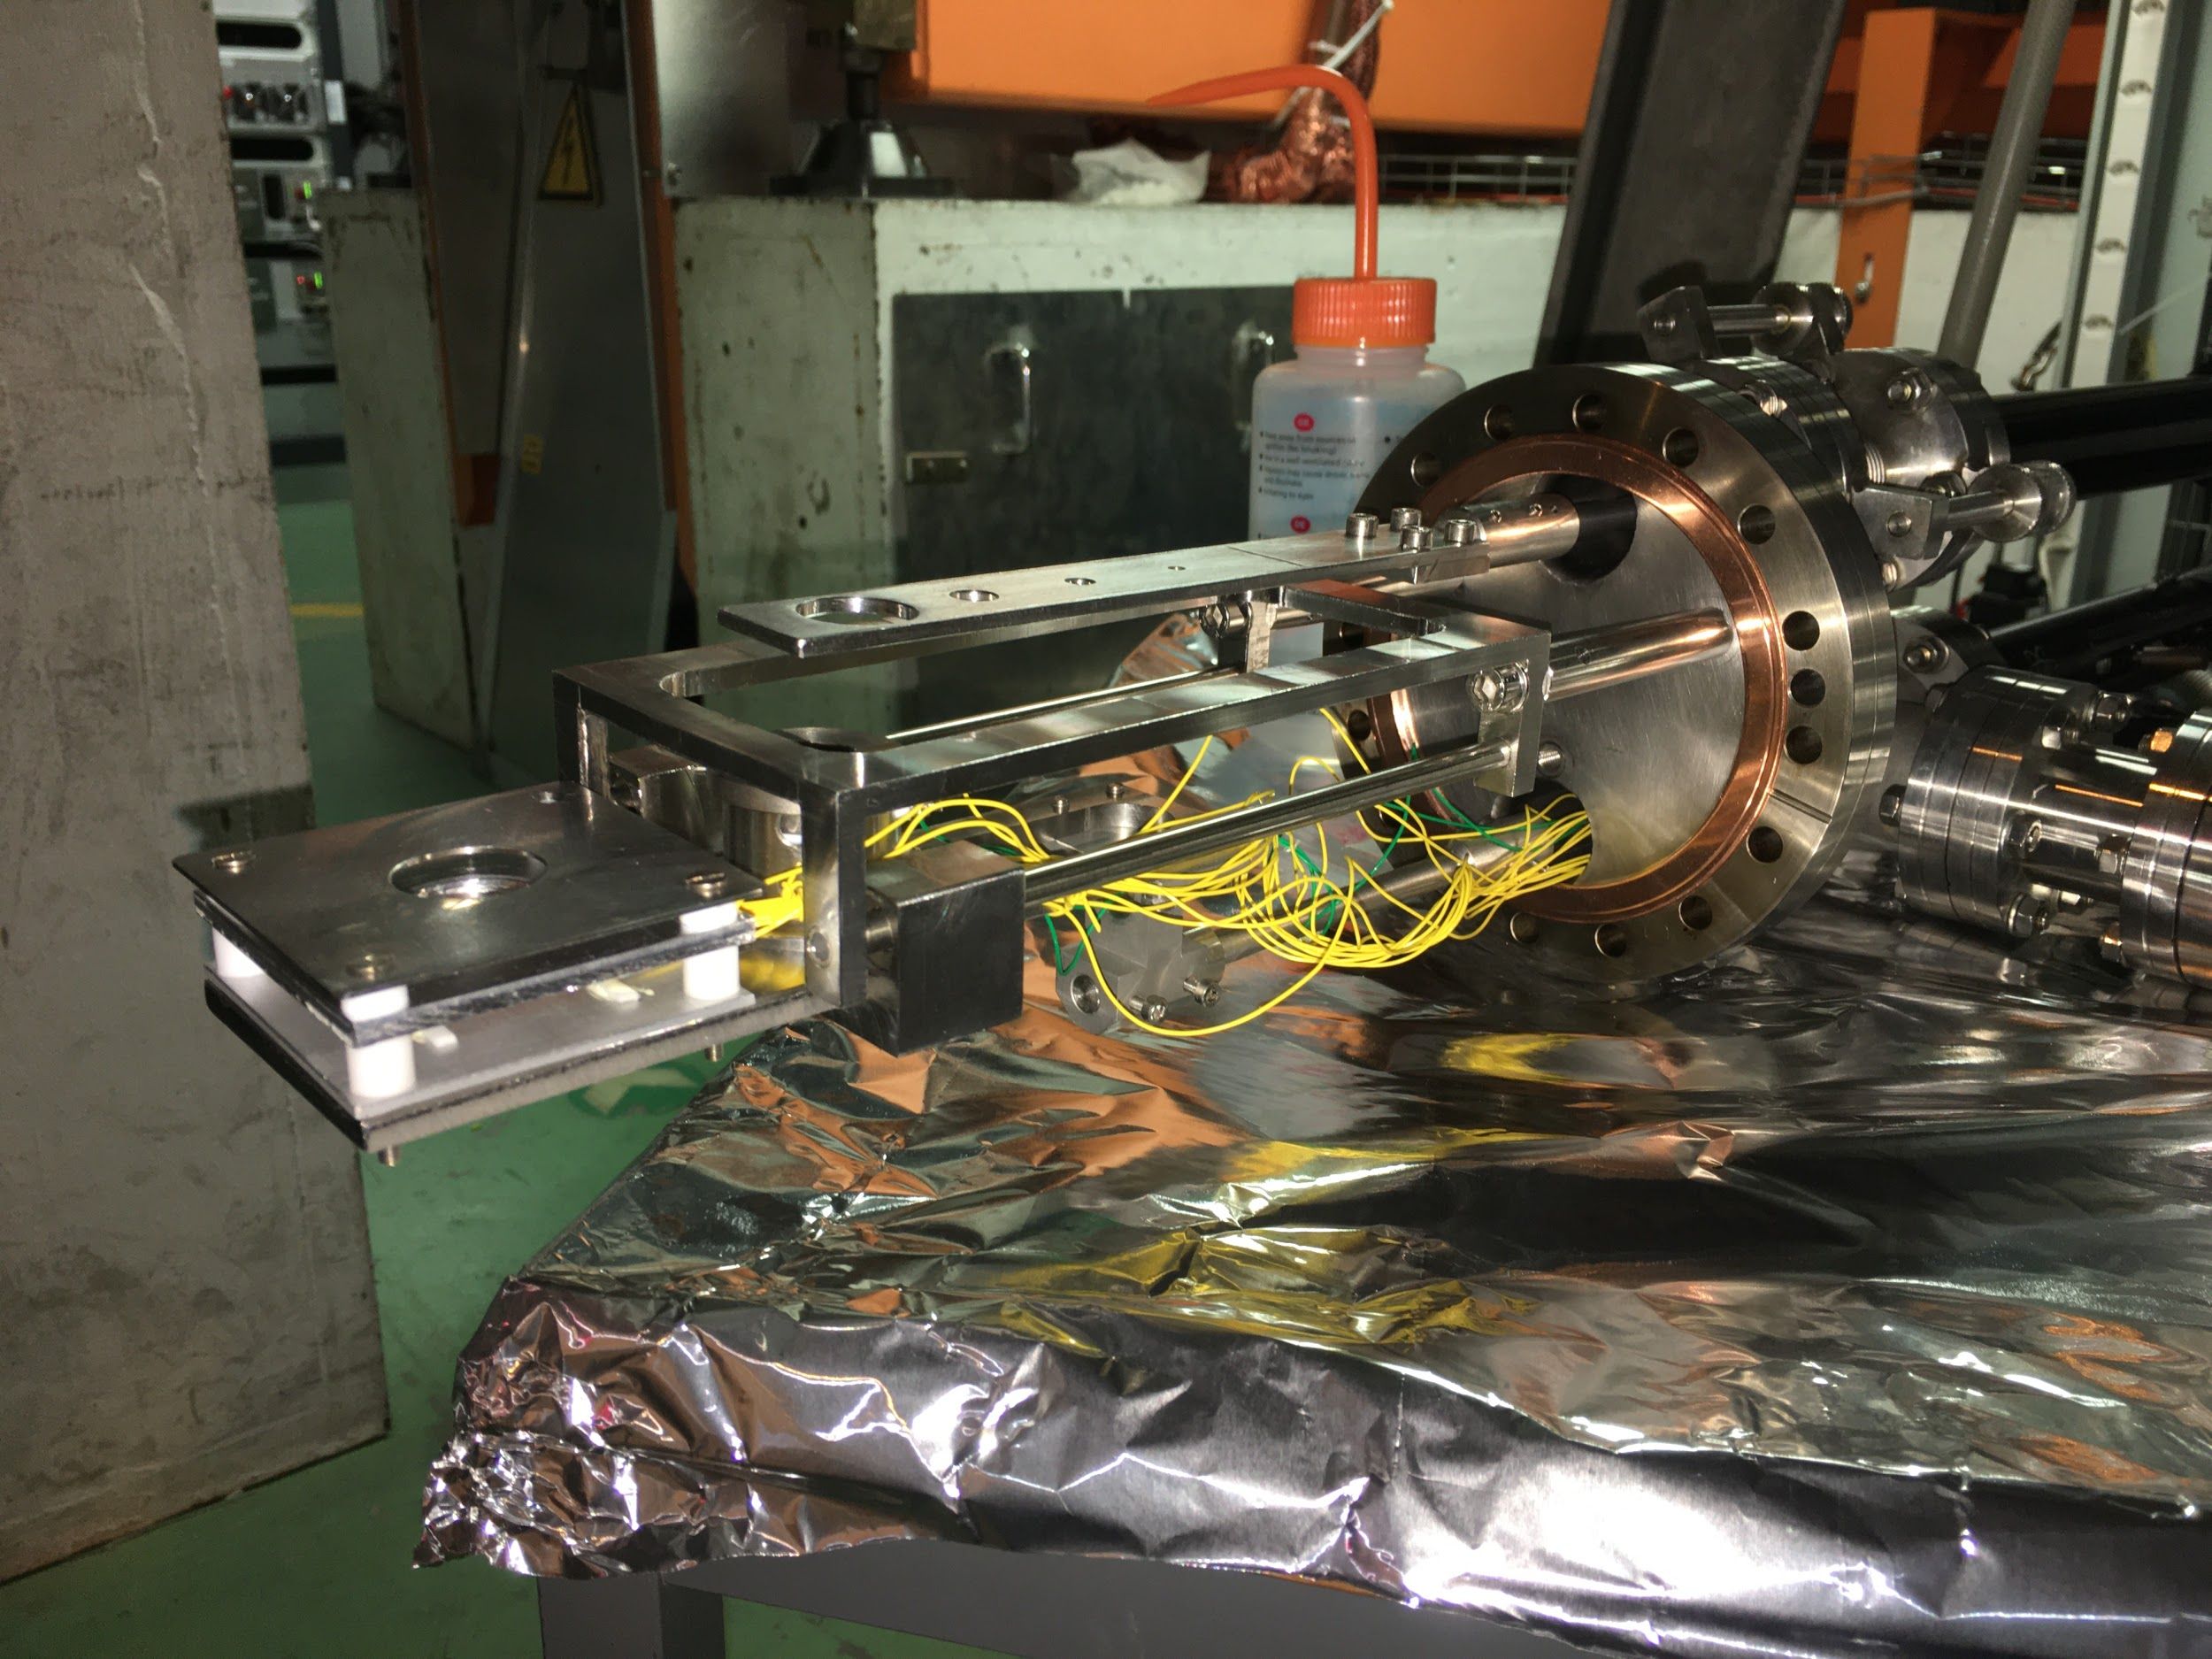
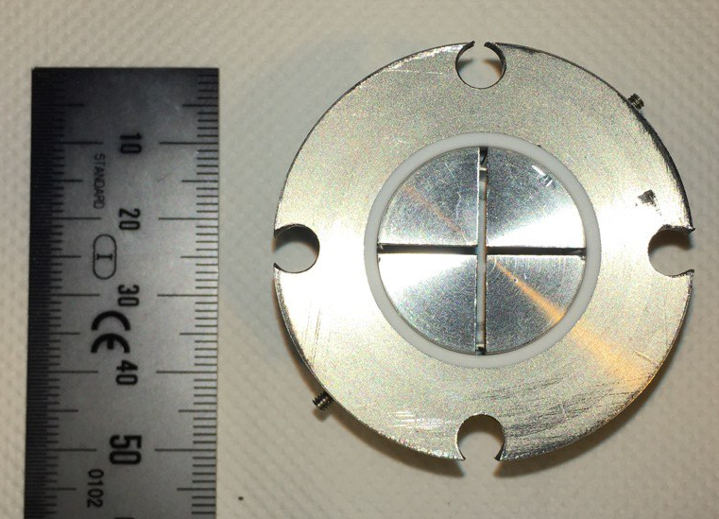
Segmented FC
Design complete and manufactured
4 segments (1mm gap between electrodes)
Assembly at 95% complete (researching a support plate)

Slide 12
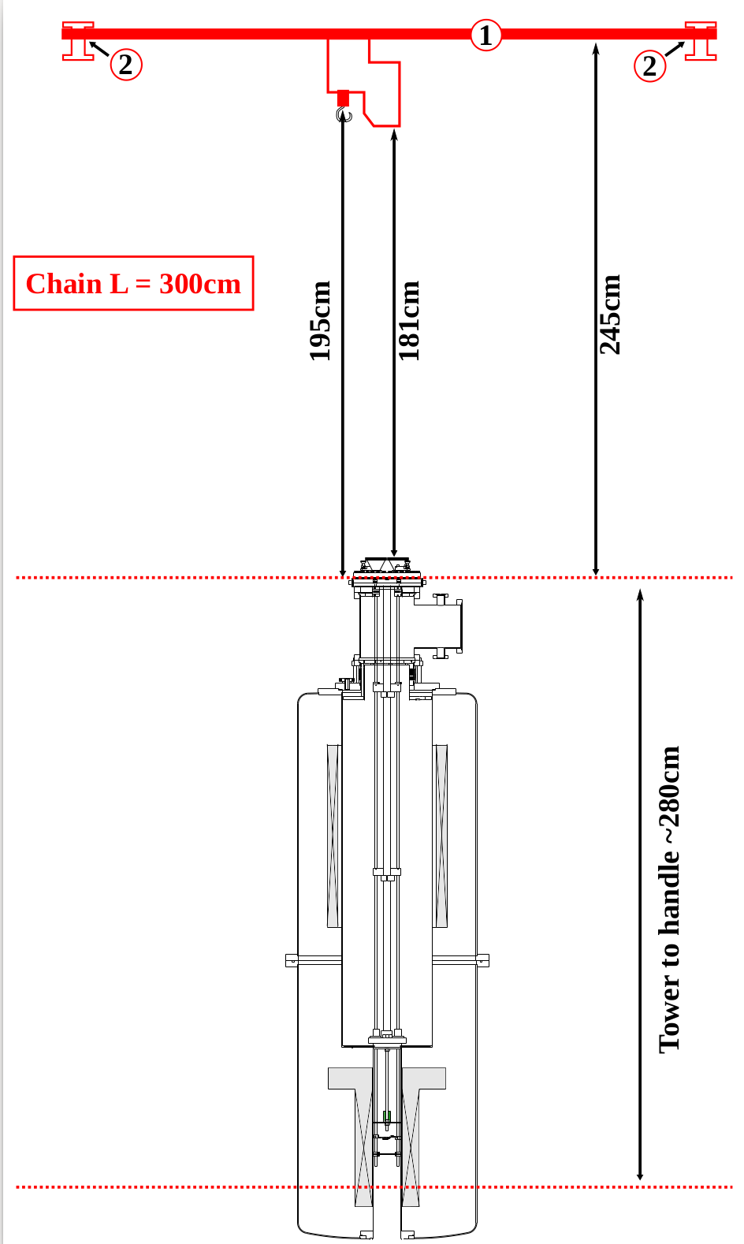
old Hoist constraints
Length of new legs advised according to existing hoist
New hoist and support structure purchased by ISOLDE/CERN
New length advised at least 1m from the current position.

Slide 13
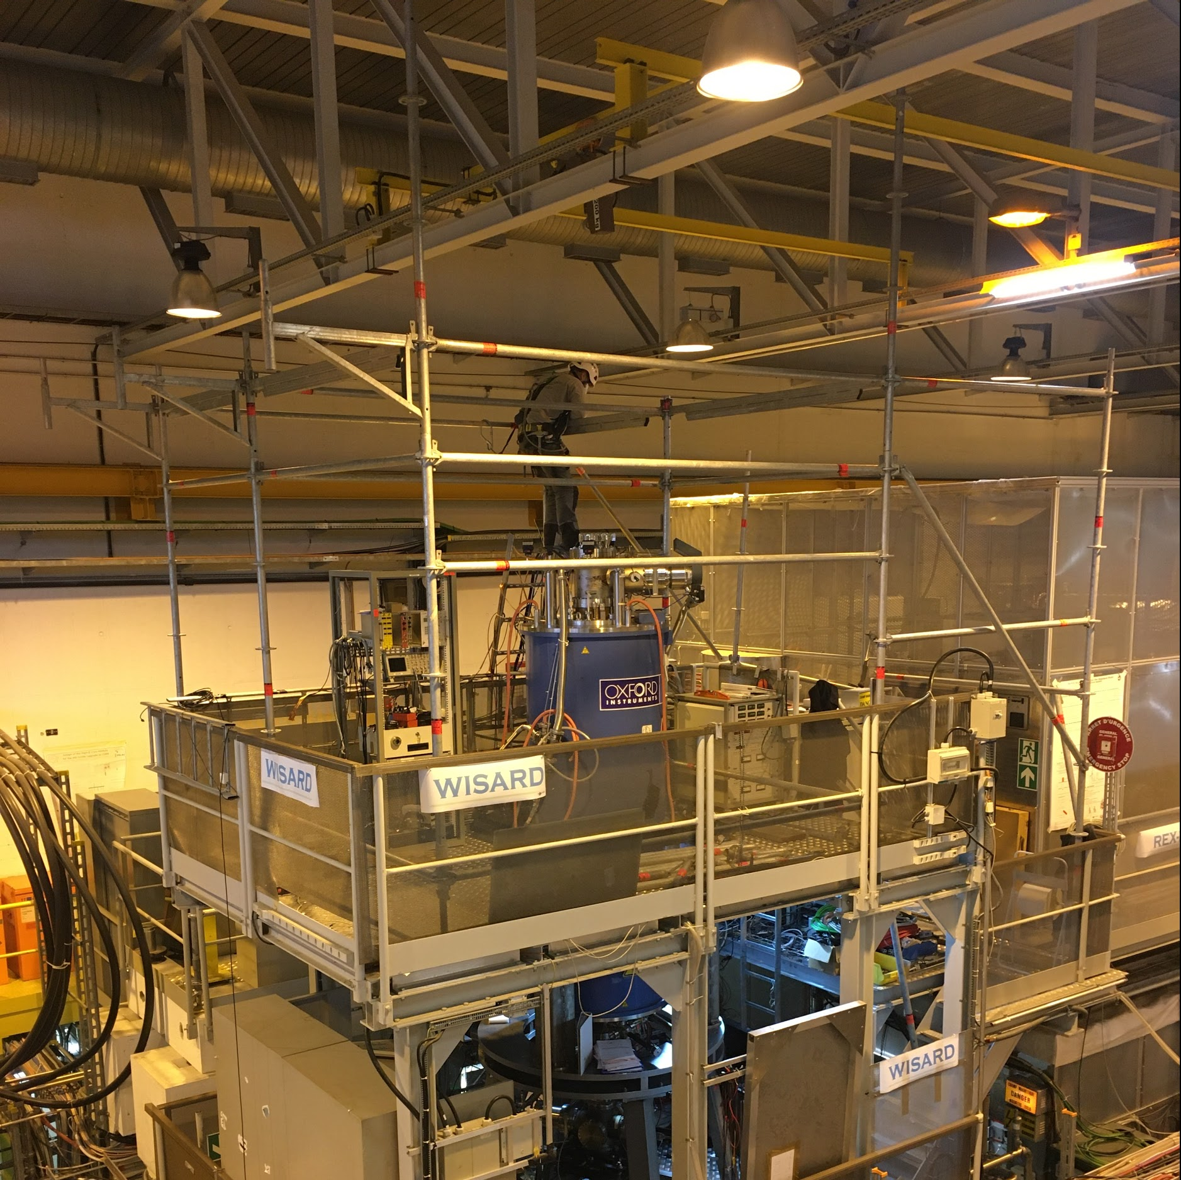
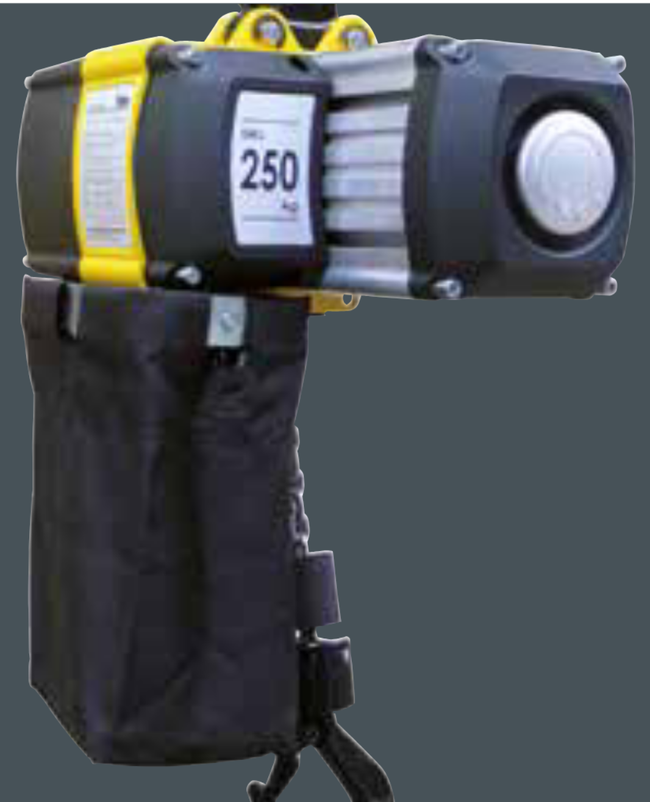
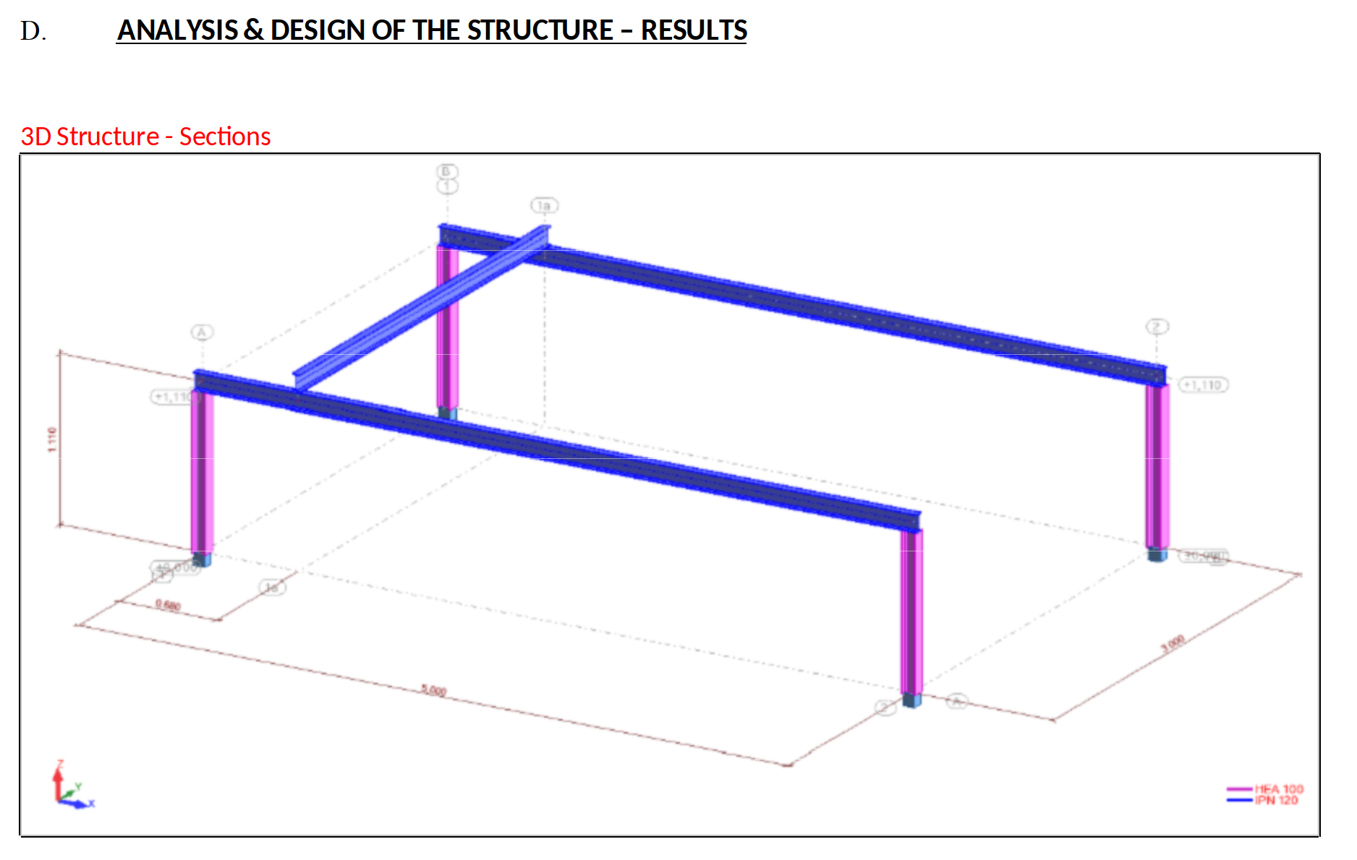
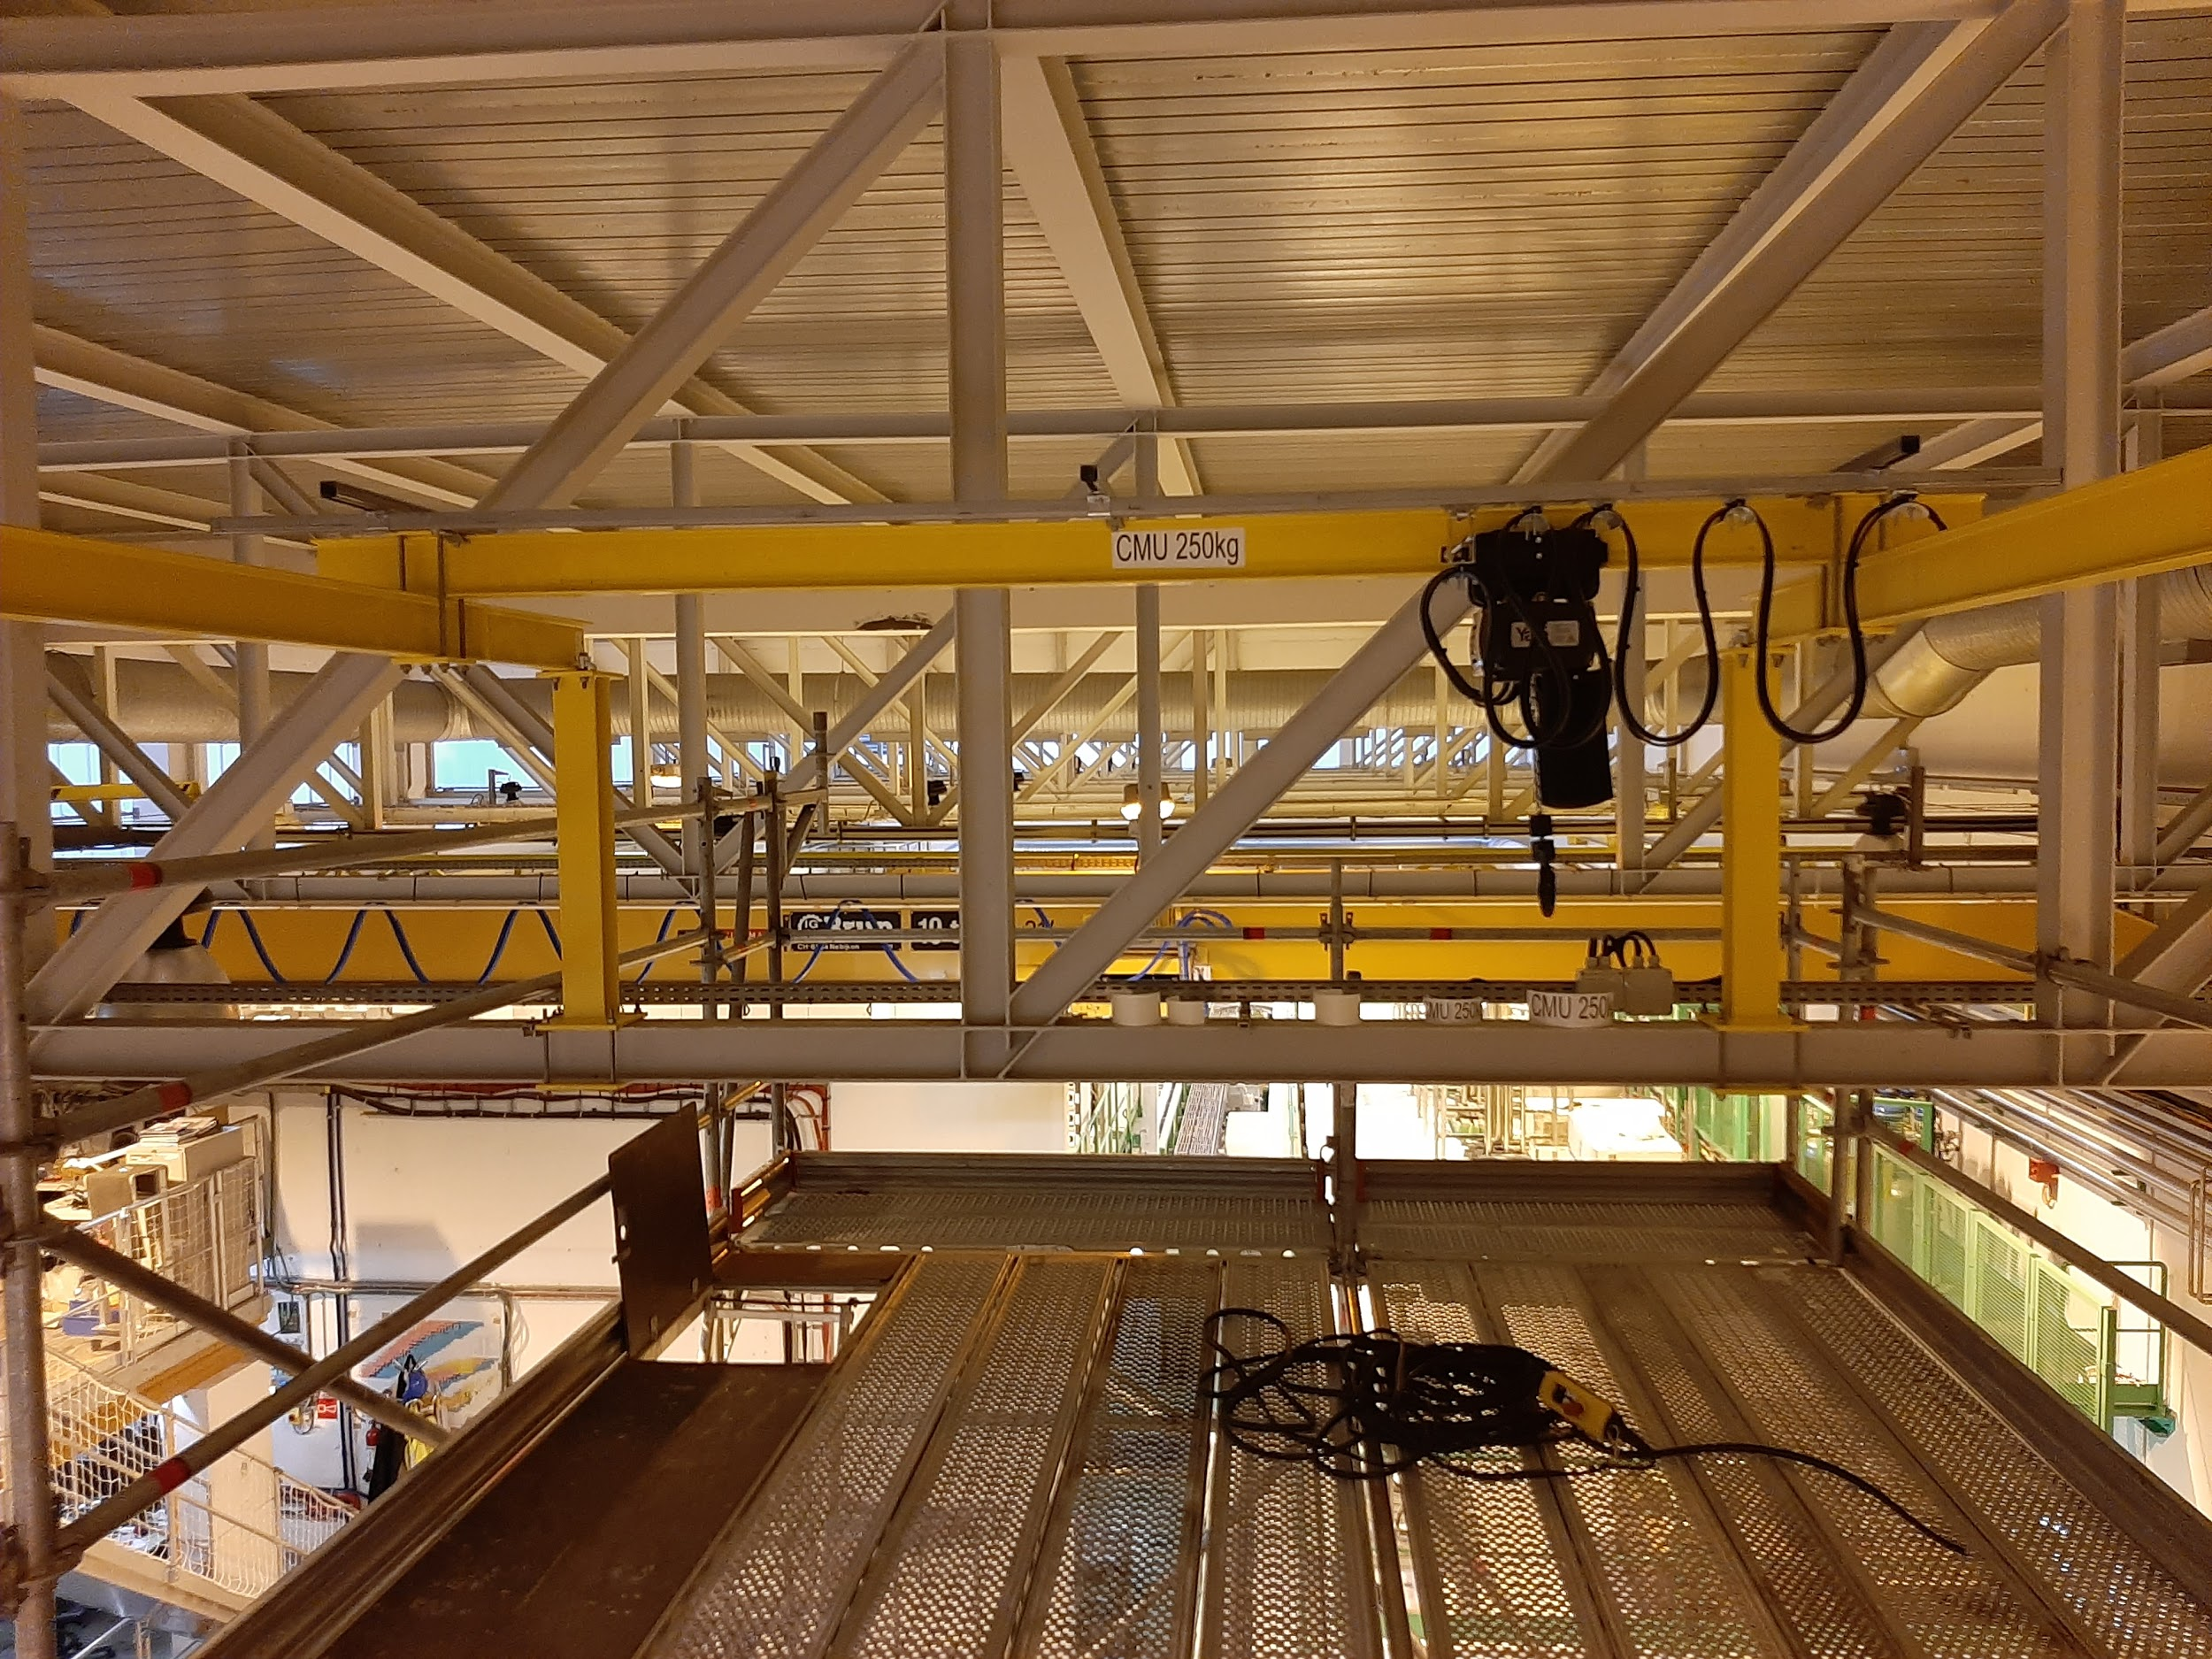
Hoist Installation
Lifting capacity of the hoist: 250kg
Scaffolding build on top platform - Jan 2021
Exchange of support beams
NEW support H = 1.1m (eff. 0.98m)

Slide 14
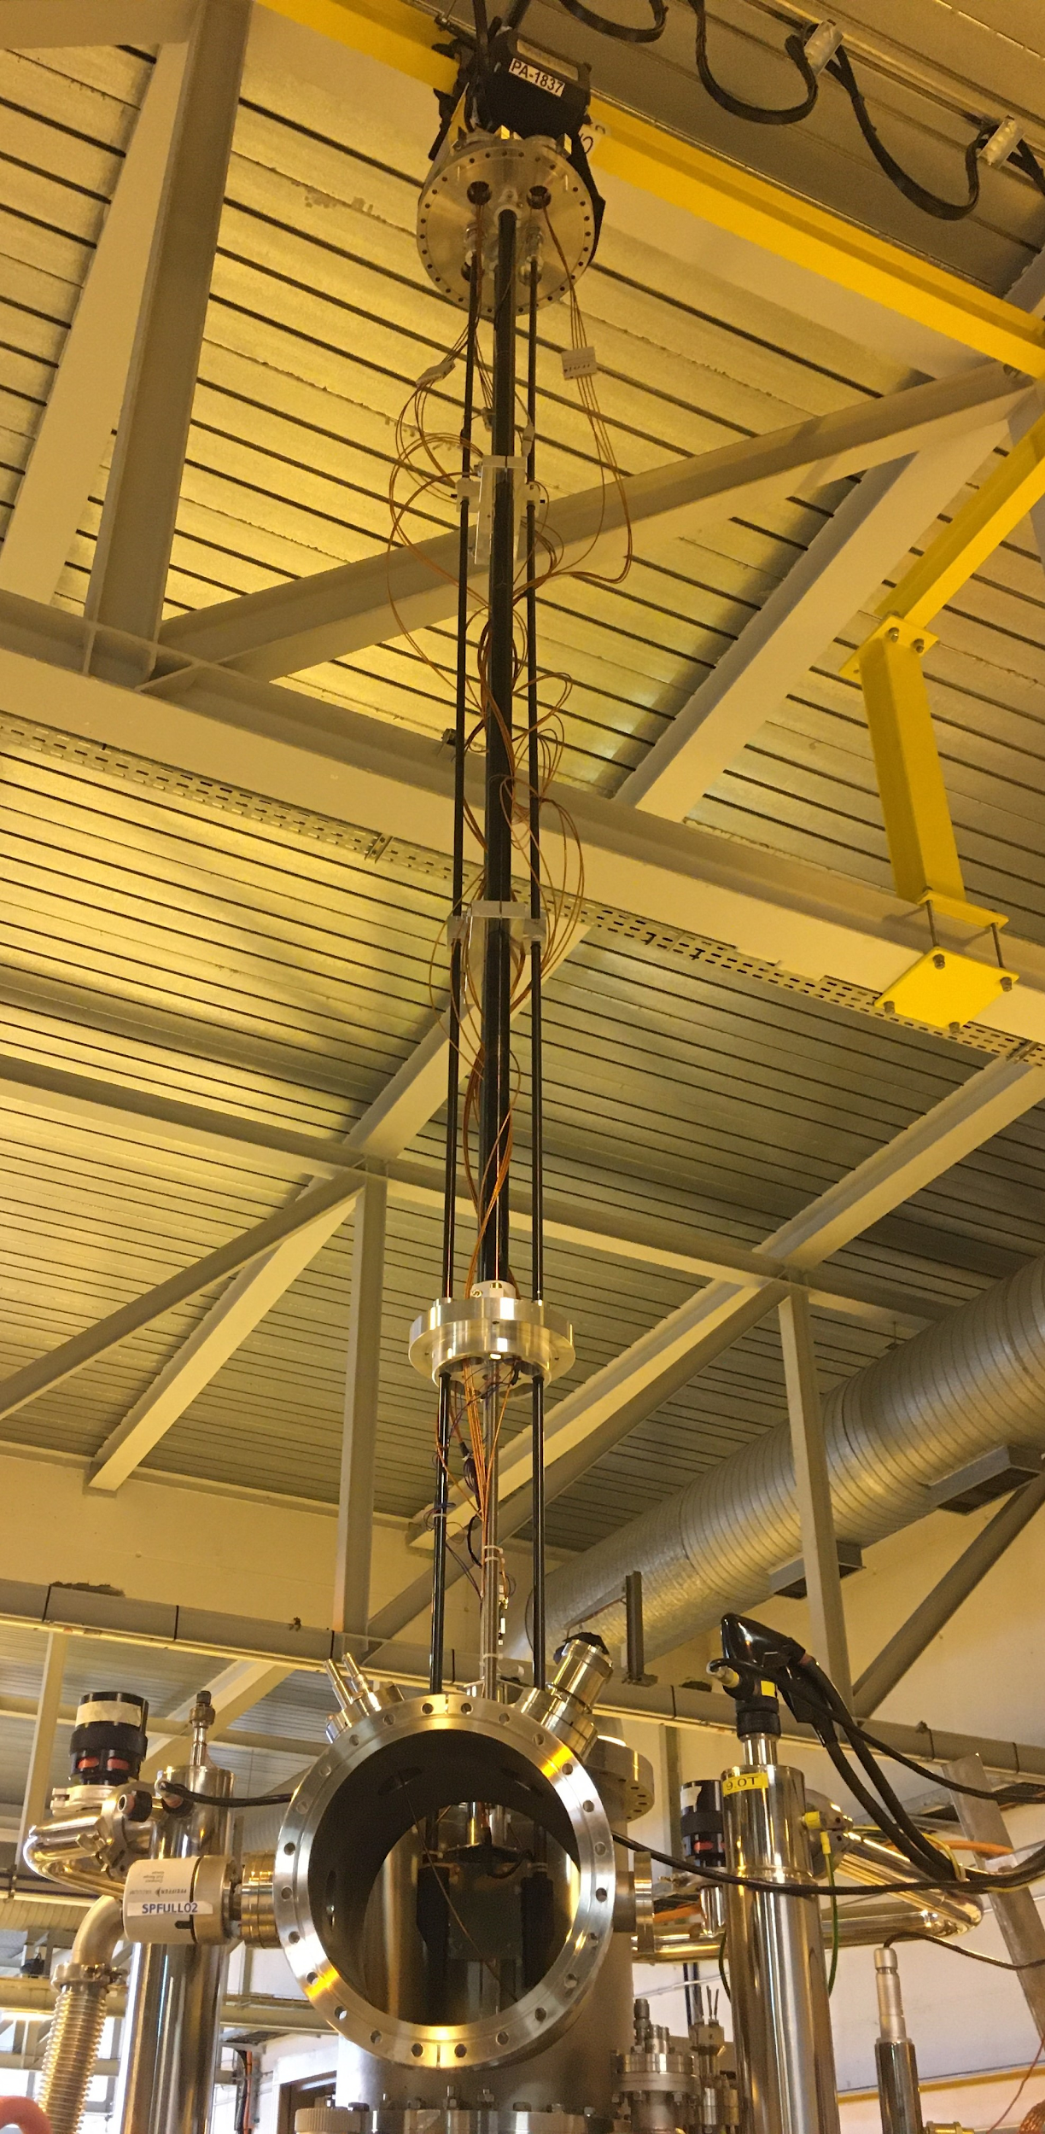
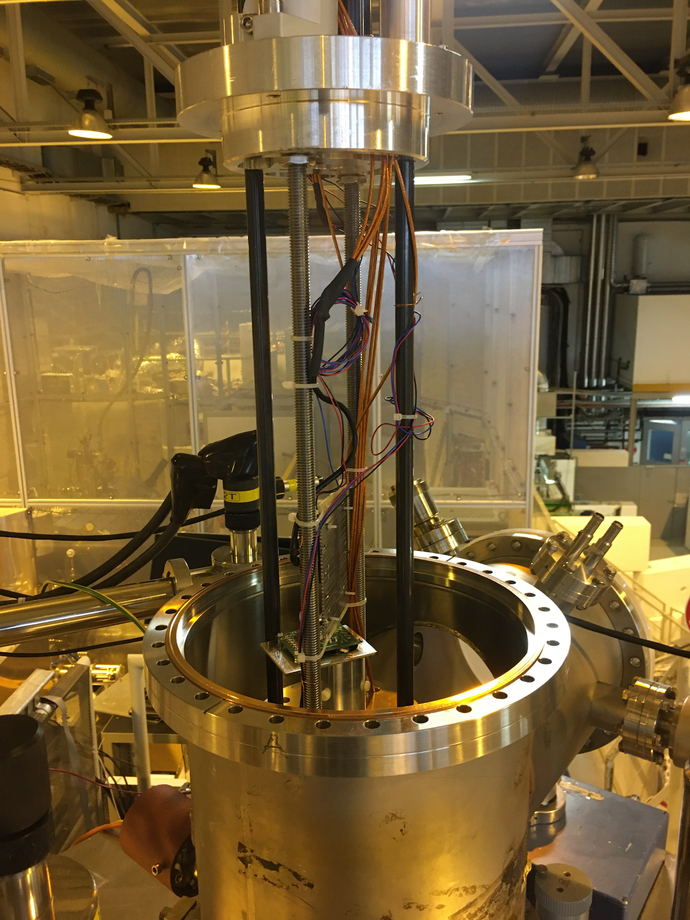
Hoist Installation

Slide 15
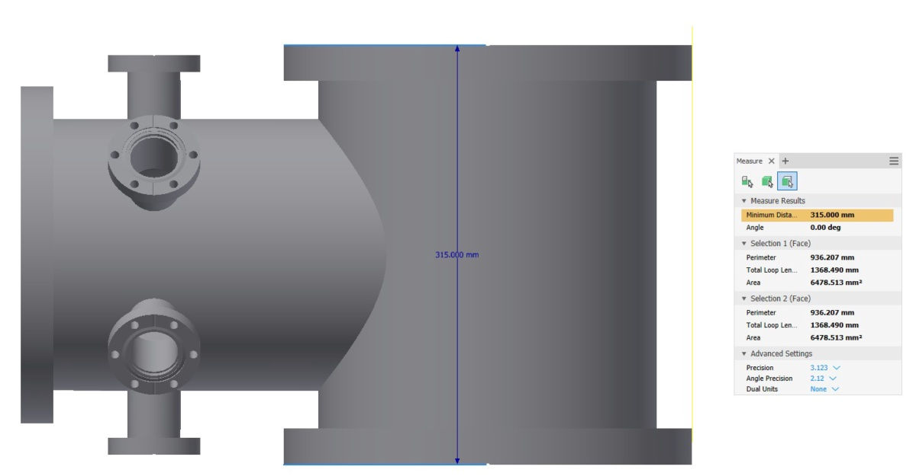
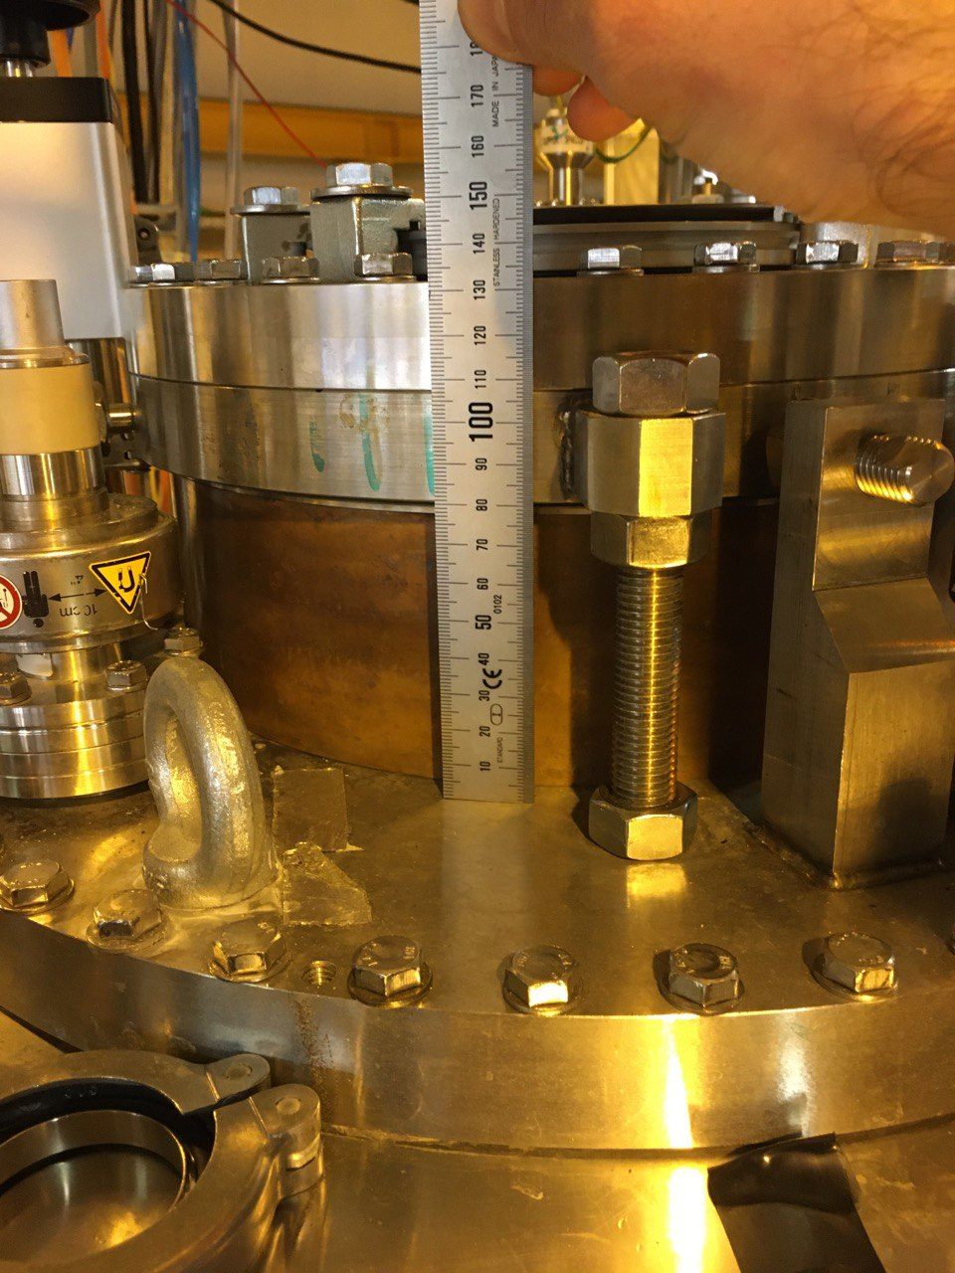
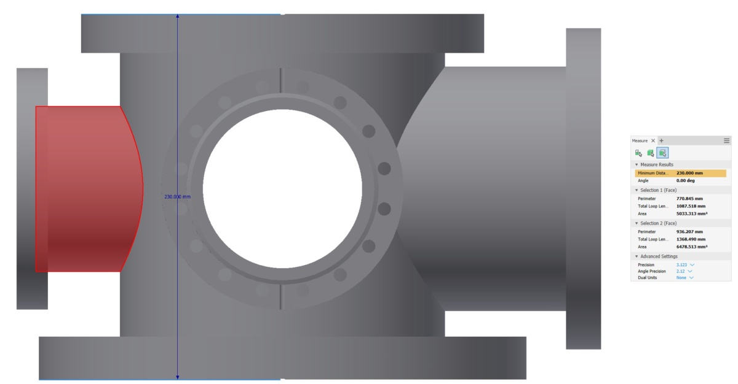
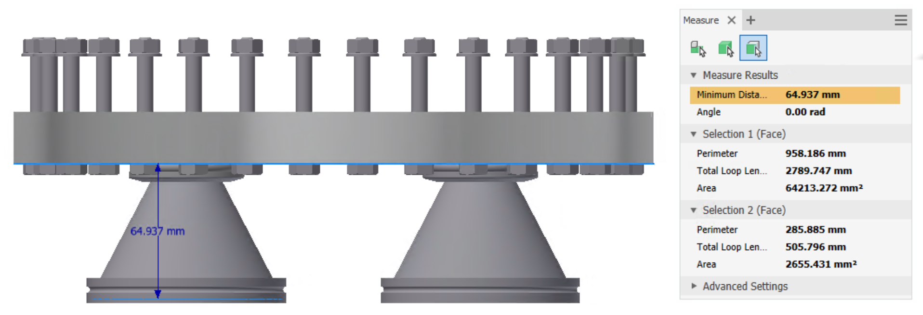
Solutions
DN250CF
Existing 6 way cross:
Gain 8-10 cm
(efectively 16 cm due to shorter tower)
Gain 5-6 cm from Connical adaptors
DN200CF
315 mm
DN200CF
DN250CF
230 mm
DN200CF
64 mm
DN250CF

Slide 16
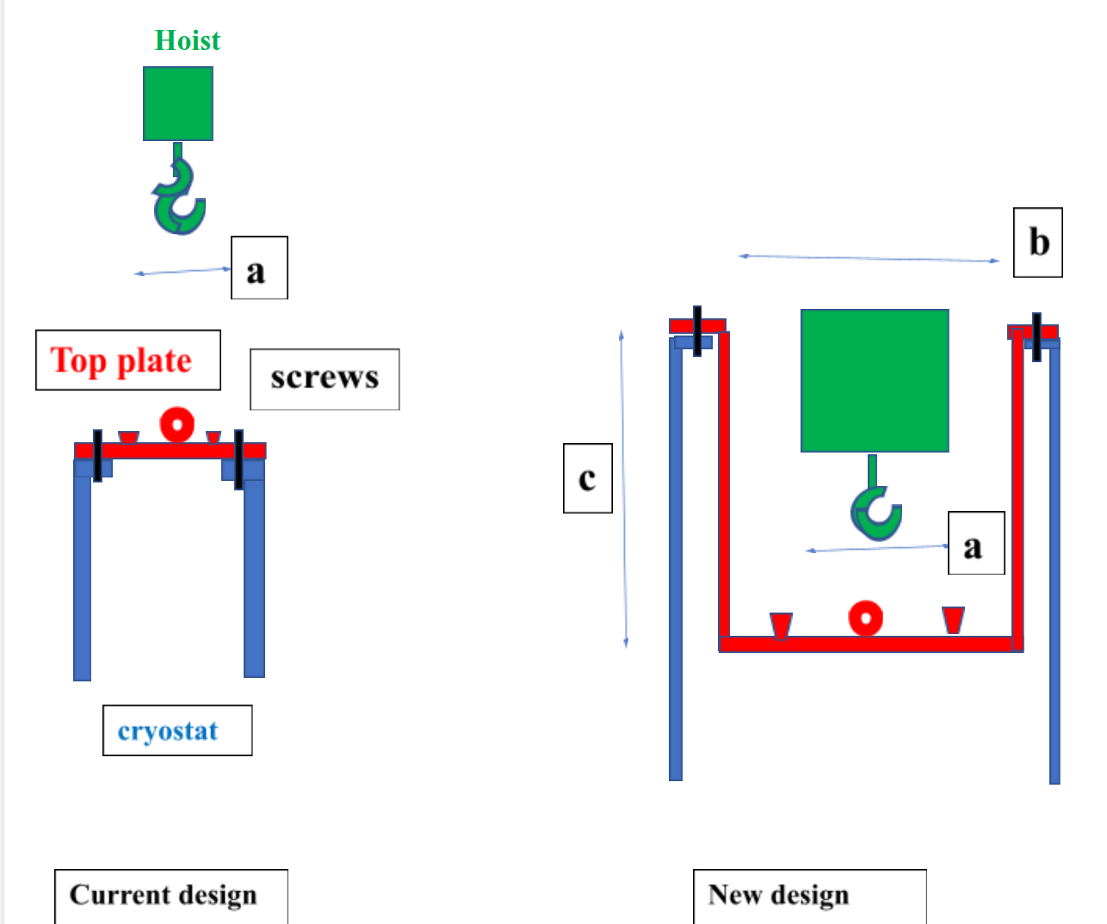
Solutions
Adjust the Top flange for pot-like operation
D. Zakucki

Slide 17






Thank you
Ph. Alfaurt, V. Araujo-Escalona, P. Ascher,
D. Atanasov, B. Blank, F. Cresto, L. Daudin, X. Fléchard,
Garcia, M.Gerbaux, J. Giovinazzo, S. Grévy, T. Kurtukian-Nieto,
E. Liénard, D. Melconian, M. Pomorski, N. Severijns,
S. Vanlangendonck, M. Versteegen, D. Zakoucky
Funding:
ANR-18-CE31-0004-02,
European Union’s 7th Framework Programme, Contract No. 262010 (ENSAR)
Flemish Fund for Scientiﬁc Research FWO

